Slide 1
Motion
Chapter 12

Slide 2
12-1 Frames of Reference
I can explain why all motion is relative.

Slide 3
When describing something that is moving, you are comparing it with something that is assumed to be stationary (not moving).
The frame of reference is the background or object that is used for comparison.
Ex: You are on a train that just left the platform.
  The people standing on the platform see you moving away. (earth)
  The person sitting next to you does not see you moving. (train)

Slide 4
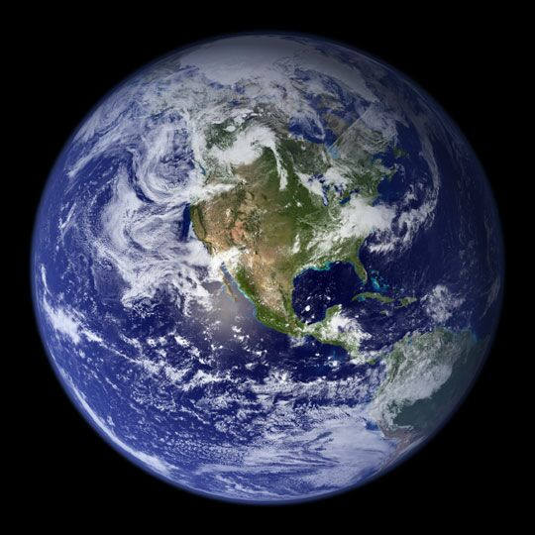
Frame of reference depends on the type of movement and position from which you are observing.
An actor may be standing still and the background is moving, but to us we think the actor is going somewhere.
  We assume the background
  is stationary.
Earth is the most commonly
used frame of reference.

Slide 5
12-1 Frames of Reference
I can explain why all motion is relative.

Slide 6
Book Work
12.1 Section Review
  Page 301
  # 1-4
  Vocabulary: Frame of Reference
  12.1 WS

Slide 7
12.2 Measuring Motion
I can define motion and speed.
I can calculate speed, using the formula speed = distance/time.
I can distinguish between constant speed and average speed.
I can represent speed graphically as distance/time.
I can distinguish between speed and velocity.

Slide 8
Motion
Motion is a change in position in a certain amount of time.
When you say that something has moved, you are describing motion.
In describing motion, you are comparing it with some frame of reference.

Slide 9
Speed
In a race, the runners had to move or change positions to get to the finish line in a certain amount of time.
To describe motion you need to know:
  distance traveled (meters – m)
  how long it took to go that distance (seconds – s)

Slide 10
Speed
Speed is the rate at which an object moves.
The faster a runner’s rate of motion, the faster the runner’s speed.
Speed = distance/time
Units = m/s

Slide 11
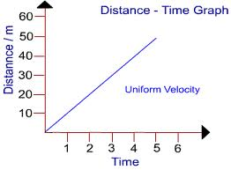
Constant Speed
Objects in motion that their speed does not change is moving at a constant speed.
Total distance divided by total time give speed at any point in time.
Graph is a straight
line for constant speed.

Slide 12
Problem
At what speed did a plane fly if it traveled 1760 meters in 8 seconds?
Steps:
  1 – Write a formula
  2 – Substitute given numbers and units
  3 – Solve for the unknown
Notes:
1 - speed = distance/time
2 – speed = 1760 meters/8 seconds
3 – speed = 220 meters/second or 220 m/s

Slide 13
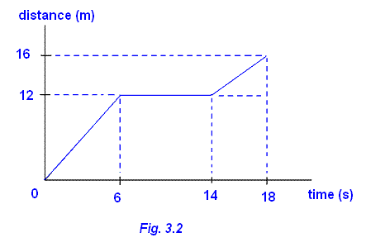
Average Speed
Not all objects move at constant speeds.
The average speed also uses the formula speed = total distance/ total time
Going to Columbus, you
change speeds during the
drive many times. So over
all you travel at an average
speed.

Slide 14
Let’s Practice
Calculating Motion
#1. 800m, 60s 13.3 m/s
#2. 472m, 15s 31.45 m/s
#3. 2500m, 110s 22.72 m/s

Slide 15
Velocity
Velocity is speed in a given direction. It is also determined by using the distance from the starting position to the ending position, rather than the distance of the path taken.
A runner moves eastward at 10m/s.
  speed is 10m/s
  velocity is 10m/s east
Velocity is very important for airplane pilots, weather forecasters and anyone driving from one place to another.

Slide 16
12.2 Measuring Motion
I can define motion and speed.
I can calculate speed, using the formula speed = distance/time.
I can distinguish between constant speed and average speed.
I can represent speed graphically as distance/time.
I can distinguish between speed and velocity.

Slide 17
Book Work
12.2 Section Review
  Page 308
  # 1-4
Vocabulary: motion, speed, velocity
Worksheet: 12.2 Review
Lab

Slide 18
12.3 Changes in Velocity
I can define acceleration and deceleration.
I can calculate acceleration and deceleration using the given formula.
I can interpret the distance/time graph for acceleration.
I can describe circular motion.

Slide 19
Acceleration
The rate of change in velocity is known as acceleration.
If something is accelerating, it is doing one of the following:
  speeding up
  slowing down
  changing directions

Slide 20
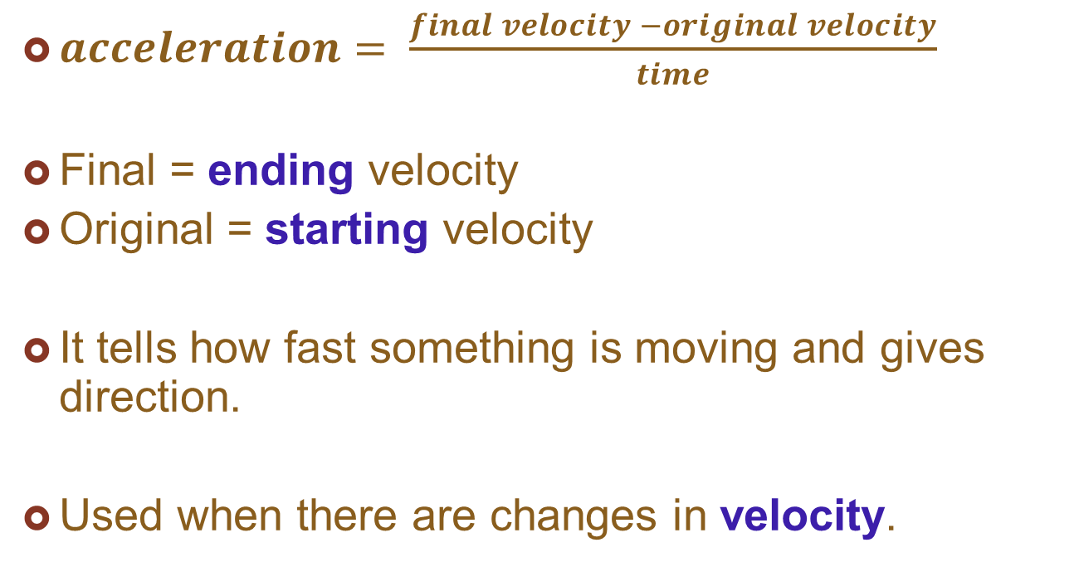
Acceleration
$acceleration= \frac{final velocity −original velocity}{time}$
Final = ending velocity
Original = starting velocity
It tells how fast something is moving and gives direction.
Used when there are changes in velocity.

Slide 21
Problem
A roller coaster’s velocity at the top of a hill is 10m/s. Two seconds later it reaches the bottom of the hill with a velocity of 26m/s. What is the acceleration of the roller coaster?
Steps:
  1 – write the formula
  2 – substitute given numbers and units
  3 – solve for the unknown
Notes:
1 – acceleration = (final velocity – original velocity)/time
2 – acceleration = (26m/s – 10m/s)/2s
3 – acceleration = 16m/s/2s = 8 m/s/s = 8 m/s²

Slide 22
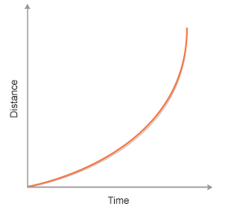
Deceleration
When there is a decrease in velocity, the value of acceleration is negative.
Negative acceleration = deceleration
Distance – time graphs
for acceleration is always
a curve.

Slide 23
Circular Motion
In circular motion, the velocity is continuously changing because direction is continuously changing.
An object in circular motion is accelerating even though its speed may be constant.
Ex: Ferris wheel, traveling in a car turning a corner, or even as you sleep (the earth is continuously rotating)

Slide 24
12.3 Changes in Velocity
I can define acceleration and deceleration.
I can calculate acceleration and deceleration using the given formula.
I can interpret the distance/time graph for acceleration.
I can describe circular motion.

Slide 25
Book Work
Calculating Acceleration Worksheet
12.3 Section Review
  Page 313
  # 1-5
Vocabulary: acceleration
12.3 review worksheet

Slide 26
12.4 Momentum
I can define momentum.
I can calculate momentum, using the equation momentum = mass X velocity.
I can explain the law of conservation of momentum.

Slide 27
Momentum
A 100kg fullback runs up the middle of the football field and collides with a 75kg defensive back running towards him.
The more massive fullback is thrown back 2 meters.
How can a 75kg defensive back stop a 100kg fullback?

Slide 28
- The defensive back has more momentum.
All moving objects have momentum.
  The more momentum, the harder to stop the object.
Momentum depends on the mass of the object and the velocity with which it is traveling.
Momentum = mass x velocity
Units = kg-m/s

Slide 29
Momentum
Train has large momentum because of it’s mass.
A bullet fired from a rifle also has large momentum but because of it’s very high velocity.

Slide 30
Conservation of Momentum
The total momentum of any group of objects remains the same unless outside forces act on the objects.
If one object loses momentum then another object must gain momentum.
Momentum is always conserved.

Slide 31
Conservation of Momentum
Total momentum of two billiard balls before they hit and after they hit must be the same.
Individual momentum can change even though total momentum remains.
Ex: if one ball speeds up after they hit, the other must slow down.

Slide 32
Examples
The momentum of a baseball bat is transferred to the ball when the bat and the ball meet.
The act of throwing an object off a boat causes the boat to move in the opposite direction. The more massive the object and the faster it is thrown, the faster the boat will move away.

Slide 33
12.4 Momentum
I can define momentum.
I can calculate momentum, using the equation momentum = mass X velocity.
I can explain the law of conservation of momentum.

Slide 34
Book Work
12.4 Section Review
  Page 316
  # 1-5
Vocabulary: momentum
Worksheet

Slide 35
Chapter Review – Page 320
Multiple Choice
  # 1-5, 7-10
True/False – Correct the false
  # 1-5, 7, 8
Concept Master
  # 3
Critical Thinking
  # 1

