Slide 1
Graphing

Slide 2
Types of graphs
There are many different types of graphs, and each one shows information a little differently.
Three of the most common types of graphs are BAR, LINE, and PIE.

Slide 3
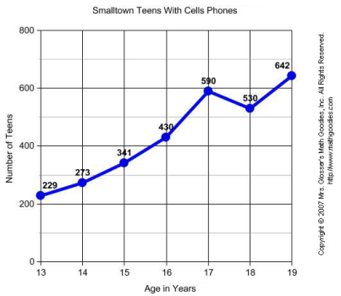
Line graphs
Used for:
Need:
  _______________ ________________
  _______________ ________________
  _______________ ________________
  _______________ ________________
  _______________
Notes:
Used for: examining patterns/trends in data

Slide 5
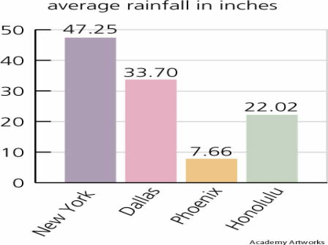
Bar Graphs
Used for:
Need:
  _______________ ________________
  _______________ ________________
  _______________ ________________
  _______________ ________________
  _______________
Notes:
Used for: comparing side-by-side data

Slide 7
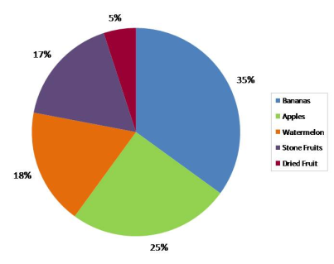
Circle Graphs
Used for:
Need:
  Title
  Key for different sections
  Different colors/patterns
Notes:
Used for: looking at percentages/parts of a whole

Slide 9
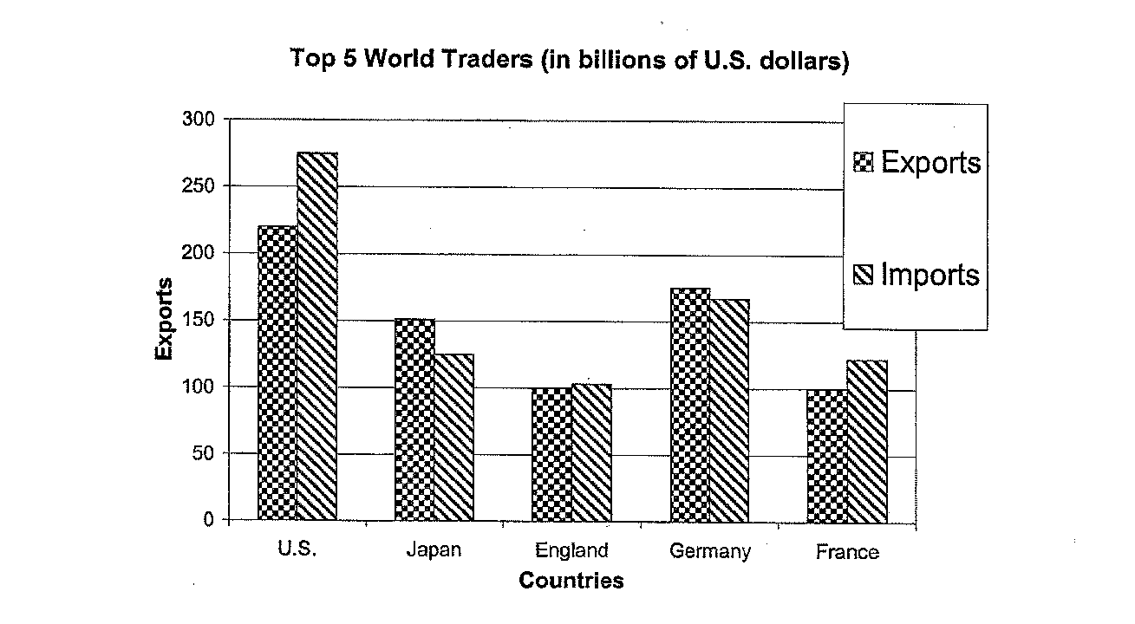
Identify the main characteristics of this graph.
Is there anything missing/confusing about it?

Slide 10
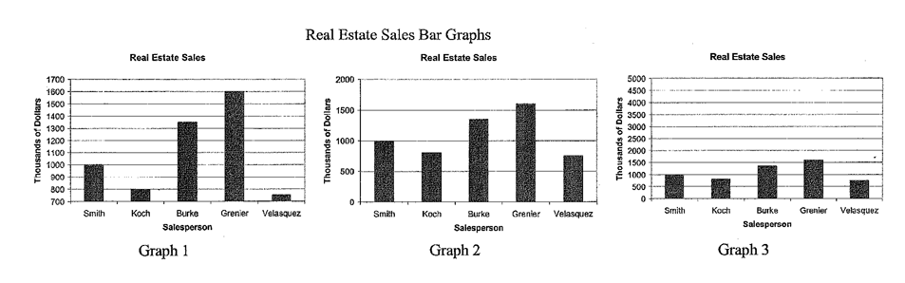
Smith, Koch, Burke, Greiner, and Velasquez all work for the same real estate company. Each year the president of the company gives an “Employee of the Year” award. One of the criteria for the award is the amount of sales.
These 3 graphs were made by 3 of the employees to convince the president that the award should go to them. Speculate on which employee made each graph. Justify your reasoning.
Notes:
honors

Slide 11
Bias – what is it?
Bias is a distortion in the way data is presented in the graph, sometimes to persuade the viewer to think a certain way.
In the following graphs, think about how the author might have wanted you to view the information.

Slide 12
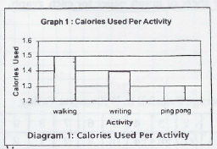
1. Grade the Graph as a 7th grade teacher. What’s missing?
2. Does it LOOK LIKE writing uses twice as many calories as playing ping pong?
Does writing REALLY use twice as many calories as playing ping pong?
What should be done to this graph so it is interpreted correctly? Why would
this be important?

Slide 13
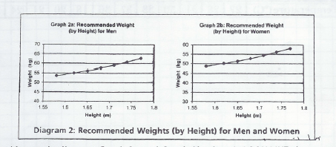
Just looking at the lines on Graph 2a and Graph 2b, does it LOOK LIKE the recommended weight is higher for a man OR woman who is 1.6m tall?
Is the recommended weight REALLY higher for a man OR a woman who is
1.6m tall?
What should be done to these graphs so they are interpreted correctly?
Why would this be important?

Slide 14
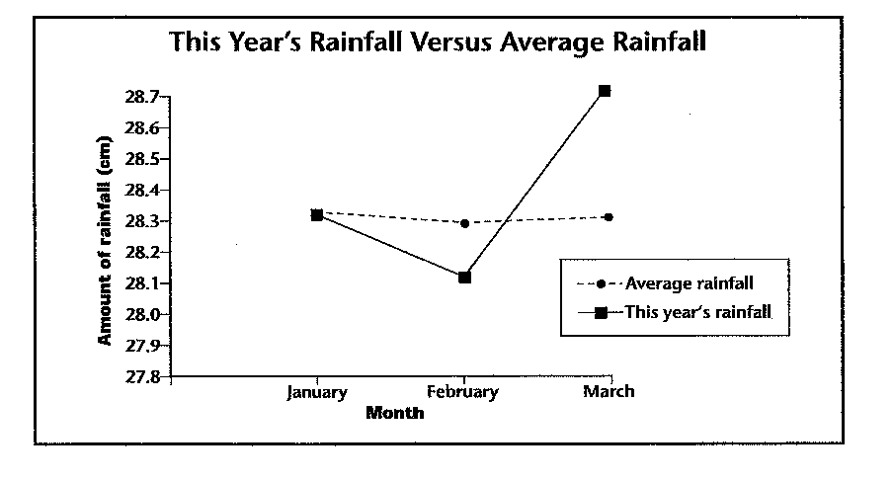

Slide 15
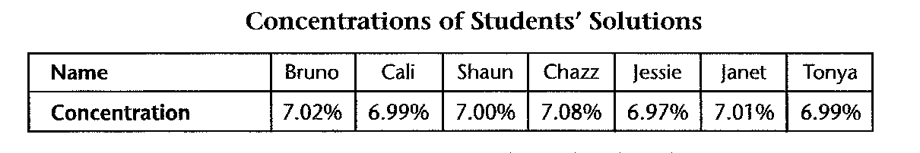
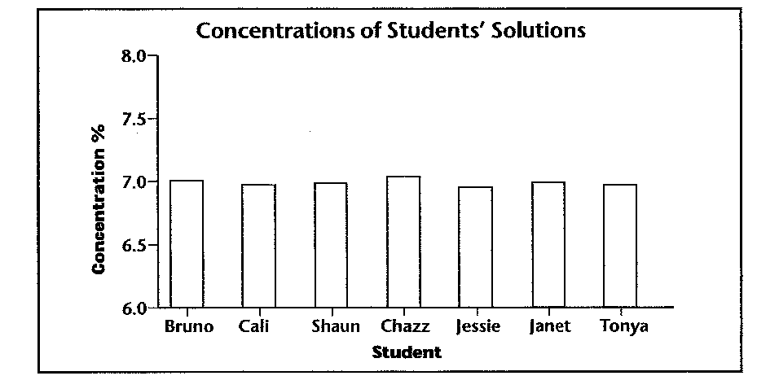
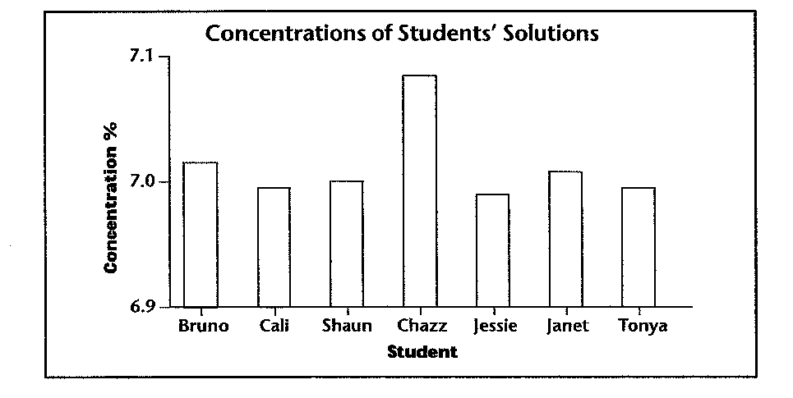
A Matter of Scale
In an experiment, seven students tried to mix a solution of salt water so that its
concentration would be exactly 7.00%. When the teacher tested the concentration of their solutions, she got the following results:
The teacher created the following graphs to show the students’ results:
Compare & contrast the graphs.
Which graph makes it easier to see the small differences between the students’ solutions? Why?
Notes:
honors

Slide 16
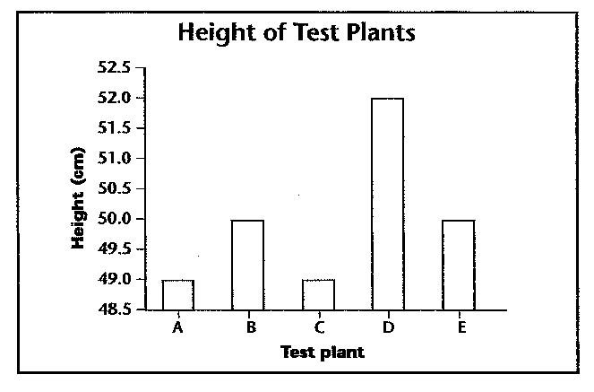
1. This graph shows that test plant D grew much larger than the other plants.
How is this information misleading?
2. Speculate on who might want this data presented in a graph like this. Justify
your reasoning.

Slide 17
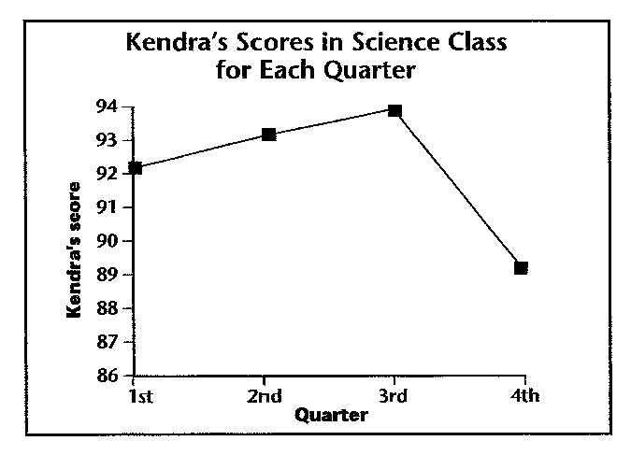
Do you think what appears to be such a large drop in her science grade
should worry Kendra? Justify your reasoning.

Slide 18
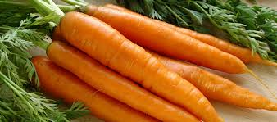
Suppose that while researching nutrition, you find this paragraph:
Vitamin A is an important nutrient. It is used to make rhodopsin,
a pigment in our eyes. Thus, Vitamin A is necessary for healthy
vision. People can develop night blindness if they do not get enough of it.
Carrots are an excellent source of Vitamin A. Carrots should be a
part of your daily diet.
This paragraph was written by people who grow carrots commercially.
The writer does not mention that ingesting too much Vitamin A can make people sick.
The writer also does not mention other great sources of Vitamin A—sweet potatoes,
eggs, pumpkin, and kale.
Notes:
honors

Slide 19

Boulder, CO
At a press conference today, Dr. Seymour Profit, senior
scientist at Larry Heartmore Laboratories, announced a
breakthrough. Dr. Profit was so excited by his findings
that he couldn’t wait for a science journal to report the
results.
In his study of an experimental blood-pressure medicine,
Dr. Profit found that the medicine lowered blood pressure
an average of ten percent in the 17 women he studied.
“Not only that, these drops happened in just one week,” Dr. Profit said. (The
women were also placed on a reduced-salt diet, but according to Dr. Profit, the
diet alone only lowered blood pressure by five percent in a control group of six men and
four women.)
Dr. Profit went on to say, “The effectiveness of the new drug has now been scientifically
proven, and once it becomes available to the public, it will surely save the lives of
millions of men and women.” Although the same company that invented the drug paid for
Dr. Profit’s study, he assured the reporters that the money in no way influenced the
results.
Notes:
honors

Slide 20
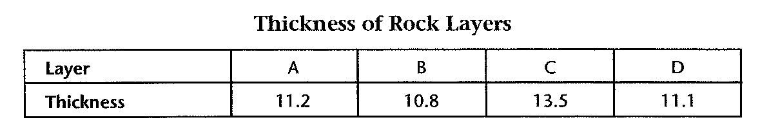
Your Turn—Graphs with an Attitude
The data in the chart below were recorded by a student measuring the thickness of four
rock layers.
Using the above data, create two bar graphs:
In Bar Graph #1 show how similar the measurements are.
In Bar Graph #2 emphasize the differences between the layers’ thicknesses.
Notes:
honors

