Slide 1

Chapter 8 Blood and Blood Splatter
By the end of this chapter you will be able to:
Explain the composition of blood
Describe the function of blood cells
Determine the blood type of a blood sample
Conduct a blood splatter analysis
Examine wounds and describe the nature of the weapon
Find and process blood evidence
All Rights Reserved South-Western / Cengage Learning © 2012, 2009

Slide 2
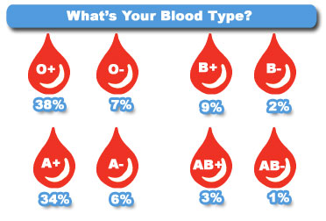
Introduction and History
Blood typing provides class evidence

Slide 3
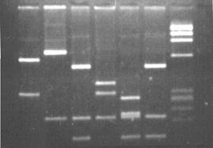
Introduction and History
DNA profiling provides individual evidence

Slide 4
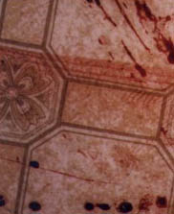
Introduction and History
A blood splatter pattern provides information
  the truthfulness of an account by a witness or a suspect
  the origin of the blood
  the angle and velocity of impact
  the type of weapon used

Slide 5
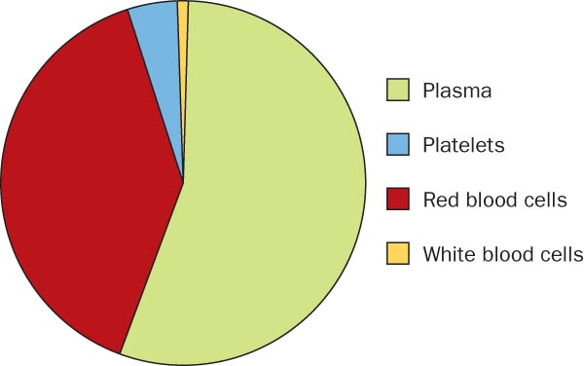
Composition of Blood

Slide 6
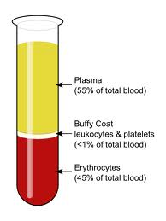
Composition of Blood

Slide 7
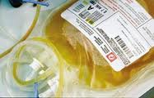
Composition of Blood
Plasma—a liquid suspending other blood components

Slide 8
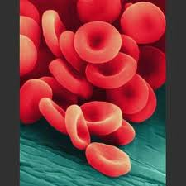
Composition of Blood
Red blood cells (Erthrocytes)—carries oxygen to the body’s cells and carbon dioxide away

Slide 9
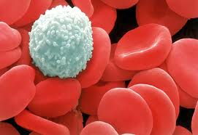
Composition of Blood
White blood cells (Leukocytes)—fights disease and foreign invaders and, alone, contain cell nuclei

Slide 10
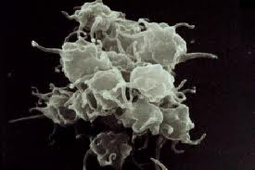
Composition of Blood
Platelets—aids in blood clotting and the repair of damaged blood vessels

Slide 11
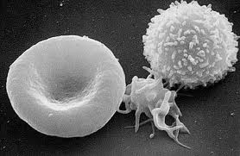
Composition of Blood
Can you identify the different blood cells?

Slide 12
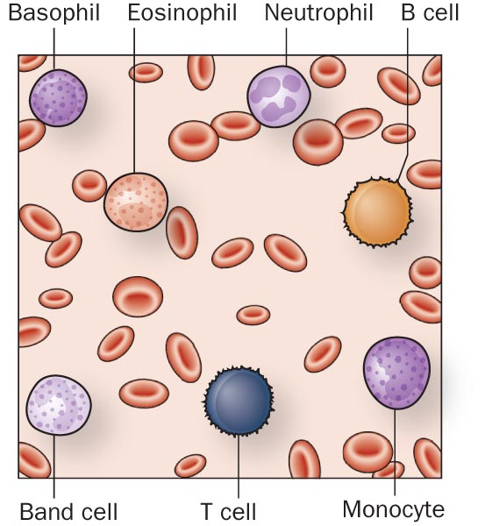
Types of Blood Cells

Slide 13
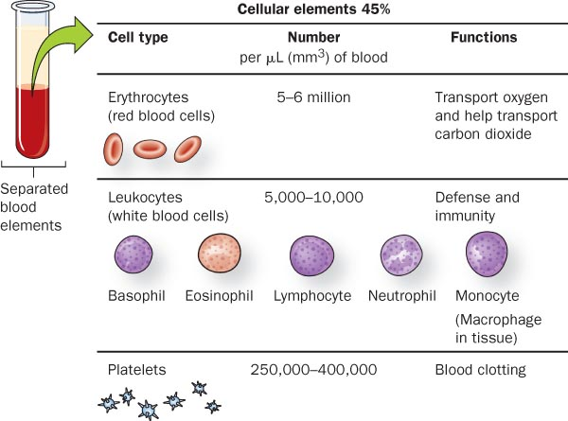
Cellular Components of Blood

Slide 14
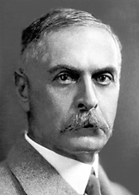
Blood Typing—Proteins
Discovered in 1900 by Karl Landsteiner

Slide 15
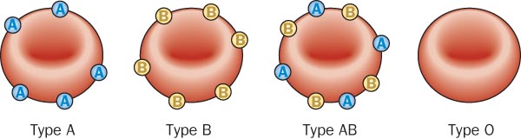
Blood Typing—Proteins
42% 12% 3% 43%
of the population in the United States

Slide 16
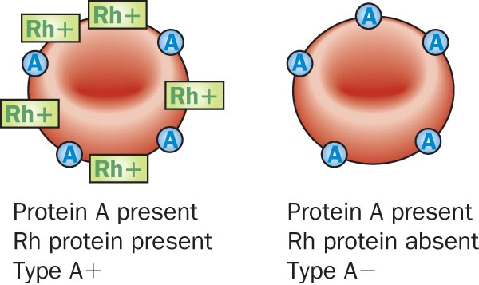
Rh Factor
85% of the population has a protein called
RH factor on their blood cells

Slide 17
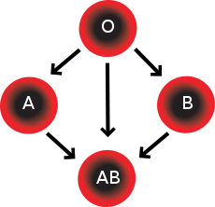
Blood compatibility

