Slide 1
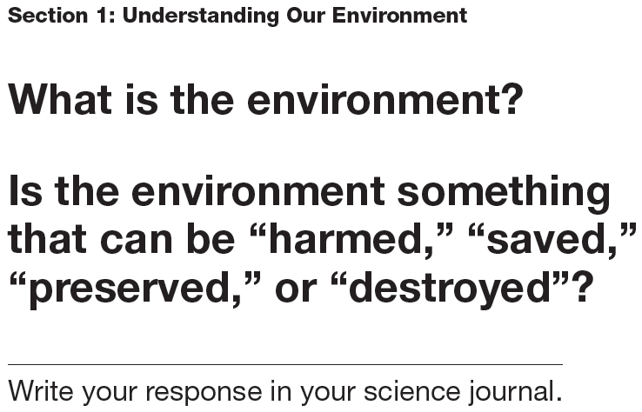
Classroom Catalyst

Slide 2
Chapter 1 Science and the Environment
Section 1 – Understanding Our Environment
Section 2 – The Environment and Society

Slide 3
Understanding Our Environment
Objectives:
Define environmental science and compare environmental science with ecology.
List the five major fields of study that contribute to environmental science.
Describe the major environmental effects of hunter-gathers, the agricultural revolution, and the Industrial Revolution.
Distinguish between renewable and nonrenewable resources.
Classify environmental problems into three major categories.

Slide 4
Section 1
What Is Environmental Science?
Environmental Science is the study of the air, water, and land surrounding an organism or a community, which ranges from a small area to Earth’s entire biosphere.
It includes the study of the impact of humans on the environment and involves the physical, biological, and social sciences.

Slide 5
The Goals of Environmental Science
A major goal of environmental science is to understand and solve environmental problems.
To accomplish this goal, environmental scientists study two main types of interactions between humans and their environment:
  How our actions alter our environment.
  The use of natural resources.

Slide 6
Many Fields of Study
Environmental science is an interdisciplinary science, which means that it involves many fields of study.
Important to the foundation of environmental science is ecology.
Ecology is they study of interactions of living organisms with one another and with their environment.

Slide 7
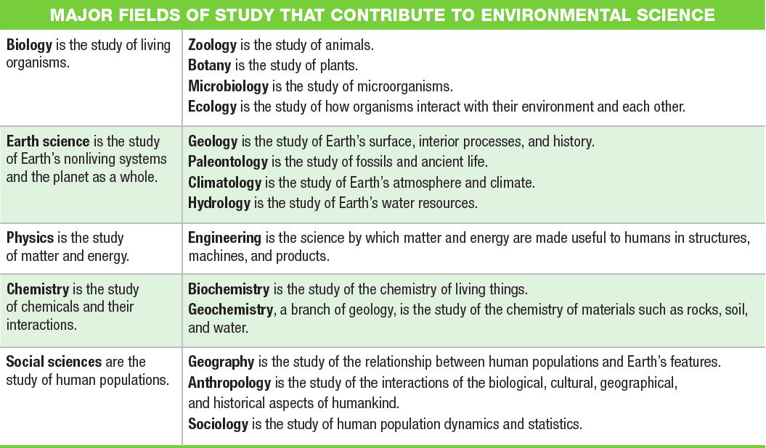
Many Fields of Study

Slide 8
Scientists as Citizens, Citizens as Scientists
Governments, businesses, and cities recognize that studying our environment is vital to maintaining a healthy and productive society.
Thus, environmental scientists are often asked to share their research with the world.
However the observations of nonscientists are the first steps toward addressing an environmental problem.

Slide 9
Our Environment Through Time
Wherever humans have hunted, grown food, or settled, they have changed the environment.
For example, the environmental change that occurred on Manhattan Island over the past 300 years was immense, yet that period of time was just a “blink” in human history.

Slide 10
Hunter-Gatherers
Hunter-gatherers are people who obtain food by collecting plants and by hunting wild animals or scavenging their remains.
Hunter-gatherers affect their environment in many ways:
  Native American tribes hunted buffalo.
  The tribes also set fires to burn prairies and prevent the growth of trees. This left the prairie as an open grassland ideal for hunting bison.

Slide 11
Hunter-Gatherers
In North America, a combination of rapid climate changes and overhunting by hunter-gatherers may have led to the disappearance of some large mammal species, including:
  giant sloths
  giant bison
  mastodons
  cave bears
  saber-toothed cats

Slide 12
The Agricultural Revolution
Agriculture is the raising of crops and livestock for food or for other products that are useful to humans.
The practice of agriculture started in many different parts of the world over 10,000 years ago.
The change had such a dramatic impact on human societies and their environment that it is often called the agricultural revolution.

Slide 13
The Agricultural Revolution
The agricultural revolution allowed human populations to grow at an unprecedented rate.
As populations grew, they began to concentrate in smaller areas placing increased pressure on the local environments.

Slide 14
The Agricultural Revolution
The agricultural revolution changed the food we eat.
The plants we grow and eat today are descended from wild plants.
However, during harvest season farmers collected seeds from plants that exhibited the qualities they desired, such as large kernels.
These seeds were then planted and harvested again. Overtime, the domesticated plants became very different from their wild ancestors.

Slide 15
The Agricultural Revolution
Many habitats were destroyed as grasslands, forests, and wetlands were replaced with farmland.
Replacing forest with farmland on a large scale can cause soil loss, floods, and water shortages.

Slide 16
The Agricultural Revolution
The slash-and-burn technique was one of the earliest ways that land was converted to farmland.
Much of this converted land was poorly farmed and is no longer fertile.

Slide 17
The Industrial Revolution
The Industrial Revolution involved a shift from energy sources such as animals and running water to fossil fuels such as coal and oil.
This increased use of fossil fuels changed society and greatly increased the efficiency of agriculture, industry, and transportation.
For example, motorized vehicles allowed food to be transported cheaply across greater distances.

Slide 18
The Industrial Revolution
In factories, the large-scale production of goods became less expensive than the local production of handmade goods.
On the farm, machinery reduced the amount of land and human labor needed to produce food.
With fewer people producing their own food, the populations in urban areas steadily grew.

Slide 19
Improving the Quality of Life
The industrial Revolution introduced many positive changes such as the light bulb.
Agricultural productivity increased, and sanitation, nutrition, and medical care vastly improved.

Slide 20
Improving the Quality of Life
However, the Industrial Revolution also introduced many new environmental problems such as pollution and habitat loss.
In the 1900s, modern societies began to use artificial substances in place of raw animals and plant products.
As a result, we know have materials such as plastics, artificial pesticides, and fertilizers.

Slide 21
Improving the Quality of Life
Many of these products make life easier, but we are now beginning to understand some of the environmental problems they present.
In fact, much of environmental science is concerned with the problems associated with the Industrial Revolution.

Slide 22
Spaceship Earth
Earth can be compared to a spaceship traveling through space as it cannot dispose of its waste or take on new supplies.
Earth is essentially a closed system.
This means that the only thing that enters the Earth’s atmosphere in large amounts is energy from the sun, and the only thing that leaves in large amounts is heat.

Slide 23
Spaceship Earth
This type of closed system has some potential problems.
Some resources are limited and as the population grows the resources will be used more rapidly.
There is also the possibility that we will produce wastes more quickly than we can dispose of them.

Slide 24
Spaceship Earth
Environmental problems can occur on different scales: local, regional, or global.
  A local example would be your community discussing where to build a new landfill.
  A regional example would be a polluted river 1,000 miles away affecting the region’s water.
  A global example would be the depletion of the ozone layer.

Slide 25
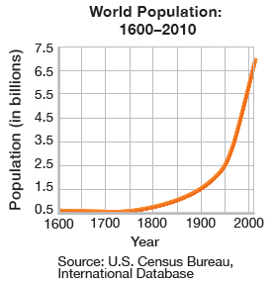
Population Growth
The Industrial Revolution, modern medicine, and sanitation all allowed the human population to grow faster than it ever had before.

Slide 26
Population Growth
In the past 50 years, nations have used vast amounts of resources to meet the worlds need for food.
Producing enough food for large populations has environmental consequences such as habitat destruction and pesticide pollution.

Slide 27
Population Growth
Scientists think that the human population will almost double in the 21st century before it begins to stabilize.
Because of these predictions, we can expect the pressure on the environment will continue to increase and the human population and its need for food and resources grow.

Slide 28
What are our Main Environmental Problems?
Environmental problems can generally be grouped into three categories:
  Resource Depletion
  Pollution
  Loss of Biodiversity

Slide 29
Resource Depletion
Natural Resources are any natural materials that are used by humans, such as, water, petroleum, minerals, forests, and animals.
Natural resources are classified as either a renewable resources or a nonrenewable resource.

Slide 30
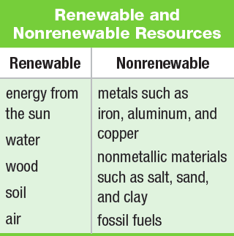
Resource Depletion
Renewable resources can be replaced relatively quickly by natural process.
Nonrenewable resources form at a much slower rate than they are consumed.

Slide 31
Resource Depletion
Resources are said to be depleted when a large fraction of the resource has been used up.
Once the supply of a nonrenewable resource has been used up, it may take millions of years to replenish it.
Renewable resources, such as trees, may also be depleted causing deforestation in some areas.

Slide 32
Pollution
Pollution is an undesirable change in the natural environment that is caused by the introduction of substances that are harmful to living organisms or by excessive wastes, heat, noise, or radiation
Much of the pollution that troubles us today is produced by human activities and the accumulation of wastes.

Slide 33
Pollution
There are two main types of pollutants:
  Biodegradable pollutants, which can be broken down by natural processes and include materials such as newspaper.
  Nondegradable pollutants, which cannot be broken down by natural processes and include materials such as mercury.

Slide 34
Pollution
Degradable pollutants are a problem only when they accumulate faster than they can be broken down.
However, because nondegradable pollutants do not break down easily, they can build up to dangerous levels in the environment.

Slide 35
Loss of Biodiversity
Biodiversity is the variety of organisms in a given area, the genetic variation within a population, the variety of species in a community, or the variety of communities in an ecosystem.
The organisms that share the world with us can be considered natural resources.
We depend on them for food, the oxygen we breathe, and for many other things.

Slide 36
Loss of Biodiversity
Yet, only a fraction of all the species that once roamed the Earth are alive today, and many are extinct.
Scientists think that if the current extinction rates continue, it may cause problems for the human population.
Many people also argue that all species have potential economic, scientific, aesthetics, and recreational value, so it is important to preserve them.

Slide 37
Section Review Questions-Homework
Describe the two main types of interactions that environmental scientists study. Give an example of each.
Describe the major environmental effects of the agricultural revolution and the Industrial revolution.
Explain how environmental problems can be local, regional, or global. Give one example of each.
Explain why environmental science is an interdisciplinary science.
What is the difference between environmental science and ecology?
Fossil fuels are said to be nonrenewable resources, yet they are produced by the Earth over millions of years. By what time frame are they considered nonrenewable? Write a short paragraph that explains your answer.

Slide 38
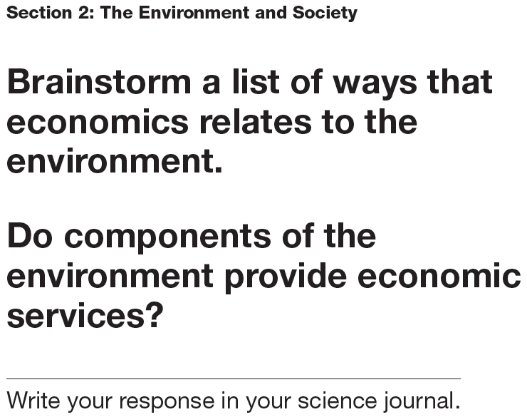
Classroom Catalyst

Slide 39
Section 2
The Environment and Society
Objectives:
Describe “The Tragedy of the Commons.”
Explain the law of supply and demand.
List three difference between developed and developing countries.
Explain what sustainability is, and describe why it is a goal of environmental science.

Slide 40
“The Tragedy of the Commons”
In his essay, ecologist Garrett Hardin argued that the main difficulty in solving environmental problems is the conflict between the short-term interests of the individual and the long-term welfare of society.
The example he used was the commons, or the areas of land that belonged to the whole village.

Slide 41
“The Tragedy of the Commons”
It was in the best interest of the individual to put as many animals in the commons as possible.
However, if too many animals grazed on the commons, they destroyed the grass.
Once the grass was destroyed, everyone suffered because no one could raise animals on the commons.

Slide 42
“The Tragedy of the Commons”
The commons were eventually replaced by closed fields owned by individuals.
Owners were now careful not to put too many animals on their land, because overgrazing wouldn’t allow them to raise as many animals next year.
Hardin’s point being that someone or some group must take responsibility for maintaining a resource or it will become depleted.

Slide 43
“The Tragedy of the Commons”
Hardin’s point can be applied to our modern commons, natural resources.
Humans live in societies, and in societies, we can solve environmental problems by planning, organizing, considering the scientific evidence, and proposing a solution.
The solution may be to override the short-term interests of the individual and improve the environment for everyone in the long run.

Slide 44
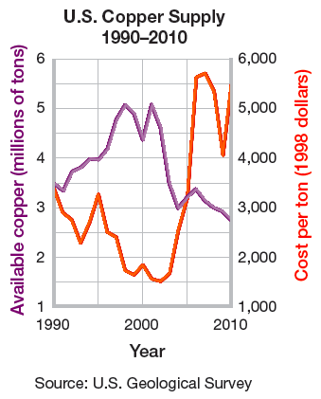
Supply and Demand
The Law of Supply and Demand is a law of economics that states as the demand for a good or service increases, the value or the food or service also increases.
An example is the world copper production.

Slide 45
Costs and Benefits
The cost of environmental solutions can be high.
A cost-benefit analysis balances the cost of the action against the benefits one expects from it.
The results depend on who is doing the analysis. For example, pollution control may be too costly to an industry, but to a nearby community, the price may well be worth it.
Often, environmental regulations are passed on to the consumer or taxpayer.

Slide 46
Risk Assessment
One of the costs of any action is the risk of an undesirable outcome.
Risk assessment is a tool that helps us create cost effective ways to protect our health and environment.
To come up with an effective solution to an environmental problem, the public must perceive the risk accurately.

Slide 47
Developed and Developing Countries
The unequal distribution of wealth and resources around the world influence the environmental problems and solutions a society can make.
Developed countries have higher incomes, slower population growth, diverse industrial economies, and stronger social support.
Developing countries have lower average incomes, simple agriculture-based communities, and rapid population growth.

Slide 48
Population and Consumption
Almost all environmental problems can be traced back to two root causes:
  The human population in some areas is growing too quickly for the local environment to support.
  People are using up, wasting, or polluting many natural resources faster than they can be renewed, replaced, or cleaned up.

Slide 49
Local Population Pressures
When the population in an area grows rapidly, there may not be enough natural resources for everyone to live a healthy, productive life.
In severely overpopulated regions, forests are stripped bare, topsoil is exhausted, and animals are driven to extinction.
In these areas, malnutrition, starvation, and disease can be constant threats.

Slide 50
Local Population Pressures
In developing countries, millions of people are starving.
Yet these human populations tend to grow the fastest.
Food production, education, and job creation cannot keep pace with the population growth, so each person gets fewer resources as time goes by.

Slide 51
Consumption Trends
To support the higher quality of life, developed countries are using much more of Earth’s resources.
Developed nations use about 75 percent of the world’s resources, although they make up only 20 percent of the world’s population.
This rate of consumption creates more waste and pollution per person then in developing countries.

Slide 52
Consumption Trends

Slide 53
Ecological Footprints
Ecological footprints are calculations that show the productive area of Earth needed to support one person in a particular country.
An ecological footprint estimates the land used for crops, grazing, forests products, and housing. It also includes the ocean area used to harvest seafood and the forest area needed to absorb the air pollution caused by fossil fuels.

Slide 54
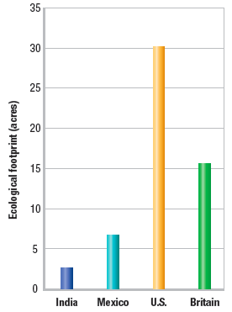
Ecological Footprints
An ecological footprint is one way to express the differences in consumption between nations.

Slide 55
Critical Thinking and the Environment
People on either side on an environmental issue may feel passionately about their cause and can distort information to mislead people about the issue.
Research done by scientists is often used to make a political point or is misinterpreted to support controversial data.

Slide 56
Critical Thinking and the Environment
Also, the economic dimension of an environmental issue may be oversimplified.
And to complicate matters still, the media often sensationalizes environmental issues.
For these reasons and others you must use your critical thinking skills when making decisions about environmental issues.

Slide 57
Critical Thinking and the Environment
Remember a few things as you explore environmental science further:
  First, be prepared to listen to many viewpoints over a particular issue.
  Second, investigate the source of the information you encounter.
  Third, gather all the information you can before drawing a conclusion.

Slide 58
A Sustainable World
Sustainability is the condition in which human needs are met in such a way that a human population can survive indefinitely.
Sustainability is a key goal of environmental science.

Slide 59
A Sustainable World
A sustainable world is not unchanging as technological advances and human civilizations continue to be productive.
However, our current world is not sustainable as the developed countries are using resources faster than they can be replaced.
Achieving a sustainable world requires everyone’s participation including individual citizens, industry, and the government.

Slide 60
Section Review Questions - Homework
Describe three differences between developing and developed nations using the examples in Figure 2.4. Would you classify Mexico as a developing nation? Explain your answer.
Explain why critical thinking is an important skill in environmental science.
Explain the law of supply and demand, and give an example of how it relates to the environment.
The law of supply and demand is a simplification of economic patterns. What other factors might affect the cost of copper?
Write a description of the “Tragedy of the Commons.” Do you think that Hardin’s essay is an accurate description of the relationship between individuals, society, and the environment?

