Slide 1
What is Science?
Section 1-1

Slide 2
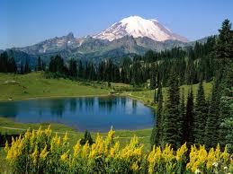
The goal of science is to investigate and understand nature.
Science is an organized way of using evidence to learn about the natural world.

Slide 3
An observation using one or more of the senses to gather information
An inference is a logical interpretation based on prior knowledge and prior experience.

Slide 4

Observation | Inference

Slide 5
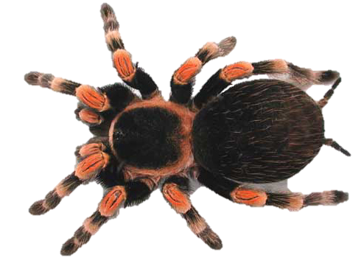
How do scientists do science?
State the problem
Form a hypothesis
Set up a controlled experiment
Record and analyze results
Draw a conclusion
Publish and repeat investigations

Slide 6
Designing an Experiment
A hypothesis is a possible explanation for a set of observations
A variable is a factor in an experiment that can change

Slide 7
Manipulated variable – the variable that is deliberately changed (independent).
Responding variable – the variable that is observed and that changes in response to the manipulated variable (dependent).

Slide 8
A controlled experiment is an experiment where only one variable is changed at a time, all other variables are kept unchanged.

Slide 9
  Control Group – in an experiment, the group of test subjects left untreated or unexposed to some procedure
  Experimental Group – in an experiment, the group of test subjects that get the treatment or exposure to some procedure

Slide 10
How a theory develops
A theory is a well-tested explanation that unifies a broad range of observations
As new evidence is uncovered a theory may be revised or replaced by a more useful explanation

