Slide 1
Branches of Earth Science

Slide 2
Earth Science
Earth science (also known as geoscience, the geosciences or the Earth sciences) is an all-embracing term for the sciences related to the planet Earth.^{[1]}
It also includes the study of the Universe and everything in space
Why should we study the earth anyway? Don’t we live here !
There are 4 major branches of earth science, with many other smaller branches . The four major are geology , oceanography, astronomy and meteorology.

Slide 3
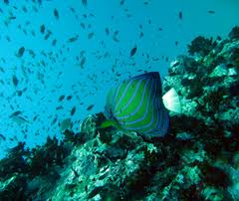
Oceanography
Oceanography is the study of the oceans. This would include tides, sharks, water composition and hurricanes

Slide 4
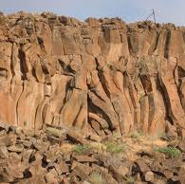
Geology
A geologist studies the earth and all the processes that are occurring on it. This would include topics such as erosion, weathering, volcanoes, earthquakes and rock

Slide 5
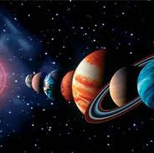
Astronomy
Astronomy is the study of space. Galaxies, stars and planets are included in this branch of earth science

Slide 6
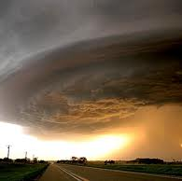
Meteorology
Meteorology is the study of weather and climate. Climate is the average temperature and rainfall for a specific area over a 30 year period.

Slide 7
Comparing the Branches with Analogies
When using analogies you are looking for relationships between items. For example
Jupiter : Mercury as Big : small or
cars : gasoline as humans : food
Now lets try one with our branches.
Geology : rocks as ____________: stars
( What is the relationship)
Oceanography: Meteorology as _______________: _____________

Slide 8
NOW WHAT??
Nothing exist alone, all these branches interact with each other. Your task is to read the sections of text on the four previous mentioned branches (pp6-7). Your assignment is to create/produce a 4 circle venn diagram using the 4 major branches of earth science. Use the template to fill in the blank venn diagram.
Check out the websites below:
Earth science - Wikipedi#110F8F
4-Circle Venn Diagram Te#111001

