Slide 1
NJSLA-Science Results:
Spring 2019 Administration
Irvington School District
June 24, 2020

Slide 2
New Jersey Student Learning Assessment –
Science (NJSLA-Science)
The NJSLA-Science:
Is a federally required state assessment administered to students in grades 5, 8, and 11
Provides a snapshot of student performance on the New Jersey Student Learning Standards for Science (NJSLS-Science).
Was developed in collaboration with NJ educators, the New Jersey Department of Education (NJDOE), and New Jersey’s contracted science vendors
Is significantly different from the New Jersey Assessment of Skills and Knowledge (NJ ASK) because NJSLS-Science are more rigorous standards and NJSLA-Science focuses on the application of science knowledge and skills rather than memorization of content.

Slide 3
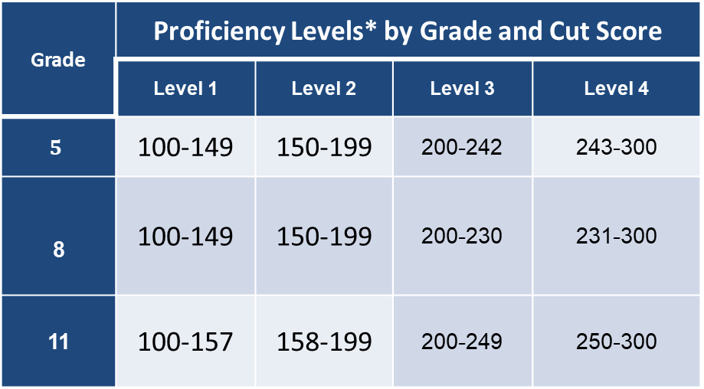
Irvington School District’s
2019 Spring NJSLA-Science
Performance Levels by Grade and Cut Score
Grade | Proficiency Levels* by Grade and Cut Score
 | Level 1 | Level 2 | Level 3 | Level 4
$$5$$ | 100-149 | 150-199 | 200-242 | 243-300
8 | 100-149 | 150-199 | 200-230 | 231-300
11 | 100-157 | 158-199 | 200-249 | 250-300
*Level 1: Demonstrate a minimal understanding of the NJSLS-S
*Level 2: Demonstrate a limited grade-level understanding of the NJSLS-S
*Level 3: Demonstrate appropriate grade-level understanding of the NJSLS-S
*Level 4: Demonstrate advanced understanding of the NJSLS-S
Students performing at Level 1 and Level 2 are considered to be below the State minimum level of proficiency.
Students performing at Level 3 and Level 4 are considered proficient and above

Slide 4
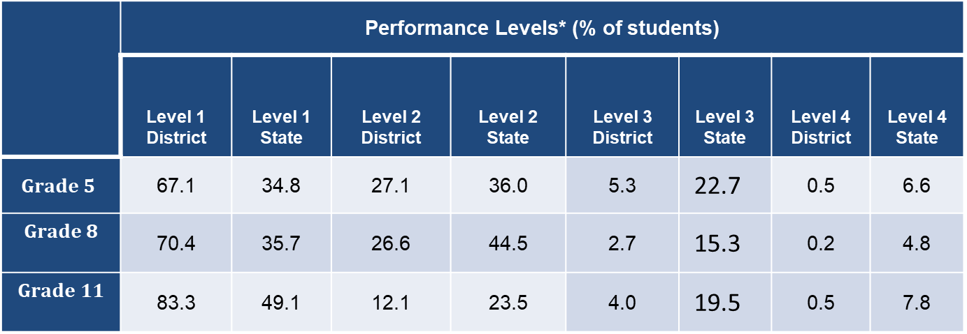
Comparison of Irvington School District’s
2019 Spring NJSLA-Science Administrations
Science to New Jersey Percentages
 | Performance Levels* (% of students)
 | Level 1 District | Level 1 State | Level 2 District | Level 2 State | Level 3 District | Level 3 State | Level 4 District | Level 4 State
$$Grade 5$$ | 67.1 | 34.8 | 27.1 | 36.0 | 5.3 | 22.7 | 0.5 | 6.6
$$Grade 8$$ | 70.4 | 35.7 | 26.6 | 44.5 | 2.7 | 15.3 | 0.2 | 4.8
$$Grade 11$$ | 83.3 | 49.1 | 12.1 | 23.5 | 4.0 | 19.5 | 0.5 | 7.8
Notes: Percentages may not total 100 due to rounding.

Slide 5
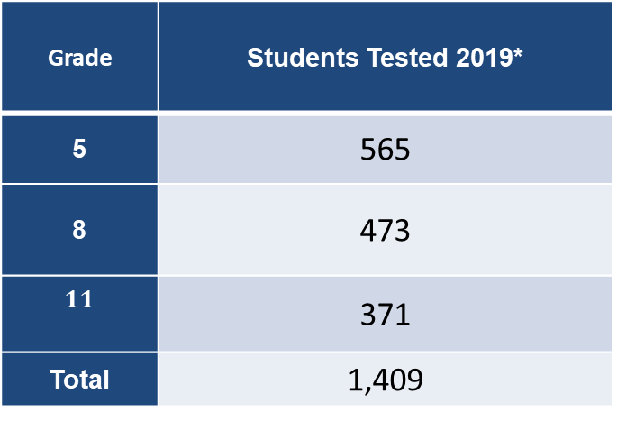
Irvington School District’s
Number of Students Tested
2019 Spring NJSLA-Science Administration
Grade | Students Tested 2019*
5 | 565
8 | 473
$$11$$ | 371
Total | 1,409
*Note: “Students Tested” represents individual valid test scores for Science.

Slide 6
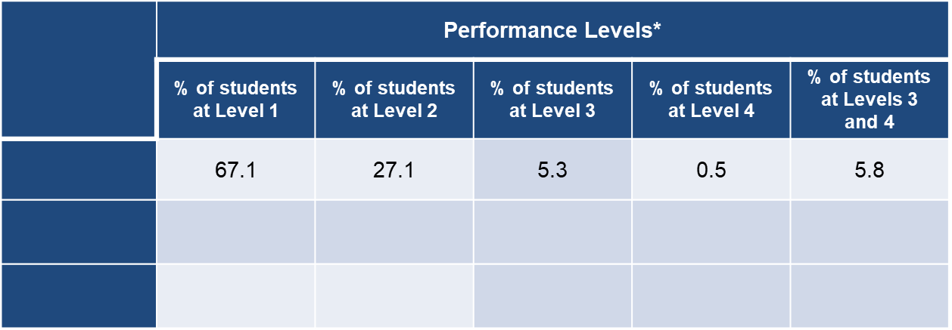
Irvington School District’s
2019 Spring NJSLA-Science
Grade-Level Outcomes-Percentages
 | Performance Levels*
 | % of students at Level 1 | % of students at Level 2 | % of students at Level 3 | % of students at Level 4 | % of students at Levels 3 and 4
$$Grade 5$$ | 67.1 | 27.1 | 5.3 | 0.5 | 5.8
$$Grade 8$$ | 70.4 | 26.6 | 2.7 | 0.2 | 2.9
$$Grade 11$$ | 83.3 | 12.1 | 4.0 | 0.5 | 4.5
*Grade 5: Level 1: (100-149) Level 2: (150-199) Level 3: (200-242) Level 4: (243-300)
*Grade 8: Level 1: (100-149) Level 2: (150-199) Level 3: (200-230) Level 4: (231-300)
*Grade 11: Level 1: (100-157) Level 2: (158-199) Level 3: (200-249) Level 4: (250-300)

Slide 7
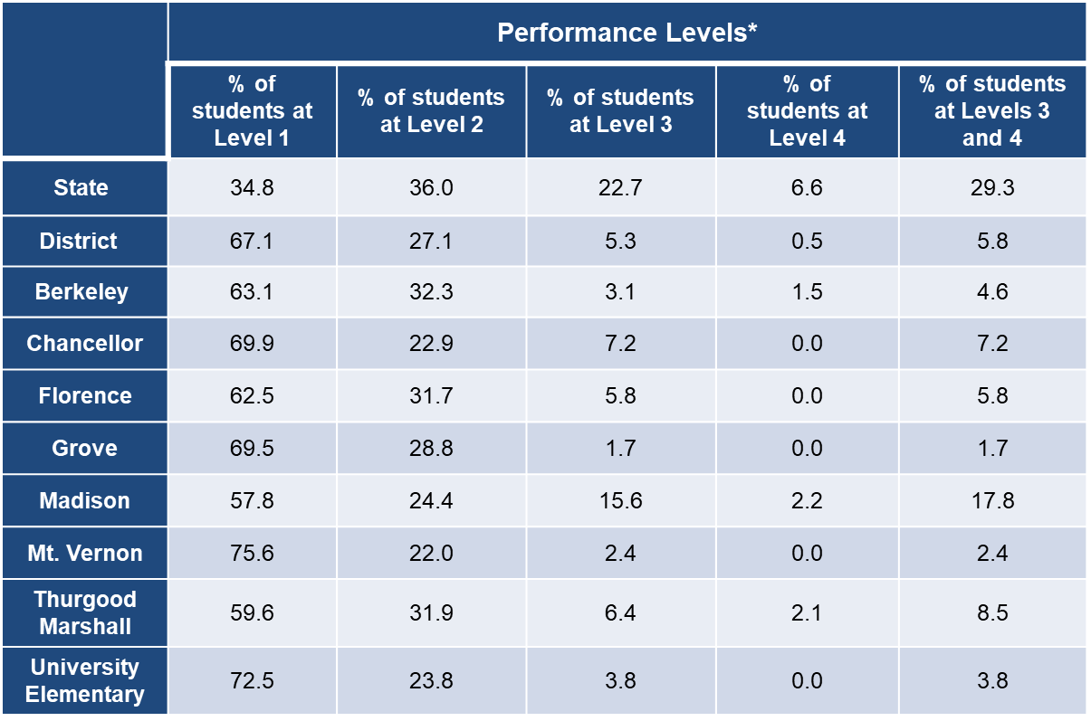
Irvington School District’s
2019 Spring NJSLA-Science: School Outcomes
Grade 5 - Percentages
 | Performance Levels*
 | % of students at Level 1 | % of students at Level 2 | % of students at Level 3 | % of students at Level 4 | % of students at Levels 3 and 4
$$\text{State}$$ | 34.8 | 36.0 | 22.7 | 6.6 | 29.3
$$\text{District}$$ | 67.1 | 27.1 | 5.3 | 0.5 | 5.8
$$\text{Berkeley}$$ | 63.1 | 32.3 | 3.1 | 1.5 | 4.6
Chancellor | 69.9 | 22.9 | 7.2 | 0.0 | 7.2
Florence | 62.5 | 31.7 | 5.8 | 0.0 | 5.8
Grove | 69.5 | 28.8 | 1.7 | 0.0 | 1.7
Madison | 57.8 | 24.4 | 15.6 | 2.2 | 17.8
Mt. Vernon | 75.6 | 22.0 | 2.4 | 0.0 | 2.4
Thurgood Marshall | 59.6 | 31.9 | 6.4 | 2.1 | 8.5
University Elementary | 72.5 | 23.8 | 3.8 | 0.0 | 3.8
*Level 1: (100-149) Level 2: (150-199) Level 3: (200-242) Level 4: (243-300)

Slide 8
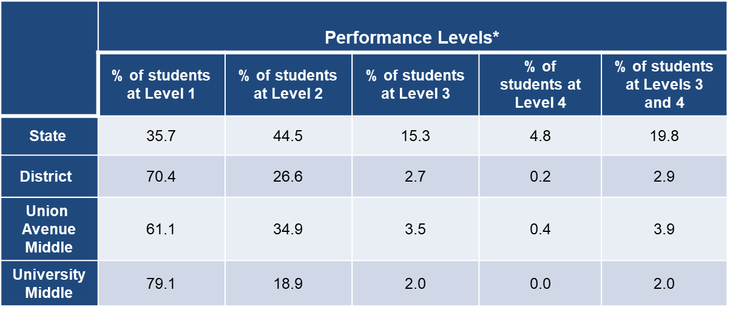
Irvington School District’s
2019 Spring NJSLA-Science: School Outcomes
Grade 8 - Percentages
 | Performance Levels*
 | % of students at Level 1 | % of students at Level 2 | % of students at Level 3 | % of students at Level 4 | % of students at Levels 3 and 4
$$\text{State}$$ | 35.7 | 44.5 | 15.3 | 4.8 | 19.8
$$\text{District}$$ | 70.4 | 26.6 | 2.7 | 0.2 | 2.9
$\text{Union} \text{Avenue}$ Middle | 61.1 | 34.9 | 3.5 | 0.4 | 3.9
University Middle | 79.1 | 18.9 | 2.0 | 0.0 | 2.0
*Level 1: (100-149) Level 2: (150-199) Level 3: (200-230) Level 4: (231-300)

Slide 9
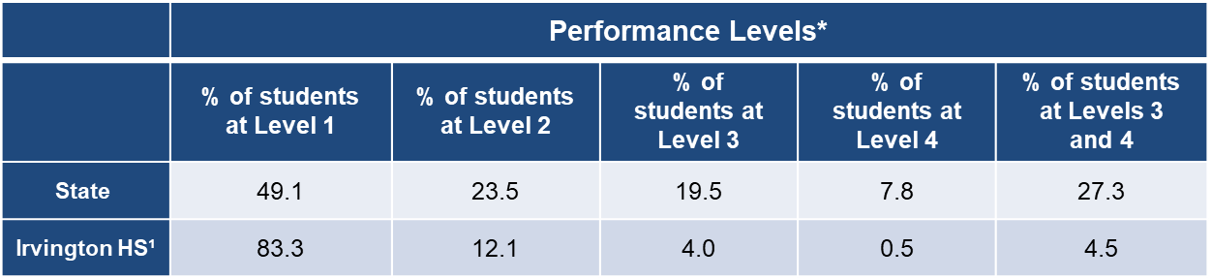
Irvington School District’s
2019 Spring NJSLA-Science: School Outcomes
Grade 11 - Percentages
 | Performance Levels*
 | % of students at Level 1 | % of students at Level 2 | % of students at Level 3 | % of students at Level 4 | % of students at Levels 3 and 4
$$\text{State}$$ | 49.1 | 23.5 | 19.5 | 7.8 | 27.3
Irvington HS¹ | 83.3 | 12.1 | 4.0 | 0.5 | 4.5
*Level 1: (100-157) Level 2: (158-199) Level 3: (200-249) Level 4: (250-300)
¹Same with the District

Slide 10
Irvington School District’s
2019 Spring NJSLA-Science
Grade 5: Subgroup Outcomes-Percentages
Subgroup | Performance Levels*
 | % of students at Level 1 | % of students at Level 2 | % of students at Level 3 | % of students at Level 4 | % of students at Levels 3 and 4
Female | 66.2 | 28.7 | 5.1 | 0.0 | 5.1
Male | 67.9 | 25.6 | 5.5 | 1.0 | 6.5
Hispanic or Latino | 64.9 | 26.8 | 7.2 | 1.0 | 8.2
Black or African-American | 67.8 | 26.9 | 4.8 | 0.4 | 5.3
White | 66.7 | 33.3 | 0.0 | 0.0 | 0.0
Economic Disadvantage | 65.2 | 28.6 | 6.0 | 0.2 | 6.2
Non-Economic Disadvantage | 73.3 | 22.1 | 3.1 | 1.5 | 4.6
Students with Disabilities | 88.6 | 10.0 | 1.4 | 0.0 | 1.4
ELLs | 89.4 | 10.6 | 0.0 | 0.0 | 0.0
*Level 1: (100-149) Level 2: (150-199) Level 3: (200-242) Level 4: (243-300)

Slide 11
Irvington School District’s
2019 Spring NJSLA-Science
Grade 8: Subgroup Outcomes-Percentages
Subgroup | Performance Levels*
 | % of students at Level 1 | % of students at Level 2 | % of students at Level 3 | % of students at Level 4 | % of students at Level 3 and 4
Female | 71.8 | 24.1 | 4.1 | 0.0 | 4.1
Male | 69.2 | 28.9 | 1.6 | 0.4 | 2.0
Hispanic or Latino | 68.8 | 25.8 | 5.4 | 0.0 | 5.4
Black or African-American | 71.0 | 26.5 | 2.1 | 0.3 | 2.4
White | 0.0 | 0.0 | 0.0 | 0.0 | 0.0
Economic Disadvantage | 71.7 | 25.8 | 2.2 | 0.3 | 2.5
Non-Economic Disadvantage | 65.7 | 29.5 | 4.8 | 0.0 | 4.8
Students with Disabilities | 88.7 | 11.3 | 0.0 | 0.0 | 0.0
ELLs | 90.0 | 10.0 | 0.0 | 0.0 | 0.0
*Level 1: (100-149) Level 2: (150-199) Level 3: (200-230) Level 4: (231-300)

Slide 12
Irvington School District’s
2019 Spring NJSLA-Science
Grade 11: Subgroup Outcomes-Percentages
Subgroup | Performance Levels*
 | % of students at Level 1 | % of students at Level 2 | % of students at Level 3 | % of students at Level 4 | % of students at Levels 3 and 4
Female | 77.5 | 17.8 | 4.1 | 0.6 | 4.7
Male | 88.1 | 7.4 | 4.0 | 0.5 | 4.5
Hispanic or Latino | 82.8 | 14.1 | 3.1 | 0.0 | 3.1
Black or African-American | 83.3 | 11.8 | 4.3 | 0.7 | 5.0
White | 0.0 | 0.0 | 0.0 | 0.0 | 0.0
Economic Disadvantage | 82.2 | 11.7 | 5.6 | 0.5 | 6.1
Non-Economic Disadvantage | 84.8 | 12.7 | 1.9 | 0.6 | 2.5
Students with Disabilities | 98.2 | 1.8 | 0.0 | 0.0 | 0.0
ELLs | 97.1 | 2.9 | 0.0 | 0.0 | 0.0
*Level 1: (100-157) Level 2: (158-199) Level 3: (200-249) Level 4: (250-300)

Slide 13
Notable Achievements
At least 25% of all students performed at Levels 2, 3, and 4 on NJSLA-S for grade 5 districtwide
At least one school recorded a 17.8% of students in levels 3 and 4 on NJSLA-S for grade 5
All schools recorded a percent of students who performed at levels 3 and 4 on NJSLA-S for grades 5, 8, and 11
A participation rate of 99.6% on NJSLA-S for grade 5
A participation rate of 98.7% on NJSLA-S for grade 8
A participation rate of 99.2% on NJSLA-S for grade 11

Slide 14
Intervention Strategies
Align instructions to learning standards: Instructions are aligned to the learning target and task for mastering a learning standard.
Use of formative assessment: Unit tests reflect the standards alignment provided by the state in grades 3-11. These benchmarks tests are delivered on the TestNav platform with technology-enhanced items, same as on NJSLA-S
Use the feedback loop concept: This involves teachers and students simultaneously determine where students are and where they need improvement
Pacing guide: Adequate time is provided to ensure that all students are engaged in mastering the content
Use cooperative learning and other strategies: These will promote Investigating and Critiquing practices around the content during instruction.

Slide 15
Intervention Strategies
Professional development: Designed to target instructional practice specific to science and training on developing lesson plans
Implementation of Integrated Science curriculum: This to familiarize students at the high school with the science program; and offer earlier exposure to the standards that may elude some students based on their course selections
Recording and enforcing time on tests: This is to provide experience similar to NJSLA-S, including recording time spent on items by each student
Adopting Science program/text: This is to support student learning away from school and provide continuity of instruction between teachers and classes
Use of state test reports: This will inform where professional development and classroom instruction should target as it pertains to disciplinary core ideas and science practices
Notes:
Remove,change, or add red highlighted words or phrases

Slide 16
Thank you

