Slide 1
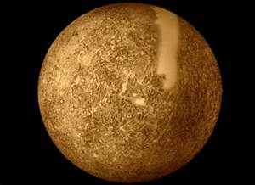
Integrated science planet project plant: mercury
Power point made by Gage King and Dalton Sims.

Slide 2
What dose mercury look like?
Mercury is the smallest planet in our solar system. It is one of the driest planets due to its close distance to the sun and because of that mercury is very sandy. Mercury is also filled with craters just like our moon.

Slide 3
Have we explored mercury?
Yes we have explored mercury by the spacecraft mariner 10 in 1974. due to mercury being to close to the sun we cannot use telescopes or satellites to view it.

Slide 4
What is mercury like feature wise?
Mercury is filled with craters, hills, and mountains on its surface. Mercury has no atmosphere nor dose it have any ice or water. But mercury is very dense with unknown gases.

Slide 5
What are temperatures like on mercury?
Mercury's average temperature is around 300 degrees.
Mercury's highest temperature is 800 degrees.
And its lowest temperature is -279 degrees.

Slide 6
Dose mercury have a atmosphere?
Mercury has no atmosphere but it dose have unknown gases in it.

Slide 7
Dose mercury have any moons?
Mercury has no moons.

Slide 8
Where dose the name mercury come from?
The name mercury comes from the Greek god Hermes.

Slide 9
What is maximum distance from the sun?
Mercury's maximum distance from the sun is 70 million km ( 43.5 million miles).

Slide 10
What are mercury's days like?
One day on mercury is equivalent to 176 earth days and the one year is equivalent to 672 earth days.

Slide 11
How long is mercury's rotation?
Mercury's rotation is 176 earth days.
Mercury's revolution is 672 earth days.
An hour on mercury is equal to 5 earth days.

Slide 12
What is mercury's mass, diameter and density like?
The diameter of mercury is 4,878 km as far as mass and density goes it is unknown as of right now.

Slide 13
Are there any interesting facts about mercury?
Mercury rotates 3 times per revolution.
Electronics can not be used to see mercury.
Mercury is the closest planet to the sun.

