Slide 1
Lee County Schools
BYOD
Internet Access
Acceptable Use of Technology
For Students
Patti Henderson
Library Media Specialist
Sanford Middle School

Slide 2
New Pilot Practice: BYOD
The goal of BYOD programs is to expand opportunities for 21st Century learning. However, using personally owned devices at school is a privilege, not a right.
This privilege may be revoked for the student body as a whole or for students individually at the discretion of the administration.
It is important that students use their devices responsibly, respect the property of others, and demonstrate that this use benefits them academically and helps them develop into good digital citizens.
Notes:
The building level principal and local school handbook shall provide specific information as to the depth at which the BYOD initiative is implemented within a specific school. Any modifications should go through the school principal.

Slide 3

Cell Phones & Electronic Devices Permitted
Laptops, Netboks, Chromebooks
Tablets (Ipad, Galaxy, Xoom, etc)
eReader/Tablets- Kindle, Nook, etc…
Internet Accessible Cell Phones (Smart Phones)

Slide 4
When & Where to Use
Students may only use their personal device in the classroom when instructed by the teacher.
Students may only use their device in the library/media center with the permission of the media specialist.
Students may not use their device to text or update personal sites/accounts during school hours or on the school bus.
Students may not use their device to record pictures, audio, or video unless directed by the teacher.
Students may use their device while on the school bus to read or play games; however, there should be no sound coming from the device that can be heard by neighboring students or the bus driver.
Students may not use their device in common areas (anywhere on campus) unless specifically instructed to do so by an administrator or teacher.
Notes:
Added for Sanford per Mrs. Rutherford
bullet regarding recording pictures, audio, video
on the school bus to the bullet pertaining text and personal accounts
Changed common areas….cafeteria, hallways, etc. to “anywhere on campus”

Slide 5
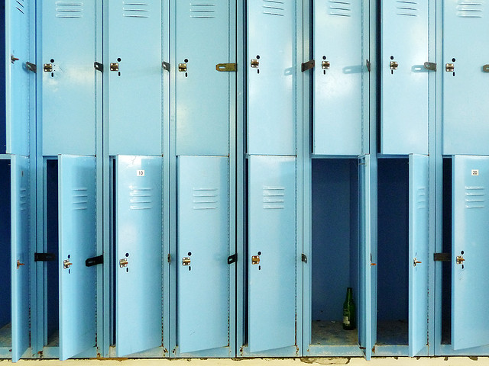
Storage of Student Personal Devices
Administrators/teachers should not be asked to retrieve devices left in school lockers
Students should not ask teachers or staff to “hold onto” or store their device

Slide 6
Internet Access
Students should ALWAYS use the school’s guest wireless network for Internet Access (not their personal wireless plan). BYOD privileges may be revoked for students found to be visiting websites which are blocked by the District’s filter. To access the wireless network:
    Choose wireless network: Leeco
password: 3343347058667
Users will be prompted to login daily, but the wireless password should only have to be entered once per device.
If a student’s personal device will not connect to the guest network, the school will not alter network settings in order to allow such devices to connect .
No guarantee is made that the school’s wireless network will always be available.
Notes:
The school’s wireless network has filters in place which are required by the CIPA (Child Internet Protection Act). If students use their personal wireless plan the filters are not in place AND their personal plan could charge them for the access……large bill comes in to the home for school access – parents will be calling!
The school’s wireless guest network should not allow students to download apps (even free ones), so if a specific app is required, it will need to be downloaded while off campus, preferably BEFORE attempting to use it in class.
Network outages may occur without notice. No quality of wireless signal is promised. Signal strength may vary depending on the location in the school and the number of devices simultaneously connecting to the network. All Schools are not currently equipped to support all students connecting to the network.

Slide 7
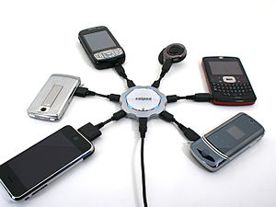
Electrical
Personal devices should be brought to school fully charged.
Access to electrical outlets for charging should not be expected.

Slide 8
Theft/Loss/Damage
The school/District will not be held financially responsible for lost or stolen devices, nor are school administrators responsible for conducting searches for lost/stolen devices.
The school/District will not be held responsible for any physical damage or data loss, including damage/data loss resulting from connecting devices to the school’s wireless network or power outlets.

Slide 9

Troubleshoot/Inspection
School/District staff, including Technology staff, will not configure, troubleshoot, or repair student devices.
Administrators may read, examine, or inspect the contents of any personal device upon reasonable suspicion that the contents or recent utilization of the device contains evidence of a violation of these or other rules and policies, as well as any local, state, or federal laws.
Notes:
Per Mrs. Rutherford, on the 2nd bullet – changed “school officials” to administrators.
REMEMBER- BYOD privileges may be revoked for students found to be visiting websites which are blocked by the District’s filter!!

Slide 10
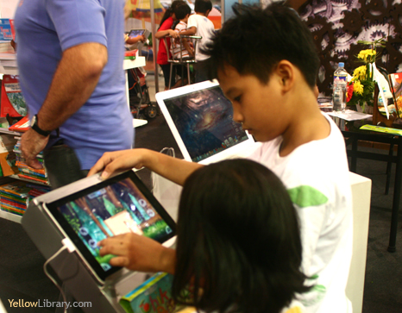
Remember, the BYOD initiative is a pilot and the privilege may be revoked for the student body as a whole or for students individually at the discretion of the administration. Therefore, it is important that students use their devices responsibly, respect the property of others, and demonstrate that this use benefits them academically and helps them develop into good digital citizens.
.

Slide 11
Internet & Technology
Some Internet content may be inappropriate for public school use. All teachers and school staff reserve the right to decide what is appropriate or inappropriate for students using the Internet.
Notes:
Remind students that these guidelines apply to ALL devices whether they are property of the school system, or personal property of the student.

Slide 12
Independent Internet Access Requirements
Students and parent (s) complete and return the Acknowledgement and Contract contained in the student handbook each school year.
The completion of this contract allows independent access to the internet by the student; and assures that both the student and parent (s) are aware of the Lee County guidelines regarding ethical use of the internet and technology resources.

Slide 13
School Rules and Internet Access
Lee County’s intent is to provide free and equal access to resources via the Internet.
All school rules for appropriate use of technology also apply to use of the internet.
Users are expected to act in a considerate and responsible manner.
Be prepared to be held accountable for your actions. Exemplary behavior is expected from all users at all times.
Individuals will use the system’s technology resources in an efficient manner so as to do no harm to individuals, institutions, or companies.

Slide 14
Guidelines for Internet Use
As with all educational materials used in the Lee County Schools, this resource used in the classroom will be screened.
Because communications on the Internet are often public in nature, all users should be careful to maintain appropriate and responsible communications.
Users are not to harm the computers or network in any way.
Copies of software or data may not be created or used on school equipment
Notes:
Ask students – which of these guidelines address using your phone/tablet to video or take pictures of other students/teachers?
Note: Written harassment/bullying – including sexual harassment is # 15 on the list of Major offenses in regards to disciplinary actions.

Slide 15
Computers should not be used to view, send, or display obscene, lewd, profane, vulgar, disrespectful, rude, threatening, or inflammatory language, messages, or pictures.
The posting of electronic chain letters or useless information is a violation of system policy.
Copyright laws allow the installation of a single copy of any software program on one computer at a time.
Users should report policy violations or problems with security to the principal or the system technology coordinator.

Slide 16
Students must not attempt to modify resources, utilities, configurations, or change restrictions on an account or attempt to breach any security system either with or without malicious intent.
Illegal copies of software may not be created or used on school computers.
No one is to share his/her computer password with another person.
No one is to use the computer or Internet to reveal personal addresses or telephone numbers (yours or some one else’s)
Accessing any work, folders, or files which are not assigned to you, under your computer password is forbidden.

Slide 17
Consequences for Policy Violations
Loss of access
Additional disciplinary action in line with existing practice regarding inappropriate language or behavior
Legal action, when applicable
Remember
Internet access is a privilege, not a right.

Slide 18

The school has no duty to regulate or review off-campus Internet/cell phone messages, statements, postings, or acts, but when those acts threaten violence against another student or employee, disrupt the learning environment or orderly conduct of school, the school can take action. Discipline can range from conferencing with the student to expulsion. Law enforcement may be contacted if necessary.

Slide 19
The Lee County Schools Guidelines Regarding the Legal and Ethical Use of the Internet and Technology Resources for Students and for Employees is located in all student handbooks and on the Lee County Web Page under Technology.
www.lee.k12.al.us

