Slide 1
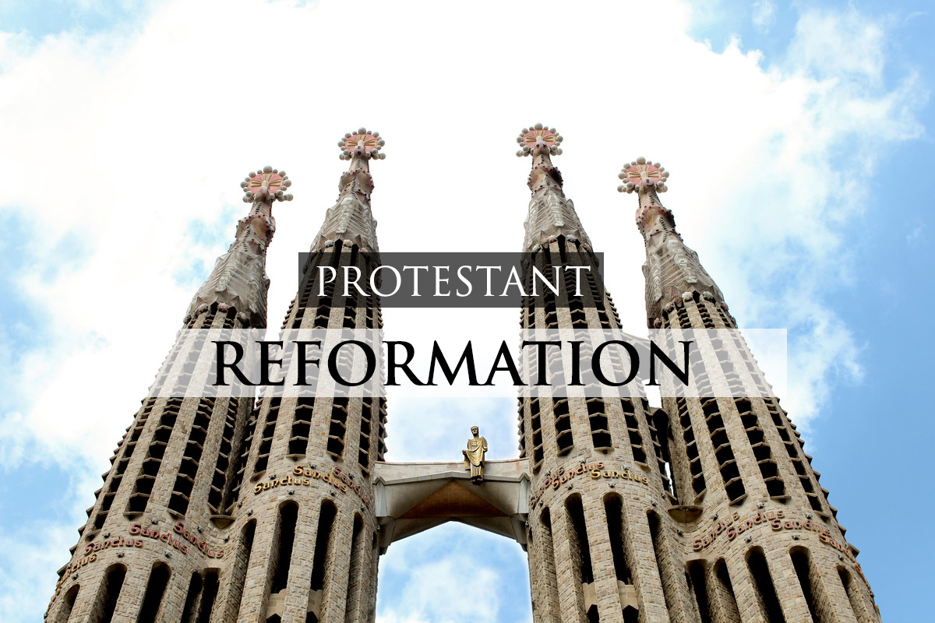

Slide 2
Bell Ringer
What root words do you see?
PROTESTANT
REFORMATION

Slide 3
Bell Ringer
PROTESTANT
REFORMATION
Reformation or Revolution???

Slide 4
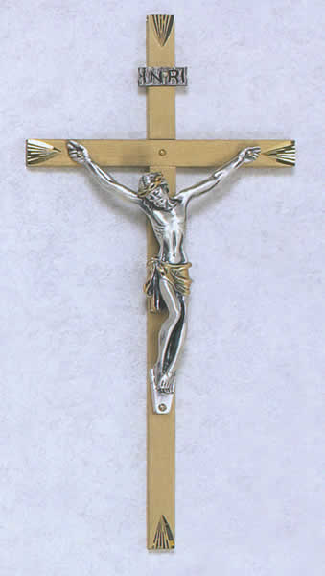

What is the Protestant Reformation?
Religious reform movement that divided the western Church into Catholic and Protestant groups.
VS.

Slide 5
Christian Humanism
Goal - reform the Catholic Church
To change society, must 1st change humanity
Human beings able to reason & improve selves
Reading for selves = more pious (having strong religious feelings)
Inner piety reform of church & society

Slide 6
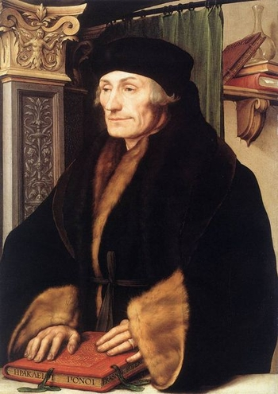
Erasmus
“the Philosophy of Christ”
Christianity should:
  show people how to live good lives
  not just give a set of beliefs to follow
  focus inward
In other words…

Slide 7
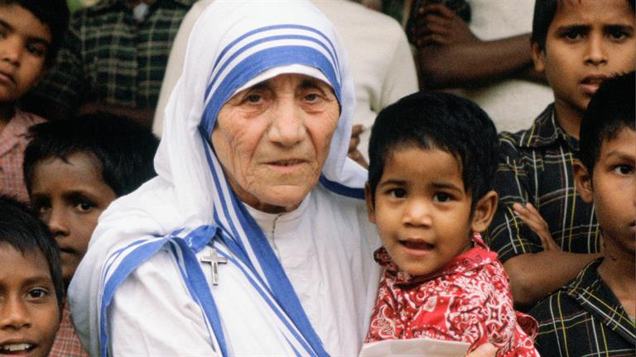



The Church should “walk the walk” not just “talk the talk!”
NO!
YES!

Slide 8


Erasmus’ Egg
Reform NOT Break
“Erasmus laid the egg that Luther hatched”
Luther

Slide 9
 | Reformation | Revolution
Means or Process
Primary Criticism
Peaceful,
Legal means
Often violent
Political rev may involve
overthrow of
gov’t
Creates instability;
Often followed by another rev
Too slow;
Not enough change
LT#1

Slide 10
 | Reformation | Revolution
Purpose
Time Frame
Emphasis
Change
Change
Gradual;
Long-term focus
Immediate;
Short-term focus
Make needed changes to old system
Totally replace old with new
Continuum

Slide 11
Setting the Stage
Holy Roman Empire
Holy Roman Emperor (HRE) Charles V
Pope Leo X
↓
↓
Cardinals
Princes govern provinces
↓
Bishops
↓
↓
Wealthy nobles/landowners
Local Priests
↓
Lower class

Slide 12
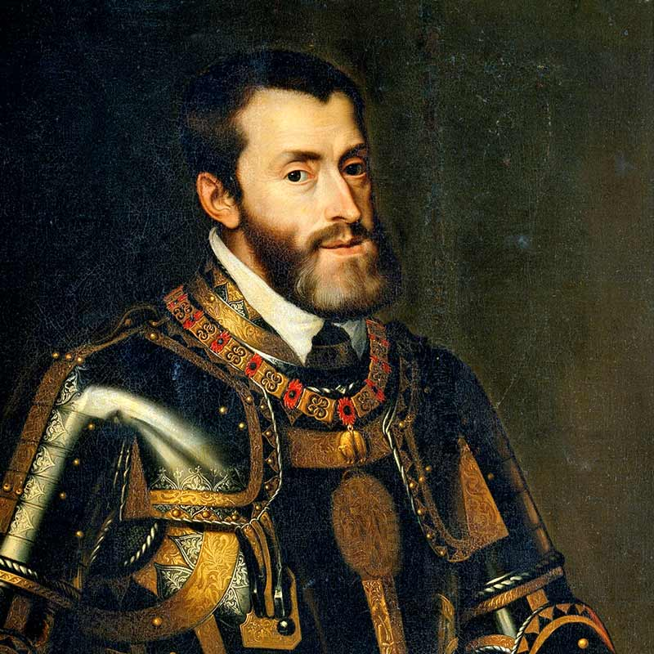
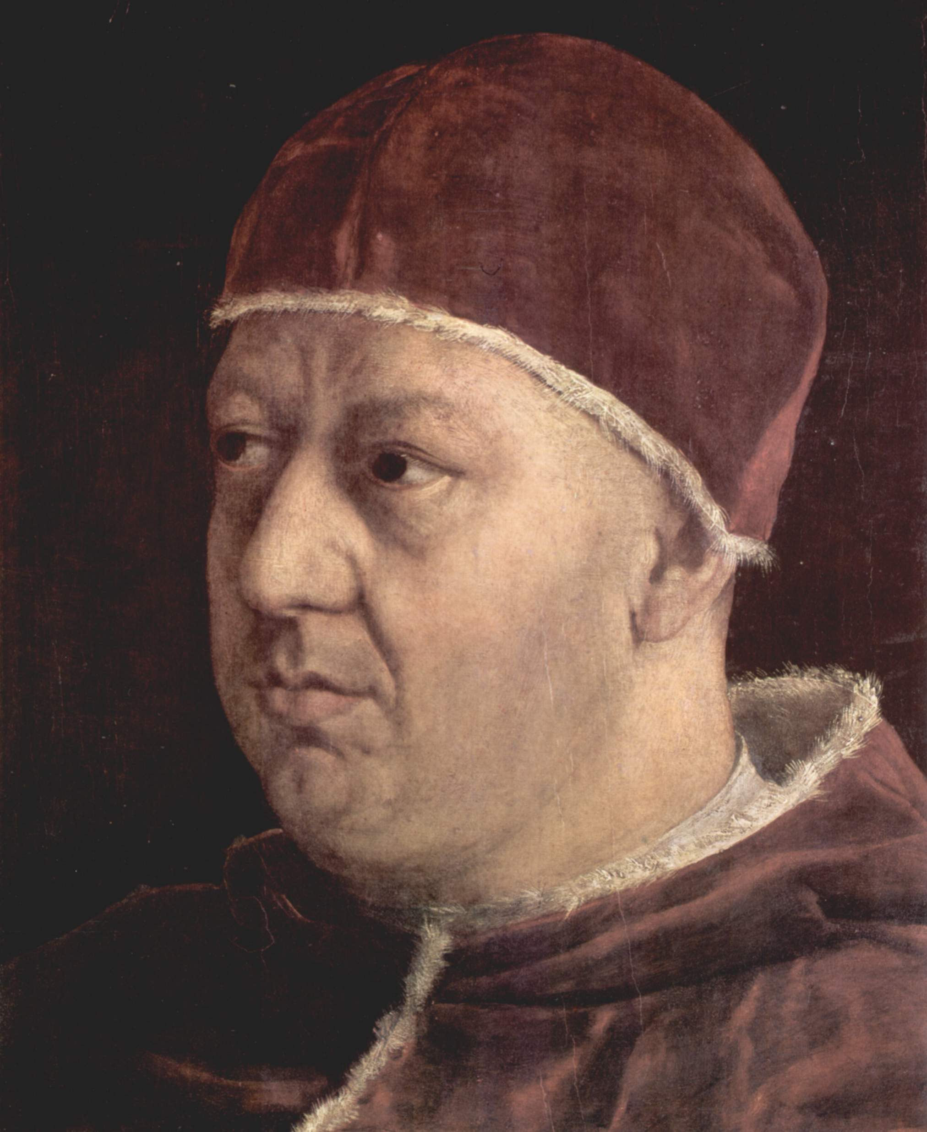
HRE Charles V
Pope Leo X

Slide 13
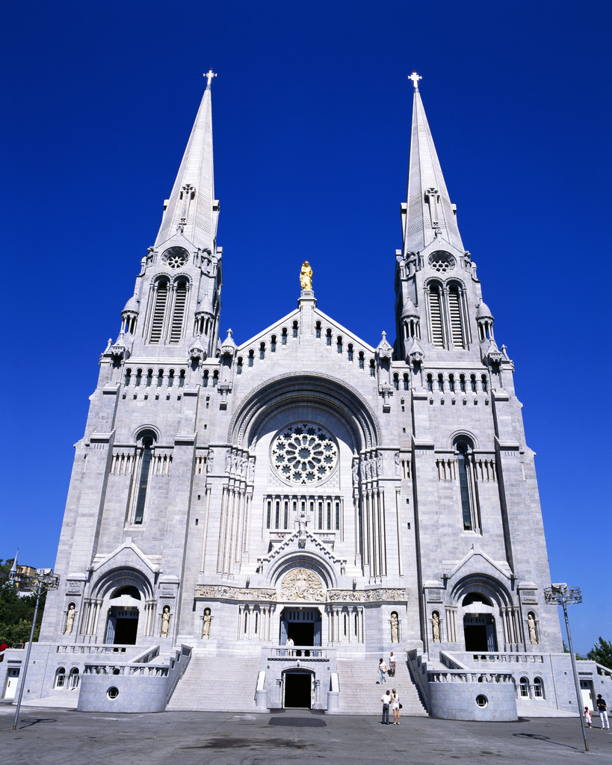
Reasons for the Reformation
Upper levels of church were wealthy & oppressive
Smaller cities/republics wanted to run own affairs in a modern way (church = too feudal & old)
Monarchy – rid kingdom of Church taxes, property, and political influence

Slide 14
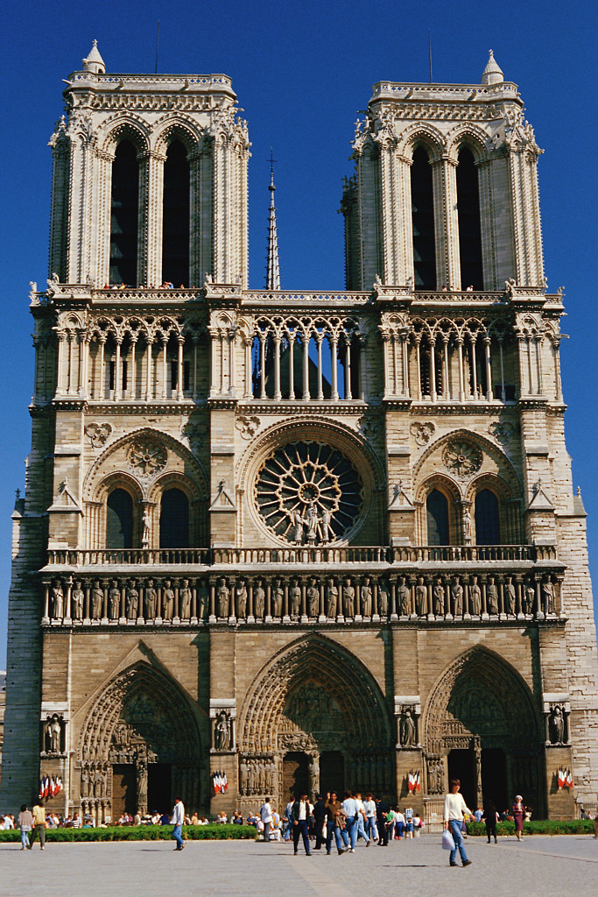
Reasons for the Reformation (cont.)
Clerical immorality – violated celibacy (&accused of drunkenness, gambling, and other vice)
Clerical absenteeism- often absent
Clerical pluralism – esp. higher level officials –and held more than one office at a time (often purchased their office)

Slide 15
Salvation
People’s spiritual needs - not met
Salvation (“How do I get to Heaven?!”)
Church answers:
  Good works
  Obtaining indulgence

Slide 16
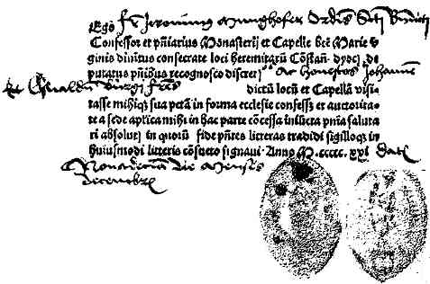
Indulgence
The release from all or part of the punishment for sin in purgatory
(a place between Earth & afterlife where one “serves time” for their sins & is purified. Time spent here is directly proportional to the number & severity of sins committed in one’s life.)

Slide 17
Skill: Analyzing Editorial Cartoons
The student will determine the meaning of editorial cartoons.
Identify main elements
  Explore use of imagery: symbolism and caricature
  Clues provided by written text
  Identify/obtain prior knowledge needed to understand the cartoon
Determine stance being taken by cartoon
Identify historical information that supports or refutes the editorial cartoon.

Slide 18
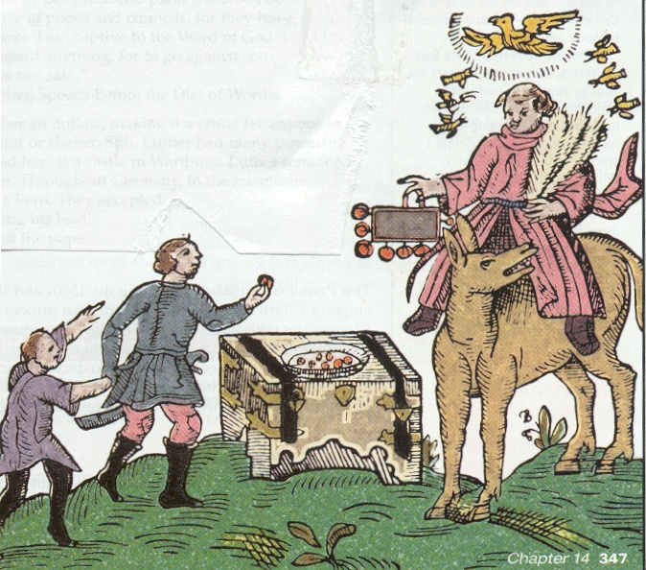
Editorial Cartoon

Slide 19
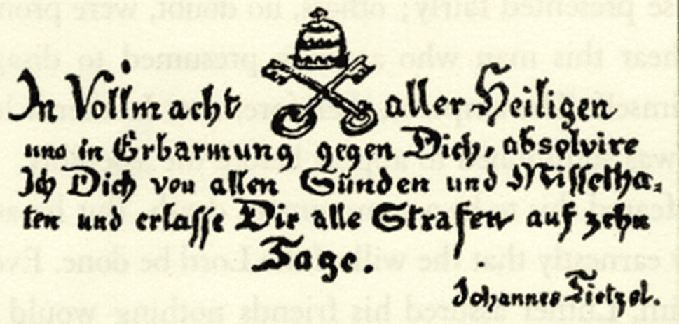
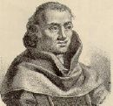

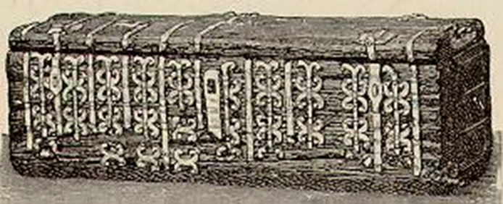


Slide 20
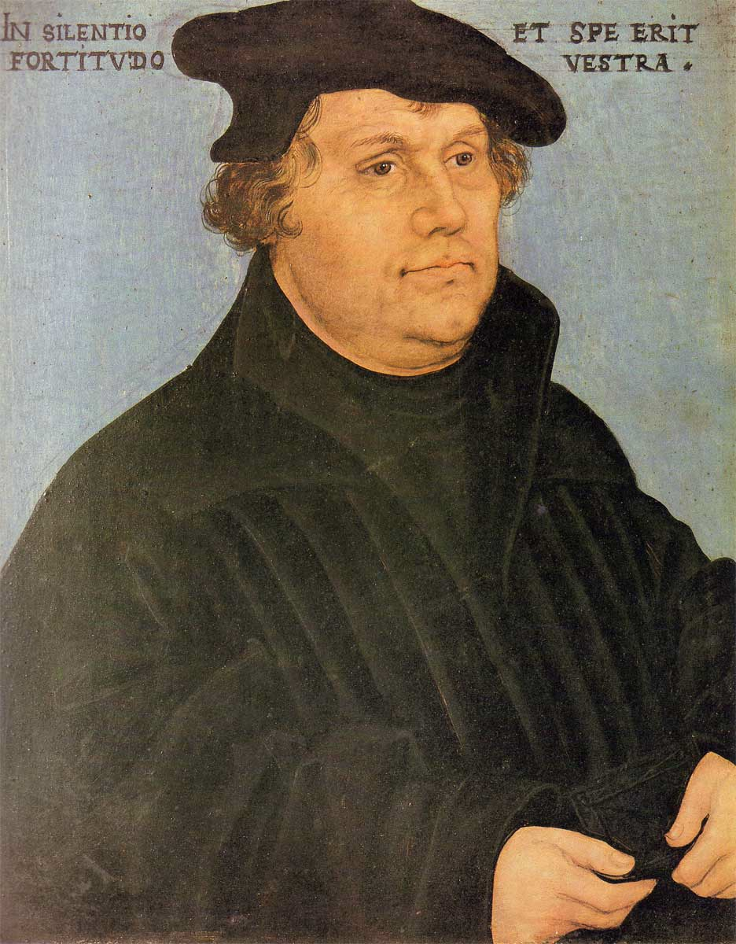
Martin Luther
Monk & professor of theology
Wittenberg, Germany
Questions Catholic teachings/practices vs. the Bible

Slide 21
Luther and Salvation
To Obtain Salvation…
  RCC: must have faith AND do good works
  ML: faith in God alone will earn salvation
  “justification by faith alone”
ML’s theory based on Bible -sole source of religious truth to Protestants

Slide 22
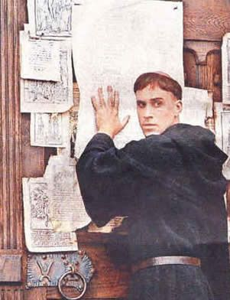
Luther’s 95 Theses
Listed out the abuses of the Church
October 31, 1517
Nailed to door of Wittenberg church
Printing Press - HUGE impact

Slide 23
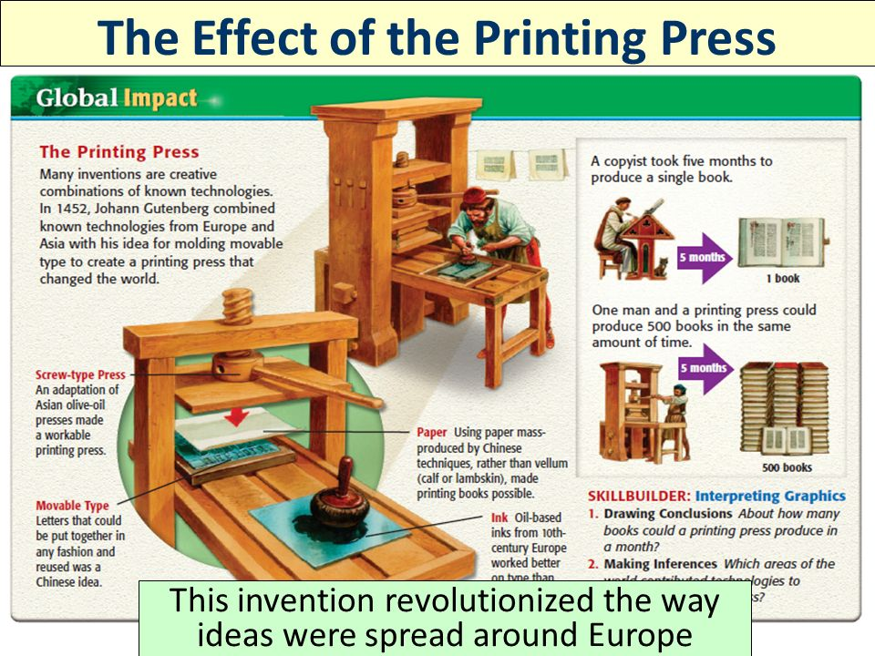

Slide 24

The Diet of Worms
IS NOT a means of obtaining nutritional sustenance from eating nothing but those little squiggly things in your garden…
IS a legislative assembly of the Holy Roman Emperor in the German city of Worms (pronounced Vuhrms)

Slide 25
Ask him to recant (take back) his criticisms
He does not
Result -
  Luther excommunicated in 1521

Slide 26
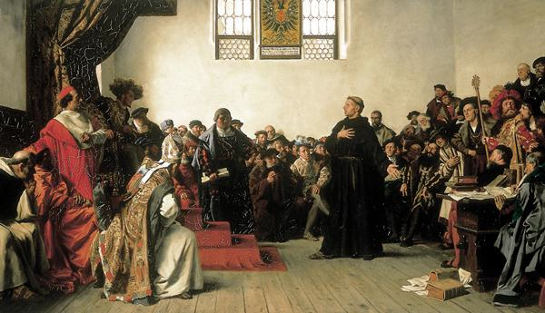
Luther - “A Simple Reply”

Slide 27
Edict of Worms
Outcomes:
  Made Luther an outlaw
  Luther’s works to be burned
  Luther to be captured & turned over to Charles V

Slide 28
Augsburg Confession
1530, Lutheran Princes refuse HRE demand to revert back to Catholic doctrine
1555 Peace of Augsburg
  Princes allowed to choose Lutheranism or Catholicism in their provinces
  Religiously divided Germany and Europe
  Thirty Years War b/t Catholics and Protestants

Slide 29
Contributions of Luther
Challenged RCC
Translates the whole Bible into German
Opened door to religious freedom
Caused Catholic Church to reform

Slide 30
Catholic (Counter) Reformation
Council of Trent
  Upheld traditional Catholic teachings
  Defend RCC
    Faith & good works
    Seven sacraments (doctrine)
    Transubstantiation
    Clerical celibacy
    Purgatory
  Reform RCC
    Indulgences (used, but NOT for sale)
    Missionary efforts to help poor
    Higher moral standards established

Slide 31
Protestants Spread
Germany: Lutheranism- Martin Luther
England: Anglican- King Henry VIII
Scotland: Presbyterianism-John Knox
Switzerland- Calvinism-John Calvin

Slide 32
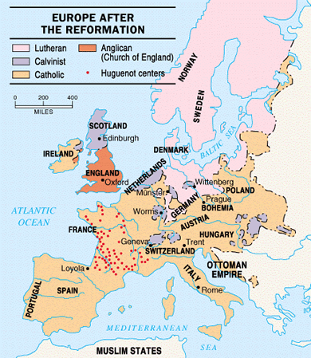

Slide 33
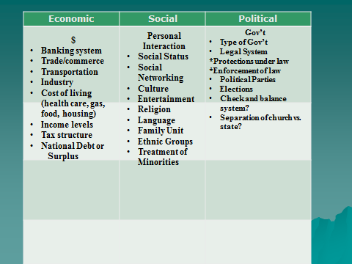

Slide 34
Long Term Impact
Economic
  RCC loses power due to economic decline
  Thirty Years War takes huge economic toll
Social
  Formation of new Protestant denominations
  Increase in literacy
Political
  As HRE power declines, loyalty to the nation-state increases (nationalism)
  Thirty Years War- Protestants vs. Catholics

Slide 35
Discussion
Reformation or Revolution???
WHY???

