Slide 1
Realism
English 11

Slide 2
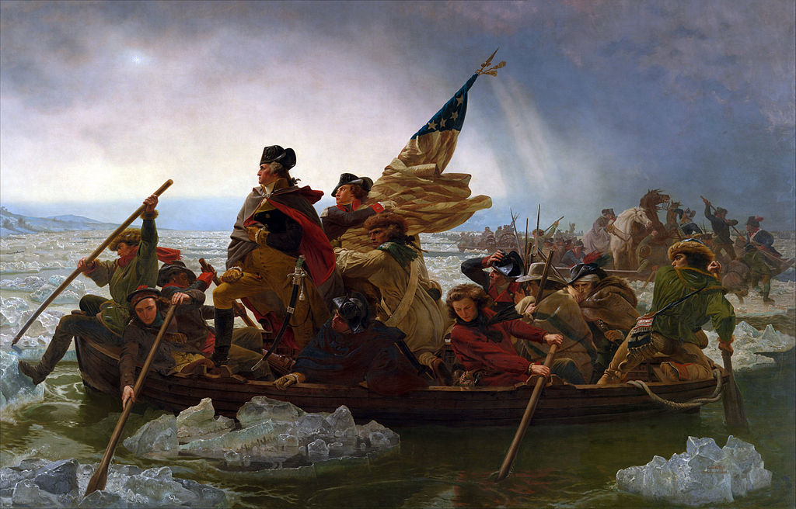

Slide 3
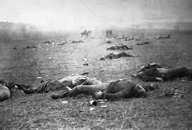

Slide 4
The Difference?

Slide 5

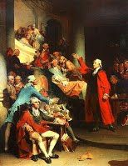



American Literature Timeline
YOU ARE HERE
The Puritan Era
Age of Reason
Romanticism
Transcendentalism
Realism
1600-1750 1750-1800 1800-1840 1840-1855 1865-1915

Slide 6
Realism Video
https://www.youtube.com/watch?v=eTCjHZWmgG0

Slide 7
Historical Context
Population is growing...rapidly!
Science, industry, and transportation are expanding.
Literature growing. No longer Romantics or Transcendentalists. Realists.
Aftermath of the Civil War left Americans less certain and optimistic.
Idealism of the Romantics seemed out of date.
Philosophy of Transcendentalists seemed irrelevant to many readers.
America was ready for writers to GET REAL.

Slide 8
What is Realism?
Representation of reality in literature
Development of believable characters
Written in natural vernacular, or dialect

Slide 9
Why did Realism develop?
The Civil War
Urbanization & Industrialization of America
As a reaction to Romanticism
Emerging middle class

Slide 10
Realism in American Literature
Purpose of writing:
  to instruct and entertain
Character is more important than the plot
  Ordinary characters
Subjects drawn from real life experiences
Avoid symbolism and romanticizing of subjects
Settings more familiar to the author
Plots emphasized “the norm of daily experience”

Slide 11
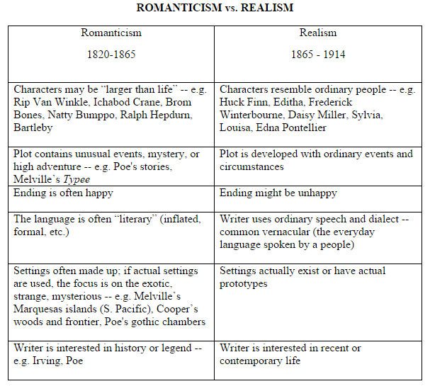
Notice the differences.

Slide 12
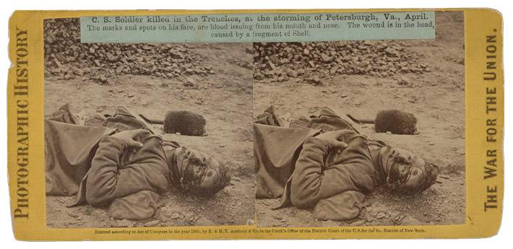
Realism in Photography (Photojournalism)

Slide 13
Realism and Photography
The Civil War is first extensively documented war
Photo documentation honest (in most cases) and brutal depiction of realities of war
Directly connected to shifting desire amongst writers to create “real” stories and depict “real” people
Photojournalism and its Impact on Realism

Slide 14
What is Regionalism?
Often called “local color”
Added regional flavor to each story
Focus on characters, dialect, customs, topography, and other features specific to a certain region.
Example: the South, the Midwest, New England

Slide 15
Why did Regionalism develop?
The Civil War and the building of a national identity
Taking Realism to the next level:
  more focus on a particular setting and its influence over characters

Slide 16
What is Naturalism?
Shaped by uncontrollable circumstances
Portrays life exactly how it is
Men are governed by place in life and environment
Often depict man in conflict with nature, society, or himself

Slide 17
Why did Naturalism develop?
Swell of immigrants...led to larger lower class and increased poverty in the cities
Prominence of psychology and the theories of Sigmund Freud
Pessimism from the Civil War and Reconstruction

Slide 18
RECAP
Realism, Regionalism, and Naturalism are intertwined and connected.
America has moved away from Romanticism and now takes a more REAL approach to writing.

