Slide 1
Randolph County School System, AL
Overview of School Desegregation Consent Decree
March 9, 2018
David G. Hinojosa
Director of the IDRA EAC-South
david.Hinojosa@idra.org
Notes:
We designed this template so that each member of the project team has a set of slides with its own theme. Members, here’s how you add a new slide to just your set:
Mark where you want to add the slide: Select an existing one in the Thumbnails pane, click the New Slide button, then choose a layout. The new slide gets the same theme as the other slides in your set.
Careful! Don’t annoy your fellow presenters by accidentally changing their themes. That can happen if you choose a different theme from the Design tab, which changes all of the slides in the presentation to that look.

Slide 2



Mission of RCSS
It is the mission of Randolph County School District to foster successful communities which begin with the acceptance and understanding of diversity.

Slide 3


Diversity Vision of RCSS
It is the vision of the RCSS to promote diversity in the schools’ communities by developing pathways of support and inclusion of minority administrators, faculty and students throughout the system.

Slide 4


Benefits of Diverse, Integrated Faculty in Schools
For students:
Improves academic achievement
Provides role models
Builds Cultural Bridges
Increased social-emotional development
For Faculty:
Reduces prejudice and bias
Increases interracial relations and competency
Increases job satisfaction
Multicultural peer supports and diversity perspectives

Slide 5
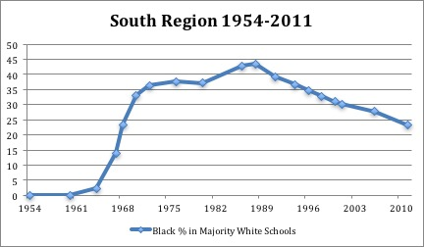
Impact of Brown v. Board, School Desegregation in the South (Frankenberg)
Notes:
This is great, I would consider going to this graph as you explain the points in the prior ppt.

Slide 6

Impact of Brown v. Board, Black Faculty
In 1954, 82,000 Black teachers educating approximately 2 million Black children.
11 yrs later, following Brown v. Board, more than 38,000 Black teachers and administrators lost their jobs.

Slide 7
RCSS Consent Order Timeline
1967
First Court Order requiring RCS to desegregate
1970
Second Court Order requiring RCS to desegregate
1994
Employment
Methods of Discipline
Policies and Programs
Address Perceptions
Curricula Offerings

Slide 8
RCSS Consent Order Timeline
2011
Personnel Hiring
2013
2016
Workforce Goal of 16% Black Certified Employees
Equity Consultant
Assignment of Student Discipline
Workforce Goal for Category 1 Employees and Interim Employment of Category 1 Teachers.

Slide 9
Remaining Vestige of Discrimination
Recruitment
Hiring
Retention

Slide 10
Vestige (Remnant) of Discrimination, Black Faculty
White-Black Students and Faculty by Campus, RCSS (2016-17)

Slide 11
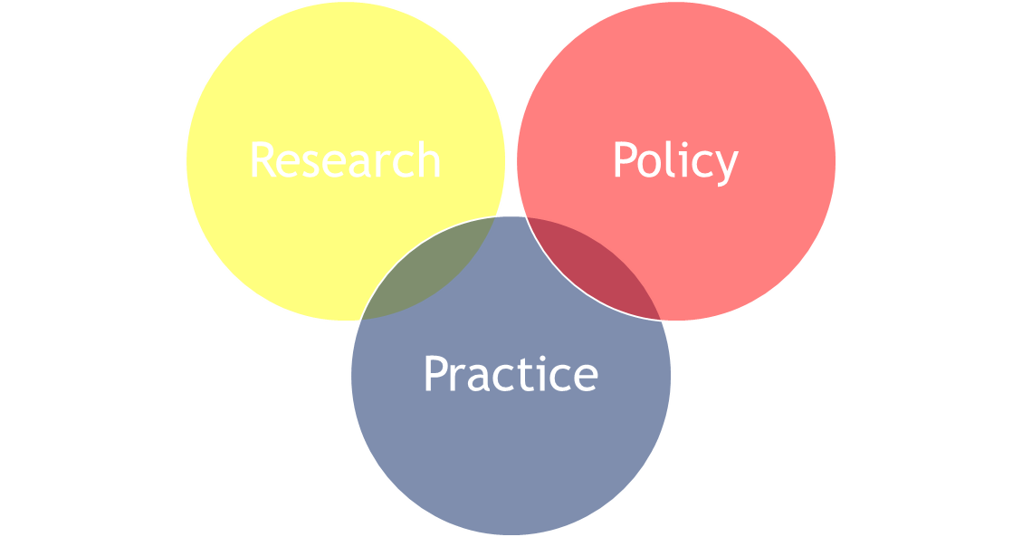
RCSS Process- 2017-18
Consent Order
Request for TA
IDRA Contextual Analysis
Collaboration with RCSS
RCSS adopts preferred recommendations
Negotiations with Plaintiffs
Court adopts RCSS plan
Implementation

Slide 12
RCSS Plan
Recruitment
Expanded, deeper partnerships w/ HBCUs
Utilize liaisons
Hiring
Expedite Hiring
Revise procedures for more holistic assessment of applications
Retention
Improve working conditions
Mentoring
Induction
Grow Your Own Teachers
Professional Development

Slide 13
RCSS Commitment to Diversity and Inclusion
Superintendent’s Advisory Committee
District-wide professional development
School Counseling Diversity Program (4th & 8th Grade)
Student Leadership Diversity Committee
Successful Students,
Successful Schools,
Successful Community

Slide 14













Intercultural Development Research Association
Dr. María “Cuca” Robledo Montecel, President & CEO
5815 Callaghan Road, Suite 101
San Antonio, Texas 78228
210-444-1710 • contact@idra.org
www.idra.org
Ensuring that educational opportunity and success
for all students are guaranteed
Sign up for IDRA email news.

Slide 15
