Slide 1
Superior Check Ligament Desmotomy
Intra-operation

Slide 2
Aim
Once performed it interrupts the transfer of the weight-bearing load on the tendon to the distal radius, bringing the muscle and tendon proximal to the superior check ligament (and therefore enhanced elasticity to the functional unit) into use during weight-bearing.

Slide 3
Indications
Flexural deformities:
  Metacarpophalangeal deformity - alone if superficial digital flexor tendon (SDFT) only involved.
  In combination with distal inferior check desmotomy, if deep digital flexor (DDFT) also involved.
Superficial digital flexor tendinitis.
May be combined with tendon splitting.

Slide 4
Welfare considerations
http://www.thehorse.com/articles/31656/equine-field-anesthesia-considerations
Please refer to the link for field anaesthesia considerations.
Also refer to the pdf for general welfare considerations.

Slide 5
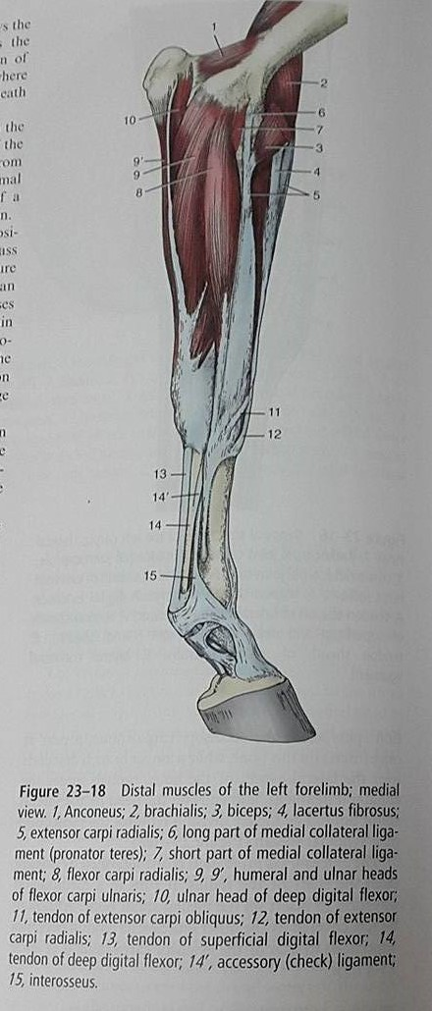
Anatomy

Slide 6
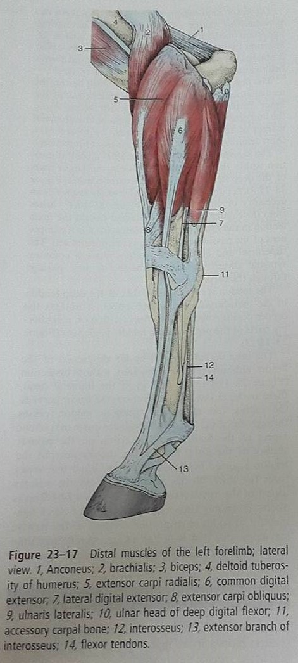
Anatomy

Slide 7
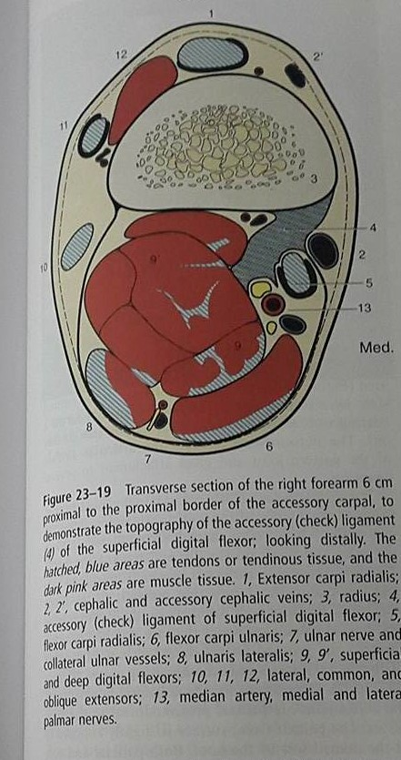
Anatomy

Slide 8
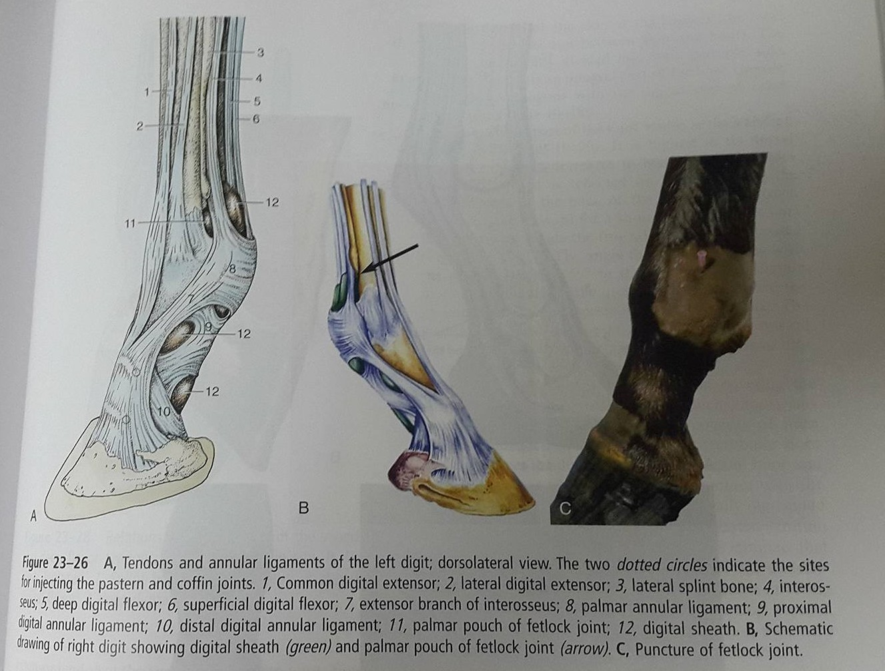
Anatomy

Slide 9
Anatomy
http://www.vet.cornell.edu/oed/horsedissection/Search.asp?Fun=SBM#

Slide 10
Equipment
Halters
Alcohol
Iodine
Chlorohexidine
Cotton/Gauze
Sterile packs
Sterile Instruments
Surgical drapes
Anaesthesia machines equipped with gas tanks.
Endotracheal Tubes
Harness
Sutures

Slide 11
Physical Examination
https://www.youtube.com/watch?v=98wQHSOQ6kw
Please view the above link, which demonstrates a distance and physical examination.
In addition the horse under going surgery must have an ASA grade 1, to perform surgery.

Slide 12
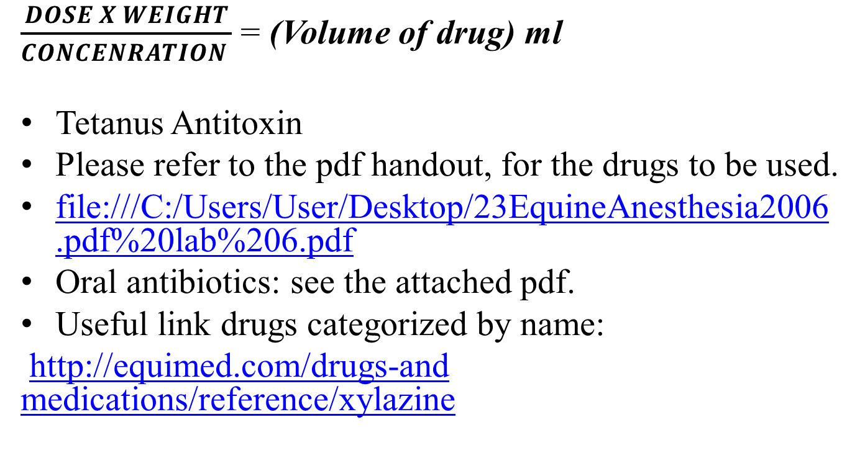
Drugs
$\frac{DOSE X WEIGHT}{CONCENRATION }$ = (Volume of drug) ml
Tetanus Antitoxin
Please refer to the pdf handout, for the drugs to be used.
file:///C:/Users/User/Desktop/23EquineAnesthesia2006.pdf%20lab%206.pdf
Oral antibiotics: see the attached pdf.
Useful link drugs categorized by name:
http://equimed.com/drugs-and medications/reference/xylazine

Slide 13
Preparation for the surgery
Administer Tetanus antitoxin by injecting 1 mL dose intramuscularly using aseptic technique. Administer a second 1 mL dose 4 to 8 weeks after the first dose. Revaccinate annually using one 1 mL dose.
Preparation for general anaesthesia please refer to the document inserted pages 4-14.
The surgery is performed with the patient in lateral recumbency with the affected leg down or in dorsal recumbency with the leg suspended which if preferable for hemostasis.

