Slide 1

LITTLE Children Growing
Pre-K Registration
January 3, 2020

Slide 2
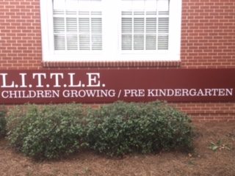
Where: 1 Academy Street, Hawkinsville
When: 8:30-4:00

Slide 3

Children must be 4 years old on or before September 1, 2020.

Slide 4
Required Documentation to Register
You will not be allowed to register if any items marked with (**) are not brought to the registration site.
· Picture ID of parent/guardian enrolling student**
· Certified Birth Certificate (not a copy)**
·
· Social Security Card (or documentation from SS that card has been applied for)**
· Proof of Address (must be a physical address—NO P.O. boxes)** e.g. utility bill, lease (other examples on school website)

Slide 5
Other Needed Documentation to Register
Needed when your child turns 4 or at the beginning of the school year:
Proof of Services for Family (if applicable): food stamp card, Medicaid care
Shot Record (form #3231)
· Ear, Eye, Dental, Nutrition Form (form #3300 - all 4 parts)
These forms can be completed by the doctor or at the health dept.

Slide 6

Please share this information with anyone you know who has a child that will be eligible for our Pre-K program.
Information can also be found on our Pulaski County schools website, as well as displayed around numerous businesses in Hawkinsville.

Slide 7

Not able to come January 3?

Slide 8

After January 3, come on any school day between 9:00 am and 2:00 pm to register your child at LITTLE Children Growing Pre-K.

Slide 9
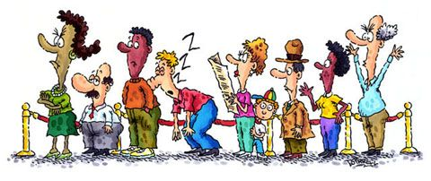
There are a limited number of spots. It is on a first-come, first serve basis— with 4 year old in-county students given priority.

Slide 10

Please remember you will NOT be able to register your child if you do not bring the documentation marked with (**).

Slide 11


Sorry, early registration
will
not
be allowed.

Slide 12

If you have any questions, please call the Pre-K office at 783-7205.

