Slide 1

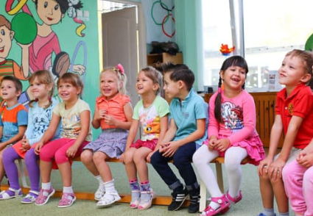

Employment changes due to COVID-19?
Your child may be eligible for
free, full day
Prekindergarten
Children must be
4 years old by September 1, 2020
Contact:
www.XXXXXXXXXXX.org

