Slide 1
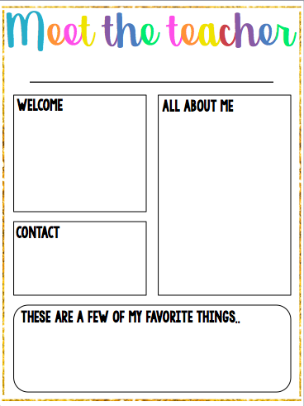
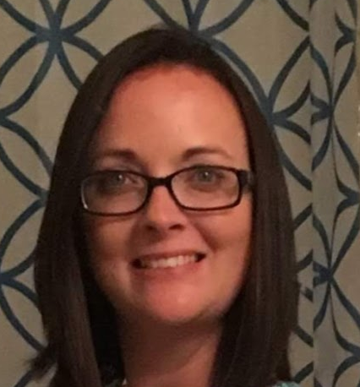
Mrs. Rebecca Stein
Welcome to First Grade! I am so excited to get to know all of you! The success of your student truly depends on a partnership between home and school. I look forward to building a bond with each one of you.
This is my first year as a Stateside Patriot! My husband Chris and I have two boys, Braden (16) and Matthew (11). We also have one fur baby, a four-year-old lab-mix named Sabbath.
This is my sixth year as an employee with OCS. I have experience in Pre-K-6th grade.
Class Dojo (easiest way to send a quick message) or
Email: Rebecca.stein@onslow.k12.nc.us
Colors: Purple/Yellow/Teal/Blue Restaurants: Outback
Drinks: Diet Pepsi/Coffee/Water Hobby: Gardening, Swimming
Sport: Football/Dallas Cowboys Author: Mo Willems
Shopping: Amazon, Target Season: Fall
Foods: Pizza, Asian Cuisine
Candy: Reese’s Sticks

