Slide 1
Fall 2016 Update:
STAAR Alternate 2
September 23, 2016
TETN Event#: 43175

Slide 2
Fall 2016 Update: STAAR Alternate 2
These slides have been prepared by the Student Assessment Division of the Texas Education Agency.
If the slide is changed for local use, please remove the TEA footer at the bottom of the slide.
This training in no way takes the place of reviewing required manuals and additional information on the TEA website.

Slide 3
Topics:
Key Dates
Test Security/Confidentiality
Presentation Instructions
Scoring Instructions
Allowable Accommodations
Student Scoring Data
Support Materials
No Authentic Academic Response (NAAR)

Slide 4
STAAR Alternate 2 is an assessment based on alternate academic standards and is designed for students with significant cognitive disabilities receiving special education services. STAAR Alternate 2 is administered in the same grades/subjects and courses as the STAAR assessments.
STAAR ALTERNATE 2

Slide 5
STAAR ALTERNATE 2
2016-2017
Enrollment Collection: Nov 7 – Dec 9
Last Date for Test Administrator Training March 17
Preview Window March 20-31
Assessment Window April 3 – 21
(NEW) Verification Window April 24 - 25
All key STAAR Alternate 2 Dates are referenced in Test Administrator Manual (TAM) p.3 & District Campus Coordinator Manual (DCCM) p.SA-4
KEY DATES

Slide 6
STAAR ALTERNATE 2
2016-2017
STAAR Alternate 2 Verification Window
The verification window for STAAR Alternate 2 is April 24 - April 25, 2017. The window closes at 7 p.m. (CT) on April 25. The verification window is intended to ensure the accuracy and completeness of all data submitted in the Assessment Management System and the collection of secure documents.
If during the verification process it is realized that a student has not been tested then the student must be tested during the verification window.
If during the verification process it is realized that a student’s data has been omitted, the data should be entered during the verification window.
KEY DATES

Slide 7
STAAR ALTERNATE 2
2016-2017
Students Who Enroll AFTER April 3, 2017
Students who transfer/move to a new district after the first day of the STAAR Alternate 2 testing window do not have to be tested.
KEY DATES

Slide 8
STAAR ALTERNATE 2
2016-2017
“No person may reveal or discuss the contents of a test booklet or secure portion of a test administrator manual before, during, or after a test administration unless specifically authorized to do so by the procedures outlined in the test administration materials. If circumstances necessitate that a test booklet or secure portion of the test administrator manual be examined, permission must first be obtained from TEA.”
                (TAM, 2017)
CONFIDENTIALITY

Slide 9
STAAR ALTERNATE 2
2016-2017
Materials to be provided to STAAR Alternate 2 test administrators per student include:
One student booklet and
one secure STAAR Alternate 2 Test Administrator manual for each grade, subject, or course tested.
Return used and unused:
secure STAAR Alternate 2 Test Administrator manuals
scoring documents
photocopies of secure test materials
SECURITY
(MATERIALS)
Notes:
Reminder, this update only reports to you the changes/additions this year. This should never take place of reading manuals and coordinator information. We added “used” and “unused” to clarify language concerning what materials test administrators receive and what they should return.

Slide 10
STAAR ALTERNATE 2
2016-2017
Info now in DCCM:
Test administrators or test administrator assistants may include:
staff members who are serving as an intervener; employed by the district and equipped with specialized skills and training to routinely provide direct support to a student with deafblindness.
Those providing brailling services to the district may serve in the role of a test administrator assistant.
DCCM, SA10
TEST ADMINISTRATOR

Slide 11
STAAR ALTERNATE 2
2016-2017
“Direct” indicates an action for the test administrator. For example, the test administrator may need to bring certain parts of the stimulus image to the student’s attention. This can be done in a variety of ways depending on a student’s needs.
The student can be alerted orally or through sign as to where to look or focus.
The student’s hand can be guided to specific places in the stimuli or paired with items for the student to explore that can be placed in the student’s hand.
Sections can be pointed to or highlighted as they are mentioned in the instructions.
Parts of the stimulus can be covered up until explained in the instructions to focus attention and avoid stimulation.
Answer choices can be color-coded, numbered, or labeled with letters to direct the student to a specific place as long as the format is equally applied to all answer choices.
Equal time and treatment must be provided for each answer choice so that a correct answer is not emphasized.
Presentation Instructions

Slide 12
STAAR ALTERNATE 2
2016-2017
Communication
A test administrator can communicate with a student in many ways depending on a student’s needs. The information can be stated, signed, translated into any other language that is routinely used with the student during instruction, provided in written form, or paired with tactile or picture symbols.
Presentation Instructions

Slide 13
STAAR ALTERNATE 2
2016-2017
Before and After the “Find” Statement
The test administrator may choose to read the “find” statement prior to the answer choice. The test administrator may reverse the order from which these are listed in the presentation instructions based on each individual student’s need.
Presentation Instructions

Slide 14
STAAR ALTERNATE 2
2016-2017
Repeating Presentation Instructions
Anytime during the administration:
Students can be redirected back to the stimulus in the cluster if the student loses focus.
Answers cannot be changed
Student can only be refocused by redirecting them to the stimulus within the cluster.
Students can be provided verbal encouragement to stay focused.
Students can request to have information repeated.
Presentation Instructions
Notes:
TAM p. 14

Slide 15
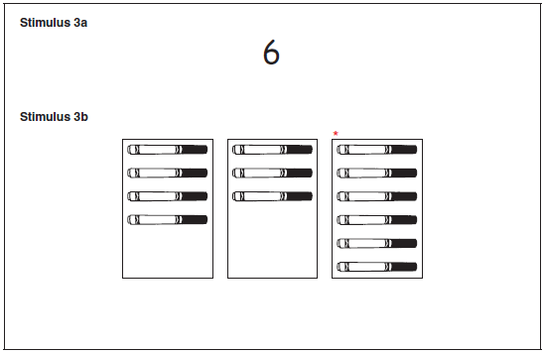
STAAR ALTERNATE 2
2016-2017
Example of Reading Presentation Instructions
Present Stimulus 3a and 3b.
Direct the student to the number 6. Communicate: This is the number 6.
 STOP and redirect.
Presentation Instructions
Notes:
For example, in this example, the student is becoming distracted to the point that he requires redirection on item 3 in the cluster.
The teacher would turn back to item 1 (if needed) or item 2 based on the student’s need, and redirect by repeating SOME PARTS of the presentation instructions.
TAM p. 14

Slide 16
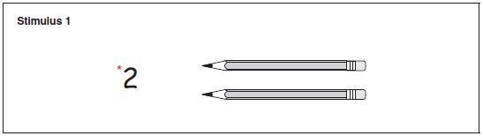
STAAR ALTERNATE 2
2016-2017
Example of Reading Presentation Instructions
Presentation Instructions
Present Stimulus 1.
Direct the student to the number 2. Communicate: This is the number 2.
Direct the student to each pencil next to the number. Communicate: One pencil, two pencils.
Notes:
Example from release items to demonstrate how to repeat presentation instructions within the cluster.
Use the redirection language the student is accustomed to in the classroom. “ Name of student, look here” The TA would present the stimulus, direct to the stimulus,

Slide 17
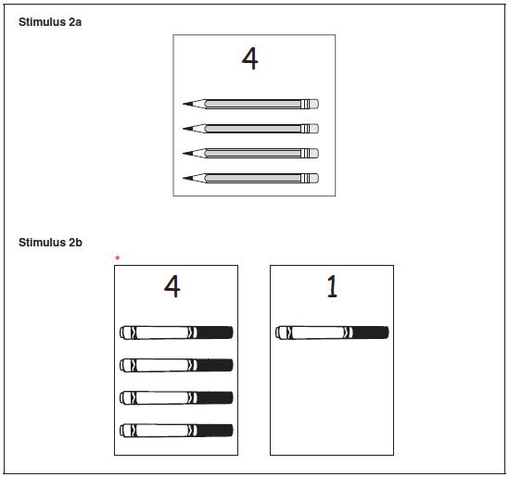
STAAR ALTERNATE 2
2016-2017
Example of Reading Presentation Instructions
Presentation Instructions
Present Stimulus 2a and 2b.
Direct the student to Stimulus 2a. Communicate: Here are four pencils. One, two, three, four.
Notes:
Example from release items to demonstrate how to repeat presentation instructions within the cluster. The TA would present the stimulus, direct to the stimulus,

Slide 18
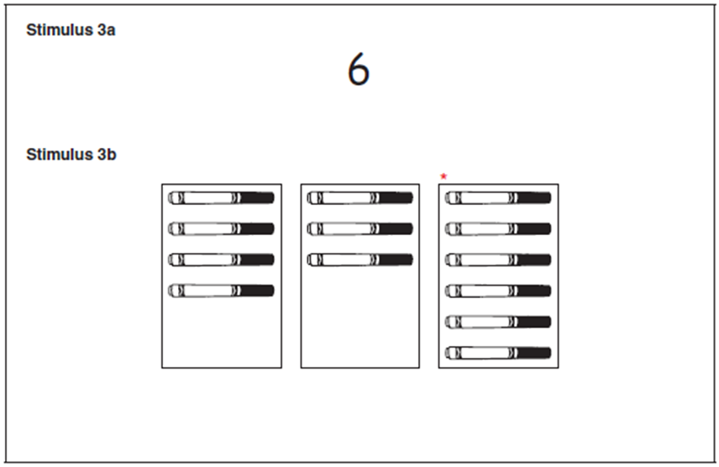
STAAR ALTERNATE 2
2016-2017
Example of Reading Presentation Instructions
Present Stimulus 3a and 3b.
Direct the student to the number 6. Communicate: This is the number 6.
Presentation Instructions

Slide 19
STAAR ALTERNATE 2
2016-2017
ITEM 3 in a cluster:
When an assist begins with a verb either the test administrator or the student may perform the assist.
EXAMPLE
• Have the student point to and/or count the sides on each figure. OR
• Trace the sides of each figure.
Scoring Instructions

Slide 20
STAAR ALTERNATE 2
2016-2017
Changes in Allowable Accommodations chart:
Use calculator, manipulatives or math tools
Reread sections of the text as described in the Presentation Instructions in this manual.
Allowable
Accommodations

Slide 21
STAAR ALTERNATE 2
2016-2017
Changes in Allowable Accommodations chart:
Removal of “photocopying” from the allowable accommodations chart.
In order to access some allowable accommodations, it may be necessary to photocopy secure materials. These allowable accommodations must be documented in the students’ IEP; and be routinely used accommodations in instruction as well as assessment. To photocopy secure materials, test administrators are required to follow the photocopying guidelines in the Test Administrator Manual in order to maintain the security and integrity of the assessment.
Allowable
Accommodations

Slide 22
STAAR ALTERNATE 2
2016-2017
Entering Student Scoring Information and Accommodations Information
Photocopying no longer appears on the scoring document.
Email will follow TETN: steps that have been eliminated to the process for transcribing student scoring information
Student Scoring Information

Slide 23
STAAR ALTERNATE 2
2016-2017
Not new, but a reminder…….
The STAAR Alternate 2 Scoring Document can be found:
in the resources section of the Assessment Management System, and
on the last page of each STAAR Alternate 2 Test Administrator Manual.
SCORING DOCUMENT

Slide 24
STAAR ALTERNATE 2
2016-2017
Not new, but a reminder…….
Who may enter scoring information into the online system?
District testing coordinator
Campus testing coordinator
Test administrator
Other campus testing personnel (employed by the district, received security training, signed an oath)
SCORING DOCUMENT

Slide 25
STAAR ALTERNATE 2
2016-2017
Educator Guide, updated & posted 9/16/2016
Participation Requirements remain the same
Instructional Terms, updated & posted, no longer imbedded within the Curriculum Framework documents.
Instructional Terms stand alone on STAAR Alternate 2 webpage resources.
Curriculum Framework, non-secure front matter Test Administrator Manual, Essence Statements coming soon!
ANCILLARY MATERIALS

Slide 26
STAAR ALTERNATE 2
2016-2017
Revisions to Vertical Alignment and Curriculum Framework documents are based on the updated Pre-K guidelines Participation Requirements remain the same
Essence Statements: one revision
  STAAR Reporting Category 1, Number and operations. 5.21., Uses numbers to demonstrate an understanding of place value.
      TEA Curriculum specialists believed the word “numbers” better encompassed the SE’s we have aligned with this essence statement rather than “decimals”.
ANCILLARY MATERIALS

Slide 27
STAAR ALTERNATE 2
2016-2017
No Authentic Academic Response (NAAR) Eligibility
The student is consistently unable to provide an authentic academic response during instruction.
The student:
is unable to demonstrate any observable reaction to a specific (academic) stimulus.
exhibits only startle responses.
tracks or fixates on objects at random and not for a purpose.
moves or responds only to internal stimuli.
vocalizes intermittently regardless of changes in environment around him/her.
No Authentic Academic Response
Notes:
Consistently is A key word here.

Slide 28
STAAR ALTERNATE 2
2016-2017
No Authentic Academic Response (NAAR) Eligibility
Reminder:
State assessment decisions are reviewed annually.
Students who receive a NAAR designation in any given year should be reconsidered annually to see if they have developed an authentic academic response.
Skill development should be closely monitored; as educators work to help students develop an authentic academic response.
No Authentic Academic Response
Notes:
Consistently is A key word here.

Slide 29
STAAR ALTERNATE 2
2016-2017
No Authentic Academic Response (NAAR) Eligibility
Authentic Academic Response
Apply knowledge and skills through prerequisites.
Responds to academic requests using verbal, physical, or visual responses.
Consistently uses a reliable response mode.
Responds in a meaningful way to academic requests, but not always correctly.
No Authentic Academic Response
Internal Stimuli Response
Only responds to favorite food/favorite item/favorite people/favorite sound.
Only responds to environmental factors (hot/cold, wet/dry).
Only responds to internal stimuli.
* This information does not encompass all scenarios.
Notes:
Consistently is A key word here.

Slide 30
STAAR ALTERNATE 2
2016-2017
Evidence of No Authentic Academic Response (NAAR)
The ARD committee must use the STAAR Alternate 2 Participation Requirements form to document its assessment decisions.
Students receiving the designation of NAAR for the purposes of STAAR Alternate 2 should have the NAAR designation documented in their IEP; the NAAR form must be included in the IEP.
The student’s IEP should provide further evidence that the student consistently is unable to provide an authentic academic response during instruction.
No Authentic Academic Response

Slide 31
STAAR ALTERNATE 2
2016-2017
Documentation to support NAAR
DO:
Use specific language in the IEP to communicate the student’s proficiency level defining what is being measured.
Write PLAAFPs to include quantitative measurement of the frequency by which student performs the academic response, i.e. % or 2/10 opportunities.
If the student has passed a portion of STAAR Alternate 2 recently, document the change in the student’s state that has taken place.
Use deliberations or other places in the IEP to document what has been attempted when the student showed NAAR, i.e. STAAR Alt 2 release tests, daily instruction activity, etc.
No Authentic Academic Response

Slide 32
STAAR ALTERNATE 2
2016-2017
Evidence of No Authentic Academic Response
(NAAR)
The NAAR designation must be in alignment with the student’s PLAAFPs.
No Authentic Academic Response
What not to do:
The student is able to use a VOD to respond to simple questions.
The student is able to answer questions when given two picture choices 80% of the time.
The student is able to choose from an array of symbols on top of her communication book.
The student is able respond to yes/no questions and responds to basic questions.

Slide 33
CONTACT INFORMATION
Texas Education Agency (TEA)
Phone: (512) 463-9536
Email: staaralt@tea.state.tx.us
Pearson’s Austin Operations Center
Phone: (800) 627-0225
Email: TXPearsonAccess@support.pearson.com

