Slide 1
Early Learning in ESSA:
Expanded Opportunities for School Districts
ESSA Federal Program Director Training
January 13, 2017
Robert Butts, Assistant Superintendent of Early Learning
Linda Sullivan-Dudzic, Special Programs Director, Bremerton School District

Slide 2
Early Learning in ESSA
In this Presentation:
Why might a district consider using ESSA funds for Early Learning?
What new opportunities are available in ESSA?
What might you do?
What process might you use to decide?

Slide 3
If a neighbor asked you what ESSA is intended to achieve, how would you respond?

Slide 4
Assist students who are struggling academically?
Help students be successful in reading and mathematics?
Increase college readiness?
Increase Kindergarten Readiness?
Help English learners master the English language?
And/or
?

Slide 5
After they heard your answer, what if they asked what are the best strategies for achieving these worthy goals using ESSA funding?
How would you respond?

Slide 6
Depending on which students you are thinking about, the answer would will vary.
However, in most all cases,
starting earlier is likely better.

Slide 7
The skills and behaviors of entering Kindergarten children vary tremendously…

Slide 8
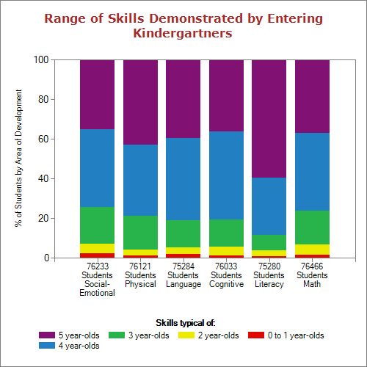
Fall 2016 WaKIDS Results

Slide 9
Once children start behind in the K-12 system, most all of them stay behind…

Slide 10
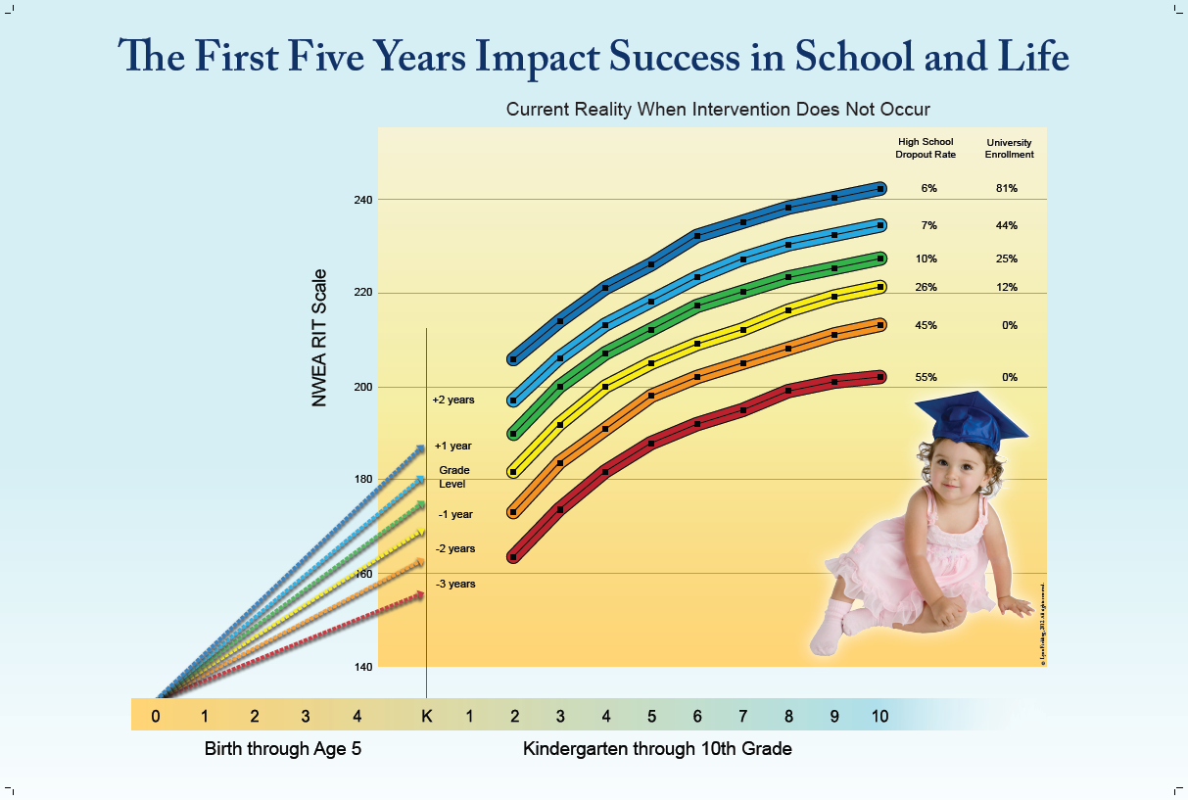

Slide 11
Investing in the early years returns the greatest benefits…

Slide 12
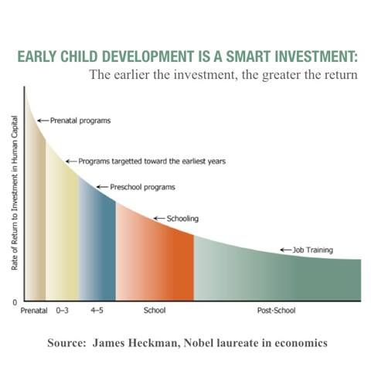

Slide 13
So, what does this have to do with ESSA?
- Thanks to Senator Patty Murray and her colleagues, more opportunities are provided to allow ESSA funds to be used to serve Pre-kindergarten children and educators
- ESSA also provides an opportunity for school districts to think about how to use ESSA funds more effectively

Slide 14
Major School district-related Early Learning Provisions in ESSA
Program/Activity | Pre-ESSA | In ESSA
Title I, Part A (Struggling Students) - Serve and provide tools and resources to Pre-K children, educators, and families | Allowed | Allowed (If used, district plan must include how the district will support, coordinate, and integrate Title IA and early childhood services. Also programs serving children must comply with Head Start educational performance standards – see following slides)
Title I Elementary Schoolwide schools must have strategies for transitioning Pre-K students into their school | Not Applicable | Required
Title IIA (Professional Development) – Provide PD to Pre-K educators in Kindergarten readiness and transition | Not Allowed | Allowed (Must focus on Transitions and K-Readiness)

Slide 15
Major School district-related Early Learning Provisions in ESSA
Program/Activity | Pre-ESSA | In ESSA
Title III (English Learners) – Provide service to Pre-K English Learners | Not Allowed | States Decide if Allowable OSPI will not have this as an option for 2017-18. Before Title III can be used, OSPI will need to develop standards, a screener, and a progress assessment.
21st Century Learning Communities – Serve Pre-K children | Not Allowed | Allowed
State School Report Card information on Preschool enrollment | Not Applicable | Required Districts will continue to be required to report Pre-K children served by the district in CEDARS

Slide 16
Excerpt from an e-mail from Diane Bragdon, Ed.D., U.S. Department of Education, Office of Elementary and Secondary regarding the requirement that schools using Title I funds meet Head Start Performance Standards:
“In the Early Learning non-regulatory guidance, we further clarify on page 9-10, “The program must also meet, at a minimum, the education performance standards of the Head Start Program Performance Standards that are aligned with the Head Start Child Early Learning Outcomes Framework Ages Birth to Five (2015)….”

Slide 17
We recommend States and LEAs review the Head Start Child Early Learning Outcomes Framework Ages Birth to Five (2015), which is grounded in comprehensive research around what young children should know and be able to do during their early years. The Domains are broad areas of early learning and development from birth to 5 years that are essential for school and long-term success. “

Slide 18

Early Learning Outcomes Framework
Notes:
If the Department of Education continues to narrowly define compliance with Head Start as limited to early childhood education, it will be important to understand two key constructs in Head Start. The first is this graphic of the Framework for Effective Practice. I apologize for the poor quality of the picture, but I could not a better version of the graphic. There are four key concepts:
Foundation: Engaging Interactions and Learning Environments which include a well-organized and managed classroom, social and emotional support, and instructional interactions and materials that stimulate children’s thinking and skills. These are typically measured by the instrument known as CLASS –Classroom Assessment System created at the University of Virginia – Bob Pianti and others.
The First Pillar – Research based Curricula and Teaching Practices. A high-quality, research-based curriculum provides learning goals and activities in key areas of children’s development that reflect support for school readiness goals. Washington State’s Department of Early Learning has issued their analysis of research-based curricula that is comprehensive and supports multiple domains of children’s development.
The Second Pillar: Ongoing Child Assessment. Ongoing assessment is integral to curriculum and instruction. Our goal is to help children achieve school readiness and individual learning goals. Teachers need to keep track of the children’s progress and use assessment to guide the teaching. The next graphic will articulate the required domains of assessment.
The Roof: Highly Individualized Teaching and Learning: Effective instruction for all children requires individualized teaching and learning opportunities to access, participate and thrive in the preschool classroom. Like the K-12 system, teachers are expected to identify large group, small group, and individual instructional needs of children, and to track each child’s development/learning.

Slide 19
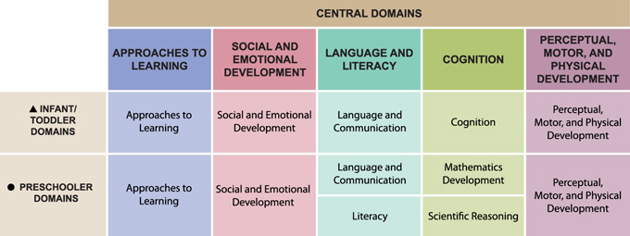
Early Learning Outcomes Framework http://eclkc.ohs.acf.hhs.gov/hslc/hs/sr/approach/elof/i-elof.html
Notes:
The Early Learning Outcomes Framework: Ages birth to five describes the skills, behaviors and knowledge that programs must foster in all children. It is grounded in research about what young children should know and be able to do to succeed in school.
This framework should be used to guide choices in curriculum and learning materials, to plan daily activities and to inform intentional instructional practices.
It is organized into the following elements: domains, sub-domains, goals, developmental progressions, and indicators.
The domains are the broad areas of early learning.
The sub-domains are categories within a domain. For example, social and emotional includes several subdomains, such as relationships with adults; relationships with peers; emotional functioning, etc.
Goals are broad statements of expectations for children’s learning and development – often referred to as standards in state early learning guidelines
Development progressions describe the skills, behaviors and concepts that children will demonstrate as they progress toward a given goal within an age period.
Indicators are identified for each goal and describe specific, observable skills, behaviors and concepts that children should know and be able to do at the end of EHS (36 months) or at the end of Head Start (by 60 months)
There is an interactive version of this at the website listed on this slide

Slide 20
Pause & Reflect
Given this new flexibility, assuming you want to invest more in Pre-K, what might you do?
How might you figure it out?

Slide 21
Pre-K Possibilities
Reallocation?
Extend Services?
Include Pre-K?

Slide 22
New Flexibility Based on the Needs of Your Community
Reallocation
                To reach more children prior to kindergarten
  Extend Services
  Use existing staff to support the work of Pre-K

Slide 23
New Flexibility Based on the Needs of Your Community
Include Pre-K
                Professional Development, Parent outreach, Facilities, Curriculum Adoption, STEM efforts, RTI and R&R

Slide 24
Engaging Your Community:
Key Questions
Who are the players?
Who has an investment in Early Childhood?
Where are your children prior to Kindergarten?
How many attend preschool now?
Who in your community has already done a needs assessment?
What does your trend data tell you?

Slide 25
Engaging Your Community: Important Steps
Prioritize the needs (one or two priority goals)
Align Pre-K goals with school/district goals
Identify effective teaching and learning practices (child development and neuroscience)
Align support systems and funding sources

Slide 26
Contacts
Jason Miller
Program Supervisor, Title I, Part A/LAP, OSPI
360-725-6232 Jason.Miller@k12.wa.us
Robert Butts
Assistant Supt., Early Learning, OSPI
360-725-0420 Bob.butts@k12.wa.us
Linda Sullivan-Dudzic
Special Programs Director, Bremerton School District
360-473-1061 Linda.sullivan@bremertonschools.org

Slide 27
Questions & Answers

