Slide 1
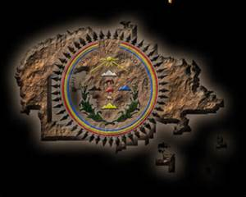
Din4 Bik4yah – Navajo Reservation

Slide 2
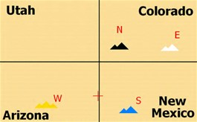
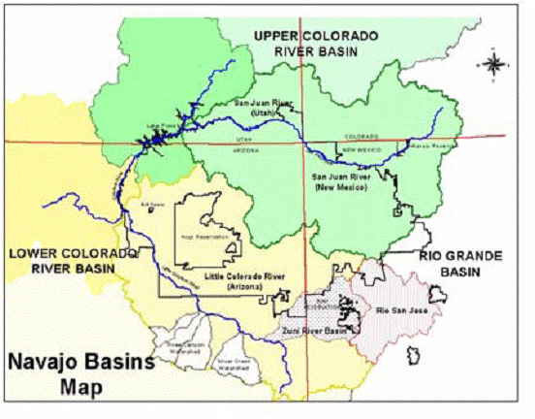
Navajo Reservation (Din4 Bik4yah)
Natural Boundaries: The land that Din4 people have always lived on is surrounded by the sacred mountain-Blanca Peak, Mount Taylor, San Francisco Peak, and Mount Hesperus as well as the 4 rivers-Rio Grande, Little Colorado River, Colorado River and Green River.

Slide 3
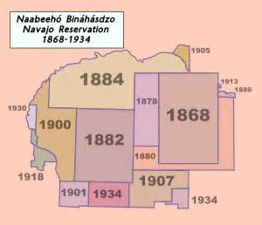
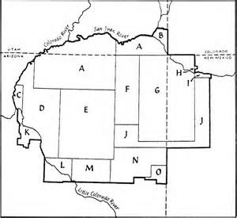
Treaty of 1868 Article II. After 4 years of interment at Bosque Redondo, an 1868 treaty allowed the Din4 people to return to their original homeland. The Navajo Reservation, set aside by the Treaty of 1868, has subsequently been enlarged through executive order and special legislation, including an 1884 executive order through which much of the land in present-day southeastern Utah was added.

Slide 4
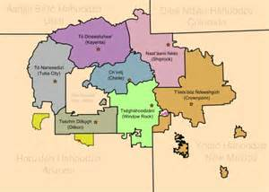
Reservation growth by Treaties, Executives Orders, Acts of Congress and Purchasing Lands

Slide 5
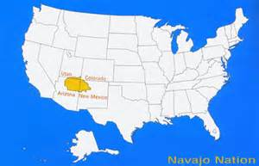
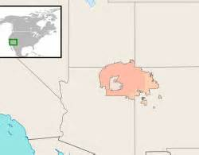
The Navajo Reservation in comparison to the United States

Slide 6
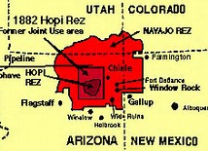
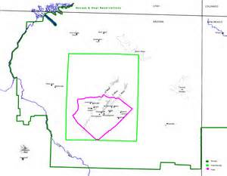
On December 16, 1882 President Arthur establishment the Hopi Reservation

Slide 7
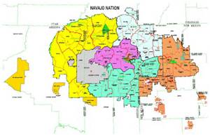
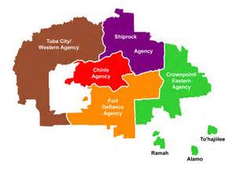
The Navajo Reservation has 5 Agencies: Tuba City, Fort Defiance, Chinle, Shiprock, and Crownpoint

Slide 8
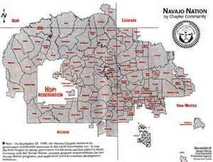
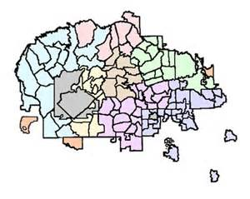
The Navajo Reservation has 110 Chapters

Slide 9
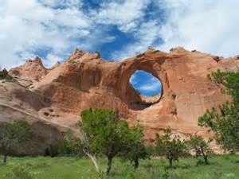
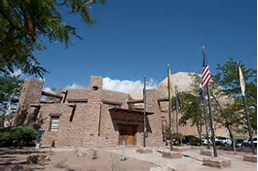
The Capital of Dine Bik4yah- Ts4gh1hoodz1n7

Slide 10
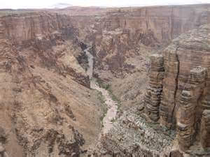
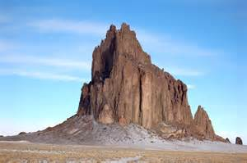
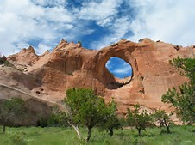
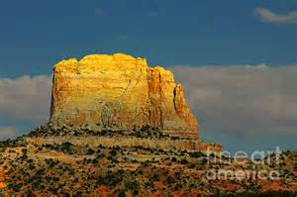
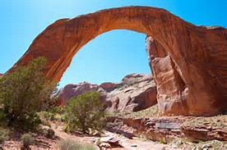
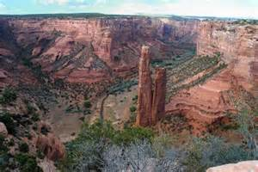
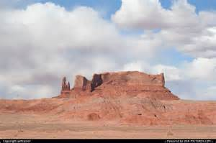
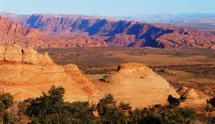
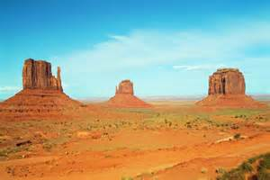
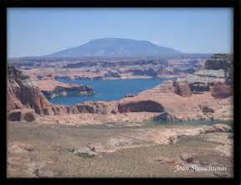
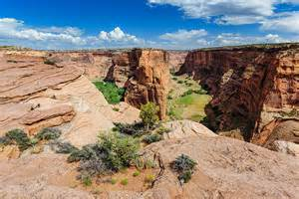
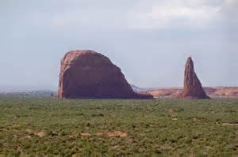
Navajo Reservation Natural Landmarks

Slide 11
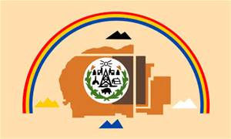

Navajo Nation Flag and Seal

