Slide 1
ROLLER COASTER PHYSICS

Slide 2
Quick Write
Choose ONE of the following prompts:
Think of your favorite roller coaster or amusement park ride. Describe where it is, when you rode on it and why it is your favorite.
What is the scariest roller coaster you have ever heard of? Describe where it is and what makes it so terrifying.

Slide 3
ROUND ROBIN
Working in teams of four, take turns reading your quick write statements to the group. The person with the shortest first name (student A) goes first, then B, C and D.
Everyone shares—even if a previous team member had the same response.
Example: “My favorite roller coaster is the same as ______, but I like it for a different reason….”
Others may not interrupt or comment until everyone has shared their experience.

Slide 4
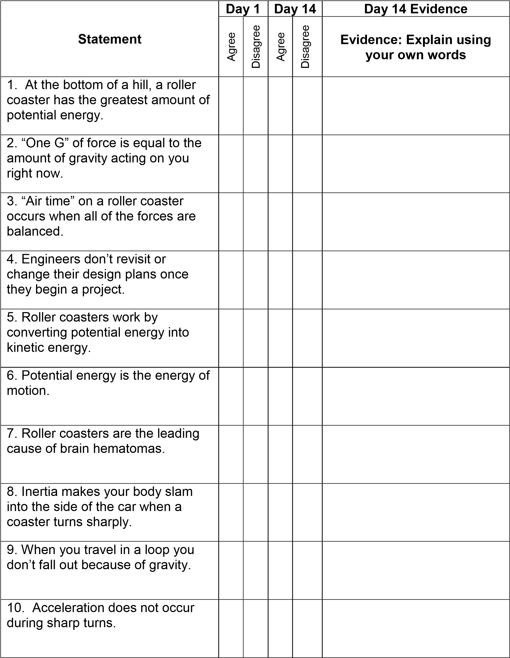

Slide 5
Article: History of Roller Coasters
Step 1: Read silently. Don’t worry if you don’t’ finish.
Step 2: Re-read aloud with a partner, alternating each paragraph. Think about “How have roller coasters evolved or changed over time?”
Step 3: Create a Thinking Map that best organizes the events in the article.
Step 4: Add a “Frame of Reference” to cite where you got

Slide 6
Final task for today!
Compare all the coasters you read
about today. What do all the coasters have in common with respect to what makes them move?

Slide 7
Thinking Map
Take a look at your Thinking Map from yesterday. ​
How do you think the roller coasters have been powered across the centuries? ​
Take 10 seconds and elaborate or clarify to your partner how you think roller coasters are powered. ​
Share out as a class

Slide 8
Let’s Take a Look at a Modern Roller Coaster
http://www.youtube.com/watch?v=zZZB0EDihq0

Slide 9
Question Focus​
Roller Coasters work by converting potential energy into kinetic energy.
Working with your team, generate as many questions as you can that correspond with the question focus. ​
Do not stop to answer any of the questions. ​
Do not judge any of the questions.

Slide 10
Energy Exploration​
Your team is now going to receive materials to investigate different types of energy. ​
You will receive: foam tubing, a marble, a stopwatch and a meter stick ​
Your objective is to come up with 4 different ways that you can have the marble roll down the tubing.

Slide 11
Guidelines: ​
The marble cannot leave the foam track in order for the trial to be recorded. ​
You must collect some type of quantitative data (numbers) for the trial to be recorded. ​
The foam track cannot be moved while the marble is moving. ​
You must release the marble only, not push it

Slide 12
Conclusion
Summarize what you noticed about what happened when you allowed the marble to roll down the tubing. ​
Possible sentence starters: ​
“In this lab, I noticed that…” ​
“When we changed the ___________, then ________ happened. I think this was because…” ​
Be prepared to elaborate on your idea and share out with the class.

Slide 13
Essential Question ​
​
How is a roller coaster able to travel up hills and do loops without an engine?

Slide 14
​
​
TYPES OF ENERGY
Step 1: By yourself, silently read the descriptions of potential energy and kinetic energy. ​
Step 2: “A” read aloud to “B” about potential energy. “B” summarize what potential energy is in your own words using the clarifying bookmarks. ​
Step 3: “B” read aloud to “A” about kinetic energy. “A” summarize what kinetic energy is in your own words using the clarifying bookmarks. ​
Step 4: Write a one-sentence definition of each word. Be prepared to share your definitions. ​
If you have time, come up with an example situation for each type.
​
​
​

