Slide 1
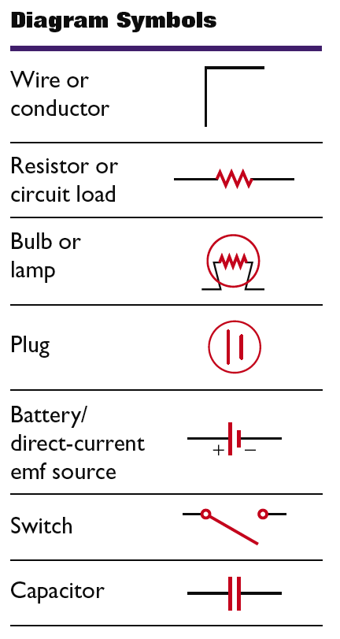

Schematic Diagrams
Section 1 Schematic Diagrams and Circuits
Chapter 18
A schematic diagram is a representation of a circuit that uses lines to represent wires and different symbols to represent components.
Some symbols used in schematic diagrams are shown at right.

Slide 2
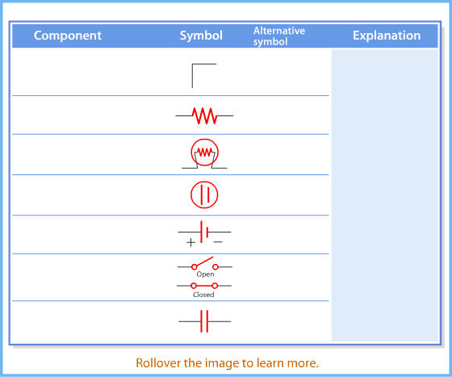
Schematic Diagram and Common Symbols
Section 1 Schematic Diagrams and Circuits
Chapter 18

Slide 3
Electric Circuits
Section 1 Schematic Diagrams and Circuits
Chapter 18
An electric circuit is a set of electrical components connected such that they provide one or more complete paths for the movement of charges.
A schematic diagram for a circuit is sometimes called a circuit diagram.
Any element or group of elements in a circuit that dissipates energy is called a load.

Slide 4
Electric Circuits, continued
Section 1 Schematic Diagrams and Circuits
Chapter 18
A circuit which contains a complete path for electrons to follow is called a closed circuit.
Without a complete path, there is no charge flow and therefore no current. This situation is called an open circuit.
A short circuit is a closed circuit that does not contain a load. Short circuits can be hazardous.

Slide 5
Electric Circuits, continued
Section 1 Schematic Diagrams and Circuits
Chapter 18
The source of potential difference and electrical energy is the circuits emf.
Any device that transforms nonelectrical energy into electrical energy, such as a battery or a generator, is a source of emf.
If the internal resistance of a battery is neglected, the emf equals the potential difference across the source’s two terminals.

Slide 6
Electric Circuits, continued
Section 1 Schematic Diagrams and Circuits
Chapter 18
The terminal voltage is the potential difference across a battery’s positive and negative terminals.
For conventional current, the terminal voltage is less than the emf.
The potential difference across a load equals the terminal voltage.

Slide 7
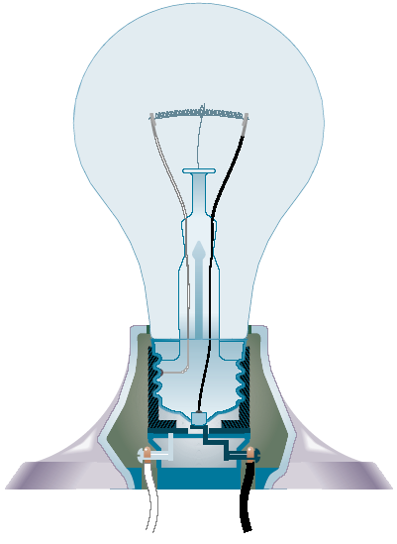
Light Bulb
Section 1 Schematic Diagrams and Circuits
Chapter 18

Slide 8
Resistors in Series
Section 2 Resistors in Series or in Parallel
Chapter 18
A series circuit describes two or more components of a circuit that provide a single path for current.
Resistors in series carry the same current.
The equivalent resistance can be used to find the current in a circuit.
The equivalent resistance in a series circuit is the sum of the circuit’s resistances.
  R_{eq} = R₁ + R₂ + R₃…

Slide 9
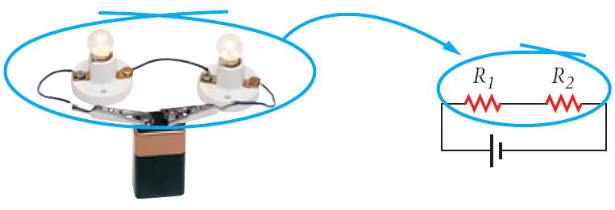
Resistors in Series
Section 2 Resistors in Series or in Parallel
Chapter 18

Slide 10
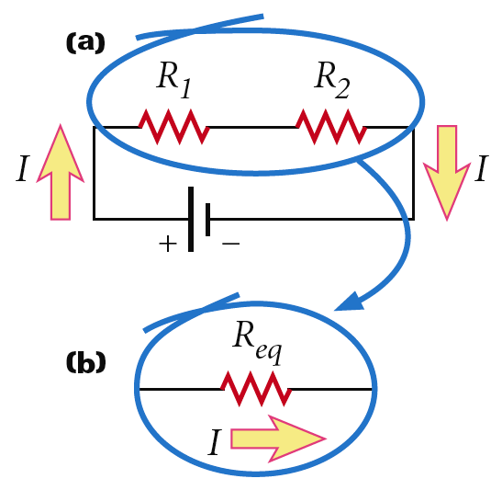
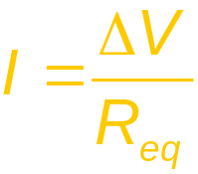
Resistors in Series, continued
Section 2 Resistors in Series or in Parallel
Chapter 18
Two or more resistors in the actual circuit have the same effect on the current as one equivalent resistor.
The total current in a series circuit equals the potential difference divided by the equivalent resistance.

Slide 11
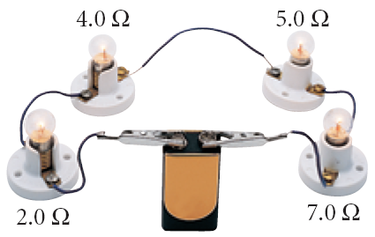
Sample Problem
Section 2 Resistors in Series or in Parallel
Chapter 18
Resistors in Series
A 9.0 V battery is connected to four light bulbs, as shown at right. Find the equivalent resistance for the circuit and the current in the circuit.

Slide 12
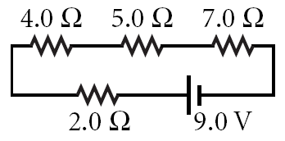
Sample Problem, continued
Section 2 Resistors in Series or in Parallel
Chapter 18
Resistors in Series
1. Define
Given:
  ∆V = 9.0 V
  R₁ = 2.0 Ω
  R₂ = 4.0 Ω
  R₃ = 5.0 Ω
  R₄ = 7.0 Ω
Unknown:
  R_{eq} = ?
  I = ?
Diagram:

Slide 13
Sample Problem, continued
Section 2 Resistors in Series or in Parallel
Chapter 18
Resistors in Series
2. Plan
Choose an equation or situation: Because the resistors are connected end to end, they are in series. Thus, the equivalent resistance can be calculated with the equation for resistors in series.
  R_{eq} = R₁ + R₂ + R₃…
The following equation can be used to calculate the current.
  ∆V = IR_{eq}

Slide 14
Sample Problem, continued
Section 2 Resistors in Series or in Parallel
Chapter 18
Resistors in Series
2. Plan, continued
Rearrange the equation to isolate the unknown: No rearrangement is necessary to calculate R_{eq}, but ∆V = IR_{eq} must be rearranged to calculate the current.

Slide 15
Sample Problem, continued
Section 2 Resistors in Series or in Parallel
Chapter 18
Resistors in Series
3. Calculate
Substitute the values into the equation and solve:
Substitute the equivalent resistance value into the equation for current.

Slide 16
Sample Problem, continued
Section 2 Resistors in Series or in Parallel
Chapter 18
Resistors in Series
4. Evaluate
For resistors connected in series, the equivalent resistance should be greater than the largest resistance in the circuit.
    18.0 Ω > 7.0 Ω

Slide 17
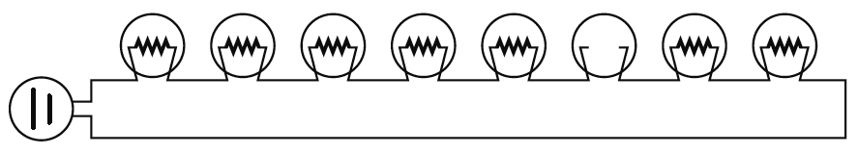
Resistors in Series, continued
Section 2 Resistors in Series or in Parallel
Chapter 18
Series circuits require all elements to conduct electricity
As seen below, a burned out filament in a string of bulbs has the same effect as an open switch. Because the circuit is no longer complete, there is no current.

Slide 18
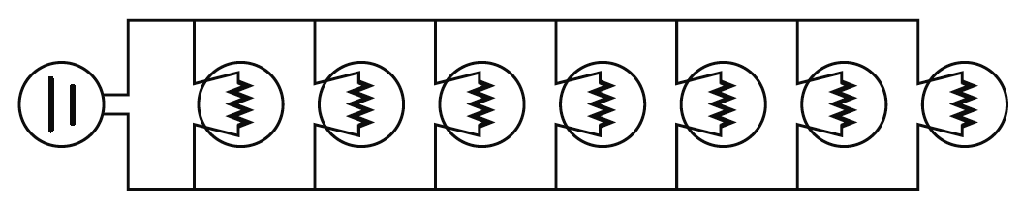
Resistors in Parallel
Section 2 Resistors in Series or in Parallel
Chapter 18
A parallel arrangement describes two or more com-ponents of a circuit that provide separate conducting paths for current because the components are connected across common points or junctions
Lights wired in parallel have more than one path for current. Parallel circuits do not require all elements to conduct.

Slide 19
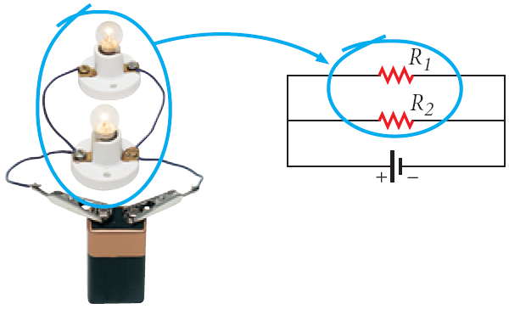
Resistors in Parallel
Section 2 Resistors in Series or in Parallel
Chapter 18

Slide 20
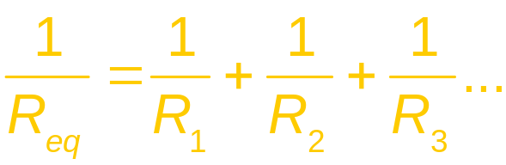
Resistors in Parallel, continued
Section 2 Resistors in Series or in Parallel
Chapter 18
Resistors in parallel have the same potential differences across them.
The sum of currents in parallel resistors equals the total current.
The equivalent resistance of resistors in parallel can be calculated using a reciprocal relationship

Slide 21
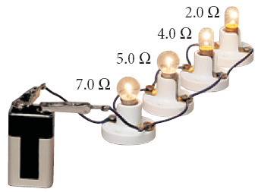
Sample Problem
Section 2 Resistors in Series or in Parallel
Chapter 18
Resistors in Parallel
A 9.0 V battery is connected to four resistors, as shown at right. Find the equivalent resistance for the circuit and the total current in the circuit.

Slide 22
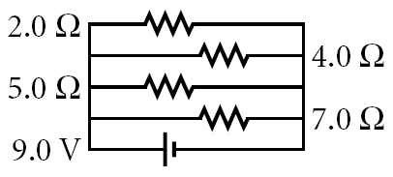
Sample Problem, continued
Section 2 Resistors in Series or in Parallel
Chapter 18
Resistors in Parallel
1. Define
Given:
  ∆V = 9.0 V
  R₁ = 2.0 Ω
  R₂ = 4.0 Ω
  R₃ = 5.0 Ω
  R₄ = 7.0 Ω
Unknown:
  R_{eq} = ?
  I = ?
Diagram:

Slide 23
Sample Problem, continued
Section 2 Resistors in Series or in Parallel
Chapter 18
Resistors in Parallel
2. Plan
Choose an equation or situation: Because both sides of each resistor are connected to common points, they are in parallel. Thus, the equivalent resistance can be calculated with the equation for resistors in parallel.
The following equation can be used to calculate the current. ∆V = IReq

Slide 24
Sample Problem, continued
Section 2 Resistors in Series or in Parallel
Chapter 18
Resistors in Parallel
2. Plan, continued
Rearrange the equation to isolate the unknown: No rearrangement is necessary to calculate R_{eq}; rearrange ∆V = IR_{eq} to calculate the total current delivered by the battery.

Slide 25
Sample Problem, continued
Section 2 Resistors in Series or in Parallel
Chapter 18
Resistors in Parallel
3. Calculate
Substitute the values into the equation and solve:

Slide 26
Sample Problem, continued
Section 2 Resistors in Series or in Parallel
Chapter 18
Resistors in Parallel
3. Calculate, continued
Substitute the equivalent resistance value into the equation for current.

Slide 27
Sample Problem, continued
Section 2 Resistors in Series or in Parallel
Chapter 18
Resistors in Parallel
4. Evaluate
For resistors connected in parallel, the equivalent resistance should be less than the smallest resistance in the circuit.
    0.917 Ω < 2.0 Ω

Slide 28
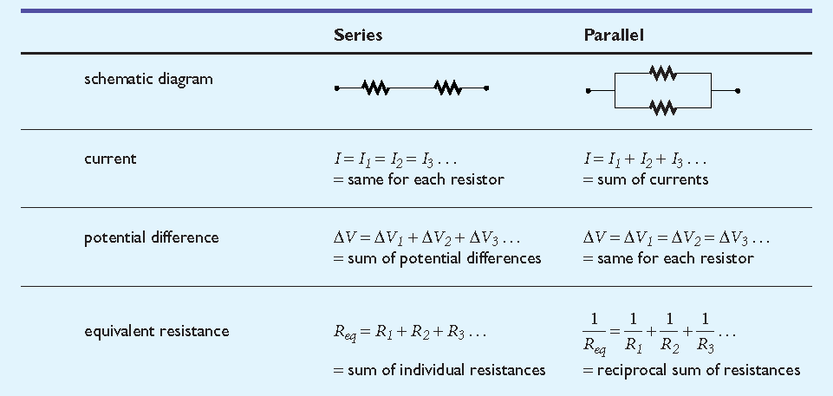
Resistors in Series or in Parallel
Section 2 Resistors in Series or in Parallel
Chapter 18

