Slide 1

Newton’s Second Law
“Law of Acceleration”
Force = Mass x Acceleration (F = ma)

Slide 2
More about F = ma
The SI unit of force is the Newton.
(Named in honor of Isaac Newton)
1 Newton of force is the amount of force needed to cause a 1 kilogram mass to accelerate at a rate of 1 m/s².
1N = kg • m/s²

Slide 3
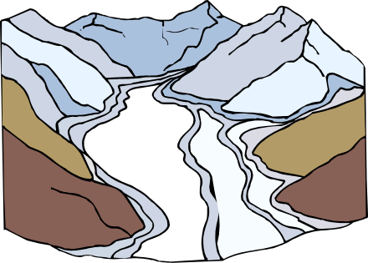

What does F = ma say?
F = ma basically means that the force of an object comes from its mass and its acceleration.
Something very massive (high mass) that’s changing speed very slowly (low acceleration), like a glacier, can still have great force.
Something very small (low mass) that’s changing speed very quickly (high acceleration), like a bullet, can still have a great force. Something very small changing speed very slowly will have a very weak force.

Slide 4
WEIGHT
A measure of the gravitational force that a massive object, puts on another mass
Weight = mass x acceleration of gravity
F_{W} = m∙g
An object’s weight on planet Earth in Newton's is equal to its mass (in kilograms) times 9.81 m/s².

Slide 5
Free Body Diagrams
A free body diagram shows all forces on a given object represented by vector arrows in the direction of the forces.
Is there gravity? ( F_{W} )
Is it sitting on a surface ( F_{N} )
Is something pushing or pulling it? ( F_{A} ) (Applied)
Is there friction? ( F_{f} )
Is there acceleration? (+ in the direction of movement)

Slide 6
Example #1
A certain net force acting on a 5-kg mass produces an acceleration of 2 m/s². Calculate the force.
F= ma
F= (5 kg) x (2 m/s²)
F= 10 N

Slide 7
Example #2
A cyclist and her machine have a combined mass of 80 kg. Calculate the constant net force required to produce a velocity of 12 m/s in 4 s when the machine starts from rest.
V_{i} = 0
V_{f} = 12 m/s
t = 4 s
a = ?
d = Who Cares
V_{f} = V_{i} + at
12 m/s = 0 + (a)(4)
a = 3 m/s²
F = ma
F = 80 kg x 3 m/s²
F = 240 N

Slide 8
Example #3
It took 2.3 seconds for a car’s velocity to change from 20 m/s to 35 m/s. The mass of the car was 1370 kg. What force was required to cause the acceleration?
F = 8,932 N

Slide 9
Example #4:
An automobile of mass 1500 kg is moving at 15 m/s. What average net forward force is required to accelerate the automobile to 25 m/s over a distance of 100 m?
F = 3,000 N

Slide 10
Example #5:
What is the weight of a 50-kg girl if the acceleration due to gravity is 9.81 m/s²?
What would her weight be if the acceleration due to gravity was 1.57 m/s²?

Slide 11
Example #6:
What is the mass of a boy who weighs 1,815 newton’s?

