Slide 1
The Human Body: Anatomical Regions, Directions, and Body Cavities

Slide 2
Overview of Anatomy and Physiology
Anatomy – the study of the structure of body parts and their relationships to one another
  Gross or macroscopic
  Microscopic
  Developmental
Physiology – the study of the function of the body’s structural machinery

Slide 3
Gross Anatomy
Regional – all structures in one part of the body (such as the abdomen or leg)
Systemic – gross anatomy of the body studied by system

Slide 4
Microscopic Anatomy
Cytology – study of the cell
Histology – study of tissues

Slide 5
Physiology
Considers the operation of specific organ systems
  Renal – kidney function
  Neurophysiology – workings of the nervous system
  Cardiovascular – operation of the heart and blood vessels
Focuses on the functions of the body, often at the cellular or molecular level

Slide 6
Physiology
Understanding physiology also requires a knowledge of physics, which explains electrical currents, blood pressure, and the way muscle uses bone for movement

Slide 7
Principle of Complementarity
Function always reflects structure
What a structure can do depends on its specific structure!!

Slide 8
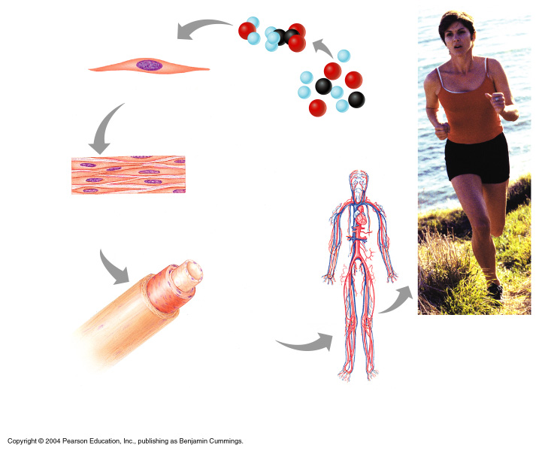
Levels of Structural Organization
Smooth muscle cell
Molecules
2
Cellular level
Cells are made up of molecules
Atoms
1
Chemical level
Atoms combine to form molecules
Smooth muscle tissue
Tissue level
Tissues consist of similar types of cells
Heart
3
Cardiovascular system
Blood vessels
Epithelial tissue
Smooth muscle tissue
Blood vessel (organ)
6
Organismal level
The human organism is made up of many organ systems
Connective tissue
4
Organ level
Organs are made up of different types of tissues
Organ system level
Organ systems consist of different organs that work together closely
5
Figure 1.1

Slide 9
Levels of Structural Organization
Chemical – atoms combined to form molecules
Cellular – cells are made of molecules
Tissue – consists of similar types of cells
Organ – made up of different types of tissues
Organ system – consists of different organs that work closely together
Organismal – made up of the organ systems

Slide 10
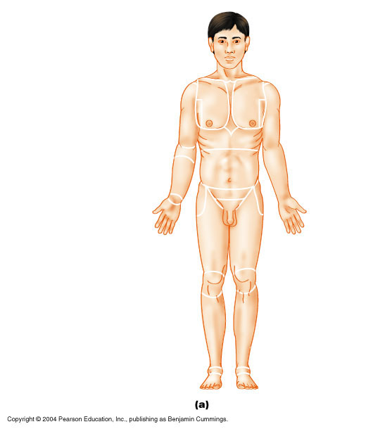
Anatomical Position
Body erect
Feet slightly apart
Palms facing forward
Thumbs point away from body
Figure 1.7a

Slide 11
Directional Terms
Superior and inferior – toward and away from the head, respectively
Anterior and posterior – toward the front and back of the body
Medial, lateral, and intermediate – toward the midline, away from the midline, and between a more medial and lateral structure

Slide 12
Directional Terms
Proximal and distal – closer to and farther from the origin of the body
Superficial and deep – toward and away from the body surface

Slide 13
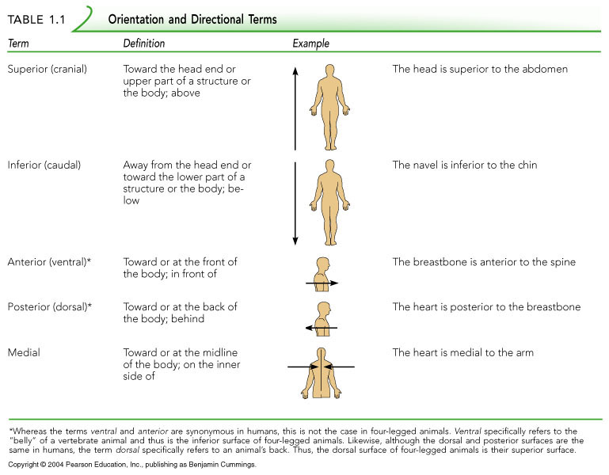
Directional Terms
Table 1.1

Slide 14
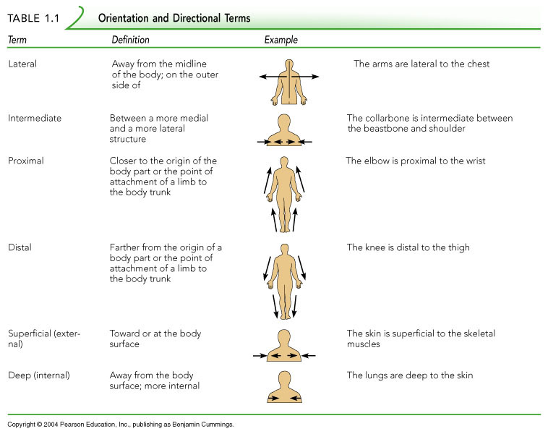
Directional Terms
Table 1.1

Slide 15
Body Planes
Sagittal – divides the body into right and left parts
Midsagittal or medial – sagittal plane that lies on the midline
Frontal or coronal – divides the body into anterior and posterior parts
Transverse or horizontal (cross section) – divides the body into superior and inferior parts
Oblique section – cuts made diagonally

Slide 16
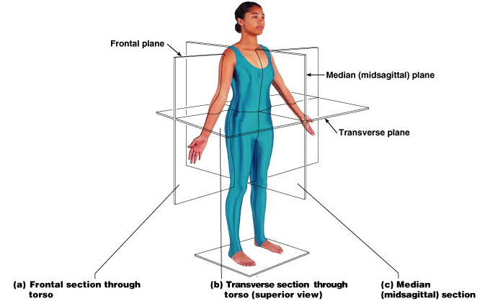
Body Planes
Figure 1.8

Slide 17
Anatomical Variability
Humans vary slightly in both external and internal anatomy
Over 90% of all anatomical structures match textbook descriptions, but:
  Nerves or blood vessels may be somewhat out of place
  Small muscles may be missing
Extreme anatomical variations are seldom seen

Slide 18
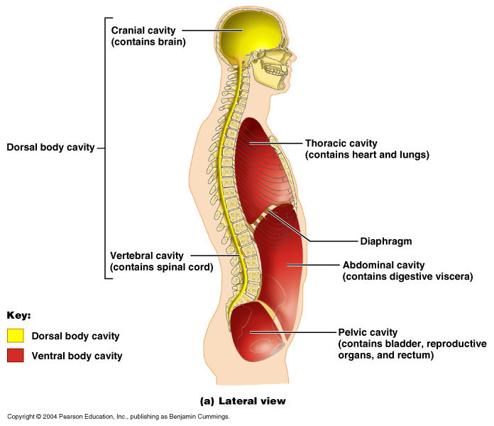
Body Cavities
Figure 1.9a

Slide 19
Body Cavities
Dorsal cavity protects the nervous system, and is divided into two subdivisions
  Cranial cavity is within the skull and encases the brain
  Vertebral cavity runs within the vertebral column and encases the spinal cord
Ventral cavity houses the internal organs (viscera), and is divided into two subdivisions: - Thoracic and Abdominopelvic cavities

Slide 20
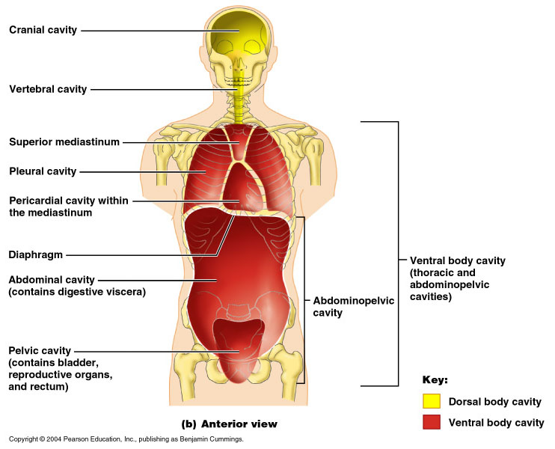
Body Cavities
Figure 1.9b

Slide 21
Body Cavities
Thoracic cavity is subdivided into pleural cavities, the mediastinum, and the pericardial cavity
  Pleural cavities – each houses a lung
  Mediastinum – contains the pericardial cavity, and surrounds the remaining thoracic organs
  Pericardial cavity – encloses the heart

Slide 22
Body Cavities
The abdominopelvic cavity is separated from the superior thoracic cavity by the dome-shaped diaphragm
It is composed of two subdivisions
  Abdominal cavity – contains the stomach, intestines, spleen, liver, and other organs
  Pelvic cavity – lies within the pelvis and contains the bladder, reproductive organs, and rectum

Slide 23
Other Body Cavities
Oral and digestive – mouth and cavities of the digestive organs
Nasal –located within and posterior to the nose
Orbital – house the eyes
Middle ear – contain bones (ossicles) that transmit sound vibrations
Synovial – joint cavities

Slide 24
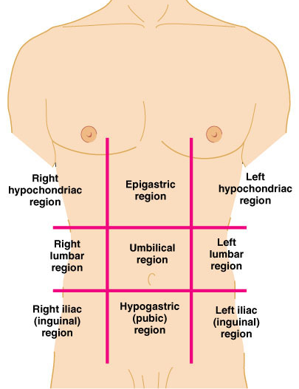
Abdominopelvic Regions
Umbilical
Epigastric
Hypogastric
Right and left iliac or inguinal
Right and left lumbar
Right and left hypochondriac
Figure 1.11a

Slide 25
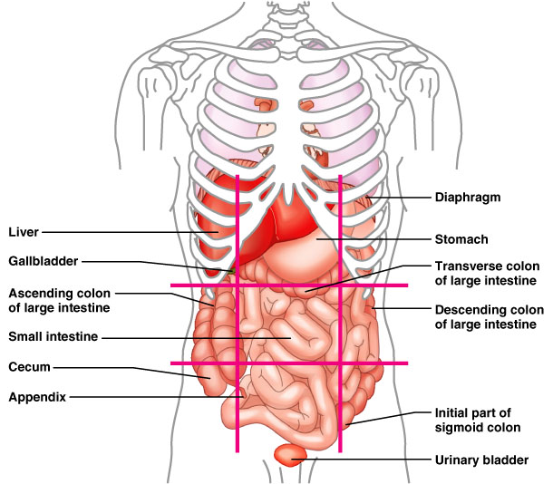
Organs of the Abdominopelvic Regions
Figure 1.11b

Slide 26
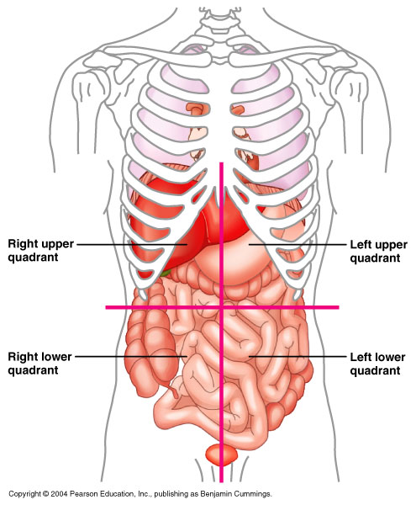
Abdominopelvic Quadrants
Right upper (RUQ)
Left upper (LUQ)
Right lower (RLQ)
Left lower (LLQ)
Figure 1.12

