Slide 1
Can you guess this Raymond School Alumni?

Slide 2
-Graduate of University of Wisconsin-Madison and University of Nebraska
-Lawyer with Domina Law Group and has run for public office
-Successfully argued case before the Nebraska Supreme Court
-Currently assisting in oral arguments in a case before the Nebraska Supreme Court
-2013 Young Democrat of the Year, Lancaster County Party
-Appointed by the Mayor of Lincoln, Nebraska as Commissioner on the Lincoln and Lancaster Women’s Commission
-Board member for the YWCA of Lincoln, Nebraska
-Has appeared in the news in USA Today (July 25, 2014), KlKn Channel 8, Omaha World Herald (November 1, 2013), Nebraska NET (March 27, 2014), Lincoln Journal Star (March 27, 2014), Advocate.com (April 1, 2014)
-2004 Graduate of Union Grove High School
-2000 Graduate of Raymond School
Who is this Raymond Alumni?

Slide 3
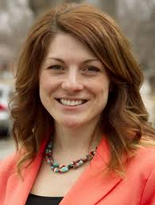
Megan Mikolajczyk

Slide 4
Can you guess this Raymond School Alumni?

Slide 5
-Graduate of University of Wisconsin-Milwaukee
-Member of the Wisconsin School Music Association
-Director of the Junior Lighthouse Brigade Marching Band of Racine
-Certified computer technician
-Website developer with the UW-Milwaukee Peck School of the Arts’ Marketing Department
-Has studied Chinese in China
-Married with a dog and two cats
-Union Grove High School Band Director
-2005 Graduate of Union Grove High School
-2001 Graduate of Raymond School
Who is this Raymond Alumni?

Slide 6
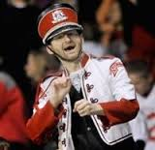
Alex Vincer

Slide 7
Can you guess this Raymond School Alumni?

Slide 8
-Graduate of University of Wisconsin-Parkside, one year at Argonne National Laboratory
-Ph.D. in Physics from Georgia Institute of Technology
-Member of Georgia Tech’s Ultrafast Optical Communications Consortium
-Held postdoctoral position at the National Institute of Standards and Technology in Boulder, CO
-Research interests include: Ultrafast semiconductor spectroscopy, nonlinear fiber optics, mode-locked fiber lasers, and quantum optics
-Assistant Physics Professor, Kansas State University
-Member of the Optical Society of America, the IEEE Lasers and Electro-Optics (LEOS) Society, and the American Physical Society
-Research funded by the Air Force Office of Scientific Research, Army Research Office, and the National Science Foundation
-1990 Graduate of Union Grove High School
-1986 Graduate of Raymond School
Who is this Raymond Alumni?

Slide 9
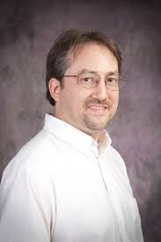
Brian Washburn

Slide 10
Can you guess this Raymond School Alumni?

Slide 11
-Graduate of University of Wisconsin-Madison, Political Science
-2007 Deputy Director of Government Affairs, Democratic Convention
-Former Senate Floor Assistant for Minority Leader Tom Daschle
-Former Senior Leadership Advisor and Floor Policy Director for Democratic Policy Committee Chairman Byron Dorgan
-Former Vice President of Government Relations for Honeywell International
-Current clients include: Caterpillar, General Motors, Goldman Sachs, Hasbro, PepsiCo, Pfizer and United Airlines
-Current Vice President of the Duberstein Group, Washington D.C.
-1990 Graduate of Martin Luther High School
-1986 Graduate of Raymond School
Who is this Raymond Alumni?

Slide 12
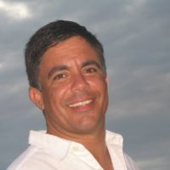
Brian Griffin

Slide 13
Can you guess this Raymond School Alumni?

Slide 14
-Current Assistant Director – Relationship Marketing
The Chicago Cubs
-Former Senior Marketing Manager, Walgreens Corporation
Piloted and launched Balance Rewards loyalty program, currently ~100M members enrolled
-2009 MBA Graduate, University of Chicago – Booth School of Business
Teaching Assistant: The Practice of Leadership in Business
-Former Corporate Partnership Representative, National Multiple Sclerosis Society, raising more than $10M annually to find a cure
-2003 Graduate of University of Wisconsin-Madison, Bachelor’s in Business Administration
-1998 Graduate of Martin Luther High School
-1994 Graduate of Raymond School
Who is this Raymond Alumni?

Slide 15
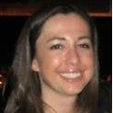
Kelly Linstroth

Slide 16
Can you guess this Raymond School Alumni?

Slide 17
-Graduate of Carthage College, Exercise & Sport Science, Athletic Training, and Education
-Previously employed by NovaCare Rehabilitation at Franklin High School and Northwestern Mutual
-Provides sports medicine care to 800 NCAA athletes at Carthage College as Head Athletic Trainer
-Professor in Carthage College Exercise & Sport Science and Athletic Training Departments, Adjunct Emergency Medical Services Instructor at Gateway Technical College
-Concussion research with Dr. Michael McCrea, Medical College of Wisconsin, US Dept. of Defense, NCAA, GE, and NFL
-Captain on the Town of Raymond Fire & Rescue Department and Hole in one #4 South Hills Country Club
-1996 Graduate of Union Grove High School, married with three children
-1992 Graduate of Raymond School
Who is this Raymond Alumni?

Slide 18
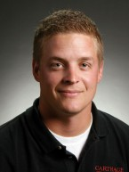
Jacob Dinauer

Slide 19
Can you guess this Raymond School Alumni?

Slide 20
-Graduate of UW Parkside, Business and Marketing, 2003
-Certified USDA Federal Inspector focusing on GMO’s in food for human consumption
-Former Controller developing sales, marketing, and logistics teams for high tech Texas based company in Wisconsin and successfully helped to reduce air pollution in Wisconsin by 1,491,726 pounds a year
-Currently a Business Development Engineer working on new technology for rescue divers allowing them to see in rough conditions using infrared and sonar
-Recently has reshored a project that brought back 250 jobs from China
-Lives in Wauwatosa and owns a dog that is the current Regent Grand Champion Dock Dog in Wisconsin and donates time helping troubled youth experience the great outdoors of Wisconsin
-1999 Graduate of Martin Luther High School
-1995 Graduate of Raymond School, 1st Place Science Fair
Who is this Raymond Alumni?

Slide 21
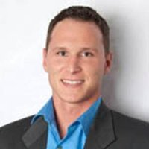
Aaron Kostuch

Slide 22
Can you guess this Raymond School Alumni?

Slide 23
-Lives and works in Guadalajara, Mexico as a collaborative pianist and choir director
-Has performed in Carnegie Hall, England, Israel, Greece, Turkey, France, Spain, Germany, Austria, Canada, Ecuador, Mexico, and of course, the USA
-Published five books on nosocomial infections and created hospital infection control sign in conjunction with the United States Disease Centers for Disease Control and Prevention
-Has been a 4H member and leader for many years
-Speaks fluent English and Spanish and understands 7 other languages
-1980 Graduate of Luther College in Decorah, Iowa and purchased his first Apple computer in 1985
-1976 Bicentennial Graduate of Union Grove High School
-1972 Proud Graduate of Raymond School
Who is this Raymond Alumni?

Slide 24
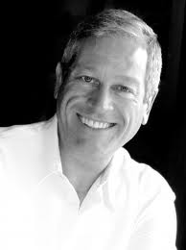
Timothy G. Ruff Welch

Slide 25
Can you guess this Raymond School Alumni?

Slide 26
-Attorney at Katz & Stefani, LLC (Chicago, IL)
-Worked the 2008 Democratic National Convention
-Interned for Major League Baseball
-Interned for United States Senate Committee on Finance (Sen. Max Baucus)
-2010 Graduate of University of Wisconsin Law School
-2005 Graduate of University of Wisconsin, BBA Finance with Distinction
-2001 Graduate of Martin Luther High School
-1996 Raymond School Science Fair Champion and 1997 Graduate of Raymond School / Salutatorian
Who is this Raymond Alumni?

Slide 27
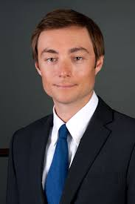
Matt Linstroth

Slide 28
Can you guess this Raymond School Alumni?

Slide 29
-Married with 3 children and passionate about volunteering.
-Has traveled to many countries such as Argentina, Brazil, Canada, China, Germany, Mexico, Philippines, Poland, and UK
-Worked at Rockwell Automation for 10 years
-Currently employed as Finance Director at SC Johnson
-Certified Public Accountant (CPA) that earned a BBA in Accounting from UW-Madison in 1994
-1989 Graduate of Union Grove High School
-1985 Graduate of Raymond School
-Some roles include: PTO Treasurer, Pack 306 Cubmaster, and Religious Education teacher
Who is this Raymond Alumni?

Slide 30
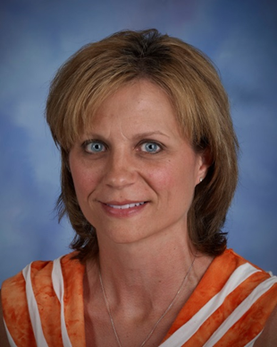
Diane Horstman (Bauer)

Slide 31
Can you guess this Raymond School Alumni?

Slide 32
-Currently dancing for CATAPULT, a shadow dance theatre company for which he's performed internationally at venues in Vegas, Salt Lake City, Switzerland, Canada, Saudi Arabia and 60 cities in Germany
-Is part of Chase Brock's company, The Chase Brock Experience, and is dancing with the Alyson Laury Dance Co
-Has danced for choreographers like Bennyroyce Royon, Catie Cuan, and Sarah Chin, presented his work at Dixon Place in New York City, and performed in music videos for Garek and Jadex
-Has worked with Marlon Gobel, for his recent showings at Mercedes Benz Fashion Week in NYC. He has also taken on the role of Managing Editor at Large for the Broadway Fashion Report
-Received scholarships to study at Perry-Mansfield in Steamboat Springs, CO as well as at The Martha Graham School of Contemporary Dance, and with River North Dance Chicago
-Attended Marymount Manhattan College to study dance and photography graduating Cum Laude with his BFA in Dance (Modern Concentration) in 2013
-Currently resides in New York City
-2005 Graduate of Raymond School and 2004 Spelling Bee Champion
Who is this Raymond Alumni?

Slide 33
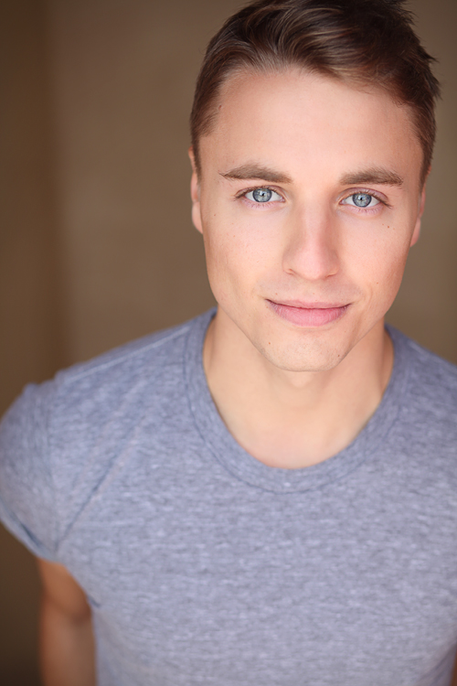
Mark Osmundsen

Slide 34
Can you guess this Raymond School Alumni?

Slide 35
-Graduated from the Communication Arts department of the University of Wisconsin-Madison, where he received his Masters in Film Studies in 1996
-He has supervised the preservation of many short films, including animation by Oskar Fischinger and John and Faith Hubley; the Oscar winning documentaries Dylan Thomas and Lindsey Anderson’s Thursday’s Children; as well as silent films, like the 1910 Thanhouser short The Actor’s Children
-Since 2002 he has also participated in the Los Angeles Latino International Film Festival, serving on the LALIFF preservation committee with the festival co-founder Marlene Dermer and Professor José Sánchez-H. of the Film and Electronic Arts Department, California State University, Long Beach
-This year this Alumni and Edward James Olmos introduced the Mexican film Los Pequeños Gigantes, preserved in collaboration with the festival and professor Sánchez-H
-At this year’s Latin American Studies Film Series at California State University, Reconciling Realities, this Alumni co-presented Jacobo Morales’ film Dios los Cría with Professor Sánchez-H
-Collaborated with 20th Century Fox on the preservation of the 70mm Best Picture winners The Sound of Music and Patton
-He has worked for the Academy Film Archive since 1998, and became Preservation Officer in 2002
-1985 Graduate of Raymond School
Who is this Raymond Alumni?

Slide 36
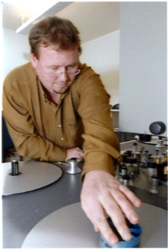
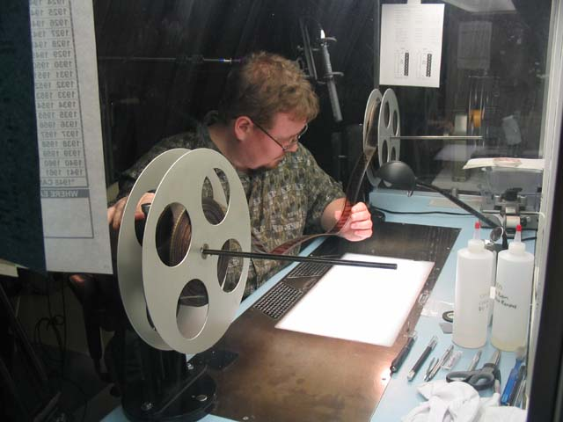
Josef Lindner

Slide 37
Can you guess this Raymond School Alumni?

Slide 38
-Was on the first team of therapists in Wisconsin to administer ABR (auditory brainstem response) hearing screenings to infants
-Worked as speech therapist at St. Mary's and St. Luke's in Racine
-Certified Forensics judge, judging High school forensics for the last 4 years
-Works the voting polls at Raymond Town Hall
-Substitute teacher at Raymond School
-Attended UW-Whitewater receiving a Masters degree in Speech/Language Pathology
-Married and proud mother of 3 daughters (Wisconsin-Madison, Northeastern University, Prairie High School) whom all graduated from Raymond School
-1984 Graduate of Union Grove High School
-1980 Graduate of Raymond School
Who is this Raymond Alumni?

Slide 39
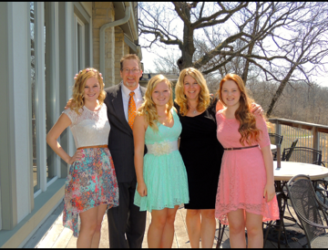
Pam Henderson (Wagner)

Slide 40
Can you guess this Raymond School Alumni?

Slide 41
-Was the first Human Resources Director at the Racine Youthful Offender Correctional Facility.
-Currently works for the State of Wisconsin in Human Resources
-Former All Conference Tennis Player at Union Grove High School
-Masters Degree in Public Administration from UW-Milwaukee
-1995 Graduate of University of Wisconsin-Madison
-1991 Graduate of Union Grove High School
-1987 Graduate of Raymond School, has two children currently attending Raymond School
Who is this Raymond Alumni?

Slide 42
Becky Eichner (Wagner)

Slide 43
Do you know an alumni that should be recognized? Please call Joe Dawidziak at Raymond School or email dawijoe@raymond.k12.wi.us

