Slide 1
4.4 Acceleration

Slide 2

4.4 Acceleration
Acceleration is the rate at which the velocity is changing.

Slide 3
In physics, the term acceleration applies to decreases as well as increases in speed.
The brakes of a car can produce a large decrease per second in the speed. This is often called deceleration.

Slide 4

A car is accelerating whenever there is a change in its state of motion.

Slide 5

A car is accelerating whenever there is a change in its state of motion.

Slide 6
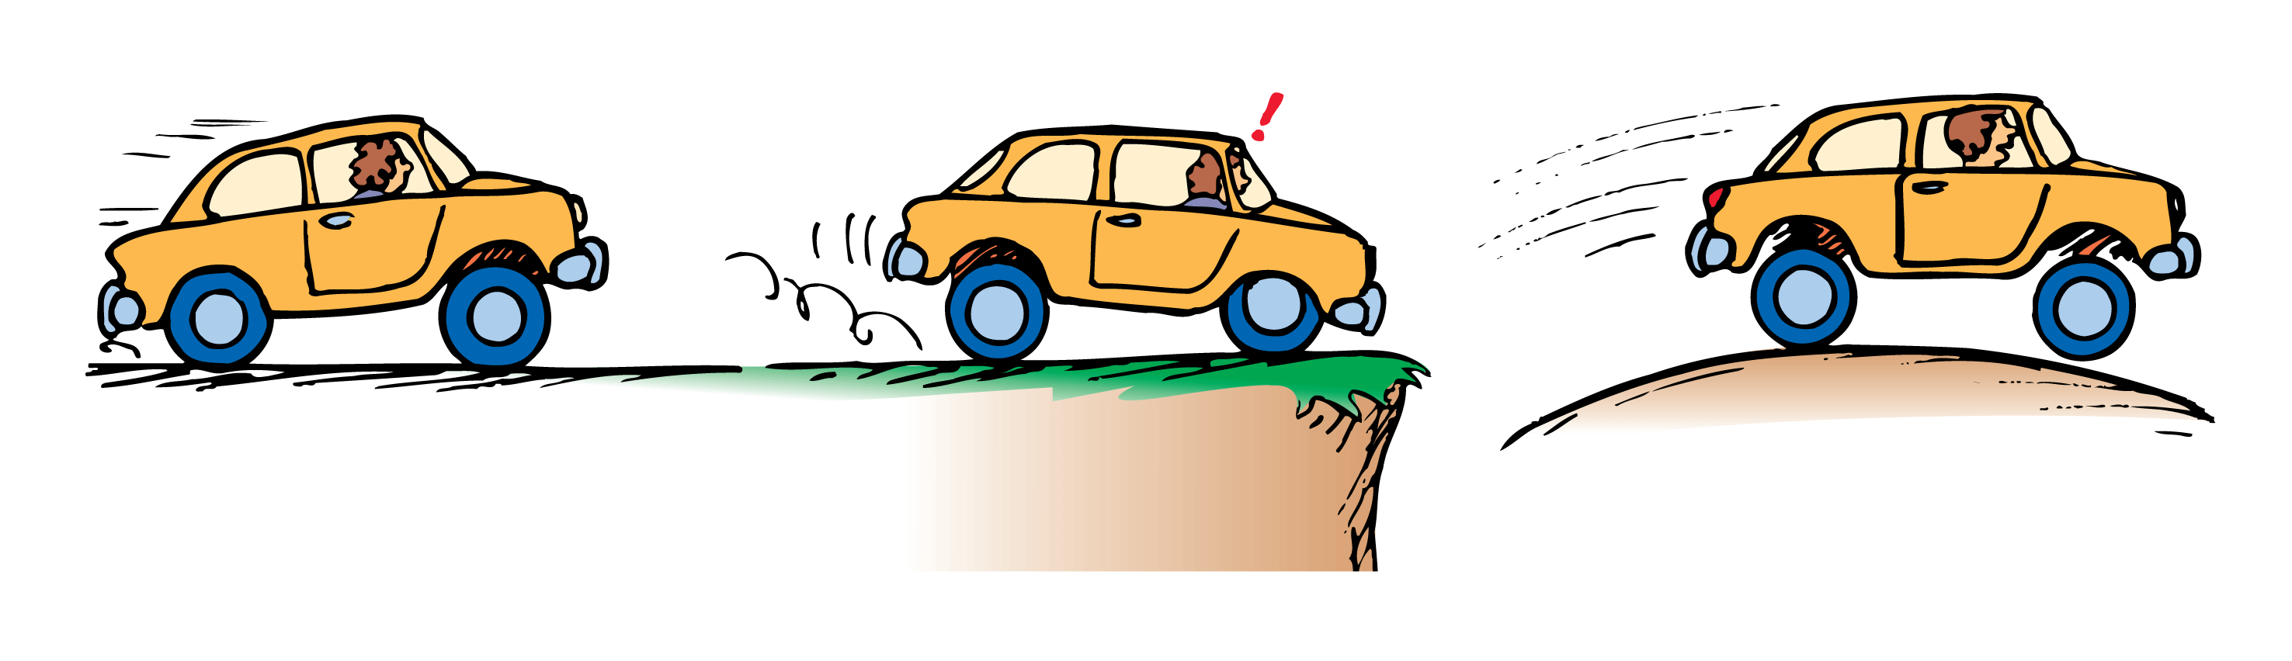
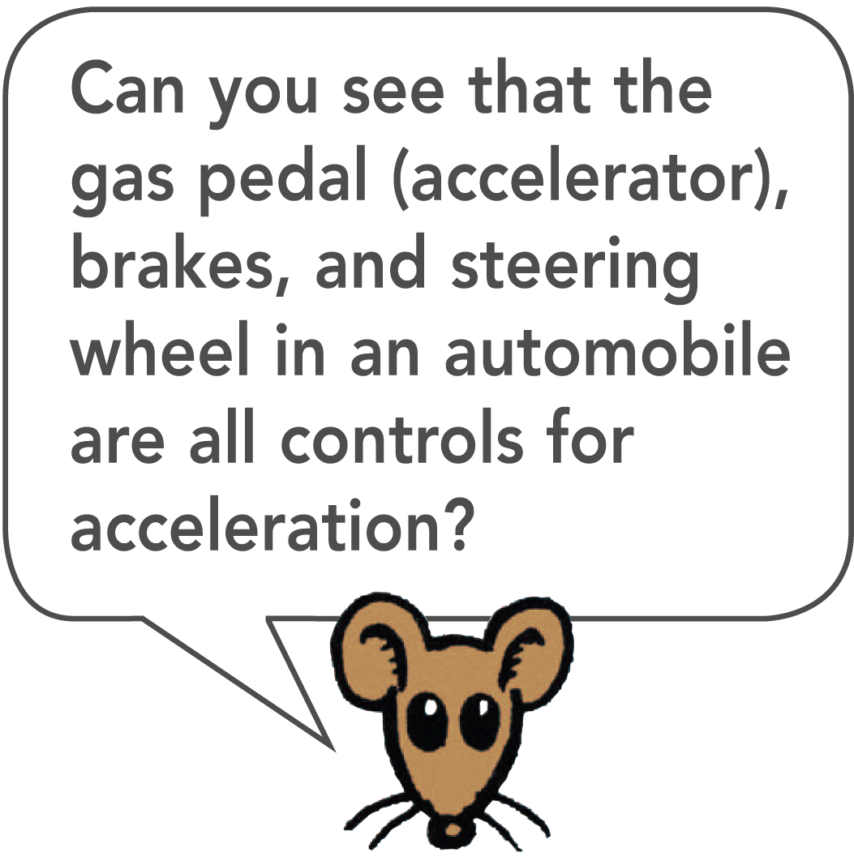
A car is accelerating whenever there is a change in its state of motion.

Slide 7
Change in Direction
  Acceleration is defined as the rate of change in velocity, rather than speed.
  Acceleration, like velocity, is a vector quantity because it is directional.

Slide 8
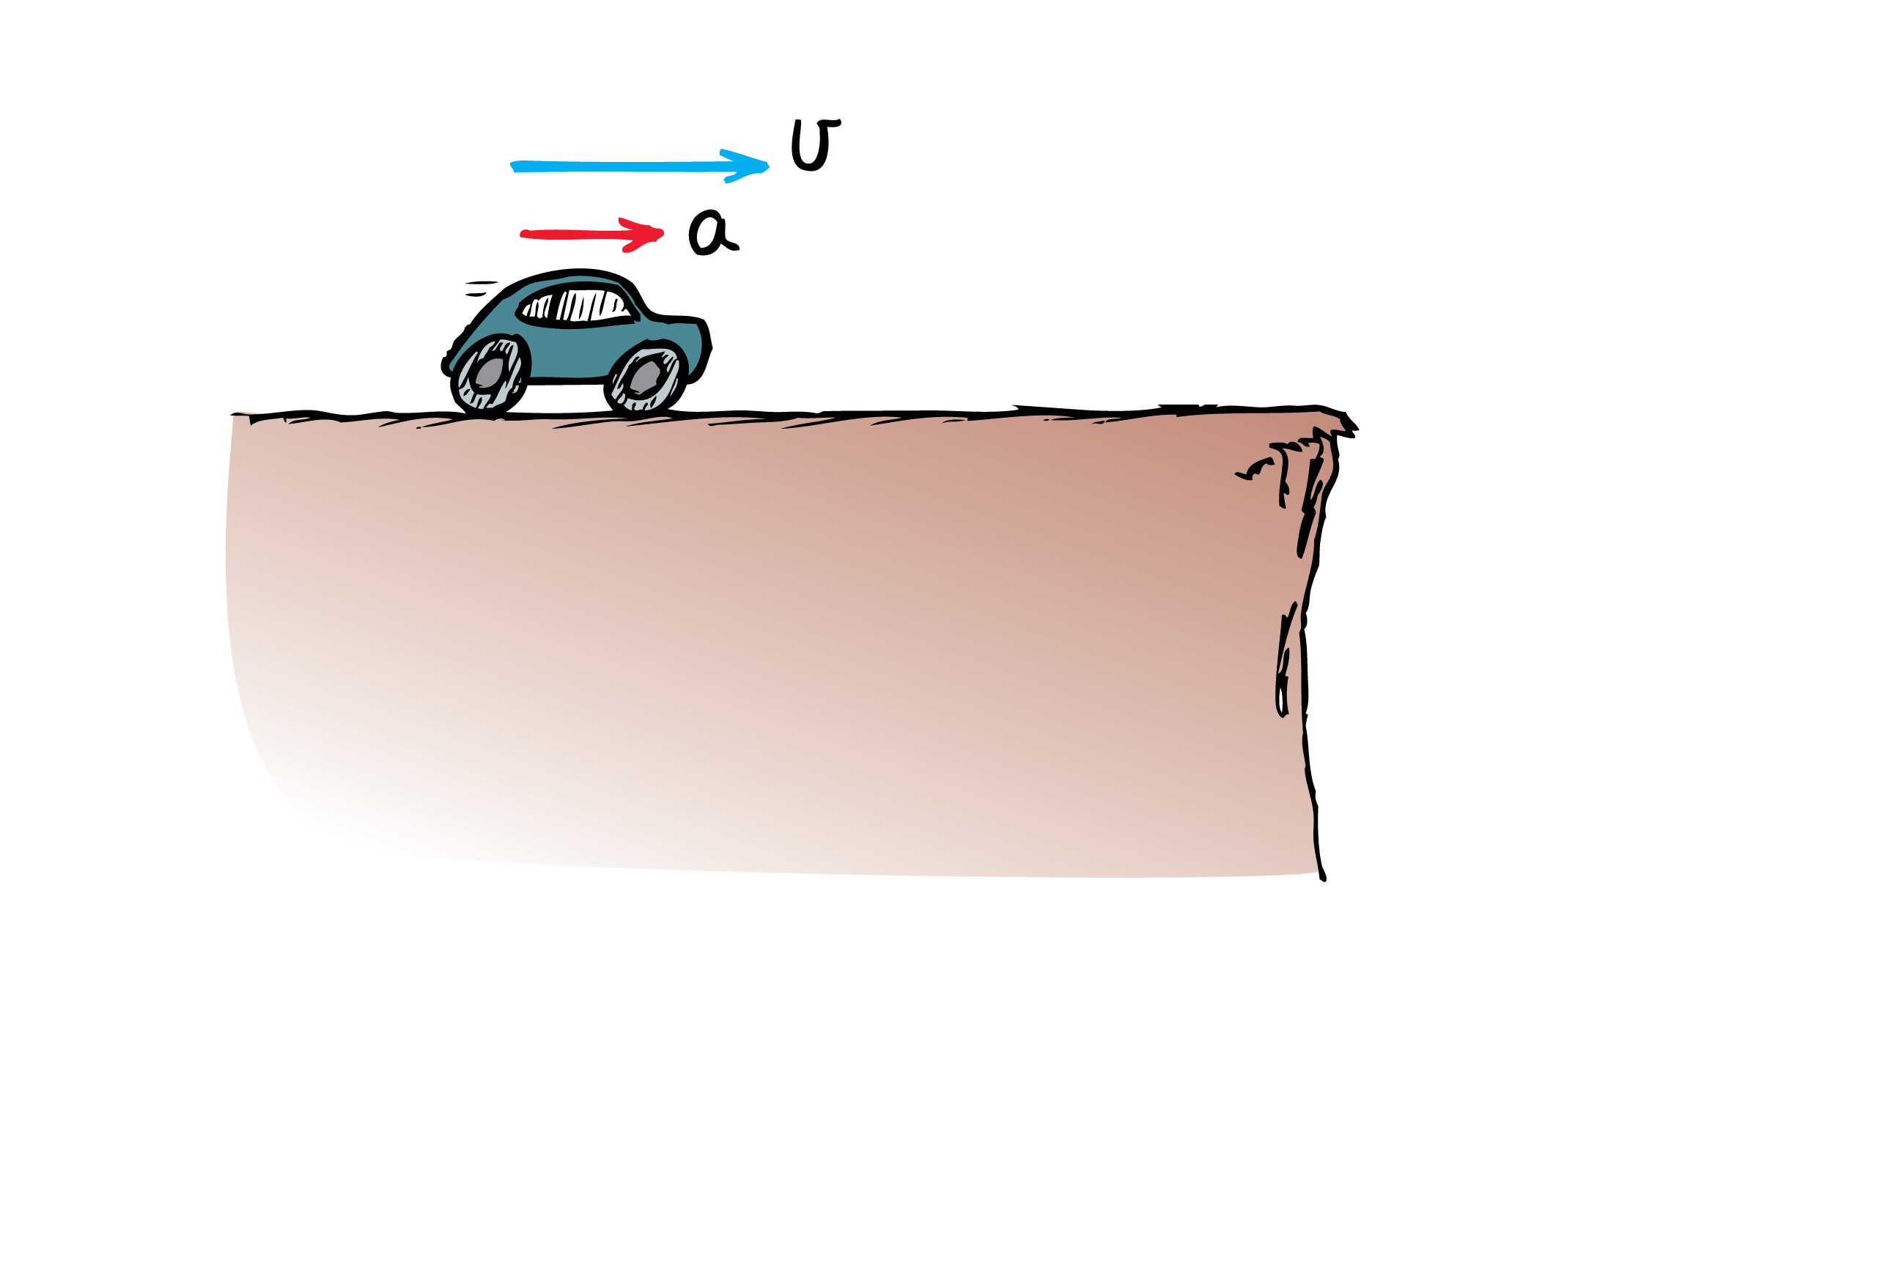
Accelerate in the direction of velocity–speed up

Slide 9
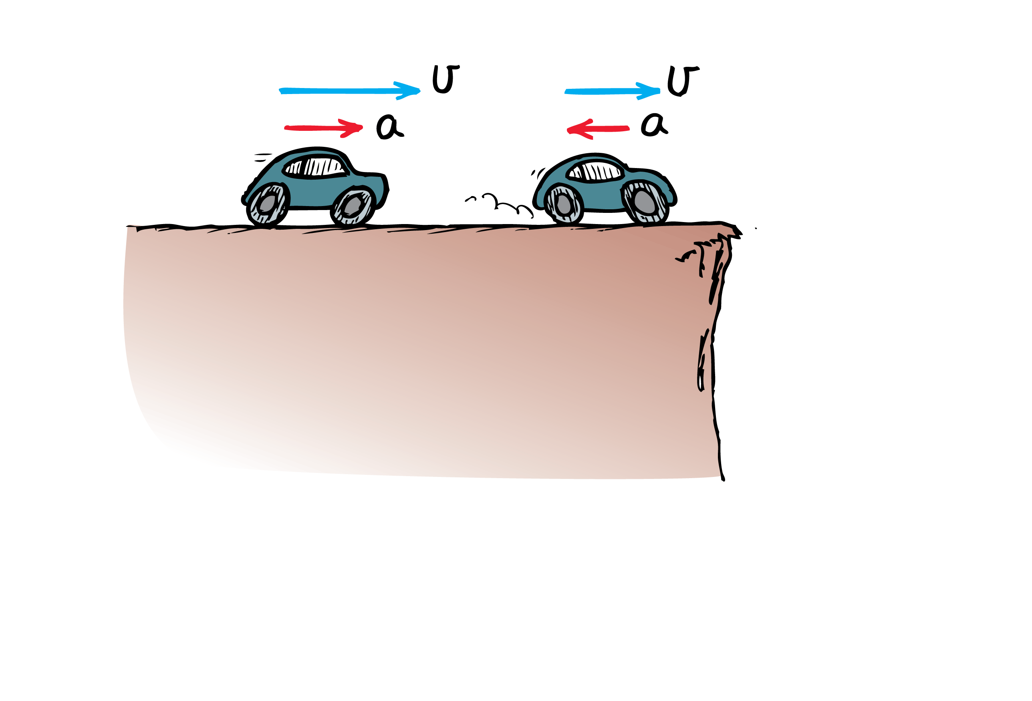
Accelerate against velocity–slow down

Slide 10
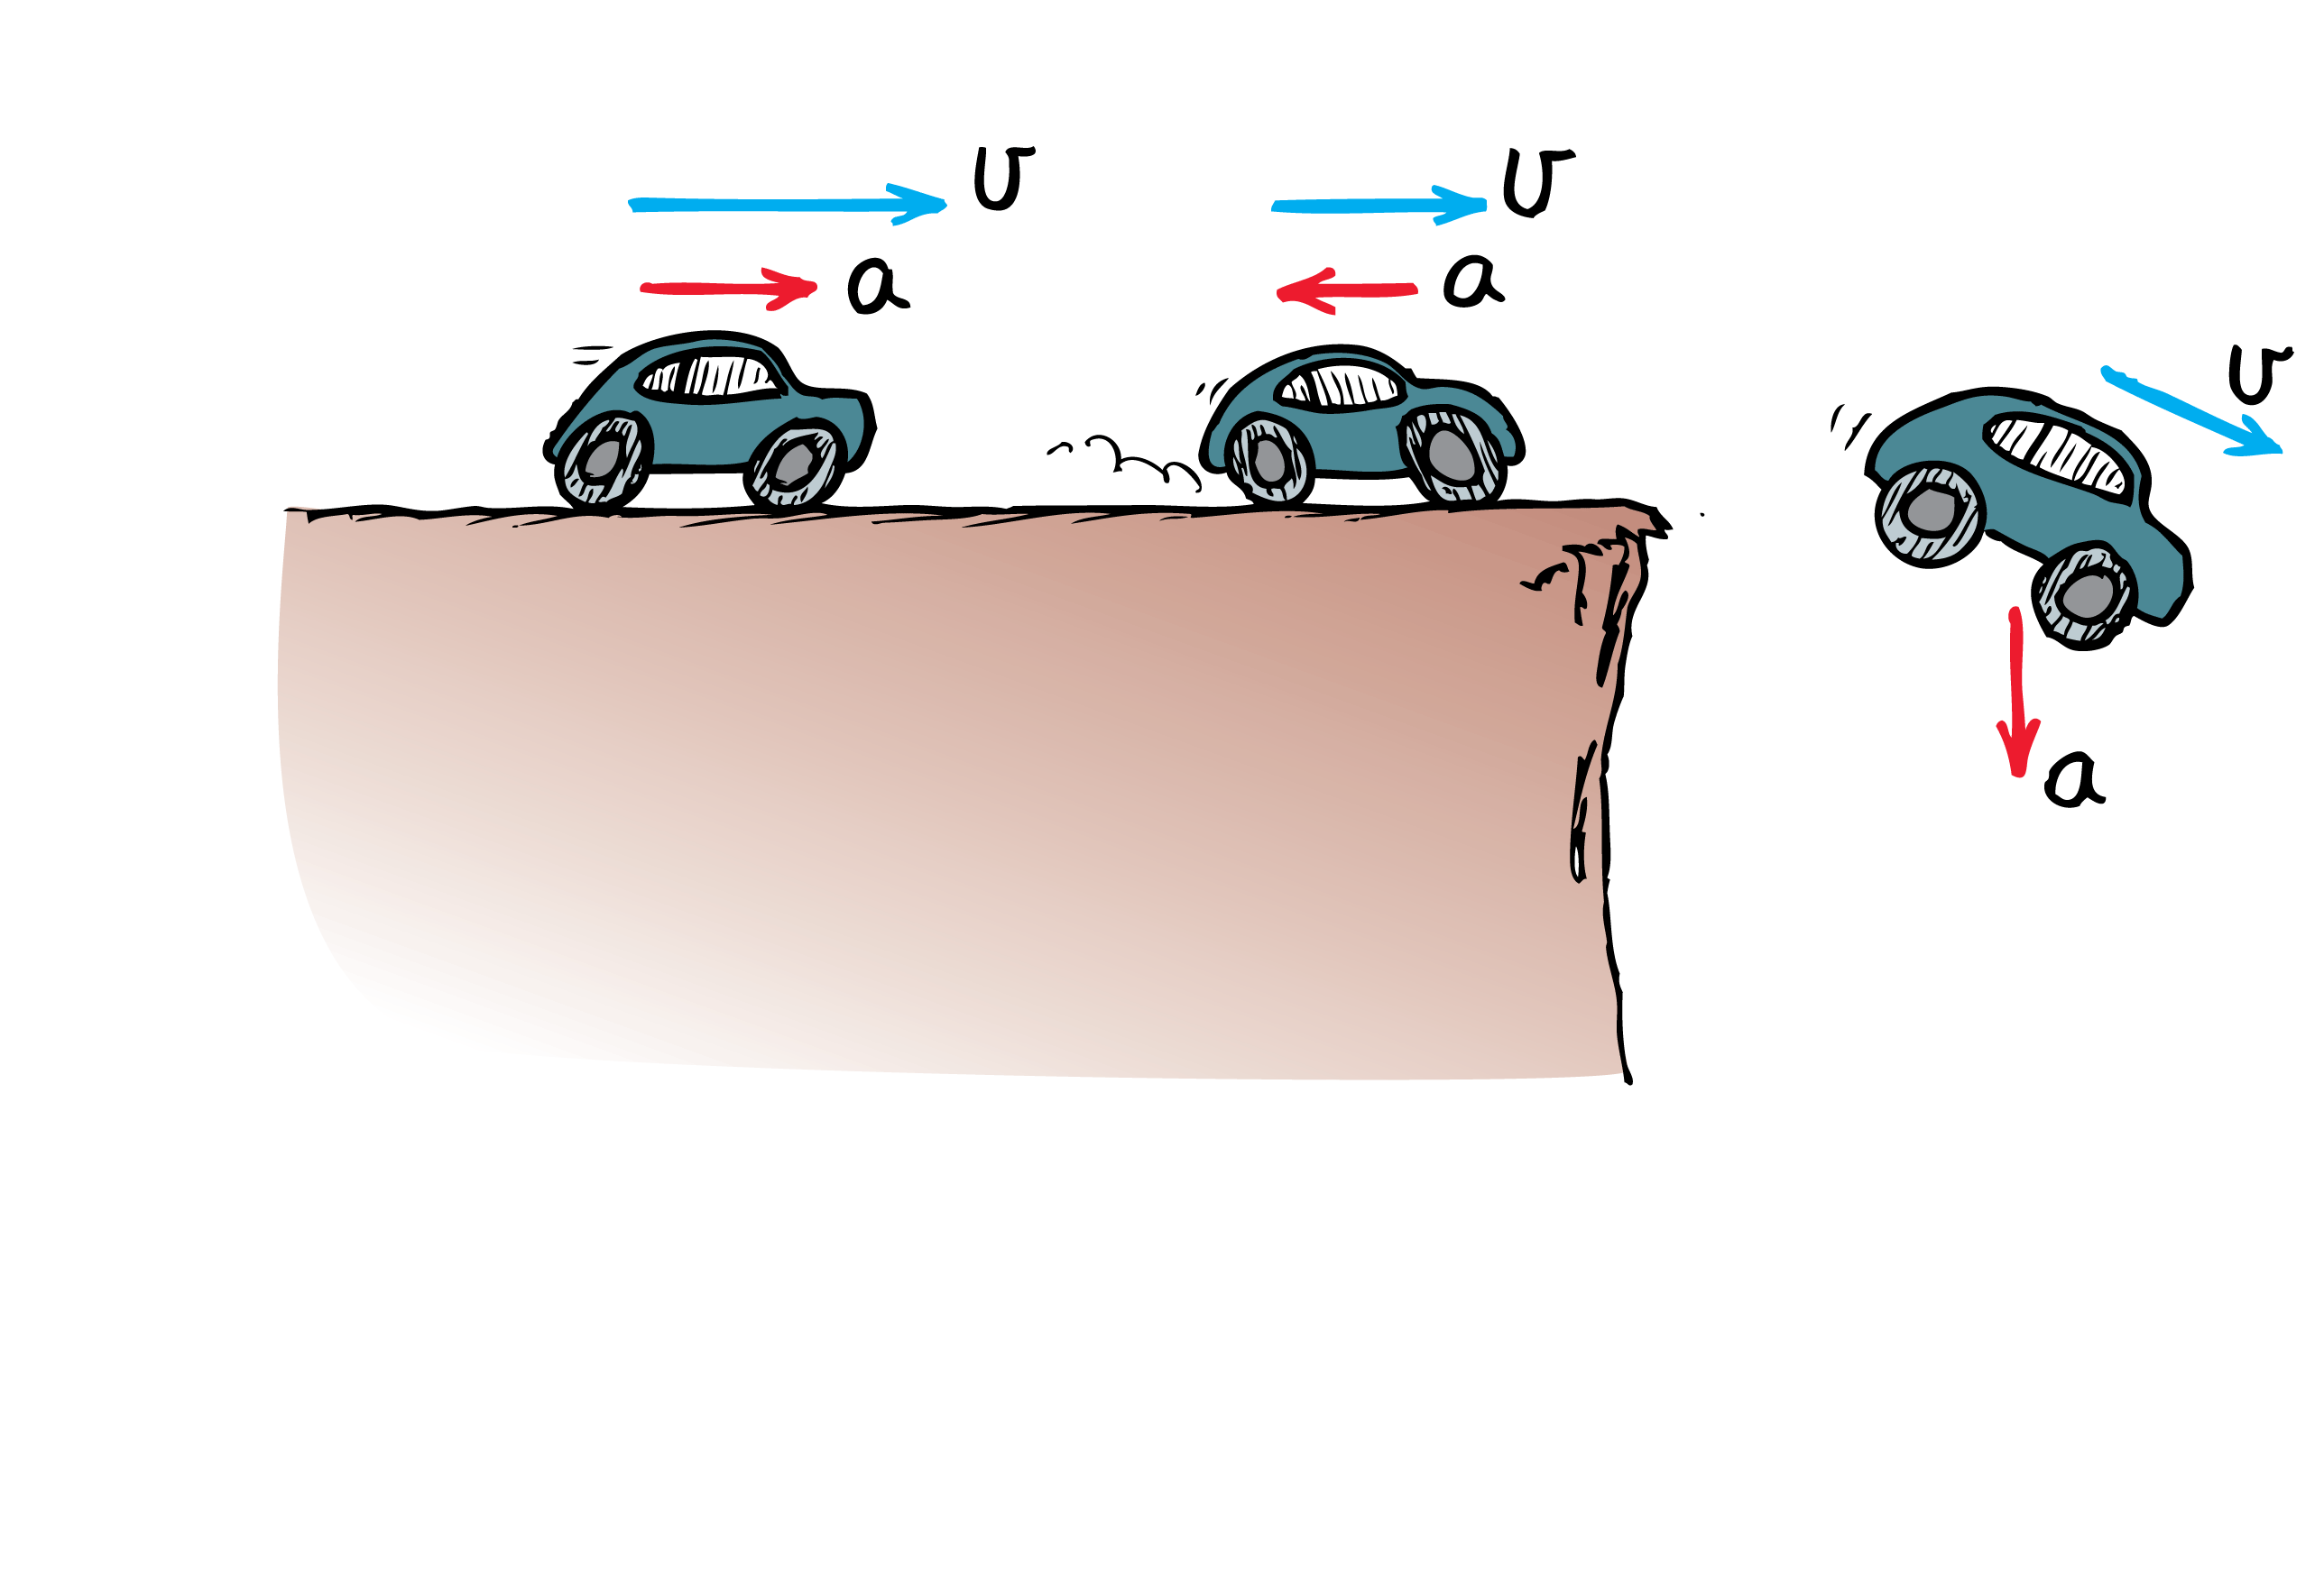
Accelerate at an angle to velocity–change direction

Slide 11
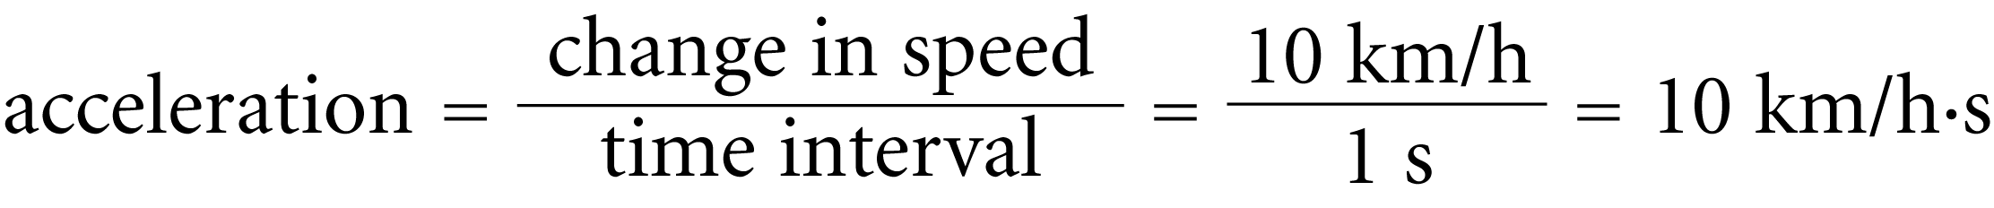
Speed and velocity are measured in units of distance per time.
Acceleration is the change in velocity (or speed) per time interval.
Acceleration units are speed per time.
  Changing speed, without changing direction, from 0 km/h to 10 km/h in 1 second, acceleration along a straight line is

Slide 12
think!
Suppose a car moving in a straight line steadily increases its speed each second, first from 35 to 40 km/h, then from 40 to 45 km/h, then from 45 to 50 km/h. What is its acceleration?

Slide 13
Answer: The speed increases by 5 km/h during each 1-s interval in a straight line. The acceleration is therefore
5 km/h•s during each interval.

Slide 14
think!
In 5 seconds a car moving in a straight line increases its speed from 50 km/h to 65 km/h, while a truck goes from rest to 15 km/h in a straight line. Which undergoes greater acceleration? What is the acceleration of each vehicle?

Slide 15
Answer: The car and truck both increase their speed by
15 km/h during the same time interval, so their acceleration is the same.

