Slide 1
Becoming a davies eagle
Registration Information
For Discovery 8th Graders

Slide 2
Using The Program of Studies https://www.fargo.k12.nd.us/programofstudies
  Course titles, descriptions, locations
  Prerequisites
  Required vs. Elective
  Credit (Semester hour = .5 credit)
  Graduation requirements
  ND Scholarship - info available at:
      https://www.nd.gov/dpi/familiescommunity/students/academic-cte-and-north-dakota-scholarships

Slide 3
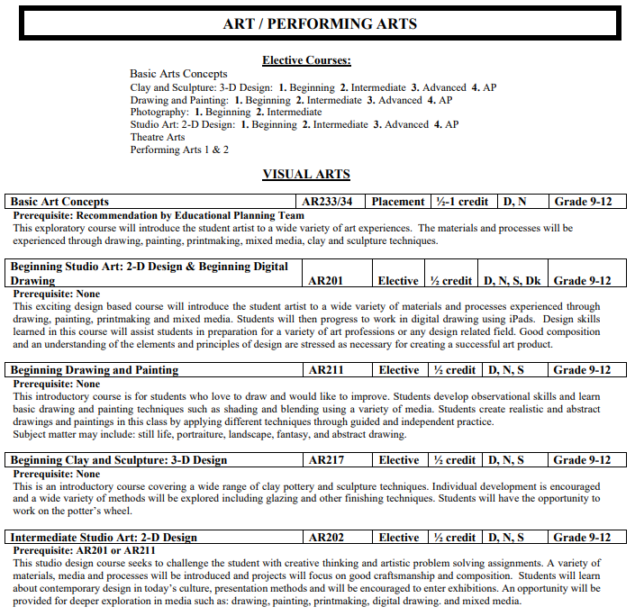
Program of Studies

Slide 4
Graduation Requirements:
24 Credits Required
4 English
3 Social Studies
3 Math
3 Science
1.5 P.E.
.5 Health
3 World Language, Fine Arts, Career or Technical Education
6 Electives

Slide 5
Typical Schedule
        English
        Math
        Physical Science
        World Cultures
        PE 1
        Health
        Electives: 1.5-3.5 credits

Slide 6
Science considerations
Regular sequencing: Physical Science in 9th grade
If you have completed Geometry and are offered a spot in Biology rather than taking Physical Science, you should consider this option only if:
    you are passionate about science and math
    you are interested in entering a science related career field
**You need to be fully aware you will need to take one year of Chemistry and one year of Physics to meet the standards for graduation if you do not take Physical Science. If this is something you are considering, we highly encourage you to speak to someone in the Science Department during the course fair or via phone or email.

Slide 7
Things to consider
Minimum and Maximum Credits
6 credits minimum load
8 credits maximum load
7 credits strongly recommended
Mastery and continuation of current courses (e.g. World Language)

Slide 8
Summer School
2 sessions - Each session covers a semester worth of a yearlong course. Session 1 aligns with semester 1 and session 2 with semester 2.
Health can be taken either session
PE requires BOTH sessions
Registration – www.fargosummerschool.com
Keep checking for the updated materials
Registering for summer school is a student’s responsibility. You must contact us if your plans change so the necessary class(es) can be added to your schoolyear schedule.

Slide 9
NCAA/NAIA
It is your responsibility as a student to make sure you are meeting the requirements for NCAA/NAIA if this is an area you wish to pursue.
We count graduation credits for a Fargo Public Schools diploma, not NCAA eligibility credits. It is a student’s responsibility to make sure NCAA or NAIA eligibility requirements are being met.
NCAA: www.eligibilitycenter.org
NAIA: www.playnaia.org

Slide 10
What’s Next?
Teachers can be very helpful within their subject area
Have conversations as a family
Course Fair at Davies – January 9th (4:30-7:30 with a presentation in the theater at 5:30)
8th grade meetings will be held with the counselors at Discovery. Share registration information with your parent/guardian and then bring your completed registration card back to school by January 13. Turn it into the counseling office and a counselor will call you down to meet.

Slide 11
Davies Eagles
We look forward to working with you as you prepare for your first year at Davies High School.

