Slide 1
Physics
Physics Tutoring Wednesday: 2:15pm – 3:15pm

Slide 2
5-Minute Warm-Up
OBJECTIVE: Discover Newton’s Third Law and its application to action/reaction pairs.
What happens to an object when a force acts on it?
What happens, if anything, to the object that exerted the force?

Slide 3
Newton’s Third Law
(1) Forces are caused by the interaction of two objects.
(2) Forces always occur in pairs, with one force exerted on each of the two interacting objects.
(3) The two forces on the two objects (action/reaction pair) are EQUAL and OPPOSITE.

Slide 4
Newton’s Third Law
(4) NEWTON’S THIRD LAW – Every action has an equal and opposite reaction.
F_{1:2} = -F_{2:1}
(5) Equal force doesn’t mean equal acceleration. Acceleration depends on MASS, not just force.
m₁a₁ = m₂a₂

Slide 5
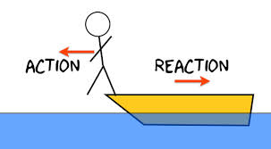
Practice #1

Slide 6
Newton’s Third Law
(6) The 3rd law does not contradict the 1st law . The 1st law describes forces on SAME object. The 3rd law describes forces on DIFFERENT objects.
FIRST LAW SECOND LAW THIRD LAW
Balanced Forces Unbalanced Forces Reaction Forces
ΣF = 0 ΣF = ma F₁₂ = -F₂₁
Forces on the same object Forces on different
objects

Slide 7
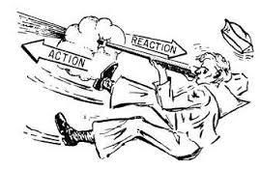
Practice #2

Slide 8
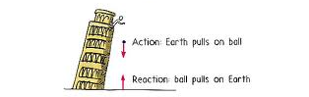
Practice #3
m_{m} = 5 grams = 0.005kg
m_{e} = 5.97x10²⁴ kg

Slide 9
Question #22
In an action-reaction pair, the
action force is exerted first.
action force and the reaction force are equal in magnitude and act in the same direction.
action force and the reaction force are contact forces only.
action force and the reaction force act on two different objects.

Slide 10
Question #23
A batter strikes a baseball with a bat. Identify an action-reaction pair and describe the forces exerted by each.
The batter exerts a force on the bat; the ball exerts a force on the bat.
The batter exerts a force on the bat; the bat exerts a force on the batter.
The bat exerts a force on the batter; the bat exerts a force on the ball.
The ball exerts a force on the bat; the bat exerts a force on the batter.

Slide 11
Question #24
In interactions of action-reaction pairs involving Earth and everyday objects, the effect on Earth’s motion is often negligible because
field forces don’t obey the third law.
Earth has great inertia.
everyday objects cannot exert forces on Earth.
all of the above

