Slide 1
Warm Up
Please write an electron configuration for Br⁻

Slide 2
Br⁻
1s²2s²2p⁶3s²3p⁶4s²3d¹⁰4p⁶

Slide 3
Questions over SA 5.1 or 5.2?

Slide 4
Section 5.3
Physics and The Quantum Mechanical Model
Honors Chemistry

Slide 5
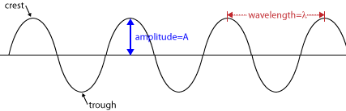
Light: an Electromagnetic Wave
Amplitude
Wavelength (λ)
Frequency (ν) – cycles per second – measured in Hertz (Hz) or as a reciprocal second (s⁻¹)

Slide 6
Light
The produce of wavelength and frequency of light always equal a constant (c), the speed of light:
c= λ ν
Where c = 2.998 x 10⁸ m/s

Slide 7
Page 140 practice problems 14,15

Slide 8
Warm Up
Find the energy in kJ for a photon with a frequency of 3.12 x 10¹⁶ Hz.

Slide 9
Warm Up
E = (6.63 x 10⁻³⁴ j▪s)(3.12 x 10¹⁶ Hz)
E=2.07 x 10⁻¹⁷ kJ x 1000 Joules = 2.07 x 10⁻¹⁴J
1 kJ

Slide 10
Atomic Spectra
https://www.youtube.com/watch?v=lJh2Ra1eygA

Slide 11

Atomic Spectra
Electrons jump from ground state to excited state when they absorb energy.
Electrons emit light when they lose energy and return to lower energy levels (ground state).

Slide 12
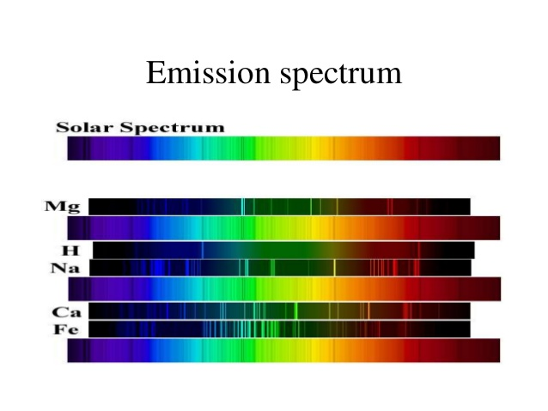
Atomic Spectra
Light emitted by atoms consists of a mixture of specific frequency.
Each frequency corresponds to a particular color.
When passing through a prism light separates
(based on frequency) into discrete lines
(atomic emission spectrum).

Slide 13
Quantum Mechanics (vs Classical)
Photons = light quanta
DeBroglie: All moving objects have wavelike behavior (however you cannot observe a wavelength unless the mass of the object is incredibly small)
Heisenberg Uncertainty Principle: It is impossible to know exactly both the velocity and the position of a particle at the same time. (only matters for very small objects)
https://www.youtube.com/watch?v=2yCgXu5rQok

