Slide 1

Advanced Placement,
college admissions, and degree choice

Slide 2
Today's Goals
Overview of AP Program
Help you make an informed decision about what is academically best for your future (School, Degree & Costs)
Introduce the Capstone program
Answer questions

Slide 3
What do selective Colleges look for?
How does one FIT?
Strength of Transcript
GPA*
ACT/SAT Scores (optional?)
Community Service/Extra-curricular Activities
Student Entrance Essay
Letter of Rec

Slide 4
What do Competitive Colleges look for?
How does one FIT? Institutional Need
Grade Point Average –
Universities use a GPA weight index to calculate the relative weight of GPA’s.
Universities even out weighted and unweighted GPA’s.
In a university’s eyes, one could have a GPA higher than 4.0.
AP classes show higher strength of transcript.

Slide 5
University Expectations-
Guaranteed Admission Program between PSD and WSU, CWU, EWU, PLU, UWT and Evergreen State
Washington state-4 YEAR COLLEGES/UNIVERSITIES
English ................... 4 yrs
Mathematics............. 3 yrs (quantitative Sr yr math or Pre-Calc and higher)
Science .................. 3 yrs (1 Alg based sci, &1 Bio, Chem or Physics)
Social Studies ........... 3 yrs
World Language ........ 2 yrs (consecutively same world language, 3 yrs fulfills college language req)
Art ……………………………. 1 yr

Slide 6
Selectivity Rankings
Whitman
UW
Gonzaga
Seattle U
UPS
WSU
PLU
CWU
WWU
Whitworth
SPU
Evergreen
EWU

Slide 7
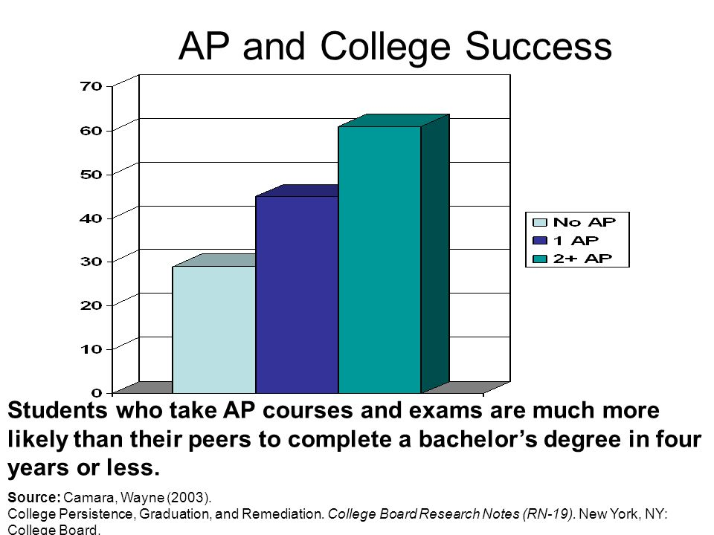
Why take AP?

Slide 8
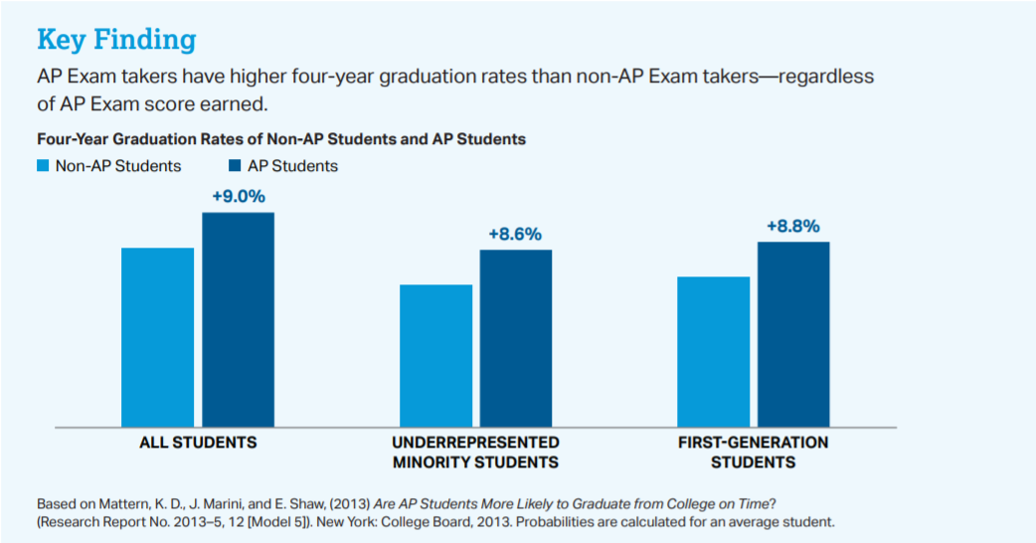
Why take AP?

Slide 9
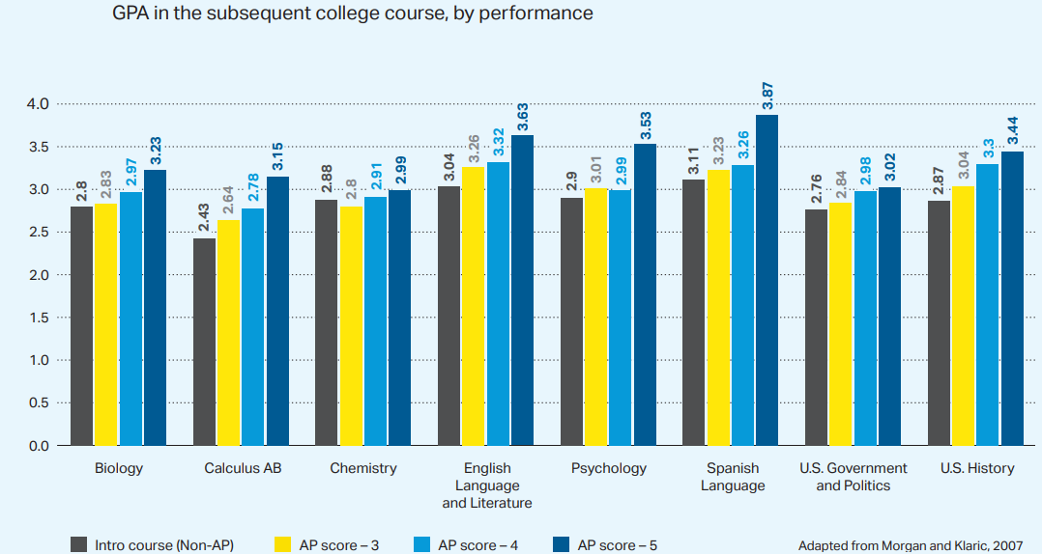
Why take AP?

Slide 10
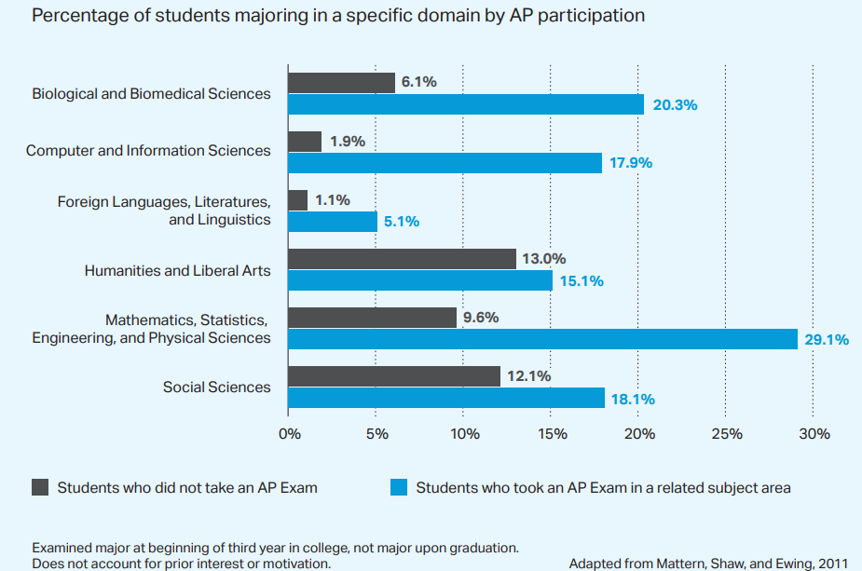
Why take AP?

Slide 11
National Student Clearinghouse © 2022
1 AP class (3+ score) =59%
2 AP classes (3+) =76%
5 AP classes (3+) =98%
RS/CC =36-42+%
High School =29%
Why Take AP?
College Success Rates

Slide 12
Why should a student take AP?
Taking AP is valued in the competitive college admission process (Selective and Highly Selective schools)
Acceptance straight into 3-4yr DEGREE PROGRAMS
Prepare for “Weed Out” courses-Chem, Physiology (A&P), Econ, Physics (Calc based)-What we offer-AP Chem, AP Bio, AP Macro Econ, AP Calc BC, Physics C: Mechanics
Live, face to face instruction shows significant outcome benefits vs online
Opportunity to earn college credits and direct placement in degree major
Opens up opportunity to take other courses to determine potential interests for major, career, or a minor

Slide 13
Degree Choice Matters
If possible, your goal should be to graduate with a degree that has an immediate job.
Industry standard is to hire first those who have completed a career related internship
Lower debt impact from Bachelors degrees than Post Grad
  Half of all student debt is from Post Grad degrees (12% of Americans have 50% of all student debt)

Slide 14
For Specific College Policies
Visit College Board at: collegesearch.collegeboard.com/apcreditpolicy

Slide 15
PSD AP Offerings
  English Lang English Lit
  U.S. Government U.S. History
  Psychology Human Geography
  World History (modern) Macro Economics
  Statistics Calculus A/B & B/C
  Multivariate Calc (Calc BC req.)
  Pre-Calculus Biology
  Chemistry Environmental Sci
  Physics 1 & 2 Physics C: Mech (Calc)
  Art and Design Music Theory
  Spanish Japanese
  French German
  Computer Science A Computer Sci Principles
  Capstone (Seminar and Research)

Slide 16
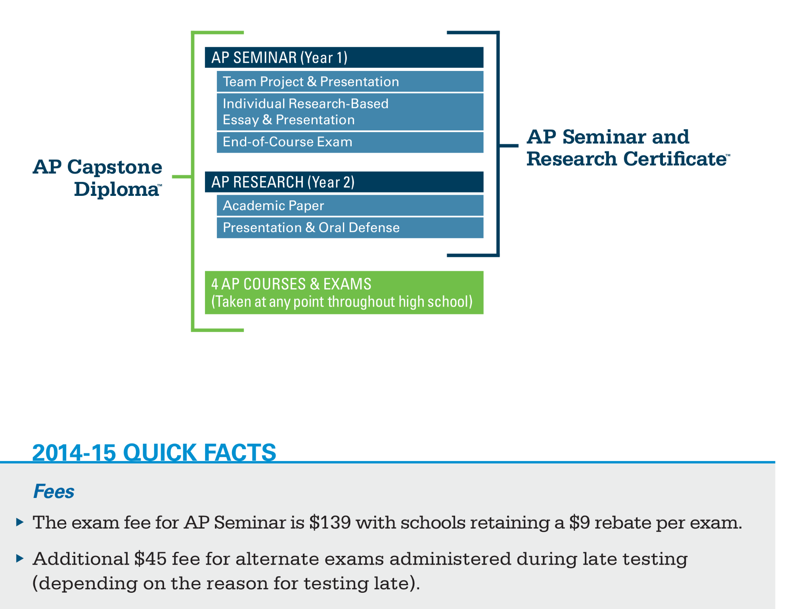

AP Capstone Diploma

Slide 17
AP Costs
AP exams $97.00
AP seminar $145.00
Fee reduction available based on financial need for students
Free/Reduced is Free

Slide 18
Costs and Benefits
UW – $32,464
WSU – $26,976
WWU – $25,044
CWU – $23,524
PLU – $64,912
UPS – $72,056
Whitman - $74,232
Gonzaga - $65,895
SPU - $55,806
Pierce CC--$225/fees +textbooks($150+/class)
Running Start student can earn up to 15 credits/quarter = 90, if attend for 2 years-Estimated/average cost is $1755/year ($585/qtr) Free & Reduced Lunch is free

Slide 19
AP or Running Start-things to consider
AP Credits transfer to 95% of all universities; If student graduates with an AA/AB/AAS etc…, then student has Direct Transfer Agreement with WA St 4 year schools. As always, Degree program choice is key
AP classes are full year. AP instructors teach you the skills required to be successful. University/CC instructors expect you to know the skills upon entry.
RS begins your college transcript immediately and cannot start over.
With RS, only contact is with student until quarter ends

Slide 20
Other ways to earn college credit within the PSD
College in the High School / Dual credit
  Med Terms
  Anatomy & Physiology
  ASL
  Pre-Calculus (depending on school)
      *Can change from year to year

