Slide 1
Physics Skills

Slide 2
Units of Measurement
Metric System primarily used
SI Units
  International System of Units (SI)
  Also known as MKS Units
  Base Units: Fundamental units from which all other units can be derived.

Slide 3
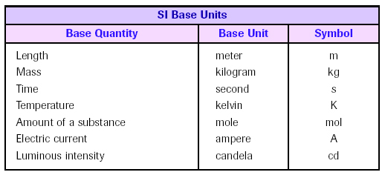
MKS or SI Base Units

Slide 4
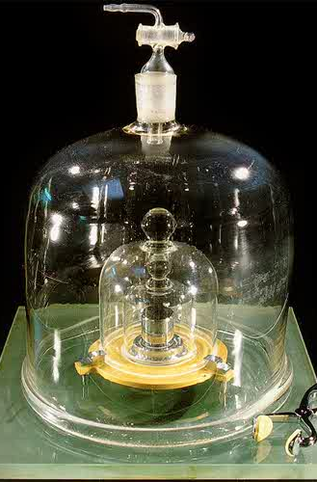
Standard Kilogram
Standard Kilogram
A hunk of platinum-iridium alloy that’s been housed at the International Bureau of Weights and Measures in Sèvres, France
Kept in a air tight bell jar to help keep it from corrosion.

Slide 5

Standard Meter
The French originated the meter in the 1790s as one/ten-millionth of the distance from the equator to the north pole along a meridian through Paris.
It is realistically represented by the distance between two marks on an iron bar kept in Paris.
The International Bureau of Weights and Measures, created in 1875, upgraded the bar to one made of 90 percent platinum/10 percent iridium alloy.
In 1960 the meter was redefined as 1,650,763.73 wavelengths of orange-red light, in a vacuum, produced by burning the element krypton (Kr-86).
More recently (1984), the Geneva Conference on Weights and Measures has defined the meter as the distance light travels, in a vacuum, in 1/299,792,458 seconds with time measured by a cesium-133 atomic clock which emits pulses of radiation at very rapid, regular intervals.

Slide 6

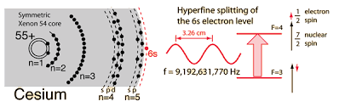
Standard Second
In 1967 the base unit for time, the second, was officially defined/standardized as:
the duration of 9,192,631,770 periods of the radiation corresponding to the transition between the two hyperfine levels of the ground state of the cesium 133 atom
In 1997, this definition was made even more specific with the stipulation that this refers to a cesium atom at rest at a temperature of 0° Kelvin.

Slide 7
Derived Units
Derived Units: Units that consist of combinations of base units.
  Examples: volume, density, Newtons, Joules

Slide 8
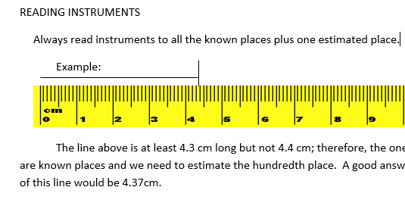

Slide 9
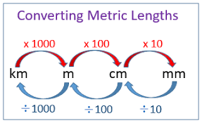
Converting Units in the Metric System
Converting from a large prefix to a small prefix ➔ move the decimal to the right
Converting from a small prefix to large prefix ➔ move the decimal to the left
Number of decimal places are equal to the difference between the powers of each prefix

Slide 10
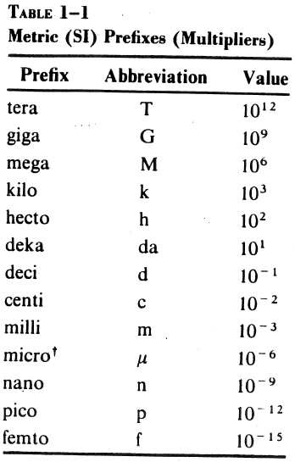
Prefixes

Slide 11

Other Prefixes
Prefix: | Symbol: | Magnitude: | Meaning (multiply by):
Yotta- | Y | 10²⁴ | 1 000 000 000 000 000 000 000 000
Zetta- | Z | 10²¹ | 1 000 000 000 000 000 000 000
Exa- | E | 10¹⁸ | 1 000 000 000 000 000 000
Peta- | P | 10¹⁵ | 1 000 000 000 000 000
Tera- | T | 10¹² | 1 000 000 000 000
Giga- | G | 10⁹ | 1 000 000 000
Mega- | M | 10⁶ | 1 000 000
myria- | my | 10⁴ | 10 000 (this is now obsolete)
kilo- | k | 10³ | 1000
hecto- | h | 10² | 100
deka- | da | 10 | 10
- | - | - | -
deci- | d | 10⁻¹ | 0.1
centi- | c | 10⁻² | 0.01
milli- | m | 10⁻³ | 0.001
micro- | u (mu) | 10⁻⁶ | 0.000 001
nano- | n | 10⁻⁹ | 0.000 000 001
pico- | p | 10⁻¹² | 0.000 000 000 001
femto- | f | 10⁻¹⁵ | 0.000 000 000 000 001
atto- | a | 10⁻¹⁸ | 0.000 000 000 000 000 001
zepto- | z | 10⁻²¹ | 0.000 000 000 000 000 000 001
yocto- | y | 10⁻²⁴ | 0.000 000 000 000 000 000 000 001

Slide 12
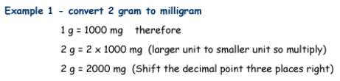

Examples

Slide 13
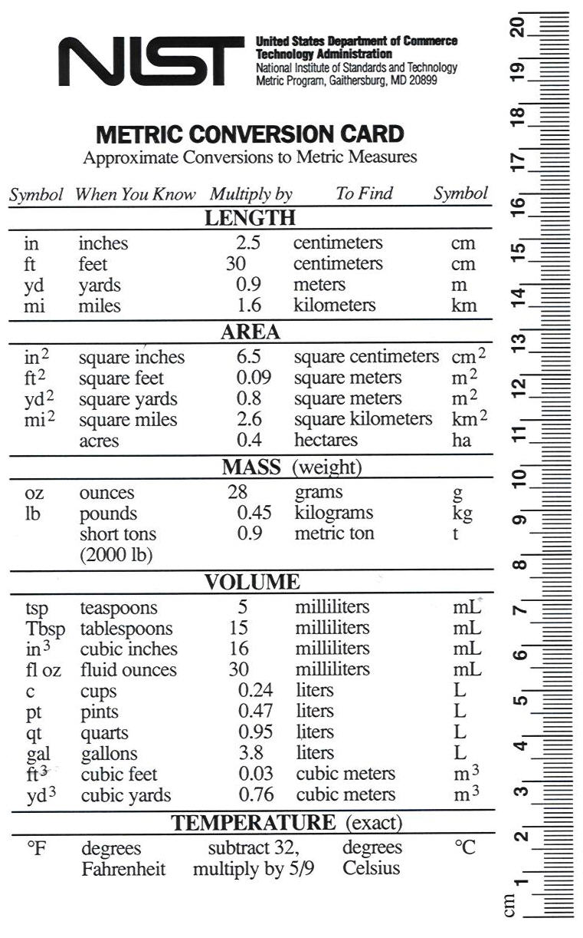
Converting Units between systems

Slide 14
SCIENTIFIC NOTATION
Scientific Notation: Representing very small or very large numbers in compact form.
Converting to Scientific Notation
  While counting the number of spaces/digits, move the decimal until it is just to the right of the first non-zero digit.

Slide 15
SCIENTIFIC NOTATION (continued)
  The number of spaces yields the value of the exponent
    Moving the decimal to the right yields a negative exponent
    Moving the decimal to the left yields a positive exponent
Converting from Scientific Notation to expanded notation
  Preform same steps, but in opposite order/direction

Slide 16
Examples
Given: 289,800,000
Use: 2.898 (moved 8 places)
Answer: 2.898 x 10⁸
Given: 0.000567
Use: 5.67 (moved 4 places)
Answer: 5.67 x 10⁻⁴

Slide 17
More Examples
Given: 5.093 x 10⁶
Answer: 5,093,000 (moved 6 places to the right)
Given: 1.976 x 10⁻⁴
Answer: 0.0001976 (moved 4 places to the left)

Slide 18
Algebra Review
y = xz Solve for x
➔ x = y/z
When x is multiplied by another variable/number divide both sides by that variable/number.

Slide 19
Algebra Review (Cont.)
y = x/z
➔ x = zy
When x is divided by another variable/number multiply both side by that variable/number.

Slide 20
Algebra Review (Cont.)
y = z/x
➔ x = z/y
When x is in the denominator first multiply both sides by x, then isolate x by either dividing or multiplying both sides by the other variable/number.

Slide 21
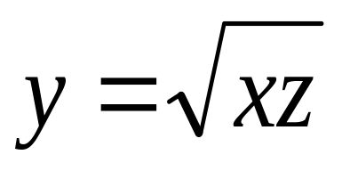
Algebra Review (Cont.)
➔ x = y²/z
If x is under the radical sign first square both sides, then isolate x by either dividing or multiplying both sides by the other variable/number.

Slide 22
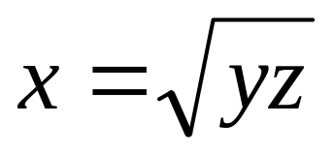
Algebra Review (Cont.)
y = x²/z
➔
If x is squared, either take the square-root of both sides, then isolate x by either dividing or multiplying both sides by the other variable/number, or isolate x² first then take the square-root

