Slide 1
Substances, Mixtures, and Solubility
Chapter 8
Physical Science

Slide 2
8.1 – What is a Solution?
Objectives:
Distinguish between substances and mixtures.
Describe two different types of mixtures.
Explain how solutions form.
Describe different types of solutions.

Slide 3
Why it’s important to you!
The air you breathe, the water you drink, and even parts of your body are all solutions.

Slide 4
Substances
We see differences in everything around us
  Water
  Orange juice
  Salt water
  Chemistry explains how these are different and how they are connected.

Slide 5
Atoms & Elements
Atoms – basic building block of ALL matter
Atoms of one kind make up the elements
Atoms chemically combine to make substances like compounds

Slide 6
Pure Substances
Element is pure
    One type of atom only
Compound is pure
    Two or more elements chemically combined to form a new matter that is pure
    Has the same ratio of elements always
    Has new set of properties unlike those of the elements that make it up

Slide 7
Mixture
Combination of substances that are not bonded together
How do you know?
Each substance retains its own properties
So you will taste the salt in a salt water mixture.

Slide 8
Unlike compounds, mixtures do not keep the same proportions of substances that make them up
A mixture may taste really sweet or not so sweet depending on the amount of sugar added to the mixture

Slide 9
Kinds of Mixtures
Homogeneous
Heterogeneous

Slide 10
Homogeneous Mixture
Contains two or more substances
Evenly mixed on a molecular level
NOT bonded together
Examples – pop, kool-aid, popsicle
Another name is a solution

Slide 11
Heterogeneous Mixture
Two or more substances unevenly mixed
One particle typically larger than the other
Examples – seeds in a watermelon, bowl of cold cereal in milk, jello

Slide 12
How Solutions Form
Solute – substance dissolving
(smaller amount)
Solvent – substance does dissolving (larger amount)

Slide 13
Solutions of many kinds
Solutes can fall out of a solution
Process of crystallization
In a chemical reaction, a solid can form between two solutions this solid is a precipitate – Example - minerals (soap scum) in your sink when soap and water combine

Slide 14
Formed from solutions
Stalactites (cave roof)
Stalagmites (cave floors)
Formed when a solution of minerals drips in the cave and the liquid evaporates leaving the mineral behind

Slide 15
Types of Solutions
Solutions come in many forms
  Gas/ gas solutions (air)
  Gas/ Liquid solutions (pop)
  Solid/ solid solutions (solder)
  Liquid/ solid solutions (apple juice)

Slide 16
Solid / Solid solutions can make solder for welding or statues
Remember that the two solids would need to be heated and mixed before allowing them to cool into the solid solution they will form

Slide 17
Test YourSelf
How are substances and mixtures different?
What are the two types of mixtures?
How do you form a solution?
Describe different types of solutions.

Slide 18
8.2 Solubility
Objectives
Explain why water is a good general solvent.
Describe how the structure of a compound affects which solvents it dissolves in.
Describe how temperature affects the reaction rate.
Explain how solute particles affect physical properties of water.

Slide 19
Why it’s important
How you wash your hands, clothes, and dishes depends on which substances can dissolve in other substances. It is important to understand why this happens.

Slide 20
Water – the Universal Solvent
Since many substances dissolve in water, it is called the universal solvent
All chemical reactions in your cells take place in a water environment so this is an important fact

Slide 21
Molecular Compounds
Happen when atoms share electrons
This forms a covalent bond
Sometimes the electron sharing is not equal

Slide 22
Molecular Compound Bonds
Polar – the electrons are unevenly shared so one element keeps them closer to its nucleus than the other
  Water is an example
Nonpolar – electrons are evenly shared between the atoms

Slide 23
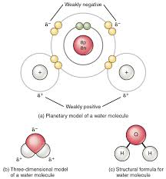
Polar Bond
Notice the electrons are closer to the oxygen than the hydrogen.
This gives a positive end (Hydrogen) and a negative end (Oxygen)

Slide 24
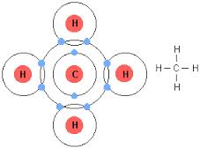
Nonpolar Bond
Sugar
Methane
Since the electrons move evenly between both atoms
https://www.google.com/search?q=nonpolar+bond+methane+image&tbm=isch&source=iu&imgil=O3WkTPLzPPNQOM%253A%253Bhttps%253A%252F%252Fencrypted-tbn0.gstatic.com%252Fimages%253Fq%253Dtbn%253AANd9GcQ7GXcBK0PUJGzMGhHjanvRPiDX49lpVJwqvXBt8diVTh_co37IeQ%253B284%253B211%253BX7tXIgoMhCqHvM%253Bhttp%25253A%25252F%25252Ffaculty.clintoncc.suny.edu%25252Ffaculty%25252Fmichael.gregory%25252Ffiles%25252Fbio%2525252520101%25252Fbio%2525252520101%2525252520lectures%25252Fbiochemistry%25252Fbiochemi.htm&sa=X&ei=NM7OUseXHo7foASW9YCwDA&ved=0CDYQ9QEwBQ&biw=1024&bih=569#facrc=_&imgdii=_&imgrc=O3WkTPLzPPNQOM%253A%3BX7tXIgoMhCqHvM%3Bhttp%253A%252F%252Ffaculty.clintoncc.suny.edu%252Ffaculty%252Fmichael.gregory%252Ffiles%252Fbio%25252520101%252Fbio%25252520101%25252520lectures%252Fbiochemistry%252Fmethane.gif%3Bhttp%253A%252F%252Ffaculty.clintoncc.suny.edu%252Ffaculty%252Fmichael.gregory%252Ffiles%252Fbio%252520101%252Fbio%252520101%252520lectures%252Fbiochemistry%252Fbiochemi.htm%3B284%3B211

Slide 25
Ionic Bonds
Some atoms exchange electrons
Happens between a metal and nonmetal
This electron exchange causes an atom to have an uneven number of protons and electrons creating ions

Slide 26
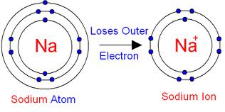
Ions
Notice the loss of one electron creates a 1+ ion
https://www.google.com/search?q=nonpolar+bond+methane+image&tbm=isch&source=iu&imgil=O3WkTPLzPPNQOM%253A%253Bhttps%253A%252F%252Fencrypted-tbn0.gstatic.com%252Fimages%253Fq%253Dtbn%253AANd9GcQ7GXcBK0PUJGzMGhHjanvRPiDX49lpVJwqvXBt8diVTh_co37IeQ%253B284%253B211%253BX7tXIgoMhCqHvM%253Bhttp%25253A%25252F%25252Ffaculty.clintoncc.suny.edu%25252Ffaculty%25252Fmichael.gregory%25252Ffiles%25252Fbio%2525252520101%25252Fbio%2525252520101%2525252520lectures%25252Fbiochemistry%25252Fbiochemi.htm&sa=X&ei=NM7OUseXHo7foASW9YCwDA&ved=0CDYQ9QEwBQ&biw=1024&bih=569#q=ion+image&tbm=isch&facrc=_&imgdii=_&imgrc=guBRd1a4VDXQGM%253A%3B4zv1jbRwGg25yM%3Bhttp%253A%252F%252Fwww.gcsescience.com%252FSodium-Atom-Sodium-Ion.gif%3Bhttp%253A%252F%252Fwww.gcsescience.com%252Fa4-sodium-ion.htm%3B396%3B198

Slide 27
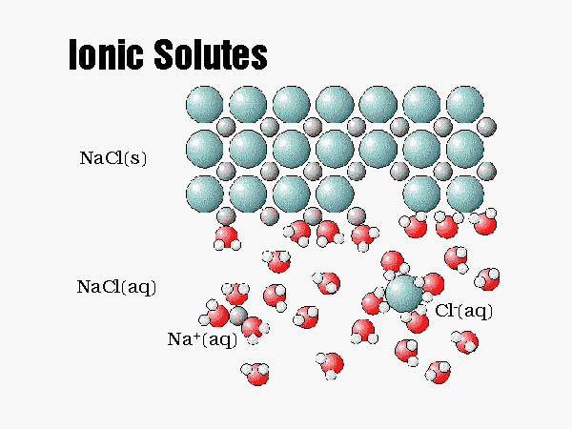
Dissolving Ionic Compounds
Each ion is surrounded
by the water molecules
Notice the positive
Hydrogen end surrounds
The negative Chlorine ion
And the positive Oxygen
End surrounds the Na+
http://www.shs.d211.org/science/faculty/S2B/Old%20Stuff/water_dissolving_an_ionic_compou.htm

Slide 28
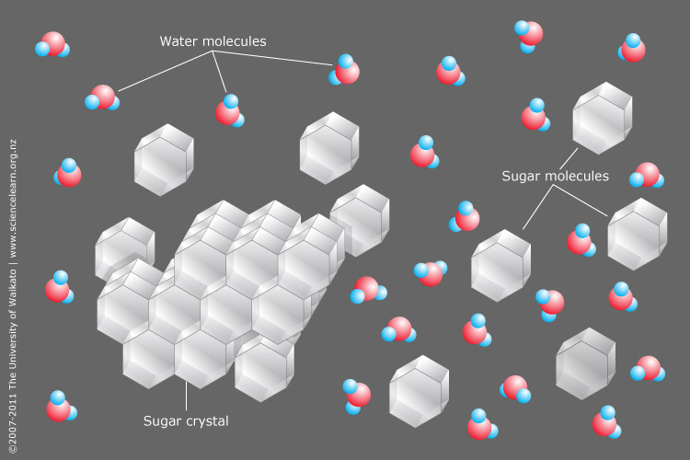
Dissolving Covalent Compounds
Notice the
Entire sugar
Molecule gets
Surrounded
Instead of parts
Of the sugar
molecule

Slide 29
What Will Dissolve?
Like Dissolves Like
Molecules of similar chemistry will dissolve others like themselves
This is why oil and water will not dissolve in one another

Slide 30
Solubility
Describes how much solute will dissolve in a solvent
This is described as 60 g of sugar will dissolve in 100 g of water.
100 g of water = 100 mL

Slide 31
Solubility
Some solutes are highly soluble
Some are not
Usually increasing the heat increases solubility
Remember our rate of reaction lab?

Slide 32
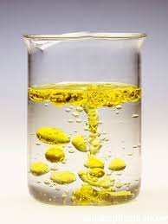
Insoluble
When a substance like barium sulfate has an extremely low solubility, we refer to it as being insoluble
This image
Illustrates oil
And water

Slide 33
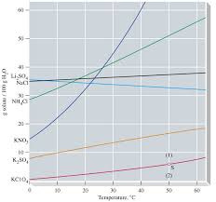
Solubility Curves
The steeper
the line, the
More soluble
The substance

Slide 34
Liquid-Solid Solutions
Temperature makes a difference
Increased temperature increases the solubility
Sodium chloride and calcium carbonate do not become more soluble with higher temperatures– they remain constant

Slide 35
Liquid-Gas Solutions
An increase in temperature decreases the solubility of a gas in a liquid- gas solution
Carbon dioxide is less soluble at lower temperatures

Slide 36
Saturated Solutions
This indicates all the spaces available in a solvent are filled by molecules of solute
No more solute can be held by the solvent unless we add heat

Slide 37
Unsaturated Solution
More Solute can be added to the solvent without adding any energy

Slide 38
Rate of Dissolving
If the molecules move faster the dissolving rate will increase
Ways to move the molecules faster include:
  Heat
  Stirring
  Lower concentration
  Greater surface area

Slide 39
Concentration
The amount of solute in a solvent
Concentrated = full of solute
Dilute = room is available for the solute to fill spaces in the solvent

Slide 40
Measuring Concentration
2 g of glucose in 100 mL of water
2g =.02 or 2% solution
100mL

Slide 41
Effects of Solute Particles
When adding a solute to a solvent if affects the melting point and boiling point of the solvent

Slide 42
Effects of Solute
Adding solute to water when freezing the water changes how the water molecule arrange while trying to form crystals
To overcome this interference the temperature must get lower to freeze the solvent
This is why salt is placed on icy walkways

Slide 43
Boiling with a Solute
When water boils, each molecule of solvent gains enough energy to change states
Solutes in the water will disrupt this energy absorption so MORE energy is needed to boil the water– the boiling point will be higher

Slide 44
Review
How does adding a solute to a solution change its boiling point?

Slide 45
The boiling point is elevated because it takes more energy to get each of the solvent molecules to energy level needed to escape the liquid phase and turn into a gas

Slide 46
A ___________ changes color to identify the hydronium ion concentration and determine if there is an acid or base present.

Slide 47
Indicator

Slide 48
8.3 Acidic & Basic Solutions
What You’ll Learn
Compare acids and bases and their properties
Describe practical uses of acids and bases
Explain how pH is used to describe the strength of an acid or base
Describe how acids and bases react when they are brought together

Slide 49
Why it’s important?
Many common products, such as batteries and bleach, work because of acids and bases. Since we use these products daily, we need to understand them.

Slide 50
Acids
Are substances that release positively charged hydrogen ions in the water
Hydrogen ions are represented as H⁺

Slide 51
Hydronium Ion
H₃O⁺
Is created when a water molecule bonds with a hydrogen ion
This is what acids typically are made up of

Slide 52
Properties of Acidic Solutions
Sour taste
  Think about the foods that are sour
Conduct electricity
Corrosive- meaning they can break down certain substances
Some acids react strongly with metals releasing hydrogen gas

Slide 53
Acids
Can corrode
  Fabric
  Skin
  paper

Slide 54
Uses of Acids
Vinegar – acetic acid
Lemons, limes, oranges
  Ascorbic acid = Vitamin C
Ant stings
  Formic acid

Slide 55
Products of Acids & Uses
Sulfuric Acid
  Fertilizers, steel, paints
  Batteries
Hydrochloric acid
  Pickling metals
  Clean mortar from brick walls
Nitric acid
  Fertilizers, dyes and plastics

Slide 56
Acid in the Environment
Cave formation
  Carbonic acid formed from carbon dioxide in the soil dissolving in ground water
  This carbonic acid then dissolves large basic rocks like limestone which is Calcium Carbonate
  When the rock is dissolved, a cave forms

Slide 57
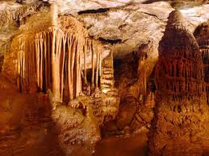
Lewis & Clark Caverns

Slide 58
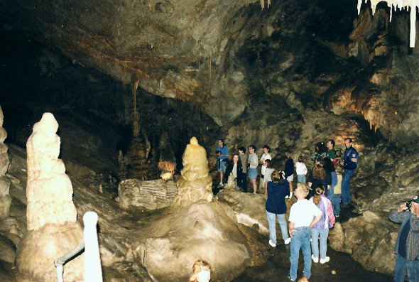
Lewis & Clark Caverns

Slide 59
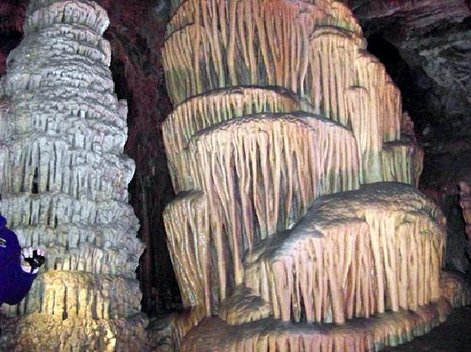
Lewis & Clark Caverns

Slide 60
Cave Formations
Stalactites – form when the acidic solution drips from the ceiling and the water evaporates off leaving a hanging formation
Remember they hold “tight” to the ceiling

Slide 61
Cave Formation
Stalagmites
  Form as the acidic solution drips onto the floor building a column
  Remember they “might” reach the top

Slide 62
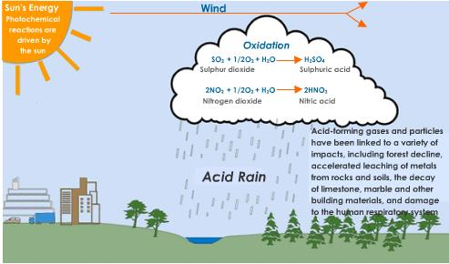
Acid Rain

Slide 63
Bases
Substances that accept hydrogen ions
Causes the formation of a hydroxide ion (OH⁻) which is an indication of a base

Slide 64
Properties of Basic Solutions
Most soaps
Slippery
Taste bitter
Corrosive
Conduct electricity
Not as reactive with metals as acids are

Slide 65
Uses of Bases
Ammonia – cleaner
Chalk
Calcium Hydroxide
  Athletic field lines (chalk)
  Garden and soil treatment
Sodium Hydroxide
  Also called Lye
  Oven cleaners and unclog drains

Slide 66
What is pH?
A measurement of how acidic or basic a solution is
Each time the pH increases there is a power of 10 difference in the level of ions
This means a pH of 2 is 10 times stronger than a pH of 3!

Slide 67
Comparing pH
A pH of 9 vs a pH of 11
  Since there is a difference of 2 between 9 and 11 there is 10 X10 difference in the concentration of ions
  10 X 10 = 100 X stronger
  11 is 100 X stronger than 9 because a bigger number is more basic

Slide 68
pH Solution
pH measures the concentration of Hydronium ions
The more hydronium ions in a solution the fewer hydroxide ions (acidic)
The fewer hydronium ions, the more hydroxide (basic)

Slide 69
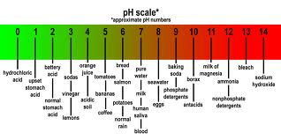
pH Scale

Slide 70
pH Scale
0 – 7 Acidic
  Closer to 0 the stronger the acid
7 – Neutral
  Even concentrations of hydroxide and hydronium ion concentrations
7-14 Basic
  Closer to 14 the stronger the base

Slide 71
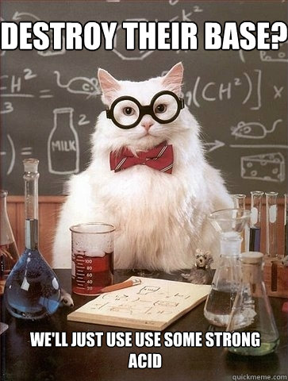
Strong Acids
Hydrochloric – HCl
Sulfuric – H₂SO₄
Nitric – HNO₃

Slide 72
Weak Acid
Acetic – CH₃COOH
  Vinegar
Carbonic – H₂CO₃
  Pop or first aid
Ascorbic – H₂C₆H₆O₆
  Vitamin C

Slide 73
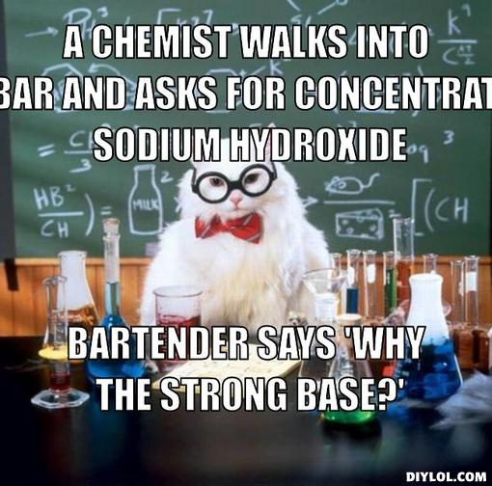
Strong Base
Sodium hydroxide (NaOH)
Potassium hydroxide (KOH)

Slide 74
Weak Base
Ammonia – NH₃
Aluminum hydroxide Al(OH)₃
Iron(III) hydroxide Fe(OH)₃

Slide 75
Indicators
Substances that change color to indicate the strength of an acid or base
They are triggered by the hydronium ion concentration in the solution
The indicator however does not change

Slide 76
There are many natural indicators like red cabbage
We will test with red cabbage
There are also man made indicators like pH paper
Electronic pH meters too

Slide 77
Neutralization
The reaction between an acid and a base
The ions of the base – OH⁻
Combine with the ions of the acid H⁺
To produce water and an ionic compound called a salt

Slide 78
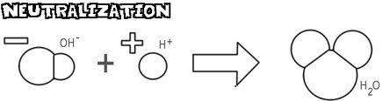
Neutralization

Slide 79
Review 8.3
How much more acidic is a pH of 2 than a pH of 4?

Slide 80
Answer
Since there is a difference of 2 pH values and each one equals a power of 10 difference
10 X 10 = 100 x
2 is the stronger acid
2 is 100 times stronger than 4

Slide 81
Be able to list industrial uses for acids.
Be able to list household uses for bases.

