Slide 1
RCD Unit 3- Physical Science
Bonding and Naming

Slide 2
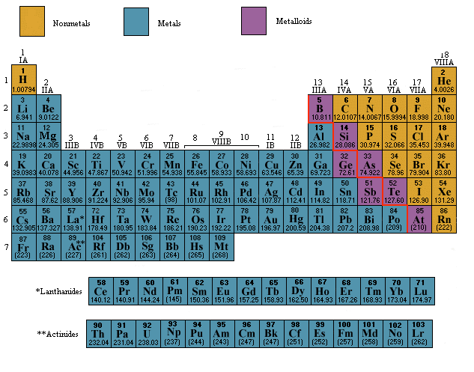
On Your Periodic Table Label : Metals, Nonmetals and Metalloids

Slide 3
Bonding and Naming
Two types of bonds:
Ionic bond: bond in which one or more electrons from one atom are removed and attached to another atom, resulting in positive and negative ions which attract each other.
Covalent bond: bond in which one or more pairs of electrons are shared by two atoms.

Slide 4
Classifying Compounds
Compounds are either ionic (metal and nonmetal) or covalent (nonmetal and nonmetal)
Naming ionic Compounds:
  Identify the cation (+)
  Put the cation first and change the letters of the second element to –ide.

Slide 5
Ionic Bonds
NaCl
Na+ Cl-
Sodium chloride
LiF
Li+ F-
Lithium Fluoride
Practice naming the following compounds formed by ionic bonds

Slide 6
Naming Covalent Compounds
Covalent bond: nonmetal to nonmetal
Use prefixes to indicate how many atoms of each element.
Change the ending of the anion to –ide.
CO (both are nonmetals)
Carbon monoxide
CO2
Carbon dioxide

Slide 7
Most Used Prefixes
1 = mono
2 = di
3 = tri
4 = tetra
5 = penta
6 = hexa
Examples: N2O = dinitrogen-monoxide
        N2O3 = dinitrogen-trioxide

Slide 8
Writing Binary Formulas
Binary formulas combine 2 elements
Steps:
  1) Write the symbol and the charge
      Ex. Sodium = Na 1+
        Chlorine = Cl 1-

Slide 9
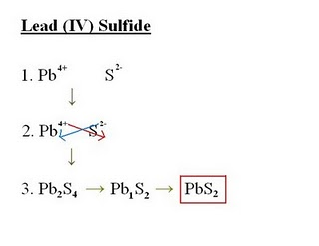
Writing Binary Formulas
Steps:
  2) Cross the compound by drawing arrows

Slide 10
Writing Binary Formulas
  Practice writing the following formulas:
  Ba 2+ and F 1-
  Cr2+ and S 2-
  Mg and Br (you need to find the oxidation # for this one yourself!)

Slide 11
Writing formulas from Names
Steps:
1) Is it an ionic or covalent bond?
2) What are the symbols for the elements?
3) What are the oxidation #’s ?
4) Is their a prefix? (covalent bonds only)
Example: Potassium Chloride
K 1+ and Cl 1-
= KCl

Slide 12
What are those Roman Numerals FOR ?!
Transition Metals:
  Found in groups 3-12
  Some of the first elements discovered
  One property of transition metals is the ability to form compounds with distinctive colors
  Can have more than one oxidation state. Represented by Roman Numerals

Slide 13
Roman Numerals
I = One
II = Two
III = Three
IV = Four
V = Five
VI = Six
VII = Seven
*Most common are I – V ☺

Slide 14
Examples of Transition Metals
What is the oxidation state on Fe (III) ?
+3
Vandadium (IV) ?
+4
Copper (II)
+2

Slide 15
Writing formulas from Names
Practice!
Iron (III) Oxide
Fe 3+ and O 2-
Reverse crisscross!
Fe2O3
Zinc (II) Chloride
Zn 2+ and Cl 1-
Reverse crisscross!
ZnCl2

Slide 16
Polyatomic Ions
3-D models of polyatomic ions:
http://www.chemistry.wustl.edu/~edudev/LabTutorials/PeriodicProperties/Ions/ions.html
Polyatomic ions are charged molecules . The atoms within a polyatomic ion are usually very tightly bound together, so the ion retains its identity within ionic compounds and over the course of many chemical reactions.

Slide 17
Polyatomic Ions
(On the back of your handout)
DON’T Break them apart!
Treat them as ONE compound!
Box them in when you see them so that you learn to identify them.
DON’T Break them apart!
DON’T Break them apart!
DON’T Break them apart!

