Slide 1
Physical Science- Unit B
Chapter 1-Lesson 1
What are elements?

Slide 2

What is matter?
Matter is anything that has mass and takes up space

Slide 3

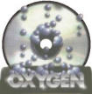


What are the building blocks of matter?
ELEMENTS cannot be broken down into another substance by heat light or electricity

Slide 4
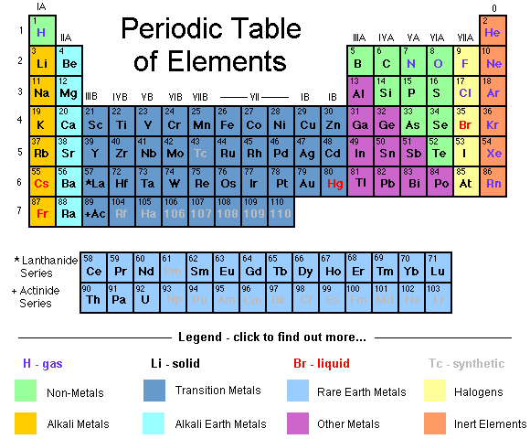
What is the periodic table?
A chart that classifies elements by their properties
Created by Russian Scientist- Mendeleev

Slide 5
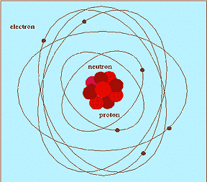
What are atoms?
The smallest particles of an element that has the properties of the element
Contains proton, neutrons and electrons

Slide 6

How do elements differ from each other?
By their properties- metals, non-metals, etc…
By the # of protons, neutrons and electrons in each atom of the element

Slide 7

Lesson 2:
What are compounds?

Slide 8
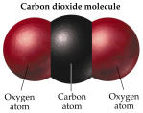
What are molecules?
Smallest unit of most substances
Two or more atoms joined together

Slide 9
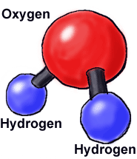
What are compounds?
Two or different elements that join together
Difficult to separate once joined
Forms a new substance
Atoms chemically combine

Slide 10

What are chemical formulas?
Examples: H2O=water- (two atoms of hydrogen one oxygen)
CO2= carbon dioxide
(one carbon, 2 oxygen)
CaCO3= calcium carbonate (1 Calcium, 1 carbon, 3 oxygen atoms)

Slide 11

Lesson 3:
What are mixtures and solutions?

Slide 12

What are mixtures?
2 or more substances that are mixed and CAN be separated
Ex. salad

Slide 13

What are the different types of mixtures?
Homogeneous- same amount of particles throughout (milk)
Heterogeneous- a mix of particles in different amounts

Slide 14

What is a solution?
A mixture in which substances break up into their most basic parts that can’t be seen
Particles spread evenly throughout

Slide 15
Lesson 4:
How can substances be described?

Slide 16



What are physical properties of matter?
characteristics of matter that you can observe with your senses (texture, shape, luster, hardness, magnetism…)
Also mass and weight

Slide 17
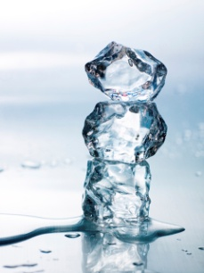
What are physical changes?
A change in one or more physical properties
No new substance is formed
Ex. Snowman melting, folding or ripping paper, grinding peanuts

Slide 18

What are chemical properties?
Describes the way a substance reacts with other substances
Ex. Statue of liberty- copper that turned green

Slide 19

What are chemical changes?
a change that produces a brand new substance with new properties
Ex. Baking a cake, food burning, baking soda and vinegar!

