Slide 1
colloid

Slide 2
Definition must be word for word typed from the physical science book:
homogeneous mixture in which the particles are mixed together but not dissolved

Slide 3
4 examples of colloids
milk, toothpaste, whipped cream, suntan lotion

Slide 4
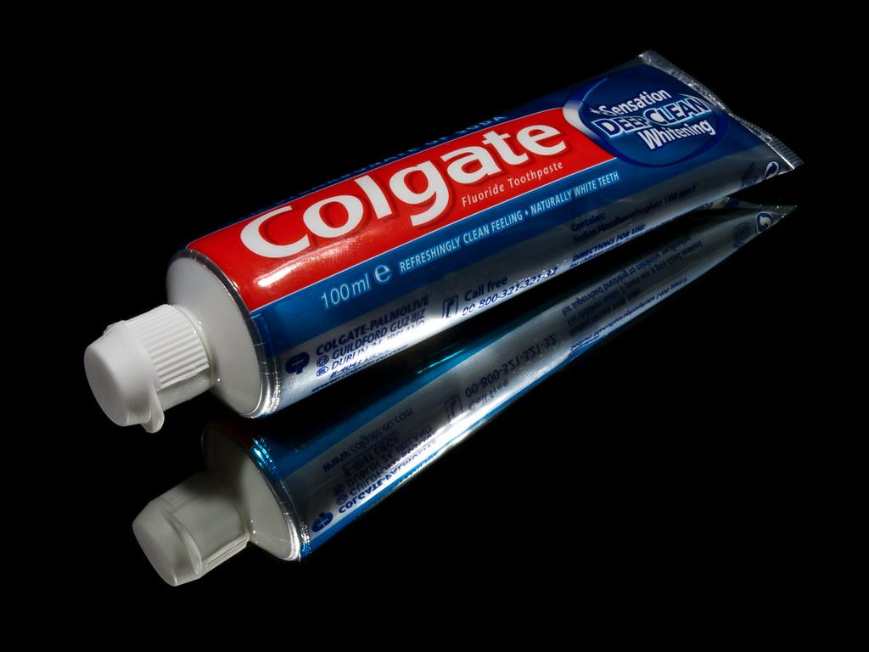
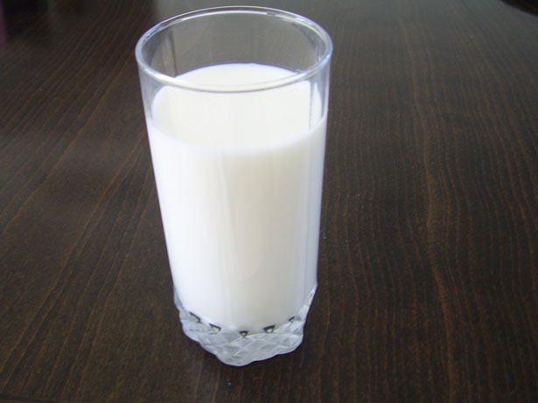
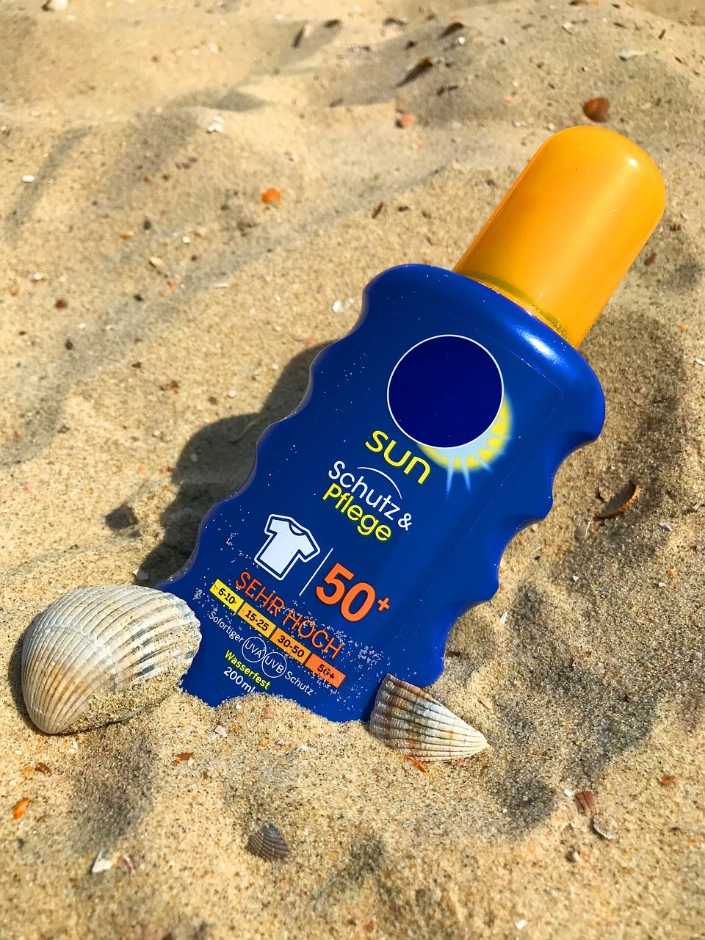
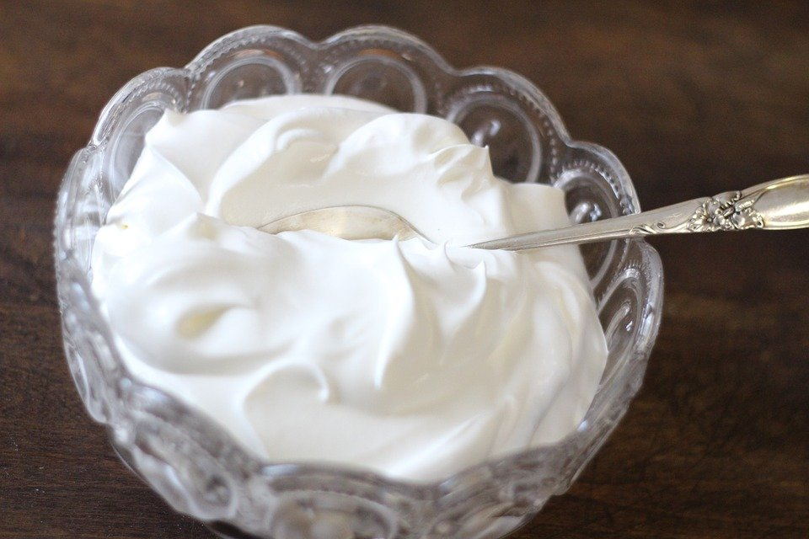

Slide 5
mixture

Slide 9
heterogeneous mixture

Slide 13
homogeneous mixture

Slide 17
solution

Slide 21
solute

Slide 25
solvent

Slide 29
soluble

Slide 33
insoluble

Slide 37
solubility

Slide 41
alloy

Slide 45
pure substance

Slide 49
element

Slide 53
atom

Slide 57
chemical symbol

Slide 61
compounds

Slide 65
molecule

Slide 69
chemical formula

Slide 73
subscript

Slide 77
chemical equation

Slide 81
coefficient

