Slide 1

Welcome To Centralia High School!
For more information visit our web site:
http://www.centralia.k12.wa.us/chs/site/default.asp

Slide 2
Introduction
Congratulations on being part of the class of 2021!
Counselors
  Jim Parker [A-G]
  Matt Whitmire [H-O]
  Deb Everley [P-Z]
  Administrators
    Mr. Lowe, Principal
    Mr. Johnson, Vice principal

Slide 3
NEW Class of 2021 Graduation Requirements
Total credits: 25.0
  English 4.0
  CHS Capstone 0.5
  Math 3.0
  Fine Arts * 2.0
  World Language* 2.0
  Social Studies 3.0
  Science 3.0
  PE/Fitness 1.5
  Health 0.5
  CTE 1.0
  Washington State History NC
  Electives 4.5
  * Can be part of Personalized Pathway Choice

Slide 4
Class of 2021 Graduation Requirements
Testing Success
  SBAC ELA 2548
  SBAC Math 2595
  Science 400- End of Course Biology
4 P’s
  Portfolio
  Presentation (senior year)
  Pathway (career)
  Plan (the fifth year, after CHS)
All above parts equal one CHS diploma

Slide 5
Four year schedule Matrix
S1 | S2
1 | 1
2 | 2
3 | 3
4 | 4
5 | 5
6 | 6
S1 | S2
1 | 1
2 | 2
3 | 3
4 | 4
5 | 5
6 | 6
S1 | S2
1 | 1
2 | 2
3 | 3
4 | 4
5 | 5
6 | 6
T1 | T2 | T3
1 | 1 | 1
2 | 2 | 2
3 | 3 | 3
4 | 4 | 4
5 | 5 | 5
6 | 6 | 6
Grade 9 Grade 10 Grade 11 Grade 12

Slide 6
Freshman Course Offerings
English or Honors English
Algebra 1 or Geometry
Fine Arts: Music & Art
Social Studies: Law & Community
Earth and Physical Science PE/Fitness, PE, Yoga, Strength & Conditioning
VCTE: Health, Robotics, Marketing, Woods, Metals, Web Design, Digital Design
We are offering SPANISH 1 for grade 9
For more course offerings, see course description booklet at CHS website

Slide 7
New Classes for 9th graders in 2017-18
Floral Design
Landscape Design
American Sign Language
Computer Applications

Slide 8
Typical 9th Grade Schedule
Pd | Semester 1 | Semester 2 | Yearly Credit
1 | English 9A | English 9B | 1.0
2 | Algebra 1A | Algebra 1B | 1.0
3 | Science 9A | Science 9B | 1.0
4 | Law & Comm A | Family Health B | 1.0
5 | PE A | PE B or Elective | 1.0
6 | Elective A | Elective B | 1.0

Slide 9
Advanced 9th Grade Schedule
Pd | Semester 1 | Semester 2
1 | Honors English 9A | Honors English 9B
2 | Geometry A | Geometry B
3 | Science 9A (Choose Honors) | Science 9B Choose Honors)
4 | Law & Comm A | Family Health B
5 | Elective A | PE B
6 | Spanish 1A | Spanish 1 B

Slide 10
Course Description Sample:
Web site: http://www.centralia.k12.wa.us/chs/site/default.asp
STEM ROBOTICS 101 A & B ** NEW in 2013-14***
  Skyward Code: CTE 209 & CTE 210
Grades: 9, 10, 11, 12
Course length: Two Semesters, One year
Credit Type: CTE or Elective
This course uses a hands-on approach to introduce the basic concepts in robotics, focusing on mobile robots and illustrations of current state of the art research and applications. This introductory course uses the LEGO MINDSTORMS NXT Education Base Set and NXT-G software to teach the class. In this course, basic concepts will be discussed, including coordinate transformations, sensors, path planning, kinematics, feedback, and feed-forward control, stressing the importance of integrating sensors, effectors and control. Students will work in teams to build and test increasingly more complex LEGO-based mobile robots, culminating in an end-of-semester robot contest.

Slide 11
Registration Process
  LAST Name first, email address, cell phone
  Circle each correct subject
  WE NEED 12 Classes (6A and 6B classes)
  ADD 2 Alternates (1A and 1B)
    Circle them and put an A1 and A2 next to it
  English
  Math
  Science
  PE/Fitness
  Law & Community
  Family Health
  Elective [list 2-4]

Slide 12
Registration Process
  Give me one copy now
  Have parent sign other copy
  Return by NEXT Friday to CMS Teacher
  If you are way late, give it to CMS counselors

Slide 13
9th grade Orientation
Link Freshman First Day
  First day of school
  LINK activities
  Repeat schedule
  Fun, get to know you, great transition

Slide 14
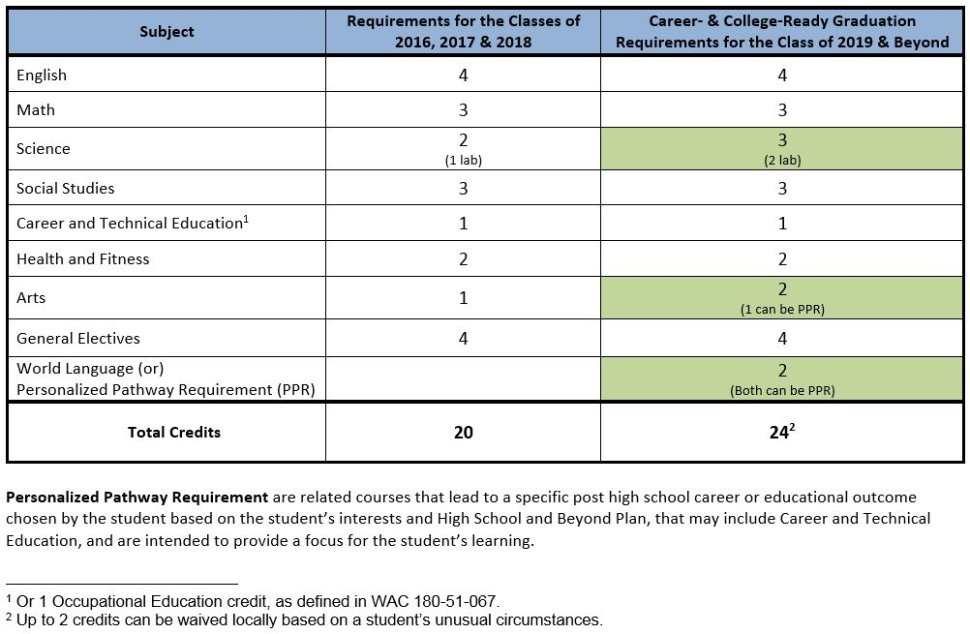
New Graduation Requirements
Table of WA State Graduation requirements: State Board of Education, 2014
Use this table as a quick reference for credit comparisons in the class of 2021.
Note the definition of Personalized Pathway Requirement {PPR} in the table above.

Slide 15
High School & Beyond Plan
CHS is working with the Skyward HS & Beyond Plan
Electronic login and work
Developed over three years with Nav advisory
Fourth year may be different with tri-mesters.

Slide 16
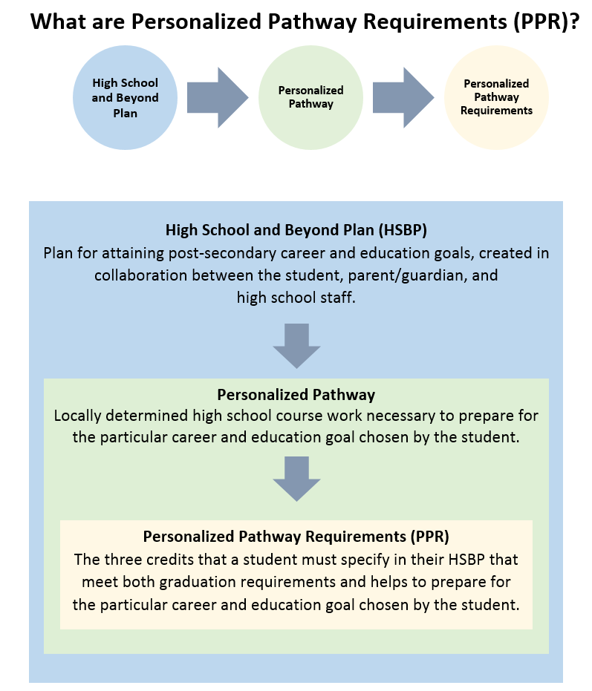
Personalized Pathway

Slide 17
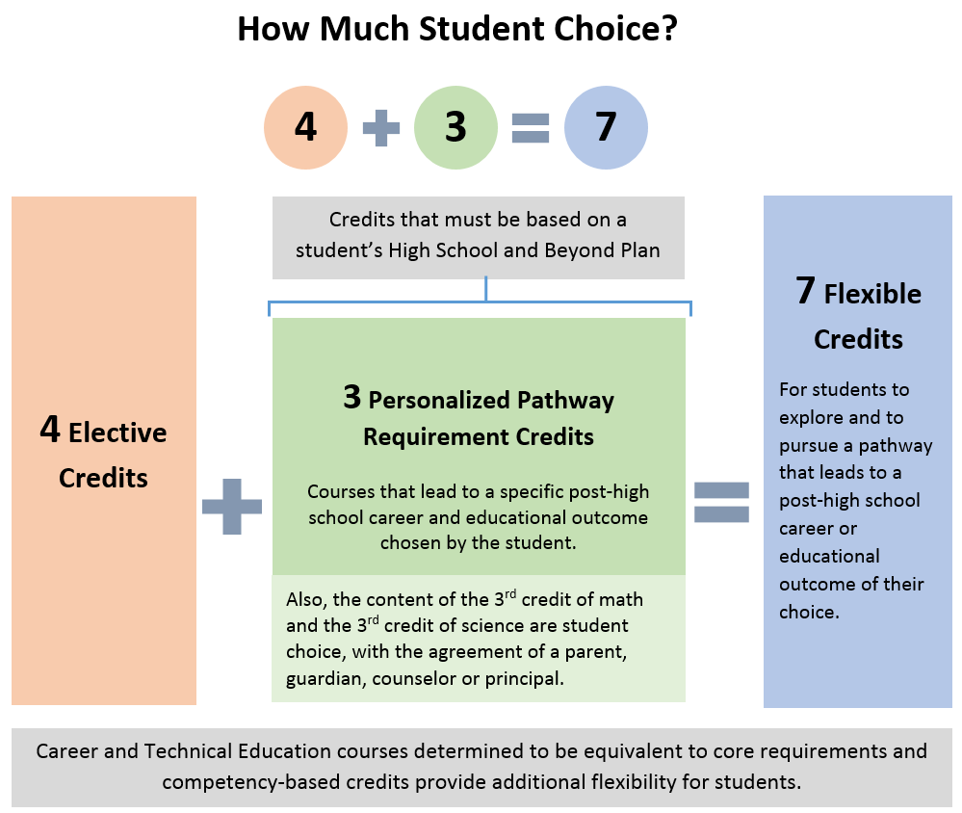
Student Flex Credits

Slide 18
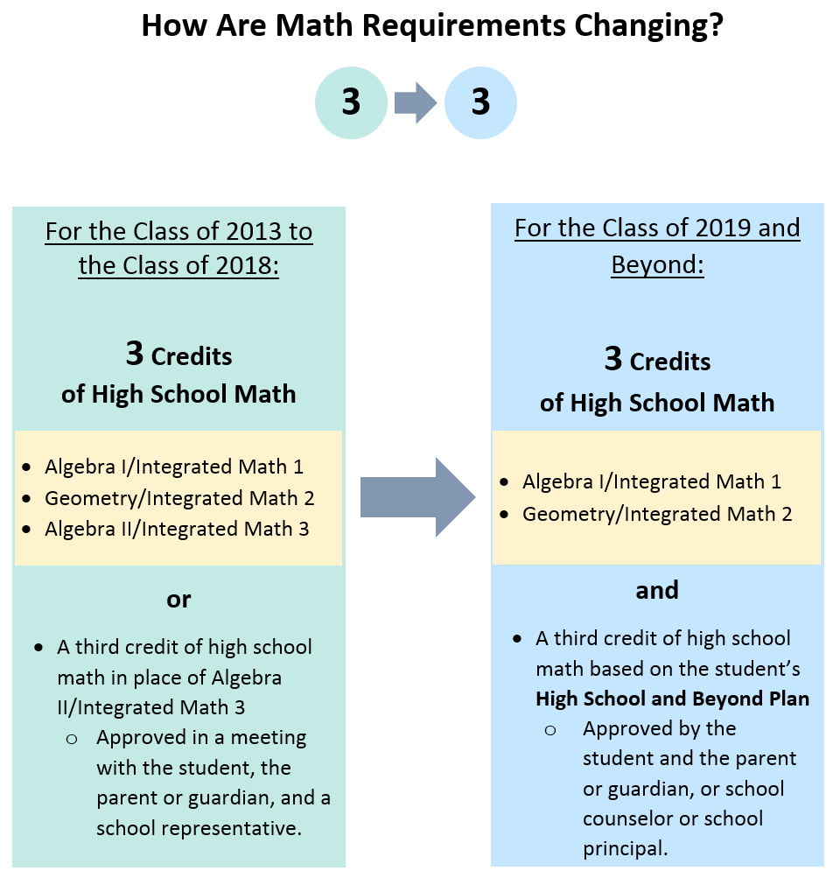
Math Choice Changes

Slide 19
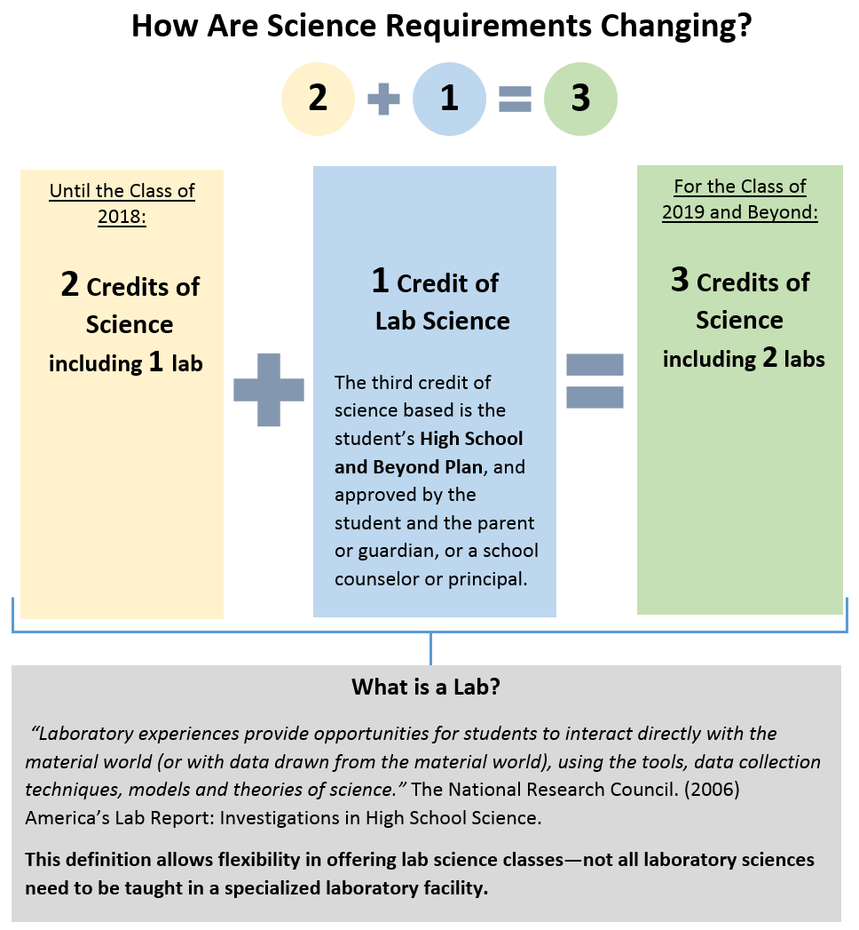
Science Choice Changes

Slide 20
Questions?
Call 330.7609 or email us:
Jessica Boeck; Grade 9 Counselor
  jboeck@Centralia.wednet.edu
Jim Parker, counselor [A-G] Grades 10-12
  jparker@centralia.wednet.edu
Matt Whitmire , counselor [H-O] Grades 10-12
  mwhitmire@centralia.wednet.edu
Deb Everley, counselor [P-Z] Grades 10-12
  deverley@centralia.wednet.edu

