Slide 1
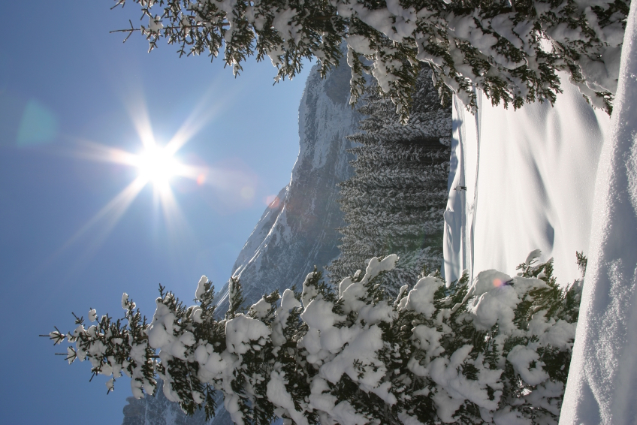

Winter Wonderland!
The Fine & Performing Arts Students
present
~Thursday, December 13, 2012 ~
5 p.m.
Connally ES

Slide 2

Winter Wonderland!
Prelude—Drum Cadences
by CES Drum Line
Mr. James Howard, Director
Mr. Snow Rap—Pre-K, Kindergarten, 1st & 2nd grade students
Ms. Nadirah Simmons, Director

Slide 3
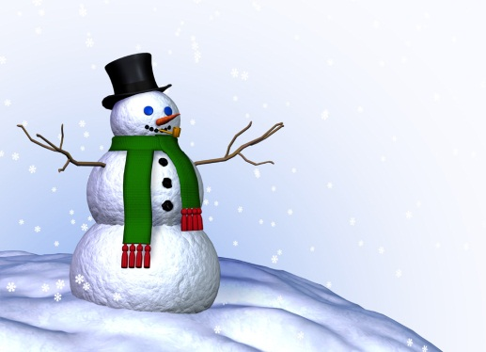
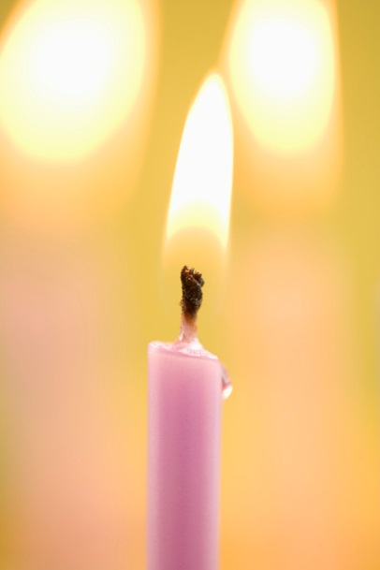
Winter Wonderland!
Five Little Snowmen—Pre-K, Kindergarten, 1st & 2nd Grades
Ms. Nadirah Simmons, Director
Goruyju Demonstration (Martial Arts)
Sensei Tiga Lee, Instructor
  My Favorite Things, CES Band
  Mr. James Howard, Director
Las Velitas, 3rd, 4th, & 5th Grade
Ms. Nadirah Simmons, Director

Slide 4
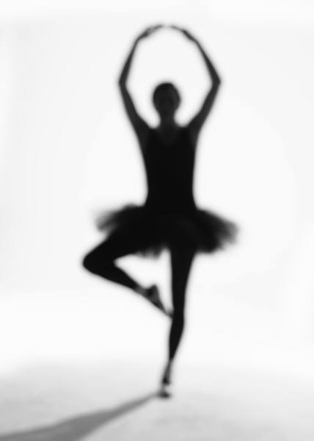
Winter Wonderland!
Deck the Halls
Winter Wonderland— 3rd, 4th & 5th Grade
Ms. Nadirah Simmons, Director
Think Aaliyah
Music & Me—CNG Dance Troupe
Ms. LaToya Jackson, Choreographer

Slide 5

Winter Wonderland!
~The Grand Finale~
Jingle Bells
Audience, Faculty, Staff
&
All CES Singers

Slide 6
Winter Wonderland!
Please take a gallery walk to see all of the unique art of our CES Artists on the Art Studio Hallway.
Dr. Clarice Bell,
Art Director

Slide 7
Closing Comments
Ms. Pickett, Principal

Slide 8
Thanks to our Mistress of Ceremony—
Ms. Kristen Hall, 5th Grade
& to all of our
Parent Volunteers!

Slide 9
Thank you so very much for supporting us in our
Winter Wonderland Evening of the Arts!!
Connally Fine & Performing
Arts Department
&
The CNG Staff

Slide 10
Winter Wonderland
Dr. Clarice Bell, Art
Mr. James Howard, Band
Ms. Nadirah Simmons, Music
Ms. LaToya Jackson, Dance
Sensei Tiga Lee, Martial Arts
Ms. Jacqueline Glaster, Executive Director, CNG
Ms. Aukejshia Boyce-Gaskins, Program Director

