Slide 1
Samples
Be sure to take notes!

Slide 2
Sample VS population
Use this website to find the definition of the vocabulary terms: sample and population.
What is the difference between a sample and a population?
population = everybody
sample = actual people I survey/observe

Slide 3
Why do we use samples?
You should be able to get the answer from the same website.
Be sure to state this in YOUR OWN WORDS in your notes.

Slide 4
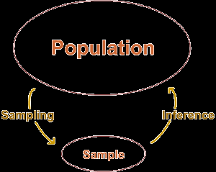
Copy this flow map into your notes and write a few sentences about the purpose of sampling.

Slide 5
Random sample
All members of a population are equally likely to be chosen
If a certain population is overrepresented or underrepresented then the sample is ….BIASED
Read the article about two ways to create random samples. DO NOT WORRY ABOUT THE MULTI-STAGE RANDOM SAMPLING.

Slide 6
Would it create a random sample?
Asking every tenth person coming out of a theater how many times a week they go to the theater to determine how often city residents support the performing arts
b) Surveying people going into a pet store to find out if the city’s residents support the building and maintaining a dog park
No; if they are already at the theater then they already support the performing arts
No; if they are already at the pet store then you can assume they probably have a pet

Slide 7
Would it create a random sample?
c) Asking every player at a golf course what sport they prefer to watch on TV
d)Calling 100 randomly selected numbers and asking for their opinions on a local tax
e) Going to a football game and asking 100 random fans about their favorite sport
No; they will probably say golf…
yes
No; they will most likely say football

Slide 8
Why is this common sense?
Larger sample = better = more accurate
  Smaller standard deviation if you use a larger sample
  Margin of error should also decrease as your sample size increases

Slide 9
Vocabulary
Census
Observation
Experiment
Survey
Simulation
Convenience Sample
Systematic Random Sample
Cluster Sample
Stratified Sample
Self-Selected Sample
Define each of the above terms.

Slide 10
What is this: a survey, simulation, observational study, or experiment?
  One Algebra I teacher is not allowed to use any technology. Another must use technology every day. The students are given the same tests and the grades are compared.
  experiment
You do not have to write these examples down UNLESS you feel like you really need them.

Slide 11
What is this: a survey, simulation, observational study, or experiment?
One study of cell phones and the risk of brain cancer looked at a group of 469 people who have brain cancer. The investigators matched each cancer patient with a person of the same sex, age, and race who did not have brain cancer, then asked about the use of cell phones. Result: “Our data suggest that use of hand-held cellular telephones is not associated with risk of brain cancer.”
  observational study
You do not have to write these examples down UNLESS you feel like you really need them.

Slide 12
What is this: a survey, simulation, observational study, or experiment?
Before a new variety of frozen muffin is put on the market, it is subjected to extensive taste testing. People are asked to taste the new muffin and a competing brand and to say which they prefer.
  experiment
You do not have to write these examples down UNLESS you feel like you really need them.

Slide 13
What is this: a survey, simulation, observational study, or experiment?
You want to find opinions on a presidential election. So, you ask students in each of your classes.
  survey
You do not have to write these examples down UNLESS you feel like you really need them.

Slide 14
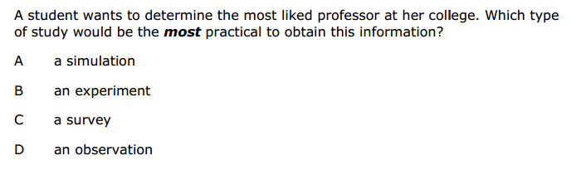
This is the question from the final exam…(easy right?)

Slide 15
Class work
Random Samples
Worksheet
(you can work with a partner so you will only turn in ONE worksheet per group (put in the bin), but be sure I see two different hand writings)

Slide 16
Homework
Review
Worksheet
TEST TOMORROW
(key will be up on my website after 2:15)

