Slide 1
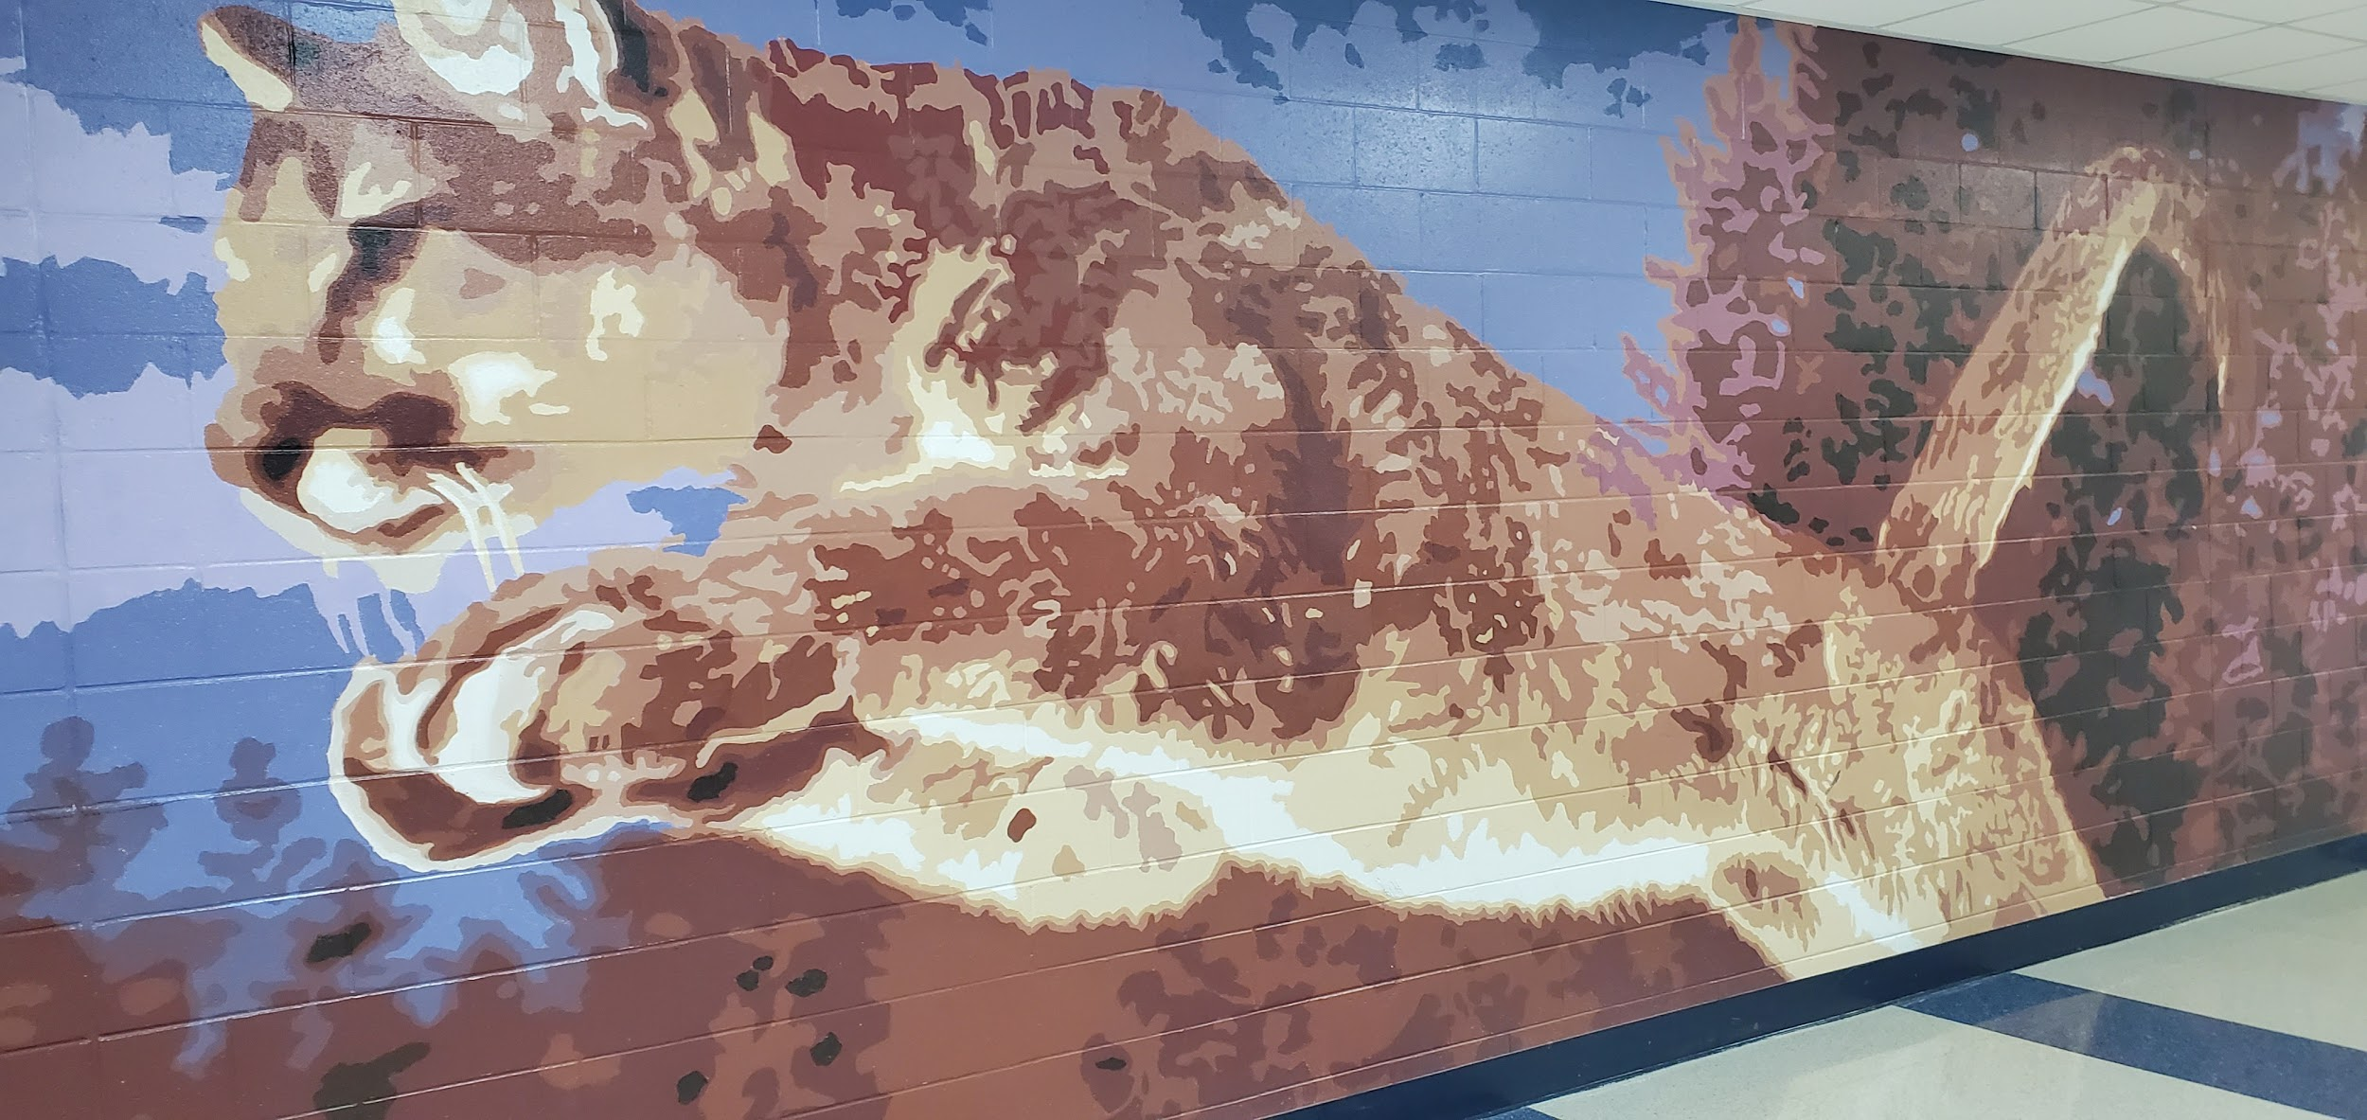
Colleton County High School
Public Information Forum
April 12, 2021

Slide 2





Senior Activities
These activities will be designated for graduating seniors, in order to celebrate our Class of 2021.
Band Activities
Activities and performances in which the current members of the CCHS Band of the Blue will participate.
Chorus Activities
Activities and performances in which the current members of the CCHS Chorus will participate.
Athletic Activities
Activities and Events in which our Student Athletes will compete.
School-wide Activities
Activities designated for other specified groups of students at CCHS.
Summer School Programs
Programs that will be offered to CCHS students over the summer.
Senior Class Shoutout
Scholarship total for our Class of 2021.
Thank you for Supporting
CCHS
EDUCATE
EXPLORE
EMPOWER

Slide 3
Prom: “Moonlight Masquerade”
Date: May 7, 2021
Time: 7:00 PM - 11:00 PM
Cost: $30.00 Per Ticket
Tickets to Prom 2021 are only available for purchase by the Class of 2021.
Each eligible ticket purchaser may also purchase a ticket for one guest who fit the following criteria: between the ages of 15-20; any student who has been expelled from CCSD during the 20-21 or 19-20 school years will not be allowed to attend.
Senior Activities
Class of 2021 Twilight Program
Date: Early May 2021
Eligible Seniors will receive counselor notification.
Accelerated academic program designed for seniors who are missing a required credit for on time graduation.
Class of 2021 Virtual Senior Awards Night
Date: May 20, 2021
Recognition Awards for the accomplishments of the students. This also includes recognition of scholarship awards.

Slide 4
Senior Activities
Class of 2021 Final Exams
Dates: June 1 and June 2, 2021
Seniors Last Day is June 2, 2021
Seniors Last Day to Clear Student Debt
Date: June 9, 2021
Location: PAC Lobby during school hours
All student debt must be cleared to participate in graduation ceremony.
Mandatory Class of 2021 Graduation Practice
Date: June 18, 2021
Time: 9:00 A.M. Cougar Stadium
Students will report to Cougar Stadium and be seated on the Home side bleachers.

Slide 5
Senior Activities
Class of 2021 Graduation
Date: June 19, 2021
Time: 8:30 A.M. Cougar Stadium
Graduates will report to their assigned classrooms no later than 7:00 A.M.
.

Slide 6
Band of Blue Spring Concert
Date: May 23
Time: 4pm
Costs: Free
At Discovery Center in downtown Walterboro (if it rains then we will be in the PAC at CCHS)
Our Annual Spring concert featuring our symphonic/concert/jazz bands in a fusion group. Also our Winter Percussion and Winter Guard will perform.
FREE!
Band Activities
Band of Blue in Rice Festival Parade
Date: June 5
Time: 11 am
Parade starts at St. Anthony’s Catholic church and ends in parking lot near movie theatre.
The Band of Blue will march in the 45th Annual RIce Festival Parade. The Band of Blue has been in every parade since 1976.
Public is invited
Band of Blue Awards Night
Date: June 10
Time: 6pm
Sponsored by the Band of Blue Booster Club
Annual event to recognize our Band of Blue Seniors and our outstanding student musicians and guard members.
Free

Slide 7
Miss Cougar Pageant
Sponsored by CCHS Chorus
Date: May 5, 2021
Time: 7:00 PM
Costs: $10.00
Location: CCHS Performing Arts Center
Includes bio book and program
The public is invited
Chorus
Activities
WHAM! Walterboro Music and Art Festival
Date: May 6 and recorded event TBA
Time: TBA
CCHS Chorus
Virtual performance
New festival showcasing Music Art and History of Walterboro/Colleton
Many events are free contact Farmer’s Market and Museum for event prices
The public is invited
Mamma Mia!
The Musical
Date: June 3rd, June 4th, and June 7th
Time: 7:00 PM
The CCHS Chorus CCHS Performing Arts Center
Fully Licensed Broadway Musical to be presented in conjunction with the Walterboro Rice Festival
10.00 admission available at https://colletoncountycougars.com/event-tickets
Ticket Sales go live May 3, 2021 at noon

Slide 8
Chorus
Activities
Rice Festival Finale before Fireworks:
CCHS Chorus presents Mamma Mia!
Date: Saturday, June 5
Time and Location: Walterboro Wildlife Outdoor Amphitheater at 7:00 pm
Fully Licensed Broadway Musical to be presented in conjunction with the Walterboro Rice Festival
Costs: $10.00 admission available at https://colletoncountycougars.com/event-tickets
Ticket Sales go live May 3, 2021 at noon

Slide 9
Athletic Activities
Softball Senior Night
Date: April 21
Time: 7:00 PM
Cost: $7.00 price of admission
Senior Softball athletes will be recognized prior to the game starting.
Baseball Senior Night
Date: April 26
Time: 6:30 PM
Cost: $7.00 price of admission
Senior Baseball athletes will be recognized prior to the game starting.
Girls Soccer / Track and Field / Golf Senior Night
Date: April 30
Time: 7:00 PM
Cost: $7.00 price of admission
Senior Soccer athletes will be recognized prior to the game starting.

Slide 10
School-wide Activities
Project Search Skills Day
Date: Tuesday, April 13th
Time: Begins at 10 AM. Times are scheduled in 15 minute intervals.
Cost: Free to any student, ages 18-21 that is registered in the district and has a disability - must be off diploma track.
Prospective interns will move through various tasks and interviews to become interns of Project Search
YMCA Youth In Government Model Legislature & Court Conference
Information coming soon.

Slide 11
Final Exams
Final Exams- Grades 9-11
1st Block- June 7 (8:30-11:30)
2nd Block- June 8 (8:30-11:30)
3rd Block- June 9 (8:30-11:30)
4th Block- June 10 (8:30-11:30)
Class of 2021 Final Exams
1st and 2nd Block- June 1, 2021
3rd and 4th Block- June 2, 2021
Last day for Seniors is June 2, 2021

Slide 12
Summer School Programs
Rising Freshman Summer Bridge:
Date: June 28 - July 23
Tentative Time: 8 AM - 1 PM
Location: CCHS
Cohorts of students will participate in a four day orientation and team building activities. How to be a successful Cougar!
Summer School Credit Recovery
Date: June 28 - July 23
Tentative TIme : 8 AM - 1 PM
Location: CCHS
Students who may have fallen behind in their academic studies in the 2020-2021 school year will have a chance to recover a missed credit needed for high school graduation.

Slide 13
Shout- out to CLASS OF 2021
As of today, April 12, 2021, our scholarship total is $11,130,198.00
* This includes State Lottery Scholarships, Palmetto Fellows, LIFE, and HOPE
As well as, Raise.Me

Slide 14
Colleton County High School
Educate, Explore, Empower
Public Information Forum
April 12, 2021
Maurice Cannon
Principal

