Slide 1

Local Control Accountability Plan
2015-2016

Slide 2
Local Control Accountability Plan
Districts are funded through the Local Control Funding Formula
(LCFF)
LCAP defines how the District will use funds to produce best outcomes for our students, staff, and parents
District planning involves feedback from several Stakeholder Groups, including Parents, Staff, Students, and Community
Input for the LCAP must be based on the 8 state priorities

Slide 3
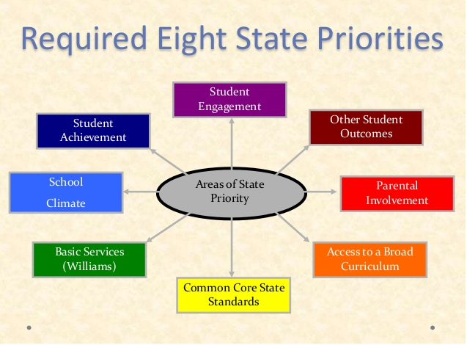
State Priorities
The 8 State Priorities provide a roadmap for what is included in the LCAP plan

Slide 4
Instruction
District LCAP Goal:
Provide high quality standards-based instruction that is rigorous and engaging
Continue alignment of instructional materials and resources to standards
Build rigorously aligned units of study that incorporate best standards based practices
Develop student learning environments that are engaging and utilize technology in the learning process

Slide 5
Implementation of State Standards
District LCAP goal:
Ensure implementation of state academic/ELD development standards embedded in 21st Century Learning Skills
Professional development on the new academic standards, District focus on ELA/ELD framework, literacy by the 3rd grade, math adoption materials and alignment with numeracy and problem solving
Professional development and support on using students’ motivations , interests, and interactions to shape instruction supported through 21st Century Skills

Slide 6
Broad Course of Study
District LCAP Goal:
Provide all students a broad and enriching course of study that reaches beyond the core
Focus on literacy standards in Social Studies and Science in grades TK-8
Scaffold access for at-risk student populations in implementing Social Studies and Science
Teach literacy through digital resources, visual and performing arts

Slide 7
Student Achievement
District LCAP Goal:
Ensure that students are high school, college, and career ready by demonstrating continuous progress towards academic and ELD achievement
Universal Access Choice and Challenge (UACC) time at each school provides students with individualized attention to address needs and enrichment.
Imagine Learning and LexiaCore5 assessments assist teachers in grouping students and focusing on skills and concepts students still need to master.
STAR Early Literacy, Reading and Math to monitor student progress
Superintendent goal meetings with Administrators will include progress monitoring.

Slide 8
Achievement Cont.
District LCAP Goal: College and Career Readiness Continued
Title I site support and coaching on literacy and effective reading instruction.
Intensive special education focus on literacy in grades K-8: Edmark, System 44, and Read 180
Supplemental instruction utilizing Voyagers, Read Naturally
District-wide Behavior Supports using PBIS: Positive Behavior Intervention Supports

Slide 9
Parent and Student Engagement
District LCAP Goal:
Provide safe learning environments that promote engagement and school connectedness with parents and students
  Student engagement and connectedness to the school community
  Motivational instructional practices in the classroom
  Parent involvement as decision makers and participants in the school community

Slide 10
May I answer any questions?

