Slide 1
Peer Pressure

Slide 2

Peer Pressure is like Football…

Slide 3
What exactly is Peer Pressure?
Feeling and thought pattern
When you feel like someone or a group of people about your age are pushing you to do or go along with something you do not want to
The choice can be GOOD or BAD!
The tug of war in your mind between what YOU want to do and what a PEER wants you to do.

Slide 4

How can you tell if you’re experiencing peer pressure?

Slide 5

You might feel…
Anxious
Pressured
Annoyed
Angry
Powerless
Out of Control
Confused
Unimportant
Guilty
Curious
Manipulated
Tricked
Torn
Indecisive
Excited
Scared
Alone
Can you think of others?

Slide 6

You might be Thinking…
Will people think I’m cool?
Will people think I’m a baby?
What will happen if…?
How did I get myself into this?
What can I do to get out of this?
Why won’t they leave me alone?
I wish I could…
Will they still be my friend?
Will I fit in more?
Will anyone notice?
Can you think of other thoughts?

Slide 7




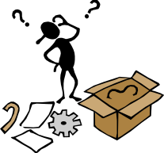
How did we wind up here?
Remember…Peer pressure is like football! There are strategies or tricks that people use (intentionally or unintentionally) to get their way!

Slide 8
Two Types of Peer Pressure
1 - Spoken – Someone or multiple people use their words to influence how another person thinks, feels, or acts.
  Put Downs
  Rejection
  Reasoning
  Warning

Slide 9
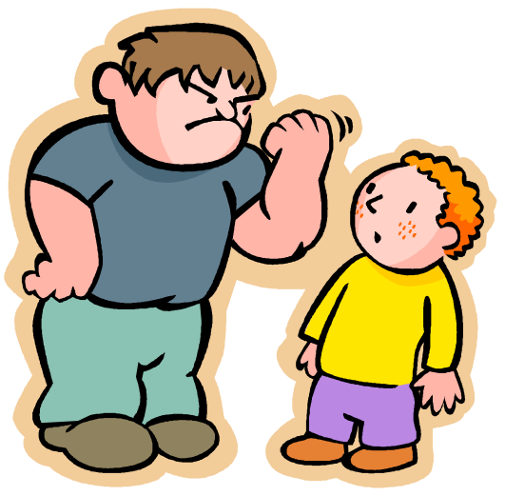
Spoken pressure
Put Downs
Insulting or calling names to make someone feel bad about the choice they want to make.

Slide 10
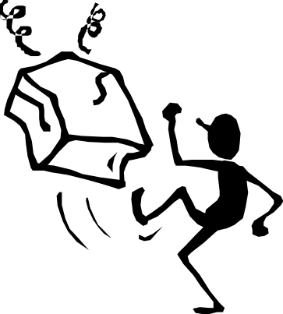
Spoken Pressure
Rejection
Threatening to leave someone out or end a friendship.

Slide 11
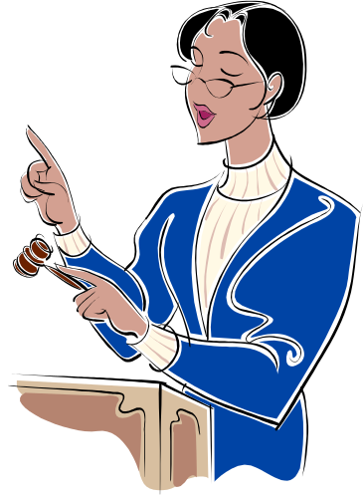
Spoken Pressure…
Reasoning
Giving reasons to do something or why it would be OKAY to do it.

Slide 12


Spoken Pressure
Warning
Uses threat of consequences or warnings to get control of your behavior.
“If you do/don’t…then…”

Slide 13
Two Types of Peer Pressure
2 - Unspoken – Pressure comes from how we perceive (think and feel) the actions of others (but not so much what they say)
The Example
The Huddle
The Look

Slide 14



Unspoken Pressure
The Example
Kids who others consider popular buy or wear something, and because they set an example, others want to follow.

Slide 15

Unspoken Pressure
The
Kids who think they have power over your actions will give you the “look” that makes you feel like “man I’m so uncool”!

Slide 16
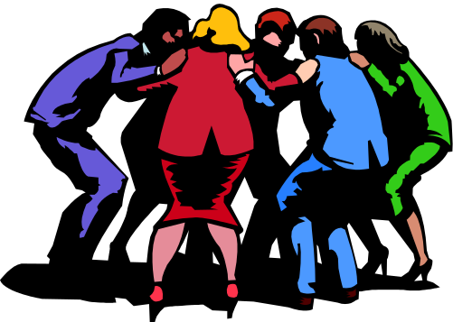
Unspoken Pressure
The Huddle
A group stands together talking and laughing, maybe looking at something you can’t see, with their backs out to others.
Often unintentional, but makes others feel crummy either way!

Slide 17
What To Do About…Spoken Pressure
Speak up assertively – Use a calm, serious voice. Look the person in the eye and stand up tall.
Suggest something else to do.
Remove yourself from the pressure.
Consider the consequences (good or bad) of giving in to the pressure.
Stick with people who encourage good choices!

Slide 18
What To Do About…Unspoken pressure
Be your own best friend! Practice positive self-talk.
Focus on working towards the goals you have set for yourself!
Find positive role models.
Ask a trusted grown up or friend for encouragement.

Slide 19
Put It All Together!
The remaining slides have activities you and your family or friends can do while you are home!
BrainPop Video and Activities
Role-play activity

Slide 20
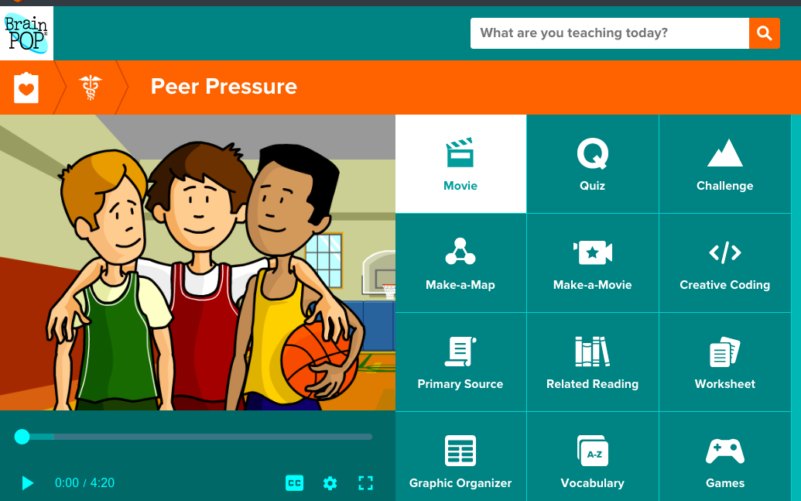
Activity 1: BrainPop “Peer Pressure”
Open Classlink and select the BrainPop icon
Search for Peer Pressure
Watch the Video
Take the Quiz
Complete the challenge

Slide 21
Activity 2: Let’s Practice Identifying Types of Peer Pressure
1. Read the scenarios (stories) in the next few slides.
2. Plan
  Choose how your will act out the story and assigned “peer pressure trick”
  The purpose is to help your friends/family use SUBTLE clues to determine how peer pressure is working, so please keep the actions as realistic as you can make them to day-to-day life
  3. Perform

Slide 22
Let’s Practice Identifying Types of Peer Pressure (continued)
4. Test Your Guests! Can they tell you…
  Was this SPOKEN or UNSPOKEN PRESSURE?
  Which PEER PRESSURE TRICK was used?
  What FEELINGS or THOUGHTS might the situation have resulted in?
  5. Swap and let them act out a story and the peer pressure tricks!

Slide 23
Situation Sweater
Pretend you and your friend are hanging out at your house. Your friend really likes your sister’s fleece, and she asks if she can borrow it to wear to school tomorrow. You tell her that it’s your sister’s, so it is not yours to loan.
How will your friend peer pressure you?
How will you stand up to the peer pressure?

Slide 24
Friendship Fiasco
Pretend that Marco is your next door neighbor, and you have played together as long as you can remember. This year, you’re in different classes. You have made friends with some new kids who seem really popular. One day, your new friends seem surprised that you play with Billy. Your new friends try to tell get you to quit being friends with Marco…
How are you being peer pressured?
How will you stand up to peer pressure?

Slide 25
Pranking Problem
You and Rebecca are working on the computer at school one day. Your friend dares you to send an email a classmate, pretending to be a boy she likes. You know this would be really embarrassing for the classmate, but you’re not really friends with her. And. you want Rebecca to think you’re cool.
How are you being peer pressured?
How will you stand up to peer pressure?

Slide 26
Money Matters
In the cafeteria, you see a $10 bill on the ground. You pick it up and Carl (the kid standing next to you) says, “Nice dude!” When you ask if you should turn it in, Carl tells you to keep the money because, “Finders keepers losers weepers!”
How are you being peer pressured?
How will you stand up to peer pressure?

Slide 27
Homework Horrors
You get to school early and go to the cafeteria. While talking to your friends, your very best friend shouts, “Ugh! I forgot to put my math homework in my bag. I did it, and my mom checked it. Can I look at yours real quick, so I don’t lose Friday incentive?”
How are you being peer pressured?
How will you stand up to peer pressure?

Slide 28
Instagram Insanity
It feels like you’re the only kid who doesn’t have an Instagram account, but your parents have strict rules about how you use the Internet. (Something about they don’t want your picture all over the web) At your friend’s house one day, you’re competing to make the silliest faces. Your friend snaps a picture and says she’s going to post the pictures to her account. You know mom would NOT like this, but you’re the only kid with these restrictions.
How are you being peer pressured?
How will you stand up to peer pressure?

Slide 29

Berenstain Bears – Double Dare

