Slide 1
Payroll & Benefits
2017-2018
Mountain Brook Schools
Notes:
Welcome to the Mountain Brook City School System.
Today’s objective is to provide an overview of several items related to payroll and benefits.
We hope that most of your questions will be answered as we go along
but we will take time to answer questions at the end of the presentation.
The one question that is on everyone’s mind is…
Next slide

Slide 2
When do I get my first Paycheck?
Nine month employees
  September 30*
Ten & Eleven month employees
  August 31*
Twelve month employees
  July 31*
  *Checks are always issued on the last business day of the calendar month.
Twelve month employees
  July 31*
  *Checks are always issued on the last business day of the calendar month.
Notes:
Your new employee packet had a Payroll Calendar with Pay Period Cut Off Dates for the 2010-2011 school year.
Each pay period ends approximately mid-month...
Except December which ends quite early so we can get payroll processed in time to issue checks before employees leave for winter break.
When you receive your first paycheck you may notice the difference between your gross pay and the amount you actually receive.
Next slide.

Slide 3
What about Take Home Pay?
Hire Date Before 01/01/2013
Wages $ 1953.33
Soc Sec -121.07
Medicare - 28.80
Federal -119.73
State -58.14
Retirement -146.50
7.50%
Take Home $1,479.09
Hire Date After 01/01/2013
Wages $ 1953.33
Soc Sec -121.07
Medicare - 28.80
Federal -119.73
State -58.14
Retirement -117.20
6%
Take Home $1,508.39
Notes:
This chart lists mandatory deductions for every employee in the system.
On an individual basis employees may have additional deductions, but never fewer deductions.
In addition to the taxes that are withheld from your check, the board also has financial obligations to meet on behalf of every employee.
Next slide.

Slide 4
Wages & Employer Taxes Paid
Wages $ 1,953.33
Soc Sec + 121.07
Medicare + 28.32
SUI + .78
Retirement
12.24% +239.08
Total Cost $ 2,342.58
Paid by the
School System
Notes:
For every dollar an employee pays in Social Security and Medicare taxes, the board of education is required to make a matching payment on that employee’s behalf.
SUI – State Unemployment Insurance is also paid by the board of education on behalf of its employees.
RETIREMENT: Employees have 7.25% of their gross pay withheld for their retirement account at the Teachers’ Retirement System in Montgomery. Currently, the board pays 10.08% to the retirement system on behalf of each employee.
Compare the $253.85 withheld from the employee paycheck to the $365.35the board of education is obligated to pay. This is a good example of why retirement from the Teachers’ Retirement System is sought after.
Next slide.

Slide 5
Salary
Employees are placed on the salary schedule based on years of experience prior to joining the Mountain Brook School System.
The salary schedule increases every year until it reaches the top according to that particular class of employee.
This is called a step raise.

Slide 6
SALARY
Annual increments are not automatic and must be recommended to the Board of Education by the principal and the supervisors.

Slide 7
Summary of Payroll Procedures
Employees who are away from work must submit a leave form documenting their absence.
This includes, but is not limited to:
  Sick leave
  Personal leave
  Vacation leave
  Professional leave
  On-the-job injury
Please see your local school bookkeeper for specific submission instructions for leave forms for your location.

Slide 8
Summary of Payroll Procedures
All employees receiving compensation for any work performed on school premises must be paid thru the school payroll system. This is a Federal Fair Wage and Hour requirement. No exceptions to this procedure are allowed.

Slide 9
Summary of Payroll Procedures
Hourly employees must clock in and out for all duties performed. This includes any duties performed on school premises outside normal work schedule.

Slide 10
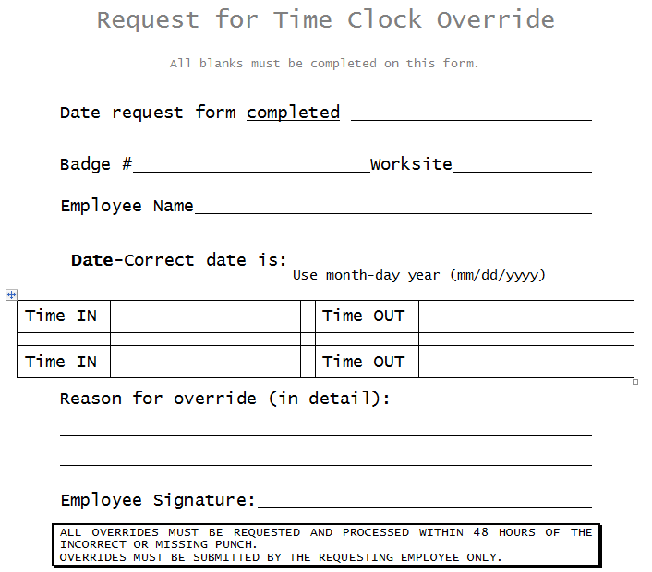
Summary of Payroll Procedures

Slide 11
Direct Deposit
Improved Security
No waiting in lines at the bank
Money available the morning of payday
Choose your own bank
  The first month a pre-note transaction test is performed and employee receives a check.
  The second month funds are direct deposit.
Notify Payroll Department immediately
  If you change banks and/or your account is closed.
  If your account number changes.
Notes:
Direct Deposit is required for all employees and is the most secure method of payroll delivery.
It is so important that you understand that if there is any change in your bank account you must notify the payroll department immediately.
We depend on you, the employee, to keep us up to date with your financial information.
Next slide.

Slide 12
Health Benefits - PEEHIP
Blue Cross/Blue Shield
  Basic Major Medical
  No Referrals
  Monthly Premium
    $ 30 Single
    $207 Family
    $307 Family/Spouse
VIVA Health Plan –HMO
  Major Medical
  Vision
  Dental
  H M O
  Monthly Premium
    $ 30 Single
    $207 Family
    $307 Family/Spouse
Notes:
PEEHIP is the acronym for Public Education Employees Health Insurance Plan.
PEEHIP has two options for hospital/medical coverage and hopefully you have taken some time to review your packet and have made your decision.
Each employee is eligible, on a voluntary basis, for certain types of health insurance. A full insurance allocation is available for each full time employee. Employees that work less than full time may be eligible for a portion of the insurance allocation & benefits available through PEEHIP.
If you have been hired for less than full time work, you will need to see me at the end of the meeting.
The state insurance allotment is $775 per month to assist in the purchase of such insurance.
The currently monthly premium for PEEHIP is $777 for single coverage and $909 for family coverage.
Your out-of-pocket expense is noted here… single coverage is $2 per month and family coverage is $134 per month.
Compared with the monthly premium for insurance coverage, the out-of-pocket rates are great.
Monthly premiums are payroll deducted.
Your first check, issued on September 28, will have a deduction for the premium that pays for the October coverage.
As new employees you can choose to have your insurance coverage begin during the month you officially start work, August 6th , or the first day of the following month, September 1st. Information on coverage prior to October 1st and payment of the premiums due was included in your packet.
Before you turn in your insurance enrollment or status change form please make sure that you have not overlooked the question regarding tobacco use for you and /or your spouse. This is required information.
If you don’t give an answer you will be charged a $22 tobacco surcharge per month in addition to any other premium that you pay for hospital/medical coverage. This amount will increase to $23 on October 1, 2008.
PEEHIP also offers insurance coverage for those who may be covered by hospital/medical insurance carried by their spouse.
Next slide.

Slide 13
Southland Insurance
Supplemental Coverage
Cancer Program $ 38 per month*
Dental Coverage $ 50 per month
Hospital Indemnity $ 38 per month*
Vision Coverage $ 38 per month*
  Purchase supplements additional @ $38/$50ea. / month
Notes:
These four plans
Cancer, Dental, Hospital Indemnity & Vision
are administered by Southland Insurance.
There are available alone or in addition to PEEHIP hospital/medical insurance coverage.
The premium for each plan is the same regardless of whether you select single or family coverage. The difference lies in the benefits paid.
Next slide.

Slide 14
TobaccoPremium
Active/Retired, LOA/Cobra, Surviving Dependent and Covered Spouses
  Member $50.00
  Spouse $50.00

Slide 15
Wellness Premium
Active/Retired, LOA/Cobra, Surviving Dependent and Covered Spouses
  Member $50.00
  Spouse $50.00
  The wellness premium applies only to the Blue Cross Blue Shield Hospital Medical Group #14000 plan for non-Medicare eligible active and retired members, non-Medicare-eligible members on LOA or COBRA, and non-Medicare-eligible spouses on active or retired contracts. Refer to the Wellness Program section to learn how you and/or your spouse can receive a wellness premium waiver.

Slide 16
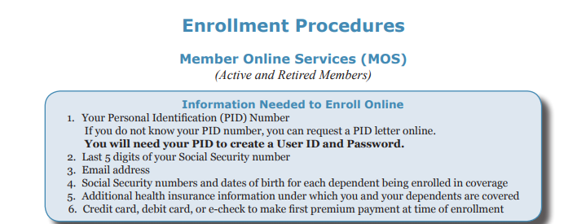
Health Benefits - PEEHIP

Slide 17
PEEHIP Insurance Allocations
“3 – 1” Rule
An employee will earn one additional insurance allocation for every three months the employee has worked at least one half of the work days in the months worked.
  Work nine months and receive three summer allocation.
  Employees working less than nine months will not earn all months and will owe an additional amount for insurance.
Notes:
The 3-1 rule is used to determine how much insurance coverage an employee earns for the summer months following the school year worked.
In the case of a nine-month employee here today this would be June, July & August of 2011.
If you work September, October & November, you earn the June 2008 insurance allocation.
December, January & February earns the July 2008 allocation.
March, April & May earns the August 2008 allocation.
Next slide.

Slide 18
Life Insurance
Group Life Insurance
  Provided at no cost to employees
        Teachers - $25,000
Support Staff - $10,000
Notes:
Group life insurance is effective on the first day you work. The board of education pays the premium for this coverage.
If you are interested in additional life insurance for yourself or your dependents, you will want to visit with some of the vendors at Institute on August 12th.
Next slide.

Slide 19
Life Insurance
Other Death Benefits - These are provided through the Teacher Retirement Program and depend on years of service and age. For example persons under 60 years of age with from 1 to 25 years of service will receive death benefits consisting of their total retirement contributions and total earned interest plus an amount equal to the previous year's salary.
-
Notes:
You are also provided death benefits through the TRS. Normally depending on years of service and age your beneficiary will receive benefits consisting of their total retirement contributions plus interest and an amount equal to the previous year’s salary.

Slide 20
Professional liability
The Board of Education protects every professional staff member by providing a blanket liability policy which covers up to $5,000,000.

Slide 21
Retirement
Teachers’ Retirement System – Tier 1
  10 years service – retire at age sixty
  25 years service – retire at any age
  After just 10 years of service you become “vested” in the Teacher’s Retirement System. Sick leave can be used to determine years of creditable service for retirement purposes.
Notes:
As you saw previously, your retirement account with the Teachers’ Retirement System will grow rapidly since contributions are withheld from your salary and the board of education adds a substantial amount to go along with your contribution.
After just 10 years you become ‘vested’ in the Teachers’ Retirement System.
At that time you are eligible to receive retirement benefits at age sixty.
And 25 years will quickly pass. Some of you will be quite young and eligible for a nice retirement benefit well before age sixty.
If you terminate employment you will have the option to withdraw your contributions from the retirement system.
Doing so will zero out all service credit for your account.
If you decide to withdraw your contributions before ten years have passed, you will only receive the contributions that were withheld from your salary, less taxes. You are not eligible nor entitled to any contributions made by the board of education unless you have more than ten years of service.
Next slide.

Slide 22
Retirement
Teachers’ Retirement System – Tier 2
  10 years service – retire at age sixty-two
  30 years service – retire at any age
  After just 10 years of service you become “vested” in the Teacher’s Retirement System. Tier 2 employees cannot use accumulated sick leave in determining their amount of creditable service.

Slide 23
Retirement
  If you terminate employment you will have the option to withdraw your contributions from the retirement system. Doing so will zero out all service credit for your account.
If you decide to withdraw your contributions before tens years have passed, you will only receive the contributions that were withheld from your salary, less taxes. You are not eligible or entitled to any contributions made by the board of education unless you have more than ten years of service.

Slide 24
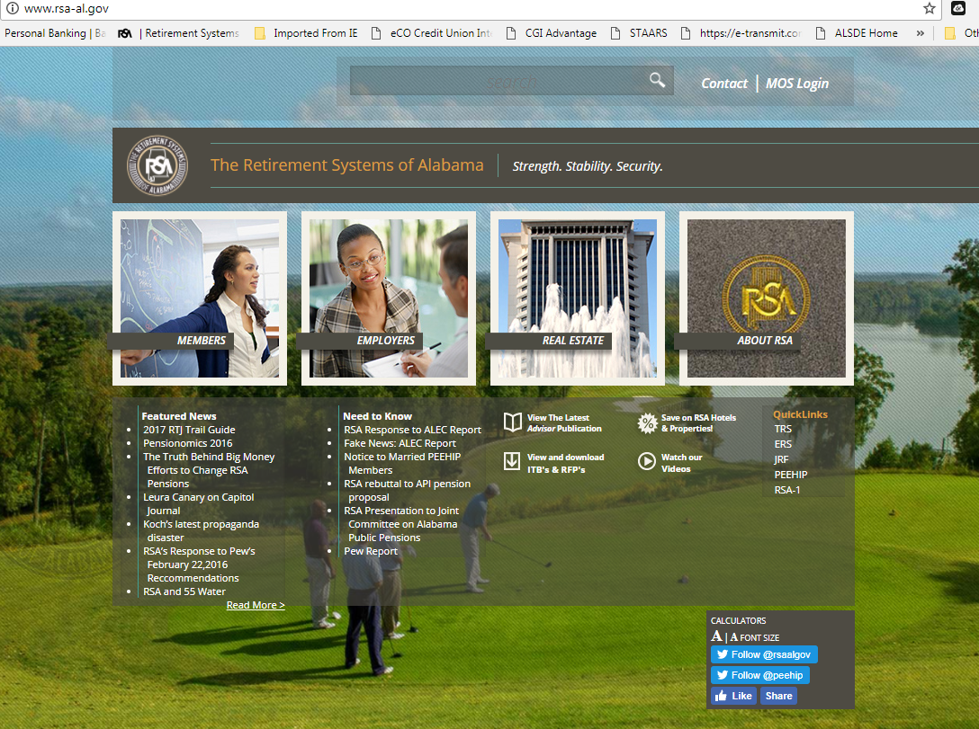
http:/www.rsa-al.gov/PEEHIP/peehip.html

Slide 25
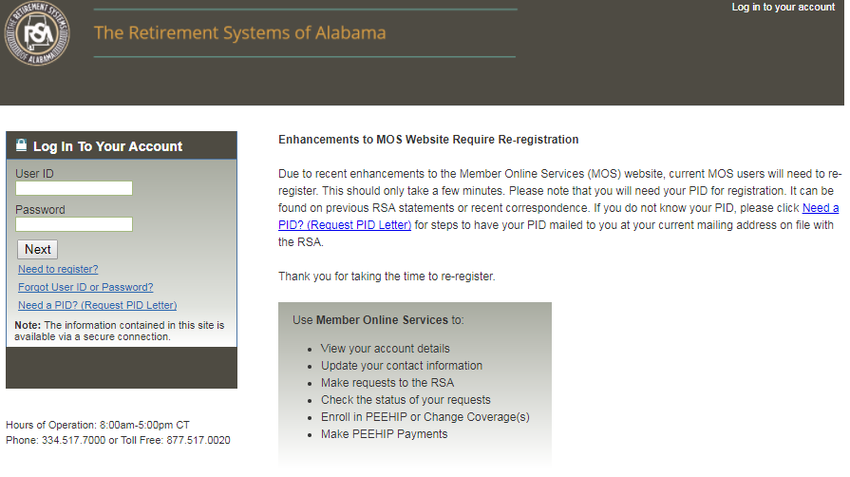
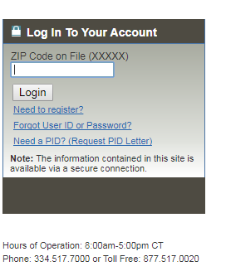

Slide 26
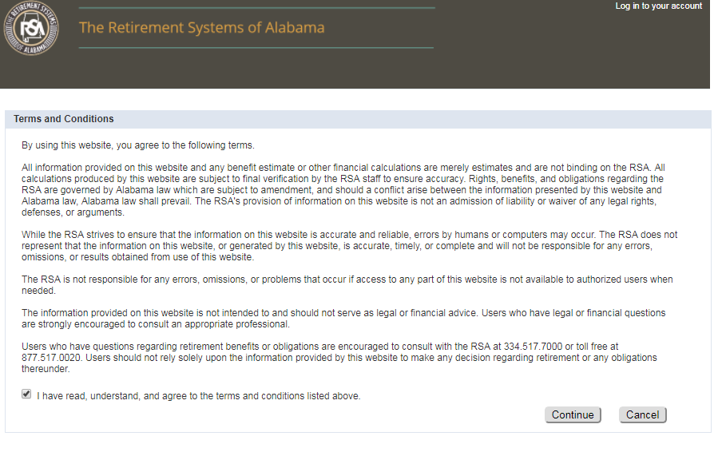

Slide 27
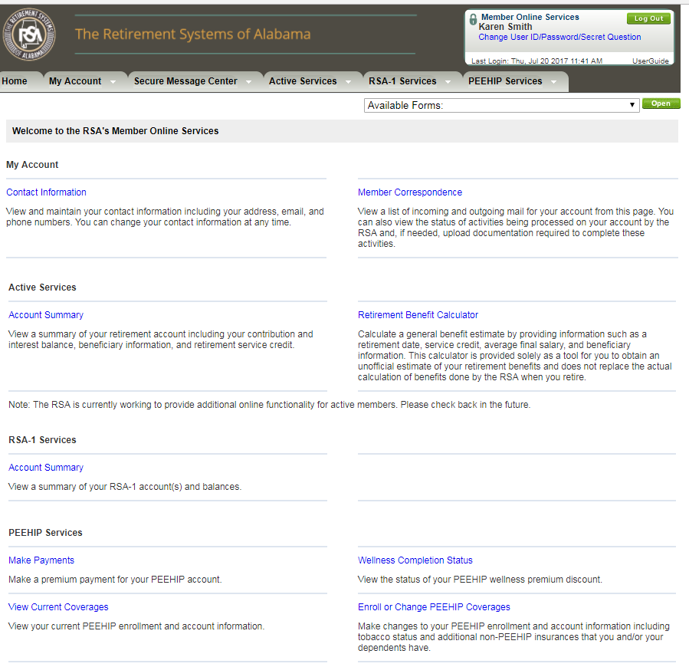

Slide 28
Types of Leave
Professional Leave
  Coordinate with the school principal
Jury Duty
  Coordinate with the school principal
  Attendance certificate required
Maternity / Paternal / Medical Leave
  Notify school principal
  Notify Dr. Barlow, Dr. Cole & Ms. Parker
  FMLA eligible if employed / worked > 1260 hours
Notes:
Employees are required to complete a leave form anytime they are away from their job.
Get to know the bookkeeper at your school. She will be able to assist you with many questions regarding leave and the necessary steps you will need to take for payroll purposes.
Next slide.

Slide 29
Types of Leave
Vacation Leave
  12 month employees only
  10 years service or less earn 10 days / year
  11 years service or more earn 15 days / year
Personal Leave – all employees
  15 years service or less earn 3 days / year
  16 years service or more earn 4 days / year
  Balance not used in July converted to sick leave
Sick Leave – all employees
  Earned at one day per month contracted
Notes:
Vacation leave is only earned by employees working a 12-month contract.
All employees earn personal leave and you can see that years of service with the system is appreciated with additional benefits for both vacation and personal leave.
Personal leave can be used to increase the number of sick days you have by conversion of personal leave to sick leave. The balance of your personal leave days as of June 30 are converted to sick leave for you. This could mean up to 3 days per year for a new employee.
Next slide.

Slide 30
Importance of Sick Leave
Sick Leave may be accumulated and applied toward service credit at retirement for employees hired before 01/01/2013.
Sick Leave may be used when
  An employee is ill or has suffered bodily injury.
  A member of the employee’s immediate family is ill.
  A death has occurred in the employee’s immediate family.
Notes:
Sick Leave guidelines are set by the State Department of Education.
Employees earn sick leave based on the number of contract months worked.
Sick leave can be used for the following:
Personal Illness
Family Illness
Death in the Family
Your sick leave is one of the most valuable things you earn as an employee.
There are two reasons to guard your sick leave carefully.
First—things happen in life that we never expect and having adequate sick leave to cover an absence will help keep your paycheck coming in.
Second—when you are ready to retire, the sick leave balance that you have is converted to service credit.
This credit can be used to attain minimum service requirements for retirement or it may be added to total service credit if the minimum service has been attained.
For instance, if you have 187 sick leave days available when you are ready to retire you can add one year of service credit. So you could work for 24 years, use sick leave for service credit and attain the 25 years required for retirement.
Next slide.

Slide 31
Sick Leave Bank
Commit two (2) days to the bank to become a member.
Eligible to give or receive donations in case of catastrophic illness.
Borrow a maximum of fifteen (15) days against future days earned.
  An approved loan application is required.
  Submit loan request to Dr. Cole.
Notes:
Membership in the sick leave bank is strictly voluntary but enrollment is offered on a limited basis.
Date employed.
Open Enrollment.
When an employee is hired.
During the annual open enrollment.
Days borrowed from the sick leave bank must be repaid. If an employee terminates and days are owed to the SLB, the employee will be docked for each day outstanding.
Next slide.

Slide 32
On the Job Injury
Report immediately to your Supervisor
OJI report should be filled out within 24 hours
Report should be sent to the CO to the attention of Karen Lusk-Smith

Slide 33
Employee Assistance Program
The Employee Assistance Program
is a confidential assessment,
counseling, and referral service
provided free of charge to all employees
who may need help in the following areas.
Marital and family issues;
alcohol/drug-related issues;
stress related issues; emotional problems; financial difficulties; legal questions.
Notes:
Confidential counseling and referral service. Marital, family issues, alcohol/drug-related issues, stress issues, financial difficulties legal questions

Slide 34
Deferred Compensation Plans
403B - Under this plan, employees may contribute as much as $18,000 (2017) of pre-tax income to an annuity each year. The contribution is automatically deducted from their paychecks. By investing money in this way before taxes are paid, employees can reduce their current income tax burden. It is permissible to transfer accumulated funds, with no dollar limit, to other qualified IRA annuity plans.
Once such an investment is made, the interest or dividends earned are only taxed as funds are withdrawn. Since the withdrawals are usually made after retirement when the participant is likely to be in a lower tax bracket, less tax is paid and funds accumulate faster.
There are currently over 25 such investment options through four agencies: American Fidelity, NEA, VALIC, Lincoln Life.
Notes:
403B is an additional savings plan to prepare for retirement. Interest or dividends earned are only taxed as funds are withdrawn which hopefully would be when you are in a lower income tax bracket. By investing in a pre-tax plan you are reducing your current income tax burden. It is permissible to transfer funds to other qualified IRA annuity plans.

Slide 35
Deferred Compensation Plans
RSA-1 - Using this plan, employees may elect to delay receiving a portion of their salary (may not exceed--if more than one 457 plan, combined deferrals must not exceed--$18,000 or $24,000 for employees age 50 or over) until some later determined date, usually after retirement. The deferred income, which accumulates interest in a special fund, is not subject to federal income tax until distributed to the employee.
RSA-1 funds will be invested in the same type of investments and are subject to the same guidelines and limitations as applicable to investments made by the Teacher Retirement System.
Notes:
RSA-1 is a 457 plan that invest your funds in the same type investments made by the TRS for your retirement account. The limit is $16,500 or if you are over the age of 50 $22,00.00 per year.

Slide 36
Flex Plan
A cafeteria plan is a way to provide employees valuable benefits and tax savings.
Benefits under a café plan may include reimbursement of dependent care expenses
and medical expenses such as co-payments
and deductibles.
Also, very importantly, you always pay insurance premiums with pre-tax dollars.

Slide 37
Flex Plan
Mandatory flex plan
  Will always include insurance premiums
Voluntary flex plan
  Dependent care / child care plans
  Medical expense / reimbursement plans

Slide 38
Open Enrollment
Open Enrollment
  The open enrollment deadline for the Flexible Spending Accounts is September 30th, for an effective date of October 1st.
  Plan deductions start on the October payroll check. Deductions end with the September payroll check of the following year.
  All deductions are processed over 12 months.
Notes:
Open enrollment ends September 30th for an effective date of October 1st. All deductions are processed over 12 months.

Slide 39
Employee Self-Serve (ESS)
Mountain Brook Schools Home Page
 Finance
 Forms & Processes
ESS can be found on our website to provide valuable information on your personal earnings at any point in time. At the end of each month you will receive an e-mail notification of your monthly direct deposit receipt. This service will house your monthly earnings information as well as your W-2 statements for future reference.

Slide 40
ESS Features
Access ESS
Log in from work or your home computer.
Google Chrome (web browser of choice).
Other compatible web browsers.
      § Mozilla Firefox.
      § Internet Explorer Version 10 or 11 – earlier versions of IE are not compatible.

Slide 41
Employee Self-Serve (ESS)
Demographics
View name, address, phone number, and email information.
Request a change** of address, phone number, email information, etc.
A color copy of your new Social Security card must be provided before the change request will be approved.
You may use your school email, or your personal email account.
Tax Withholdings
View Federal and State Tax Withholding Status.
Request a change** for Federal and/or State Tax Withholding Status.
If making a change type your name exactly as it appears on the form. This will serve as your electronic signature.

Slide 42
Employee Self-Serve (ESS)
Direct Deposit (DD)
Request a change** for Direct Deposit.
DD change form and ‘void’ check should be submitted for new DD deductions.
Deductions
View current payroll deductions (no changes allowed at this time).
Leave
View Leave balances (as shown on your paycheck).
View detailed report of leave taken.

Slide 43
Employee Self-Serve (ESS)
Paychecks
View / Print paychecks.
Earnings & W2’s
View annual earnings summary (by calendar year)
View / Print W2’s
**Change requests will be acknowledged by an automatic email from ESS to the email account listed with ESS when the change request is received and again when the change request is approved.

Slide 44
Who do I call?
Contacts for the Accounting Office
Credit Cards
  Local School Bookkeeper or Joann Gates
Payroll & Benefits
  Rachel Parker, Payroll Specialist
  Brittany Hammonds, Assistant Payroll Specialist
Accounts Payable
  Tena Walker, CO AP/Technology
  Chelsey Coletti, CO AP/Inventory

Slide 45
Who do I call?
Contacts at the Board Office 871-4608
Not sure??
  Joann Gates, Accounting Specialist
General Concerns & Board Issues
  Karen Lusk-Smith, Chief Financial Officer
Contracts, Teacher Certificates & Transcripts
  Dr. Susan Cole, Director of Personnel Services
  Carol Hollis, Secretary to the Superintendent

Slide 46
Helpful Links
Alabama Board of Adjustments
  http://www.bdadj.alabama.gov/Default.aspx
Teachers' Retirement System (TRS)
  https://www.mtnbrook.k12.al.us/Page/5379
PEEHIP
  https://www.mtnbrook.k12.al.us/Page/5567
Employee Self Service (ESS)
  https://www.mtnbrook.k12.al.us/Page/5423
VIVA Health Plan
  800-294-7780
  http://www.vivahealth.com/
Southland National Insurance
  800-476-0677
  http://www.southlandbenefit.com/PEEHIP/PEEHIP.aspx
Social Security Administration
  http://www.ssa.gov/
BCBS-PEEHIP Quick Links
  800-327-3994
  https://www.bcbsal.org/peehip/

Slide 47
Questions
Karen Lusk-Smith
Chief School Financial Officer
205-871-4608

