Slide 1



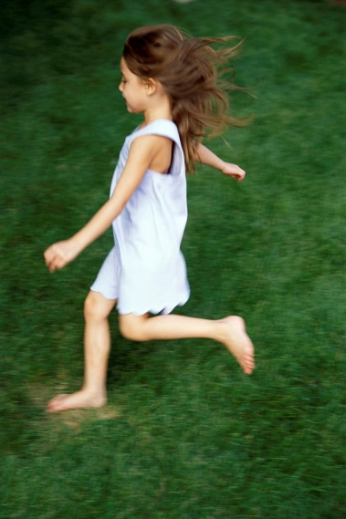

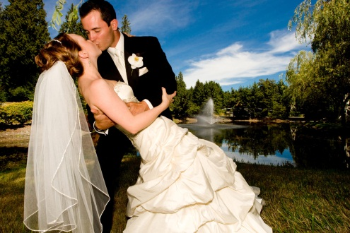


Simple Past of Verbs

Slide 2
Language Objective:
We will write complete sentences in the simple past verb tense in three forms:
declarative
negative
Interrogative.

Slide 3
Application (Why?)
We use the Simple Past to show actions that:
happened in the past.

Slide 4
Parts of Speech:
Verbs
Verb (ed)
modals: did

Slide 5
Formulas & Examples
Declarative +
Past:
Subject + verbed + finisher.
Example:
Last year, scientists discovered many new species of insects in the rainforest’s of Belize.

Slide 6
Negative -
Past:
Subject + did + not + verb + finisher.
Example:
For a long time, astronomers did not believe the earth revolved around the sun.

Slide 7
Interrogative ?
Past:
Did + subject + verb + finisher?
Example:
Did cartographers create new maps when Hawaii became a state?

Slide 8
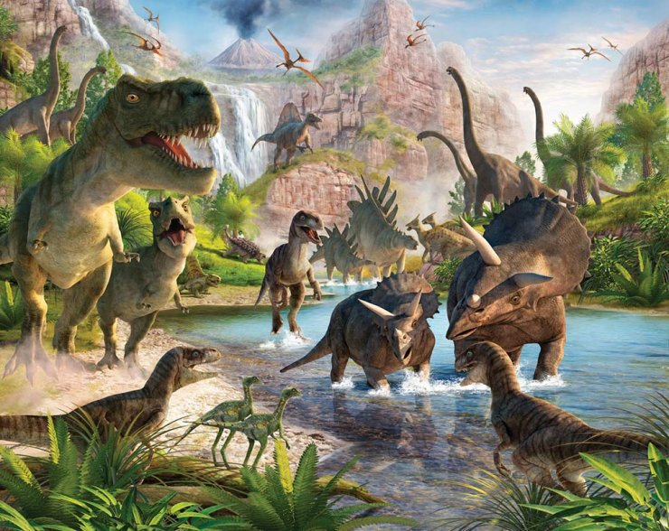

Slide 9
Subjects | Verbs (infinitive form)
Singular Plural

Slide 10
Example Sentences
Declarative
Negative
Interrogative

Slide 11
Irregular Past Tense Verbs
Language Objective:
We will complete sentences using irregular past tense verbs in three forms:
  -declarative,
  -negative,
  -interrogative.

Slide 12
Parts of Speech:
Verbs
Irregular Verbs
do not take –ed in the past tense.
-ed

Slide 13
Application (Why?)
We add –ed to most verbs to show the past tense, but we don’t add –ed to irregular past tense verbs. They have special endings or don’t change at all.

Slide 14
Formulas & Examples
Declarative +
Past:
Subject + irregular verb + finisher.
Example:
As soon as she got home, the teenager ran outside, dove into the pool and then swam from one end to the other.
I _____________ loudly in the restaurant when I ___________ the waitress my order since it __________ so loud .

Slide 15
Negative -
Past:
Subject + did + not + base verb + finisher
Example:
I did not speak for two days when I had laryngitis.
Yesterday, the coach ___________ __________ _________ enough soccer balls to practice.

Slide 16
Interrogative ?
Past:
Did + subject + base verb + finisher?
Example:
Did the toddler really sleep, or did she just shut her eyes?
______ the football team really ______ to Chandler High School?

