Slide 1

Parent University
2021

Slide 2
BJHS Counseling Center Staff
School Counselors
Mr. Johnny Fowler A-Go jfowler@madisoncity.k12.al.us
Ms. Demarius Anderson Gr-O danderson@madisoncity.k12.al.us
Mr. Cedric J. Delbridge P - Z cjdelbridge@madisoncity.k12.al.us
College & Career Counselor
Dr. Stephanie Bostick scbostick@madisoncity.k12.al.us

Slide 3
What is a Kuder account and why does my child have one?

Slide 4
Four Year Plans
The Alabama Dept. of Education requires that students create a 4 year plan by 9th grade using the Alabama Career Planning System. This is done through their Kuder account.
Notes:
Click on kuder website. Show Will’s plan and homepage with ACT Prep online and curriculum catalog.

Slide 5
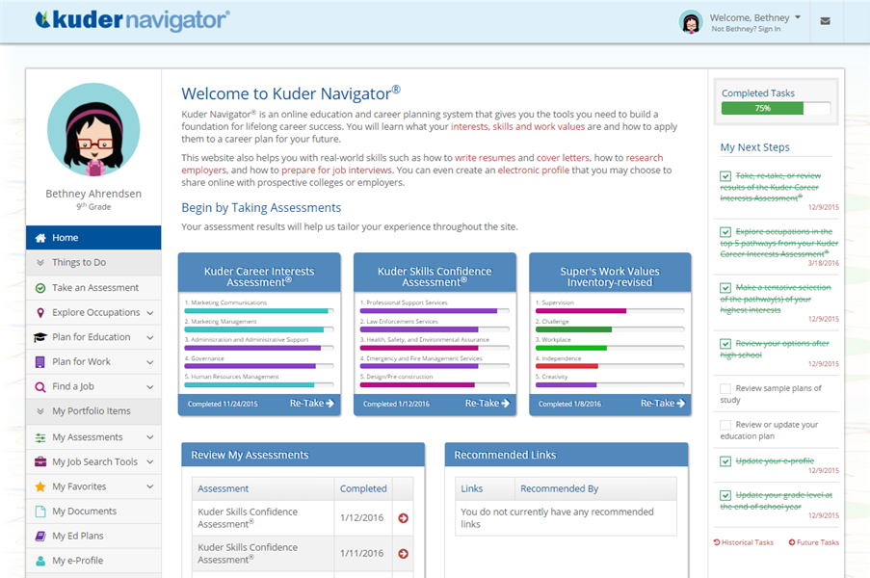

Slide 6
Scheduling Options
Dual Enrollment
Co-Op
Mid-Year Completion

Slide 7
Scheduling Options
Dual Enrollment (Must complete MCS Agreement)
University of Alabama at Huntsville
Calhoun Community College
Drake State Community College
May take up to two blocks each semester. Courses must be on the approved Madison City Schools list. Requirements include an ACT of 20, 3.0 GPA, pay tuition and own transportation.

Slide 8
Scheduling Options
CO-OP
Must work 8 hours for one block (1 credit), 16 hours for two blocks (2 credits).
Must have a job before the semester begins.
May take up to 2 blocks of COOP each semester.

Slide 9
Scheduling Options
Mid-Year Completion (Must complete the mid-year agreement)
Students may mid-year complete in December if they have met all of the requirements for graduation.
They will officially graduate in May and can attend prom but will not attend classes for the spring semester.
Parents & students must complete and sign the mid-year agreement.
Students will have to make sure they have met the College and Career Readiness Indicator
*Please note: Students will not receive FAFSA funds for January classes, and it may affect freshman scholarships. Be sure to check with the college.

Slide 10
College and Career Readiness Indicators (CCRI’s)
The state department requires students to meet their CCRI by ONE of the following:
Benchmarking on ONE of the parts on the ACT (English 18, Math 22, Reading 22, Science 23
Receiving an AP Exam Qualifying Score
Receiving a Dual Enrollment Credit
Benchmarking on the WorkKeys Test (4 or higher)
Enlisting in the Military
Receiving a Career and Technical Credential/Certification

Slide 11
#RegistrationReady
Important Dates:
March 29 Registration Packets during Advisory
Mar 29-April 16 20 Min Appointments Scheduled with the Counselors
April 5 Patriot Expedition for Rising Freshmen (virtual)
BJHS Curriculum Night (On website)
April 12-16 BJHS students enter requests in INOW
April 16 All registration materials should be turned in, requests
entered and final schedule request changes made.

Slide 12
New Course Offerings for 2021-2022
JROTC Drill and Ceremonies Leadership App
Open to
This course is designed to further develop the leadership skills required to successfully direct and move unit formations. Fundamental skills include command and control techniques, team building, and problem solving.

Slide 13
New Course Offerings for 2021-2022
Medical Academy Seminar
18 weeks/Honors Credit
Pre-req: Human Body System or Medical Interventions
This is hands-on lab will allow students time to practice and demonstrate mastery of health science skills that will prepare them for either immediate work in a healthcare field or entrance into a healthcare post-secondary program. During this lab course, students will also have the opportunity to earn an EKG credential and/or a CCMA (Certified Clinical Medical Assistant) credential.

Slide 14
New Course Offerings for 2021-2022
Drill and Ceremonies Leadership App
18 weeks
Pre-req: Must have 1 semester of JROTC, and must be taken in tandem with another JROTC course
The Drill and Ceremonies course concentrates on the elements of military drill, and describes individual and group precision movements, procedures for saluting, drill, ceremonies, reviews, parades, and development of command voice. Students are provided detailed instruction on ceremonial performances and protocol for civilian and military events and have the opportunity to personally learn Air Force drill concepts and procedures.

Slide 15
High School Math Transition Plan
All courses taken in 2020-2021 will be accepted after the implementation.
Current Year
Algebra for Mastery (A/B)
Taken by incoming 9th graders
Geometry
Algebra II w/Trigonometry
Transition Year
Algebra I with Probability**
Taken by incoming 9th graders (except those who took Algebra I in middle school)
Geometry with Data Analysis**
Taken by all 10th graders
Applications of Finite Mathematics**
Mathematical Modeling**
Algebra B - offered for those requiring it from the previous year.
Implementation Year
Geometry with Data Analysis**
Taken by incoming 9th graders (except those who took Geometry in 8th grade)
Algebra I with Probability**
Taken by all 10th graders (except those who completed Algebra I in 8th grade)
Algebra II with Statistics**
Precalculus*
2019-20
2020-21
2021-22
Students completing and showing adequate progress in 7th Grade Accelerated, 8th Grade Accelerated, and Geometry with Data Analysis may move directly to Algebra II with Statistics.
A/B options are not included in the new COS (i.e. Geometry A/B). The new COS supports struggling students through concurrent math lab courses.
*New course of study
**New courses

Slide 16
