Slide 1

Stakeholder Orientation
2020-2021

Slide 2
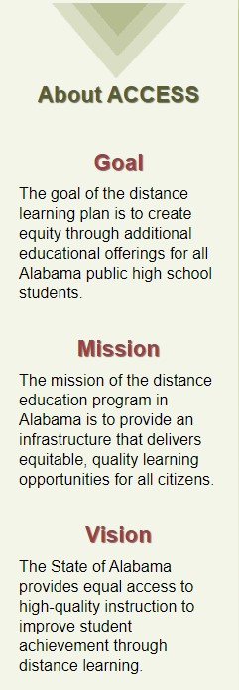

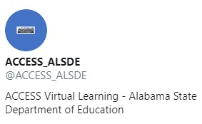

What is ACCESS?
A labama
C onnecting
C lassrooms
E ducators &
S tudents
S tatewide
Notes:
ACCESS stands for Alabama Connecting Classrooms, Educators, & Students Statewide. It is a statewide initiative for students in Grades 7-12 that is designed to provide students with equitable, educational opportunities regardless of the zip code. ACCESS is virtual learning at its best. You can follow ACCESS on Twitter and Facebook.

Slide 3
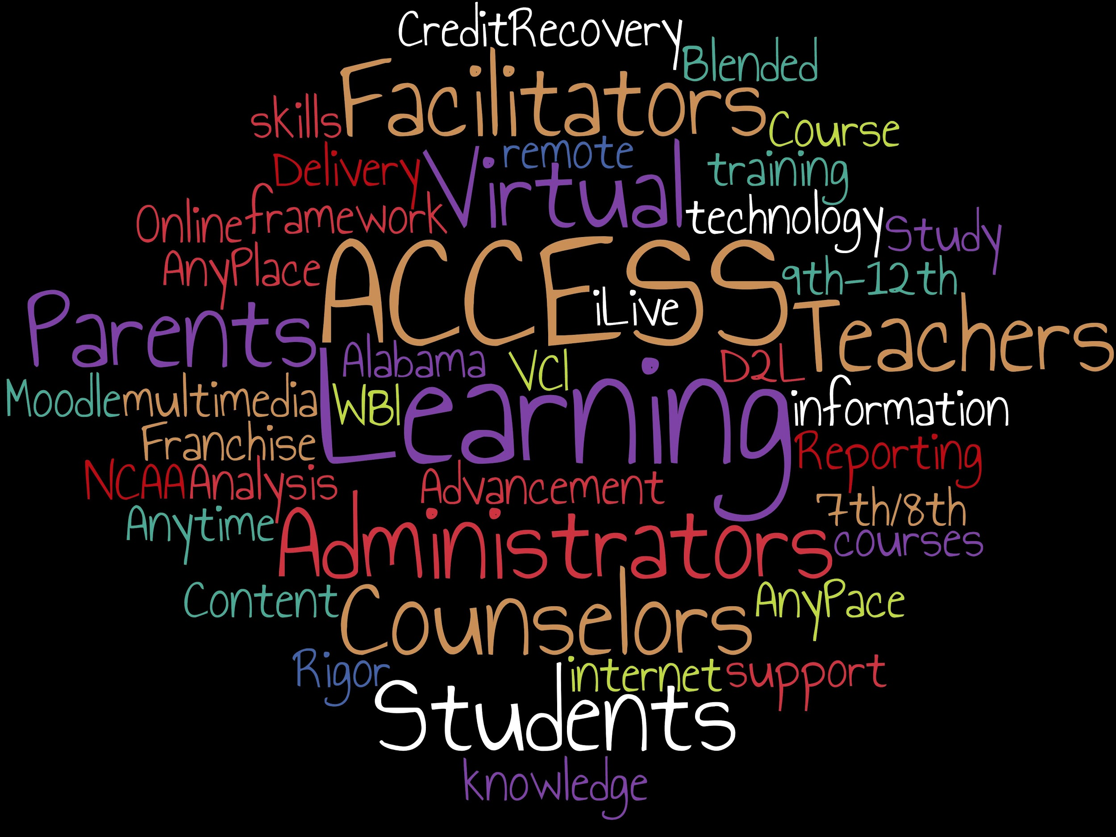
What is Virtual Learning?
What is Virtual Learning?
Notes:
ACCESS is virtual learning. So, what exactly does that mean? Michael Van Beek explains virtual learning best. According to his definition, “virtual learning uses computer software, the Internet, or both to deliver instruction to students. [It] minimizes or eliminates the need for teachers and students to share [brick and mortar] classrooms.”
We all received a taste of virtual learning during the COVID-19 pandemic. The main difference between ACCESS and the situations experienced by many others during that time is that ACCESS has 14 years of experience offering classes online. Many others were thrown into a situation with little or no preparation. Also, just because an assignment or content is put online does not mean that will be effective. ACCESS is strategically designed to maximize student learning and success and is based on best practices for high quality online instruction.

Slide 4
So, how is ACCESS different?
Certified Alabama Online Teachers
Facilitator
Minimal “Busy Work”
Designed in Alabama for Alabama Students
Similar to Online College Courses
Provides Equity
Notes:
Students work with a certified and trained online instructor. ACCESS teachers are trained. They are also required to continue their professional learning and growth in best practices for online instruction.
Students are assigned a facilitator. This person works closely and directly with the student to make sure that work is submitted and that pacing is being followed. So, students are provided with support from two professionals to be successful in ACCESS.
There is no “busy work.” Just because an assignment is placed online does not mean that it is rigorous, aligned to the content standard, or effective. Each assignment is reviewed by educational instructional specialists and designed to help a student master the instructional objective.
The entire course is strategically designed to be rigorous and aligned to the standards.
ACCESS is very similar to the design of many online college courses.
ACCESS levels the playing field by providing continuity of instruction across the state. High quality instruction by certified teachers can be received regardless of the location. Ex: Mandarin Chinese

Slide 5


Why Take An ACCESS Course?
Schools use ACCESS Courses for:
Advanced Placement
Scheduling Conflicts
Transfer Students
Missed Credits
Credit Advancement
Credit Recovery
Gateway to Dual Enrollment/College Courses
Improving Technology
Virtual Students
Optional format from Traditional F2F Classes
Notes:
There are many reasons why a student should consider taking an ACCESS course. Courses and classes should be considered as items on the “educational menu”. ACCESS, or virtual learning, is one of the many options available to students. So, if you as a parent ask, “Can my child take French?” The answer is “Yes, absolutely. The format will be online through ACCESS.” Also, our students are digital natives who often prefer to take classes online because of the motto “Any Time, Any Place, Any Person, Any Pace”.

Slide 6
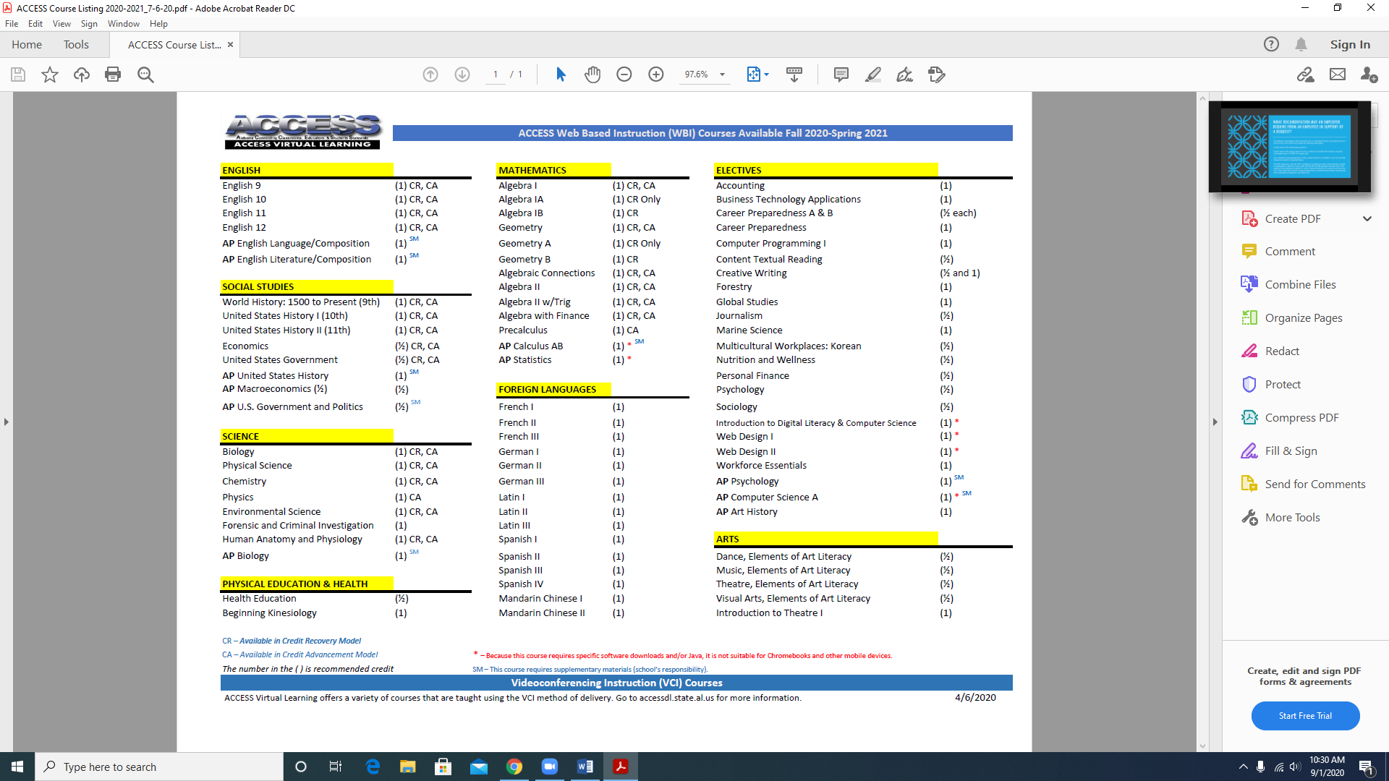
Notes:
As you can see on the next two slides, ACCESS offers over 100 total courses—including 11 advanced placement courses. These AP ACCESS courses play a major role in the state of Alabama being ranked number one for Advanced Placement Progress and increased AP test scores. ACCESS also allows students in military families and others who transition between schools to earn or transfer credits with minimal interruption. It is also important to know that over 50 ACCESS courses are approved and recognized by the NCAA for eligibility purposes. All of these courses are developed and aligned to Alabama standards by a team of course development specialists which include some of the best and most talented educators in Alabama.

Slide 7
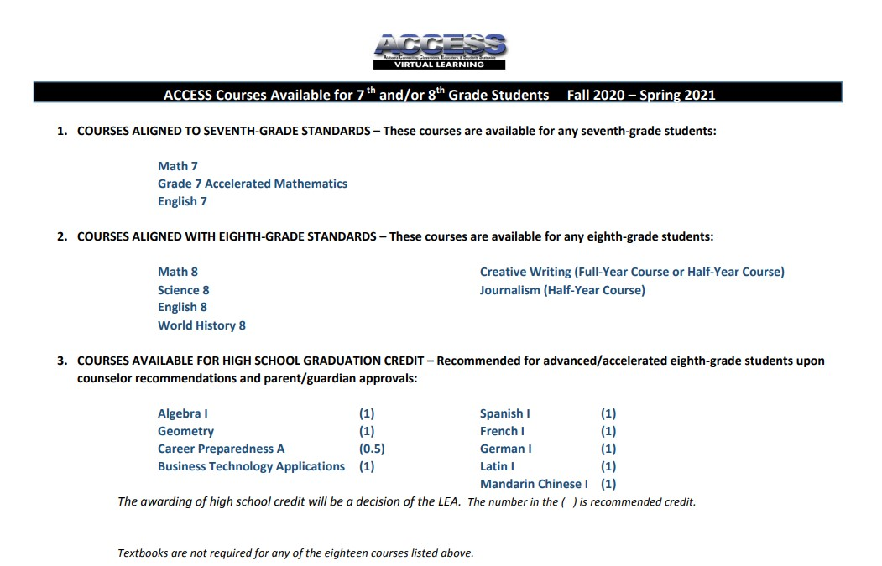
Notes:
We have ACCESS classes for middle school students, too. As a matter of fact, advanced eighth grade students can actually earn high school credits using ACCESS. For the 2020-21 school year, 7th grade Accelerated Mathematics has been added to the list.

Slide 8


My student is enrolled in ACCESS. Now what?
PARENTS/Guardians are our partners!
We must work together to help ensure student success!
Notes:
Just like with any other aspect of education, your role as a partner is necessary in order to maximize your child’s success in the virtual learning environment. Let’s take a brief look at how you can help navigate your child’s ACCESS virtual learning experience using “PARENT” as an acronym.

Slide 9

PARENT = Proactive
Check your child’s grades and read through teacher feedback weekly.
Notes:
“P”--Parents, you must be PROACTIVE. Many of you check grades online for traditional classes. ACCESS is no different. Being proactive helps your child stay on pace for completing activities. The biggest issue most students face with virtual learning is the tendency of procrastination. Because so many deadlines have flexibility, students wait to do assignments which causes them to get too far behind to ever catch up and be successful. By checking your student’s grades, not just asking how they are doing, but looking at the grades and feedback yourself, you will be taking a proactive approach that will help to ensure your child’s success in the class.

Slide 10
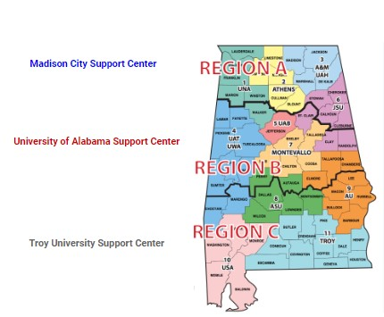
PARENT = Assured
There are three support centers to help all stakeholders!
Notes:
“A” is for “assured”. Rest assured that help and support is everywhere. In addition to the facilitator and counselor, there are three support centers across the state to help everyone who is using ACCESS. They are just a call or email away. (Provide contact information for your specific support center.)

Slide 11
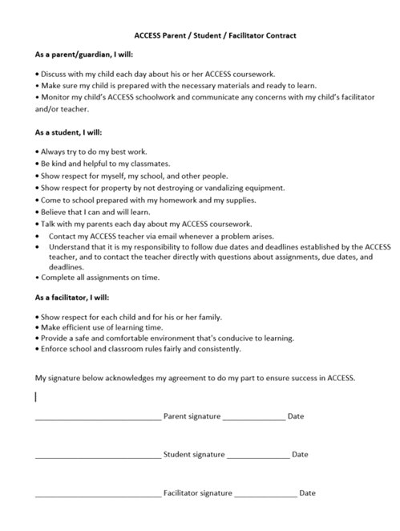
PARENT = Relationship
As a parent/guardian, I will:
Discuss with my child each day about his/her ACCESS coursework.
Make sure my child is prepared with the necessary materials to learn.
Monitor my child’s ACCESS schoolwork and communicate with the facilitator and/or teacher.
Notes:
The third letter, “R”, stands for “relationship”. Each team member (the student, parent, and facilitator) has to be committed to the process. As you can see from the contract, the majority of the responsibility lies with the student. ACCESS students have to be willing to do the work and complete the tasks. As a parent, there are three key responsibilities that we ask you to fulfill in order to make this a positive learning experience for your student. In my opinion, the most important being monitoring your child’s ACCESS work online. We will show you how to do this in a few minutes. You don’t have to know how to complete work online; you just have to require that your child shows you his/her grades, feedback, etc., weekly.

Slide 12

PARENT = Engaged
Log in to your student’s account EVERY WEEK to see what he or she is learning.
Notes:
Next, “E”--”ENGAGED”! High parental engagement often correlates with higher student success. Log in often but no less than once weekly. Check to see if your child is on pace. Has he/she turned in the required assignments by the due date? Look at grades, feedback, and news items. Talk with your student about what he/she is learning and if he/she is struggling with any content or assignments. Open dialogue and consistent accountability are keys to success for students.

Slide 13

PARENT = Nurturer
Provide students with an encouraging atmosphere at home where they can complete work if they get behind.
Slide Provided by
Traci Ferguson
UA Support Center
Notes:
“N” is for “Nurturer”. Talk with your student about what he/she is learning. Say things like “Tell me what you like about your ACCESS class. Tell me what you learned this week. What is the most difficult thing you are doing right now?”, etc. Open dialogue and consistent accountability are keys to success for students. Provide your child with opportunities at home to complete assignments, and encourage him/her to attempt all assignments to the best of his/her ability.

Slide 14

PARENT = Teammate
Together
Everyone
Achieves
More!
Communicate regularly with the facilitator or online teacher.
Support your child in their online class.
Monitor academic progress in D2L.
Slide Provided by
Traci Ferguson
UA Support Center
Notes:
Last, but not least, “T” is for “Teammate”. We are all on the same team. We all want to see your child succeed. Being a teammate with ACCESS will help to provide your child with the support he/she needs to do well in this virtual learning environment. We are looking forward to working with you!

Slide 15
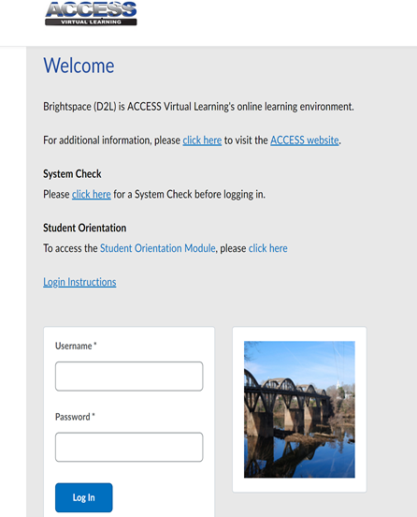
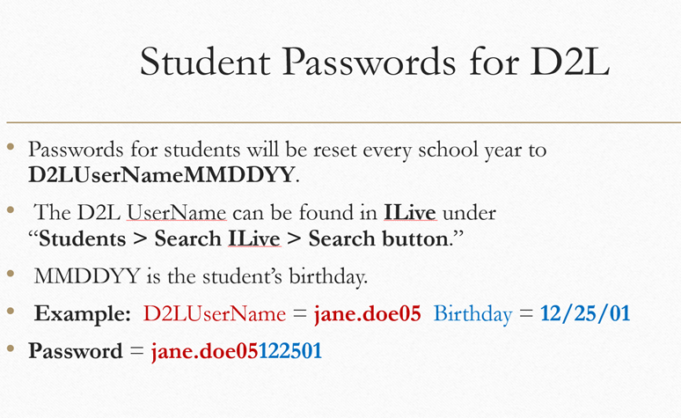
https://access.desire2learn.com/d2l/login
Slide Provided by
Traci Ferguson
UA Support Center
How do I get to my child’s course?
Notes:
Desire2Learn, or D2L, is the platform where you can locate your child’s ACCESS class. The URL is listed on the screen. Each student is provided with a unique username. Passwords are reset each school year to follow the format as indicated on the screen. (Provide a virtual tour of site if possible.)

Slide 16

ACCESS...Your Child’s Access to Virtual Learning!
It’s going to be a GREAT year!
Contact Information:
Notes:
ACCESS opens the door to educational possibilities for many students. It is another tool in our toolbox, another item on the educational menu so to speak, to help our students succeed. Thank you for being willing to partner with us to help your student be successful in this virtual learning environment. As always, please do not hesitate to reach out to us if you have questions or concerns. We are here to help you and all of our students!

