Slide 1


Welcome to 4th Grade at MBE!
Click HERE to hear a word from our awesome administrators…..

Slide 2
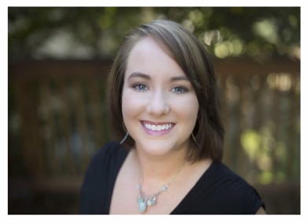
A message from our counselor…. Anna Carlisle
click here for video message

Slide 3
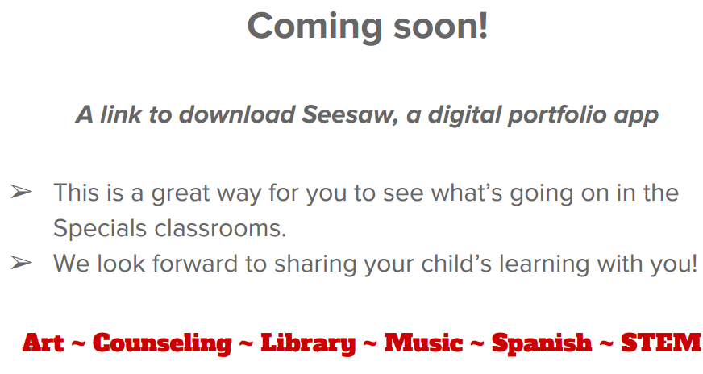
MBE Specials

Slide 4

Reading
Students will engage in a true reading workshop where they will actively choose the text they read (most of the time).
Skills and strategies will be taught during planned units through a mini-lesson and then students will apply them during their independent, partner, or small group reading time.
These skills and strategies will also be reemphasized during our class read aloud.
We use a variety of resources: Lucy Calkins Units of Study, Harcourt anthology, National Geographic Explorer, Comprehension Toolkit (nonfiction text), novels, Storyworks, Time for Kids, etc.

Slide 5
Reading continued…
Read nightly for 30 minutes. Students will log their reading at school, but not at home. In addition, students are expected to complete one reading response per week.
Students will set individual goals for reading a certain number of books per nine weeks.
Students should have a book at school at ALL times!
Students are encouraged to read a variety of genres.
Students will learn how to make “just right” book choices. We want to foster a love for reading!!

Slide 6
Grammar
We will teach grammar mini-units throughout the year using authentic writing from novels, student writing samples, etc.
Our grammar units include: capitalization, sentences (simple, compound, complex), punctuation, commas, semi-colon, ellipses, paragraphing, verb tenses, prepositions, and pronouns.

Slide 7
Grammar continued….
A short quiz will be given periodically that will assess your child’s knowledge and application of these skills. We will keep a grammar “Grammar Skills Notebook” where the students will write rules and examples for these skills.
Our goal is to teach the skills using authentic literature and hands-on activities so the students will be able to apply the rules in their writing.

Slide 8
Word Work
We will alternate spelling and vocabulary every two weeks.
Spelling words will be introduced on Monday. Words will be listed in the Weekly Newsletter.
Vocabulary words will be introduced throughout the two weeks and the definitions will be kept in the Word Work section of the binder.
During the spelling rotation, the test will be given each Friday. Vocabulary tests will be given at the end of the two weeks on Friday.

Slide 9

Writing
The students will write narrative, informational, and opinion pieces throughout the year.
Resources for teaching skills and strategies: Lucy Calkins book series, Write Traits series (traits of writing), etc.
My main goal is to improve the writer not the writing. We want to develop lifelong writers.
The class will participate in whole or small group mini-lessons determined by the common core standards and by the needs of the class.

Slide 10
Math
  Our adopted math program is Investigations; however we use many other supplemental materials to teach the common core standards.
Number Talks- This is a time when students will be able to strengthen their mental math strategies.
D.O.M. (Daily Oral Math)- Students will practice computation problems, word problems, and problems from “just taught” concepts; however these quizzes will be cumulative. A quiz will be given each week on Fridays.
  Mastery of multiplication facts is critical to success in 4th grade math. Please continue to work on these at home with your child.

Slide 11
Science
http://www.mtnbrook.k12.al.us/Page/13330
Students will complete projects and assignments from the following hands-on modules using STEMscopes curriculum:
Students progress will be evaluated throughout the study of each module.
We are currently planning field trips and guest speakers related to our units of study.
Physical Science Energy & Speed Energy & Electric Currents Energy & Collision Energy & Transformations Production of Heat Wavelength & Amplitude Information & Technologies Light Reflection | Earth Science Renewable & non-renewable resources Rock Patterns Soil Properties & Plant Survival Constructive & Destructive Forces Changing Land Plate Tectonics Natural Processes
Life Sciences Plant & Animal Studies Soil Properties & Plant Survival Body Systems Sense Receptors

Slide 12
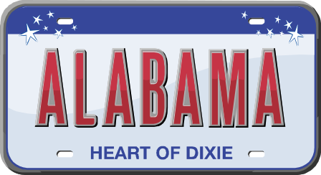
Alabama History
Our Alabama History textbook is Alabama: Our Beautiful Home, published by Clairmont Press.
Students will read and study the material in the textbook as well as from other sources such as Alabama Weekly.
Students will be assessed through small group and partner projects, student created Alabama books, and unit tests which may consist of essay, multiple choice, matching, and short answer questions.
Topics of study: Early People & Explorers, Statehood, the Civil War, Early 20th Century, and the Civil Rights Movement.
We will visit Montgomery in the Fall, which will spark much interest in our state’s past and present.

Slide 13

Intervention
We will meet with individuals or small groups based on specific needs from 12:05-12:35. Please keep this in mind as you schedule appointments.

Slide 14
Classroom Expectations
We believe all students are leaders; therefore we expect them to use the Seven Habits and take responsibility for their work and behavior.
To put it simply, students should
  Be Safe
  Be Respectful
  Be Responsible

Slide 15
Classroom Expectations
However, we understand that from time to time students do make bad choices. Therefore, the fourth grade team uses a clip chart to help students monitor their behavior. With this system, students have the opportunity to be recognized for demonstrating leadership, as well.
The first time a student clips down serves as a warning. Clipping down a second time will result in recess detention where he/she will reflect on their behavior by completing a Behavior Reflection Sheet. This sheet will be sent home for you to review, sign, and return the next day. Clipping down a third time or more will result in a parent contact and/or office referral.

Slide 16
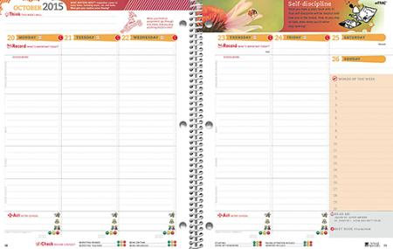
It’s time to pack up!
Agenda Books
Each day, students will record all homework assignments in his/her agenda book. Please review assignments to see that they are completed.
If there is a frequent problem with incomplete homework, the student must have a parent sign the agenda book each night.

Slide 17
School to Home Communication
In an effort to inform you of your child’s progress, graded work and other work samples will be sent home every Tuesday in the Graded Work Folder. It is important that you review these papers with your child and monitor corrections. A signature sheet will be stapled to the front and should be signed weekly.
Every Friday a newsletter will be sent home via email. Please be sure to read this newsletter, so you will know what is planned for the coming week. In addition, the newsletter will be linked on your child’s homeroom teacher’s page.
Please note each teacher has a class calendar to communicate test dates, projects, and other events! We cannot list field trips on the calendar; therefore, we will put field trip dates in the Weekly Newsletter.

Slide 18
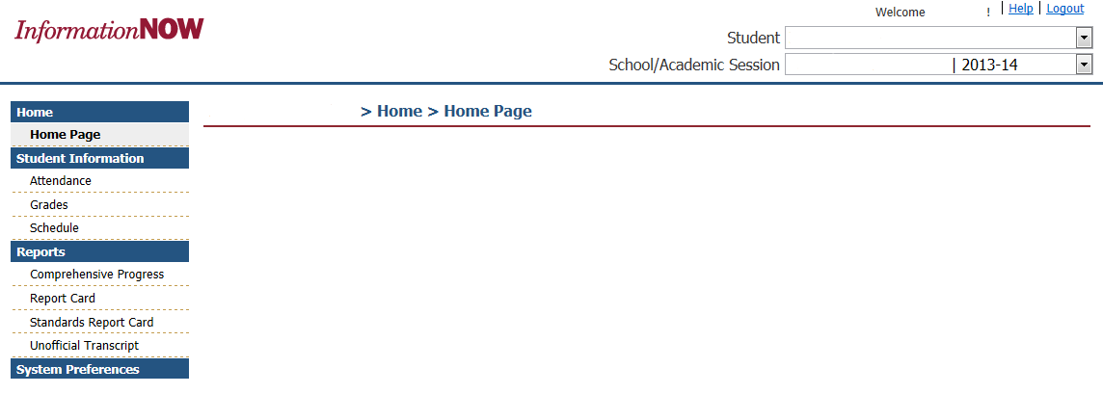
Reporting Progress in INOW
2016-17
Report Card
Grades 4 - 6
Standards Report Card
Kindergarten K–3 Grade 3

Slide 19
A word from our Room Moms

