Slide 1
Finding Money for College
Basics of Financial Aid and the FAFSA
Susan Bryant
Financial Aid Officer
Chattahoochee Valley Community College

Slide 2
We will talk about:
Federal student aid
State student aid
Student aid from colleges
Scholarships from other sources
Notes:
Here you can briefly state the main topics of the presentation.

Slide 3
We will answer:
What is financial aid?
Who can get it?
How much can I get?
How do I apply?
What happens next?
Where can I get more info?
Notes:
Here you can briefly list the questions that will be answered during the presentation.

Slide 4
What is financial aid?
Money to pay for college or career school
  Grants
  Loans
  Work-study
  Scholarships
Notes:
Financial aid is money for educational expenses for college or career school.
Grants do not have to be repaid (they are often called “gift aid”).
Loans have to be repaid with interest.
Work-study is money earned by the student at a job (often on campus) that helps the student pay his or her educational expenses. This money does not have to be repaid and is not taken into account in assessing a student’s eligibility for financial aid the following year.
Scholarships are funds that do not have to be repaid. Scholarships are usually based on academic merit but can be based on a student’s interests, hobbies, religion, ethnicity, and/or financial need.

Slide 5
Who can get federal student aid?
U.S. citizen or permanent resident
High school graduate/GED holder
Eligible degree/certificate program
Valid Social Security number
Males registered for Selective Service
Satisfactory academic progress in college/career school
Notes:
**This is not a comprehensive list of eligibility criteria for federal student aid. For complete details, visit www.ifap.ed.gov and go to the Student Eligibility chapter of the Federal Student Aid Handbook. (Students should refer StudentAid.gov/eligibility.)**

Slide 6
How much federal student aid can I get?
In general, depends on your financial need.
Financial need determined by Expected Family Contribution (EFC) and cost of attendance (COA)
EFC comes from what you report on FAFSA
COA is tuition, fees, room and board, transportation, etc.
COA – EFC = financial need
Notes:
EFC is determined by a formula that takes into account information such as the student’s and parents’ income and (often) their assets, how many people are in the family household, and how many of those people are in college. For a full explanation of the EFC formula, go to StudentAid.gov/resources#efc.
Financial need is determined by subtracting the EFC from the COA. Because COA differs from school to school, a student’s financial need will also differ from school to school.

Slide 7

Cost of Attendance (COA)
Tuition and fees
make up about one third of COA
Books and supplies
Room and board
Miscellaneous
Transportation
Notes:
Use specific school example

Slide 8
How much federal student aid can I get?
Basic amounts-dependent freshman in 2015-16:
Federal Pell Grant: $290-$5775
Direct Subsidized and Unsubsidized Loans: $5,500 total
Federal Work-Study: depends on funds available at school
Direct PLUS Loan (for parents): COA minus other aid received
Notes:
Federal work study is more for spending money.
PLUS loan students must also meet SAP

Slide 9
Other grant, scholarship, resources
Supplemental Educational Opportunity Grant $300-$1000 LIMITED
Alabama Student Assistance Program (also grant) $300-$1000 LIMITED
Academics, music, athletics, technical scholarships
Clubs, organizations or church
Business or workplace
Dependent of military-VA benefits
Notes:
Local resources for parent to investigate

Slide 10
How much federal student aid can I get?
For early estimate, use FAFSA4caster:
Go to www.fafsa4caster.ed.gov
Enter some financial information
Get an estimate
Also several schools will have estimate calculators on their website (i.e. Net Price Calculator)
Notes:
A student of any age can use FAFSA4caster.
Purpose of the tool is to provide early estimate of aid eligibility so the family can plan ahead.
FAFSA4caster asks for information such as earnings and taxes and then provides estimate of how much the student might get from the federal student aid programs.
Students and parents should remember that
FAFSA4caster is not the official federal aid application
FAFSA4caster provides information only about federal aid; students also should apply for state and institutional aid as well as private scholarships

Slide 11
How much state, school, and private scholarship money can I get?
Depends on the program; do your research!
Ask college financial aid offices for info about aid available at their schools
Free scholarship search at StudentAid.gov/scholarships
Research and APPLY!
Notes:
It’s important to research early so you don’t miss out on any aid.
Parent to parent tip: Authorization form signed by student for parent access.

Slide 12
How do I apply for aid?
Federal student aid: fill out Free Application for Federal Student Aid (FAFSASM) at www.fafsa.gov
School aid: contact financial aid offices at schools you are considering
Scholarships: visit scholarship website or call contact number for information
Notes:
Re the FAFSA, stress that it is a free application. If a student finds him or herself at a website that asks for payment, the student is not at the official U.S. Department of Education FAFSA site. There is no fee to file the FAFSA.
Note: the FAFSA is also available in paper form, but the online application is much quicker.

Slide 13
How do I apply for federal student aid?
Get a PIN at www.pin.ed.gov.
  Your parent might need a PIN too.
  Choose your own PIN or let the site choose one for you.
  Don’t tell anyone your PIN!
  Later this year, FSA ID will be implemented.
Notes:
Students and parents can get PINs at any time. The student does not have to be ready to fill out a FAFSA.
The benefit of a parent getting a PIN is that he or she, along with the student, will be able to sign the FAFSA electronically, thus speeding up the process greatly.
Important to note here that student and parent need separate PINs – one each.
FSA ID will be used same as PIN but for those with FAFSA already complete before implementation then no action will be needed.

Slide 14
How do I apply for federal student aid?
Gather the documents you need to apply.
  Find checklist at StudentAid.gov/resources#fafsa-documents
    Driver’s license, tax returns, etc.
  Optional: Use FAFSA on the Web Worksheet to prepare your answers. (Get the Worksheet at StudentAid.gov/resources#worksheet)
    Many schools will have these in financial aid office

Slide 15
How do I apply for federal student aid?
Fill out your FAFSA at www.fafsa.gov.
  Apply on or after January 1 but as early as possible to meet all deadlines.
  Need help? Use the help functions within the FAFSA (including live chat) or call 1-800-4-FED-AID.
  Don’t forget: watch for the confirmation page that says your FAFSA has been submitted. THEN log out.
Notes:
If the student and/or parents have not yet filed their tax returns, it’s okay for them to carefully estimate the amounts that will be on their tax forms and report the estimated amounts on the FAFSA. They will need to correct those amounts once they have filed their taxes.
Students need to understand that they have not finished with the FAFSA until they have submitted it and have a confirmation page on the screen.

Slide 16
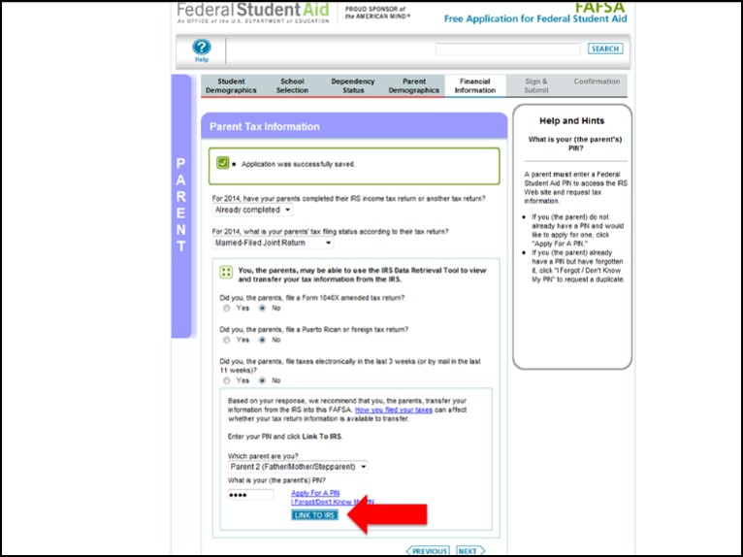
IRS Data Retrieval
Notes:
Easy to link

Slide 17
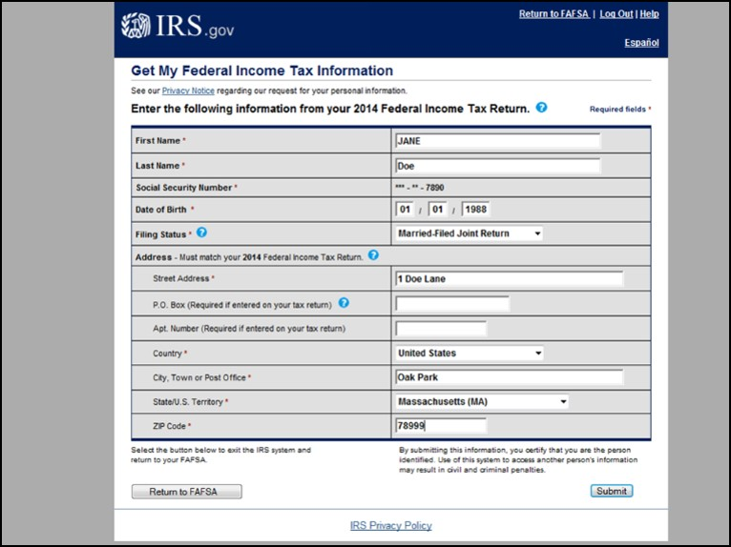
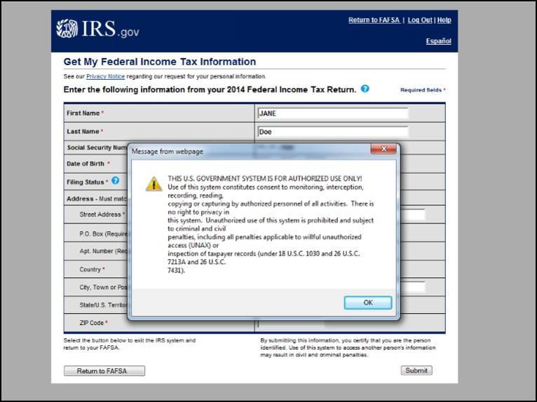
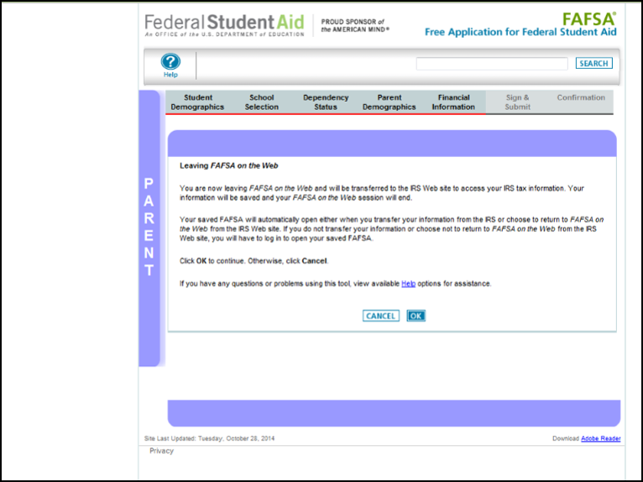
IRS Data Retrieval
Notes:
Use EXACT name and address
Do NOT change “Transferred from IRS” answers

Slide 18
How do I apply for federal student aid?
Watch for response by e-mail or by mail.
  Double-check that your info is correct by logging on at the FAFSA site and reviewing your data.
  Correct any mistakes and submit the corrected info.
  Complete the academic year student plans to attend.
  TIP: Submit admission application to each school
Notes:
The paper or online Student Aid Report (SAR) will list the student’s EFC and will show the information the student reported on the FAFSA. The student can review the FAFSA information online by logging in at www.fafsa.gov.
If the student estimated any tax or income information on the FAFSA, he or she should remember to correct that information once the taxes are filed. Many college financial aid administrators ask that the student contact them before making the corrections.
Corrections can be made on the paper SAR or online at www.fafsa.gov. Online corrections can be processed immediately in some cases. The student will then receive a new SAR, and the school will receive updated information.

Slide 19
How do I apply for federal student aid?
Watch for e-mails or letters from the schools you are considering.
  Give the schools any additional paperwork they ask for.
  Meet all deadlines or you could miss out on aid!
Notes:
Any schools that are listed on the student’s FAFSA and that have accepted the student’s application for admission will contact the student to offer an aid “package” (a list of aid the student is eligible for at that school).
A school might ask for additional paperwork, either to verify information on the FAFSA, or to submit an application for financial aid from the school’s funds.

Slide 20
What happens next?
Each school will tell you how much aid you can get at that school.
Once you decide which school to attend, keep in touch with the financial aid office to find out when and how you will get your aid.
Notes:
You might wish to point out to students that affordability is not the most important factor in choosing a school. Ideally, a student should find the school that will best suit his or her educational and training needs, as well as fitting his or her personality. If two or more schools are “tied,” then cost can be a determining factor.

Slide 21
Where can I get more info?
StudentAid.gov
  Info about aid programs
  Links to free scholarship and college searches
StudentLoans.gov
  Complete entrance counseling & MPN
  View disclosure statements and disbursements
College Navigator nces.ed.gov/collegenavigator
  Compare colleges
1-800-4-FED-AID
Notes:
Compare schools on College Navigator

Slide 22
Questions?
Discuss openly with your student college options
Notes:
College is an investment.

Slide 23
Thanks for coming
Contact information:
Chattahoochee Valley Community College
  Phone: (334) 291-4915
  E-mail: financial.aid@cv.edu

