Slide 1

Welcome to the 2014 RMS Baseball Season
Pre-Tryout Parent Meeting
3/10/14
Contact Information:
Seth Gardner: sgardner@readington.k12.nj.us
Phone: (908)534-2113x3401
Dave deVelder: DdeVelder@readington.k12.nj.us
Phone: (908)534-2113 x3420

Slide 2
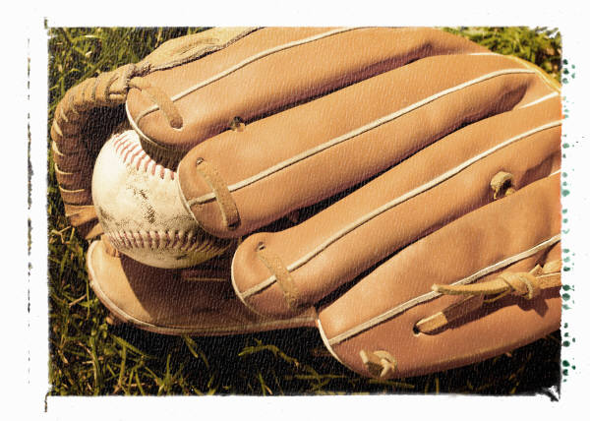
Agenda
Welcome/Introduction
Tryout Schedule
Medical Paperwork/Tryout Forms
Athletic Website
Appropriate Bats/Cleats
Storing of equipment
Questions?

Slide 3

Tryout Schedule
Pitchers and Catchers only in the New Gym from March 11th – 14th.
All other players begin tryouts on the 15th
Bring clothing to be ready to go outside for tryouts!
http://www.readington.k12.nj.us/page/541
  Inclement weather schedule
Please pick up your player by the Old Gym entrance when tryouts are over for the day.

Slide 4
After School
In the event that we have a late tryout/practice slot…
  All students must go home on the bus
  Please be back in the building no later than 4:10 to ensure that you are here on time.
  There is no Sports Homework room for Spring Sports
If you have extenuating circumstances and it is impossible to arrange a ride back for practice, please speak to the coach and we will work something out.

Slide 5
Medical Paperwork/Tryout Forms
All players must have the proper paperwork in order to tryout.
The forms can be found on the website here: http://www.readington.k12.nj.us/77220568312920/site/default.asp
In addition to the medical paperwork the player and the parent and athlete must sign the parent and athlete pledge.

Slide 6
Athletic Website
All changes to the tryout, practice, and game schedules can be found at this website.
http://www.readington.k12.nj.us/77220568312920/site/default.asp
You may sign up for automatic notifications through this website.
Parent/Student Handbook updates – pages 12 and 13

Slide 7
Appropriate Bats/Cleats
We will be using -3 BBCOR bats again this year.
NFHS Standard starting Jan. 1, 2012 — All players must swing bats that are BBCOR certified. BESR certified bats will no longer be used for high school play.
Composite-barreled bats, which were previously banned, will be allowed for play if they pass the BBCOR certification.
BBCOR stands for Batted Ball Coefficient of Restitution. This allows for a more accurate comparison between wood and non-wood bats.
Metal cleats are allowed for use in middle school play

Slide 8
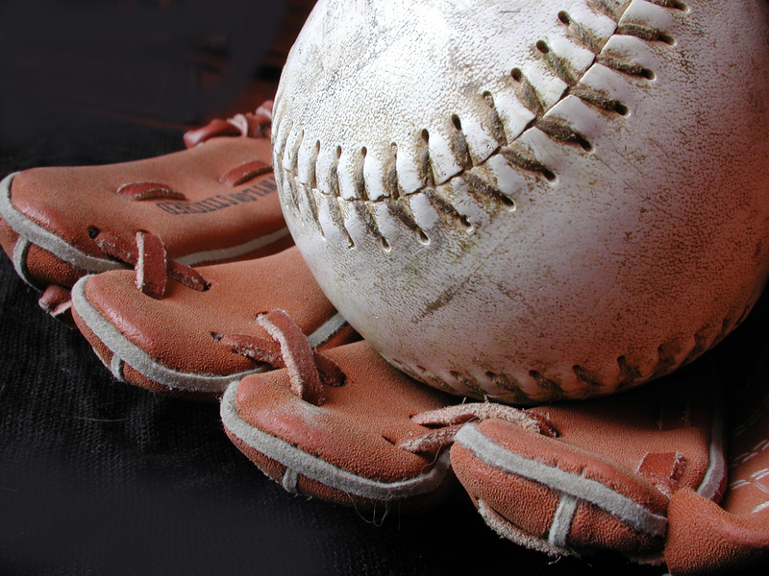
Storing of Equipment
All equipment must be stored in the New Gym boys locker room in the shower.
No equipment is allowed to be stored by reception or in teacher’s classrooms.

