Slide 1


Federal Transit Administration Requirements
Americans with Disabilities Act
Title VI
Drug and Alcohol Programs

Slide 2
Americans with Disabilities Act (ADA)
Basic Requirement:
Titles II and III of the Americans with Disabilities Act of 1990 (ADA) provide that no entity shall discriminate against an individual with a disability in connection with the provision of transportation service.

Slide 3
Americans with Disabilities Act (ADA)
Where deficiencies are found:
Vehicle accessibility violations
Facility accessibility standards deficiency
ADA service provision deficiencies
ADA maintenance deficiencies
Complementary paratransit service deficiencies

Slide 4
Americans with Disabilities Act (ADA)
The FTA Office of Civil Rights conducts on-site assessments of grantees’ compliance with ADA requirements for lift/ramp use and maintenance, stop announcements and route identification, ADA paratransit, and rail stations. The Office of Civil Rights also investigates complaints of noncompliance received from individuals who believe they have been subject to discrimination prohibited by the ADA. Both of these activities can result in findings requiring corrective actions on the part of the grantee, which are detailed in complaint resolution letters and compliance review findings transmitted to the grantee.

Slide 5
Americans with Disabilities Act (ADA)
Complaints/Lawsuits
Grantees are required to have an internal complaint review system, and to retain copies of complaints for at least one year and a summary of all complaints for at least five years. Complaints or legal actions may indicate a problem with implementation of the ADA requirements. Requiring subrecipients to notify the grantee of any complaints may be part of the grantee’s oversight program.

Slide 6
Americans with Disabilities Act (ADA)
Buses and Vans
49 CFR Part 37 includes specific requirements for the acquisition of accessible vehicles. 49 CFR Part 38 contains accessibility standards for transportation vehicles. States must ensure that subrecipients comply with the ADA requirements when acquiring vehicles and must ensure that subrecipients provide equivalent service when acquiring non-accessible vehicles for general public demand responsive service.

Slide 7
Americans with Disabilities Act (ADA)
Facilities
Any new facility to be used in providing public transportation services must be accessible according to the standards referenced in 49 CFR 37.9 and Subpart C to 49 CFR Part 37. Subrecipients must comply with ADA requirements when constructing or altering a facility. If there are parties other than the subrecipient responsible for portions of the facility, the subrecipient must ensure that they also comply with the ADA requirements.

Slide 8
Americans with Disabilities Act (ADA)
Subrecipient Oversight
Stop announcements and route identification
Transporting of wheelchairs
Priority seating.
Service to persons using respirators or portable oxygen.
Time for boarding/disembarking a vehicle.
Public information
Training.

Slide 9
Americans with Disabilities Act (ADA)
Complementary Paratransit
Each public entity operating a fixed route system must provide paratransit or other special service to individuals with disabilities that is comparable to the level of service provided to individuals without disabilities who use the fixed route system. This requirement also applies to all Section 5311 subrecipients of FTA funding, including those that are private nonprofit entities. The requirement to provide complementary paratransit service does not apply to intercity bus, commuter bus and rail, or university service.

Slide 10
Americans with Disabilities Act (ADA)
What are the subrecipient’s procedures for ensuring that the complementary paratransit service provided by subrecipients meets ADA requirements in the following areas:
• Eligibility determinations
• Service criteria
• Service capacity
• Origin-to-destination service
• Visitors’ service
• No-show policies

Slide 11
Title VI
Basic Requirement:
No person shall, on the grounds of race, color, or national origin, be excluded from participating in, or be denied benefits of, or be subject to discrimination under any program or activity receiving Federal financial assistance.

Slide 12
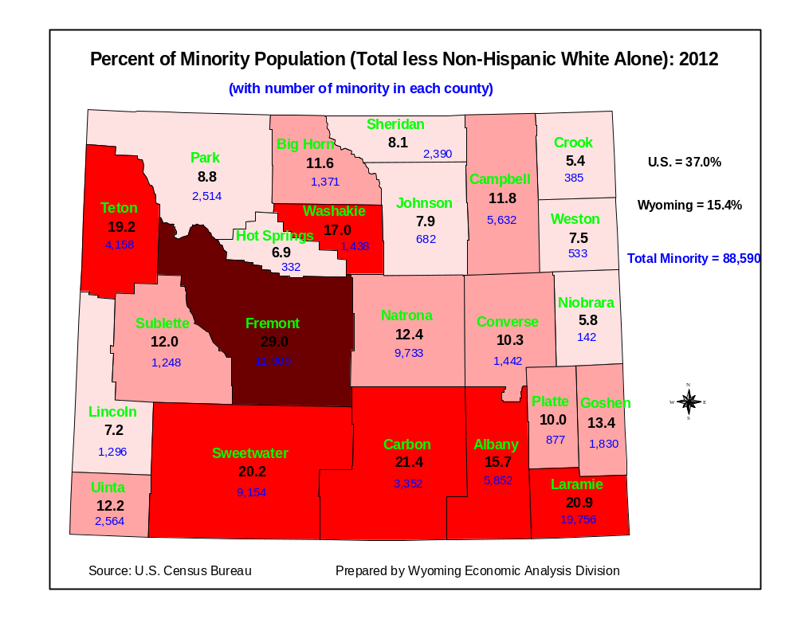
Title VI

Slide 13
Title VI
Where deficiencies are found:
Complaints not addressed properly
Lacking assessment for LEP
Public outreach deficiencies
No determination of site or location of facilities requirements

Slide 14
Title VI
Complaints
FTA requires its grantees to maintain, as part of their records, a description of the process that they use to investigate Title VI complaints filed against the agency. FTA C 4702.1B states that, “recipients and subrecipients shall develop procedures for investigating and tracking Title VI complaints filed against them and make their procedures for filing a complaint available to the public upon request.”
The process for filing a complaint should be easy to understand for the general public and not include unnecessary obstacles. The provider should have a system in place whereby it can identify which, if any, of its complaints have been filed because the complainant believes that he or she was denied the benefits of, excluded from participation in, or subject to discrimination on the grounds of race, color, or national origin under any program or activity offered by the state. Although the complainant may not refer to Title VI in the complaint to the state, the state should be able to identify and classify this type of complaint as a Title VI complaint.

Slide 15
Title VI
Title VI Language for Publications, Communications, and Public Involvement
English
Title VI Notice to Public
It is the Wyoming Department of Transportation's (WYDOT) policy to assure that no person shall, on the grounds of race, color, national origin or sex, as provided by Title VI of the Civil Rights Act of 1964, be excluded from participation in, be denied the benefits of, or be otherwise discriminated against under any of its federally funded programs and activities. Any person who believes his/her Title VI protection has been violated, may file a complaint with WYDOT's Office of Civil Rights. For additional information regarding Title VI complaint procedures and/or information regarding our non-discrimination obligations, please contact WYDOT’s Office of Civil Rights, Title VI Coordinator – Lisa Fresquez at 5300 Bishop Blvd. Cheyenne, WY 82009-3340 Phone: (307) 777-4268 FAX (307) 777-4765, Monday to Friday, 8:00 AM to 5:00 PM.

Slide 16
Title VI
Spanish
Notificación de Titulo VI al Público
Es la póliza de el Departamento de Transportación del Estado de Wyoming (WYDOT) de asegurar que ninguna persona sea excluida de participación o sea negado los beneficios, o sea discriminado bajo cualquiera de sus programas y actividades financiado con fondos federales sobre la base de raza, color, origen nacional o sexo, como proveído por el Título VI de el Acto de Derechos Civiles de 1964. Cualquier persona que cree que sus protecciones de Titulo VI han sido violadas, puede hacer una queja con la Oficina de Igualdad de Oportunidades (OEO). Para información adicional con respecto a procedimientos de quejas de Titulo VI y/o información con respecto a nuestras obligaciones sin discriminación, por favor de comunicarse con los Coordinador de Titulo VI de la WYDOT Oficina de Derechos Civiles – Lisa Fresquez 5300 Bishop Blvd. Cheyenne, WY 82009-3340 Telefono: (307) 777-4268
FAX (307) 777-4765, Lunes a Viernes, 8:00 AM a 5:00 PM.

Slide 17
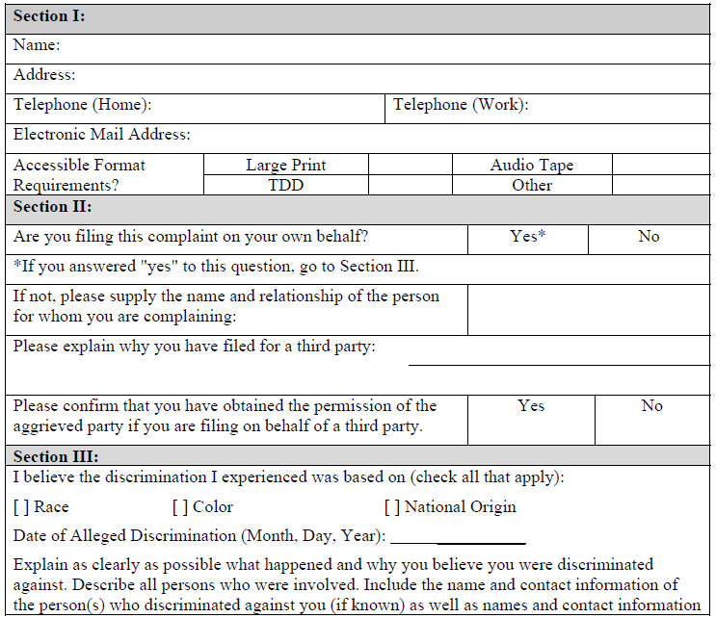
Title VI
SAMPLE TITLE VI COMPLAINT FORM

Slide 18
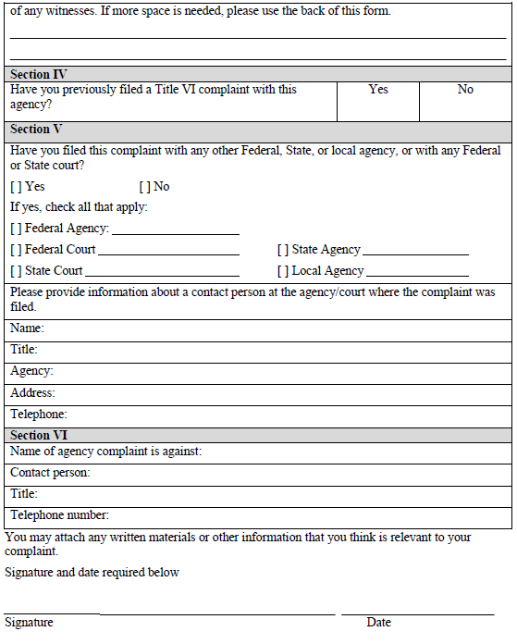
Title VI
SAMPLE TITLE VI COMPLAINT FORM

Slide 19
Title VI
Limited English Proficiency (LEP)
Individuals who have a limited ability to read, write, speak, or understand English are limited English proficient, or ‘‘LEP.” According to the 2000 U.S. Census, more than 10 million people reported that they do not speak English at all, or do not speak English well. The number of persons reporting that they do not speak English at all or do not speak English well grew by 65 percent from 1990 to 2000. Among limited English speakers, Spanish is the language most frequently spoken, followed by Chinese (Cantonese or Mandarin), Vietnamese, and Korean.

Slide 20
Title VI
Limited English Proficiency
Public transit is a key means of achieving mobility for many LEP persons. According to the 2000 Census, more than 11 percent of LEP persons aged 16 years and over reported use of public transit as their primary means of transportation to work, compared with about 4 percent of English speakers. Recent immigrants to the United States (including those persons who may not be limited English proficient) use public transportation at higher rates than native-born adults, however, transit use among recent arrivals decreases with length of residence in the United States.

Slide 21
Title VI
The U.S. DOT published revised LEP guidance for its recipients on December 14, 2005 (Federal Register, vol. 70, no. 239, pp. 74087–74100, December 14, 2005). FTA’s Circular 4702.1B states that grantees shall document the steps undertaken to implement the DOT LEP Guidance necessary to provide “meaningful access” on the basis of four factors:
• the number and proportion of LEP persons served or encountered in the eligible service population
• the frequency with which LEP individuals come into contact with the program
• the nature and importance to people’s lives of the program, activity, or service provided
• the resources available to the recipient for LEP outreach and the associated costs

Slide 22
Title VI
Grantees are required to ensure meaningful access to the LEP persons. A means to ensure meaningful access is to develop and carry out a Language Assistance Plan. FTA grantees must develop a Language Assistance Plan to ensure compliance with the requirement. Grantees have considerable flexibility in developing a plan, but at a minimum it must:
• Include the results of the four factor analysis, with a description of the LEP population(s) served
• Describe how it provides language assistance services by language
• Describe how LEP persons are notified about the availability of language assistance
• Describe how it monitors, evaluates and updates the language access plan, and
• Describe how it trains employees to provide timely and reasonable language assistance.
The program needs to be based on the results of the analysis of how the four factors apply to the grantee’s programs and activities. FTA will determine, at the time the grantee submits its Title VI program or subsequent to a complaint investigation or compliance review, whether a grantee’s plan is sufficient to ensure meaningful access and thus ensure that the grantee is not engaging in discrimination on the basis of national origin.

Slide 23
Title VI
Public Outreach
Subrecipients should seek out and consider the viewpoints of minority, low-income, and LEP populations in the course of conducting public outreach and involvement activities. An agency’s public participation strategy shall offer early and continuous opportunities for the public to be involved in the identification of social, economic, and environmental impacts of proposed transportation decisions.

Slide 24
Title VI
Some effective practices to promote inclusive public involvement include:
• Scheduling meetings at times and locations that are convenient and accessible for minority and LEP communities.
• Employing different meeting sizes and formats.
• Coordinating with community- and faith-based organizations, educational institutions, and other organizations to implement public engagement strategies that reach out specifically to members of affected minority and/or LEP communities.
• Considering radio, television, or newspaper ads on stations and in publications that serve LEP populations. Outreach to LEP populations could also include audio programming available on podcasts.
• Providing opportunities for public participation through means other than written communication, such as personal interviews or use of audio or video recording devices to capture oral comments.

Slide 25
Title VI
Location of facilities requirements
FTA C 4702.1B describes the requirements for complying with the regulations in 49 CFR Section 21.9(b)(3), which states, “In determining the site or location of facilities, a recipient or applicant may not make selections with the purpose or effect of excluding persons from, denying them the benefits of, or subjecting them to discrimination under any program to which this regulation applies, on the grounds of race, color, or national origin; or with the purpose or effect of defeating or substantially impairing the accomplishment of the objectives of the Act or this part.”
Grantees are required to complete a Title VI equity analysis during the planning stages with regard to where a project is located or sited to ensure the location is selected without regard to race, color, or national origin. Grantees must engage in outreach to persons potentially impacted by the siting of facilities. The Title VI equity analysis must compare the equity impacts of various siting alternatives, and the analysis must occur before the selection of the preferred site.

Slide 26
Title VI
When evaluating locations of facilities:
• Grantees should give attention to other facilities with similar impacts in the area to determine if any cumulative adverse impacts might result.
• Analysis should be done at the census tract or block group, where appropriate, to ensure that proper perspective is given to localized impacts.
• If the grantee determines that the location of the project will result in a disparate impact on the basis of race, color, or national origin, the grantee may only locate the project in that location if there is a substantial legitimate justification for locating the project there, and where there are no alternative locations that would have a less disparate impact on the basis of race, color, or national origin. The grantee must show how both elements are met. In order to make this showing, the grantee must consider and analyze alternatives to determine whether those alternatives would have less of a disparate impact on the basis of race, color, or national origin, and then implement the least discriminatory alternative.

Slide 27
Drug and Alcohol Programs
Basic Requirement:
Grantees receiving Section 5307, 5309 or 5311 funds that have safety-sensitive employees must have a drug and alcohol testing program in place for such employees.

Slide 28
Drug and Alcohol Programs
Where deficiencies are found
Inadequate oversight of subrecipient testing programs
Inadequate oversight of program vendors
MIS reports not properly submitted

Slide 29
Drug and Alcohol Programs
Subrecipients are required to have a drug and alcohol testing program for safety-sensitive employees. States are responsible for passing through drug and alcohol testing requirements, providing technical assistance in understanding and meeting the requirements, reporting to FTA on the testing programs, and overseeing the drug and alcohol programs of subrecipients, contractors, subcontractors, and lessees with safety-sensitive employees. The oversight program must ensure that all aspects of the drug and alcohol programs are in compliance with 49 CFR Part 655 Prevention of Alcohol Misuse and Prohibited Drug Use in Transit Operations, as amended and 49 CFR Part 40 Procedures for Transportation Workplace Drug and Alcohol Testing Programs, as amended.

Slide 30
Drug and Alcohol Programs
Elements of an effective oversight program will ensure:
• Drug and alcohol policies include required elements and are approved by the governing body
• Employees performing safety-sensitive functions are covered
• Marijuana, cocaine, opiates, phencyclidine, amphetamines, and alcohol are tested for
• Pre-employment, random, post-accident, reasonable suspicion, return-to-duty, and follow-up testing is conducted properly
• Proper forms are used, the forms are completed correctly, the records are stored in a secure location with limited access, and the records are maintained for the required amount of time
• Employees and supervisors have received the required training
• Testing performed under the employer’s own authority is segregated from the testing done under FTA’s authority (separate random testing pool, separate specimens, non-DOT forms used)

