Slide 1
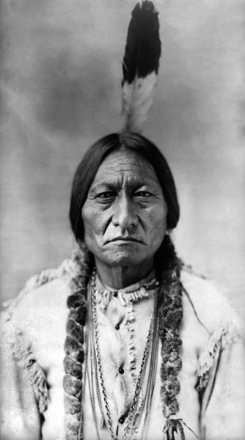
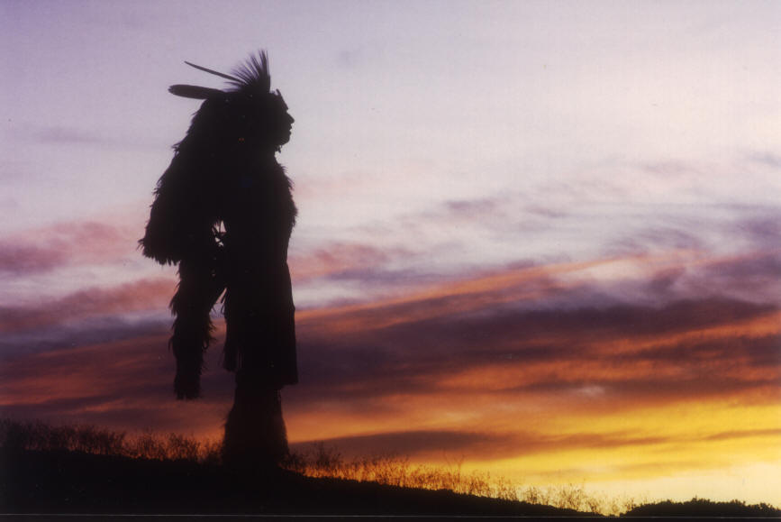
Native American Literature

Slide 2
Native American Literature: Cultural Diversity
At time of Columbus, 350 distinct languages existed in North America
Thousands of distinct cultural groups existed as well.
No single Native American culture or literature.
so

Slide 3
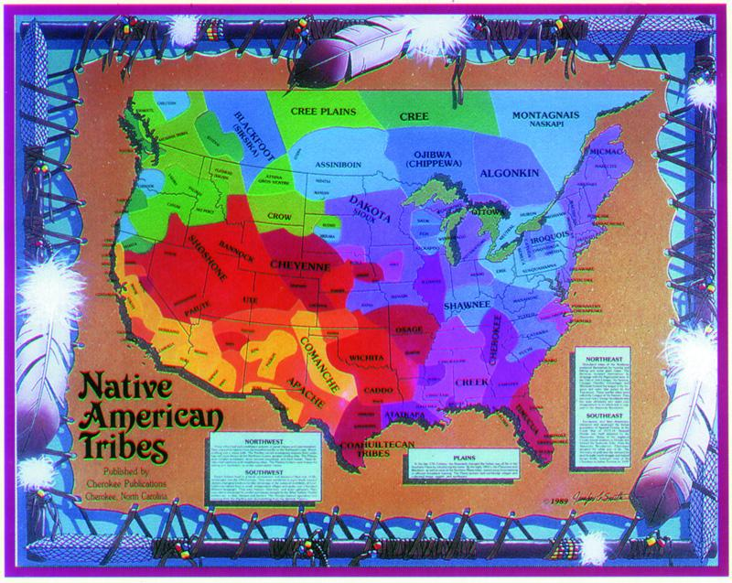
History of Stability
Prospered for thousands of years in a stable relationship with the land
Hundreds of individual tribes with their own cultural traditions (more diverse than Europe at the time)
Joined together—more in common with each other than with European settlers.

Slide 4
Native Americans came to be isolated both geographically and culturally (ghetto-ized).
Geographically: reservations on remote and least productive land
Few opportunities to demonstrate aspects of their culture.
So

Slide 5

So how did Native American Literature become known?
1856: First widely known written N.A. literature by John Rollin Ridge (Cherokee, encompassed Far West in his writing).
Late 19th century: many anthropologists began to write down stories and languages they heard while examining N.A. culture.

Slide 6
N.A. Literature not considered “valid” literature before this time due to western notions of literature.
Early American history:
described by Europeans
judged by European sensibilities
N.A. stories and culture not recognized as “good” by settlers. If it wasn’t a book, it wasn’t literature.
1960s-70s: Native American literature given a place in American literary canon.

Slide 7
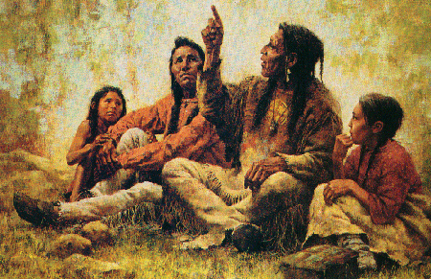
What are the characteristics of Native American Literature? (Remember, it is difficult to generalize the diverse cultures.)
Oral history:
Good speakers valued in many tribes because of tradition of participatory democracy
Stories handed down through the oral tradition

Slide 8
Lost in Translation
European invasion brought linguistic tools for written records; however:
No English words for some native terms
Poetry dependent on rhythm and repetition; translation is really new work
Caucasians rarely given full tales and/or translations shaped to fit audiences’ prejudices

Slide 9
Characteristics of Native American Literature
Oral Tradition
Storytelling: primary means of communicating and teaching about the physical world, social order, appropriate behavior, human nature, and the problem of good vs. evil.
Repetition is a common characteristic
Ritual beginnings and endings
Use of archaic language
Terse writing style

Slide 10
Additional Characteristics of Native American Literature
Explains beliefs about the nature of the physical world. Example: how did the world come to be?
Takes place in primal world or pre-civilization.
Beings are animal spirits in more or less human form: monsters, confusions of nature, etc.
Mythic age flows into age of transformation (legends), which flows into historical time (real heroes)

Slide 11
Cultural Heroes
Dramatize prototypical events and behaviors
Show how to do what is right and how we become the people we are
Shape the world and gives it its character by theft of sun, fire, or water
Often of divine birth

Slide 12
Trickster
Mischievous or roguish figure who typically makes up for physical weakness with cunning and subversive humor
Provides for disorder and change
Enables us to see the seamy underside of life
May get their comeuppance!

Slide 13
Motifs in N.A. Myths and Legends
Formation of the world through struggle
Movements from a sky world to a water world by means of a fall
Earth-diver myth:
  flood that occurred after the creation of the universe
  creation of the present world out of mud brought up from under the water by the earth-diver (muskrat or turtle)
Theft of fire
Emergence myths: ascent of beings from under the surface of the earth to its surface; ascent from a series of underworlds

Slide 14
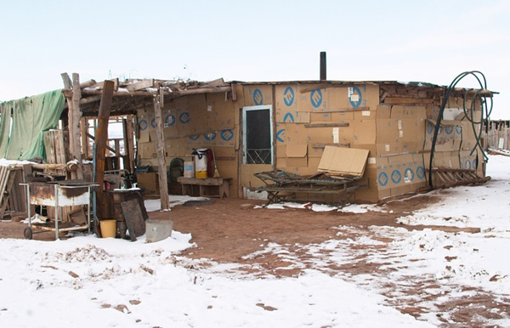
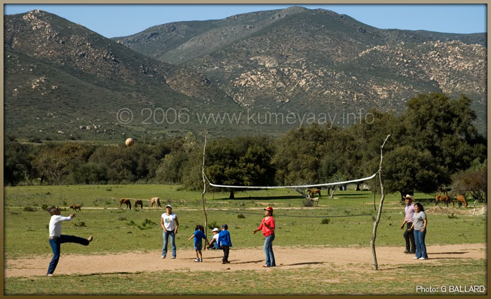
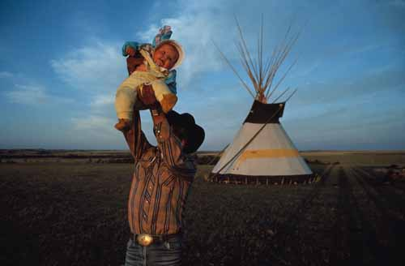
Today
Many contemporary Native American writers work to preserve their heritage, correct misunderstandings, and represent common native struggles.
Recurrent elements to look for: connection with nature and a higher power; representations of cultural values and traditions; responses to sudden changes with European invasion.

Slide 15




A Few Native American Authors
Louise Erdrich: well-known Native American author from Minnesota; has Native American bookstore
Sherman Alexie: much of his writing stems from his experience as a Native American
Paula Gunn Allen is a contemporary Native American author who also writes through a Feminist lens.
N.Scott Momaday: contemporary Native American author; The House Made of Dawn is an American classic.

Slide 16
Motifs of Contemporary N.A. Literature
Role of Native Americans in modern society
Marginalization
Paternalism
Discrimination
Rite of passage (coming of age)
Options: assimilation, annihilation, or…
Celebration of native values
  Shared ownership
  Inclusive family
  Nature

Slide 17
Sources:
Campbell. Early Native American Literature: Brief Outline Guide. 8/30/06.

