Slide 1
Dr. Espinosa Drop-In Slides

Slide 2
Acronym List
CAASPP: California Assessment of Student Performance and Progress
DLL: Dual-language learner
ECE: Early childhood education
ELL: English-language learner
EO: English only
L1: Language one (child’s first or home language)

Slide 3
Demographic Urgency: California
From 2015-2018, the percentage of ELLs reclassified to Fluent English Proficient increased from 16-18%.
There are 67 different language groups in CA.
California’s DLL/ELLs are highly diverse:
  Background, language, culture, immigration status, age of exposure to English, SES, talents, and needs
The reading achievement of ELLs was not good on the CAASPP in 2017:
  >50% below Level 1 at 3rd grade
  >68% below Level 1 at 8th grade
Of all reclassified ELLs, >64% met the standard, compared to 45% of EOs.
Notes:
Note: This slide may be helpful to use in any domain module connected to language and literacy development, dual-language learners, Family Partnerships and Culture, and The Integrated Nature of Learning.
More background information may be gathered from the recordings of the CPIN Professional Learning Institute: ELD.

Slide 4
Strong Evidence Addressed in Research
ALL infants, toddlers, and preschoolers have
capacity to learn more than one language, and balanced bilingualism carries significant social, linguistic, cognitive, and cultural benefits
Those DLLs with more balanced bilingual skills showed the greatest advantages.
Beginning bilingual exposure before three years of age leads to the best proficiency in English long-term.
It is important for children to have sufficient exposure—40% of their day—to good language role models; children need language exposure from competent speakers of that language.
Notes:
Note: This slide may be helpful to use in any domain module connected to language and literacy development, dual-language learners, Family Partnerships and Culture, and The Integrated Nature of Learning.
More background information may be gathered from the recordings of the CPIN Professional Learning Institute: ELD.

Slide 5
More Strong Evidence
5. Language interactions need to be frequent, responsive to a child’s interests, and expanded and varied to promote oral language development.
6. There should be an emphasis on oral language skills during ECE.
7. Stronger L1 and English skills at kindergarten entry predicted the best school outcomes.
8. L1 must be explicitly and systematically supported or it will decline once DLL children are exposed to English.
Notes:
Note: This slide may be helpful to use in any domain module connected to language and literacy development, dual-language learners, Family Partnerships and Culture, and The Integrated Nature of Learning.
More background information may be gathered from the recordings of the CPIN Professional Learning Institute: ELD.

Slide 6
More Strong Evidence (continued)
9. Specific instructional approaches and strategies (scaffolding language to promote English comprehension) are important for bilingual progress.
10. Frequent formative assessment is essential to program effectiveness.
11. Families must be involved in the education of DLLs.
12. ECE teachers need specific training and competencies to meet the needs of DLLs.
Notes:
Note: This slide may be helpful to use in any domain module connected to language and literacy development, dual-language learners, Family Partnerships and Culture, and The Integrated Nature of Learning.
More background information may be gathered from the recordings of the CPIN Professional Learning Institute: ELD.

Slide 7
Language Approaches for DLLs
Dual language models—balanced approaches that provide equal opportunities to learn content in both languages—are recommended, but oftentimes are not possible.
Most commonly, ECE is primarily in English with support given for L1:
    Set of strategies that all ECE staff can implement to support all DLLs
    Global high quality important, but not sufficient
                Source: California Preschool Program Guidelines
Notes:
Note: This slide may be helpful to use in any domain module connected to language and literacy development, dual-language learners, Family Partnerships and Culture, and The Integrated Nature of Learning.
More background information may be gathered from the recordings of the CPIN Professional Learning Institute: ELD.

Slide 8
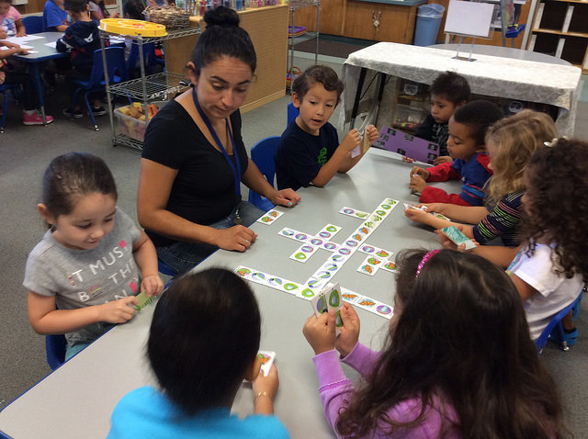
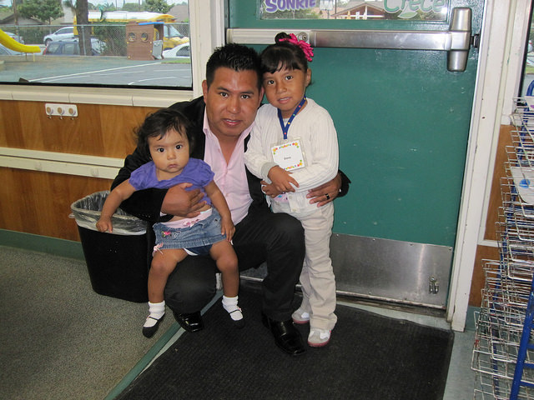
Family engagement is a process, not an event!
This process begins from the moment you first meet a family and continues throughout the time their child is in your care.
There are many ways to continually involve families in your learning community.
Notes:
Note: This slide may be helpful to use in any domain module connected to language and literacy development, dual-language learners, Family Partnerships and Culture, and The Integrated Nature of Learning.
More background information may be gathered from the recordings of the CPIN Professional Learning Institute: ELD.

Slide 9
Interactive Reading Adaptations for DLLs
Utilize small groups to get the conversation going; making groups of three-four students maximizes the opportunity for all to talk.
Use pictures to encourage labeling, discussing personal connections, and the re-telling of stories; let children become the storytellers.
Encourage and praise all of the children’s language attempts in any language.
Comment and expand on children’s responses; emphasize the targeted vocabulary.
Notes:
Note: This slide may be helpful to use in any domain module connected to language and literacy development, dual-language learners, Family Partnerships and Culture, and The Integrated Nature of Learning.
More background information may be gathered from the recordings of the CPIN Professional Learning Institute: ELD.

Slide 10
Environmental Support
The what: Culturally and emotionally supportive climates
The how: Scaffolding support for DLLs
Use the environment to help children feel safe, accepted, understood, respected, and challenged.
Labeling:
English and home languages
Start with physical items
Color-coding
Notes:
Note: This slide may be helpful to use in any domain module connected to language and literacy development, dual-language learners, Family Partnerships and Culture, and The Integrated Nature of Learning.
More background information may be gathered from the recordings of the CPIN Professional Learning Institute: ELD.

